Slide 1
EE2211 Tutorial 9 Thao Nguyen

Slide 2






Recap: Decision Tree
Class 1
Class 2
Root Node
$$x_{1}>a$$
$$x_{2}$$
Yes
Terminal Node / Leaf
No
Decision Node
$$x_{2}>b$$
1
$$b$$
No
Yes
2
Terminal Node / Leaf
Terminal Node / Leaf
Depth
$$a$$
$$x_{1}$$

Slide 3

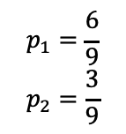


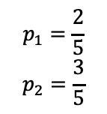
Recap: Impurity
Class 1
Class 2
A
$$p_{1}=\frac{6}{9}$$
$$p_{2}=\frac{3}{9}$$
Impurity Measurements:
Gini
Entropy
Misclassification rate
$$x_{2}$$
$$x_{1}≤a$$
$$x_{1}>a$$
B
C
$$p_{1}=1$$
$$p_{2}=0$$
$$p_{1}=\frac{2}{5}$$
$$p_{2}=\frac{3}{5}$$
$$a$$
$$x_{1}$$

Slide 4
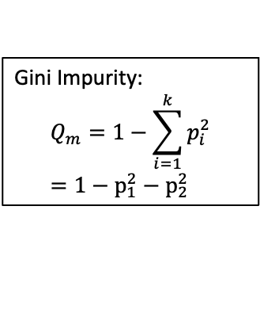
Recap: Impurity
Class 1
Class 2
A
$$p_{1}=\frac{6}{9}$$
$$p_{2}=\frac{3}{9}$$
Gini Impurity:
$$Q_{m}=1−\sum_{i=1}^{k}{p_{i}^{2}}=1−p_{1}^{2}−p_{2}^{2}$$
$$x_{2}$$
$$x_{1}≤a$$
$$x_{1}>a$$
B
C
$$p_{1}=1$$
$$p_{2}=0$$
$$p_{1}=\frac{2}{5}$$
$$p_{2}=\frac{3}{5}$$
$$a$$
$$x_{1}$$

Slide 5
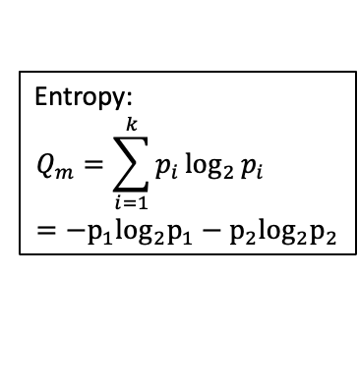
Recap: Impurity
Class 1
Class 2
A
$$p_{1}=\frac{6}{9}$$
$$p_{2}=\frac{3}{9}$$
Entropy:
$$Q_{m}=\sum_{i=1}^{k}{p_{i}\log_{2}{p_{i}}}=−p_{1}\log_{2}p_{1}−p_{2}\log_{2}p_{2}$$
$$x_{2}$$
$$x_{1}≤a$$
$$x_{1}>a$$
B
C
$$p_{1}=1$$
$$p_{2}=0$$
$$p_{1}=\frac{2}{5}$$
$$p_{2}=\frac{3}{5}$$
$$a$$
$$x_{1}$$

Slide 6
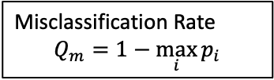
Recap: Impurity
Class 1
Class 2
A
$$p_{1}=\frac{6}{9}$$
$$p_{2}=\frac{3}{9}$$
Misclassification Rate
$$Q_{m}=1−\max_{i}{p_{i}}$$
$$x_{2}$$
$$x_{1}≤a$$
$$x_{1}>a$$
B
C
$$p_{1}=1$$
$$p_{2}=0$$
$$p_{1}=\frac{2}{5}$$
$$p_{2}=\frac{3}{5}$$
$$a$$
$$x_{1}$$

Slide 7
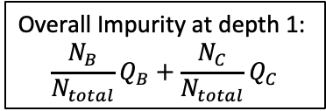
Recap: Impurity
Class 1
Class 2
A
$$p_{1}=\frac{6}{9}$$
$$p_{2}=\frac{3}{9}$$
Overall Impurity at depth 1:
$$\frac{N_{B}}{N_{total}}Q_{B}+\frac{N_{C}}{N_{total}}Q_{C}$$
$$x_{2}$$
$$x_{1}≤a$$
$$x_{1}>a$$
B
C
$$p_{1}=1$$
$$p_{2}=0$$
$$p_{1}=\frac{2}{5}$$
$$p_{2}=\frac{3}{5}$$
$$a$$
$$x_{1}$$

Slide 8
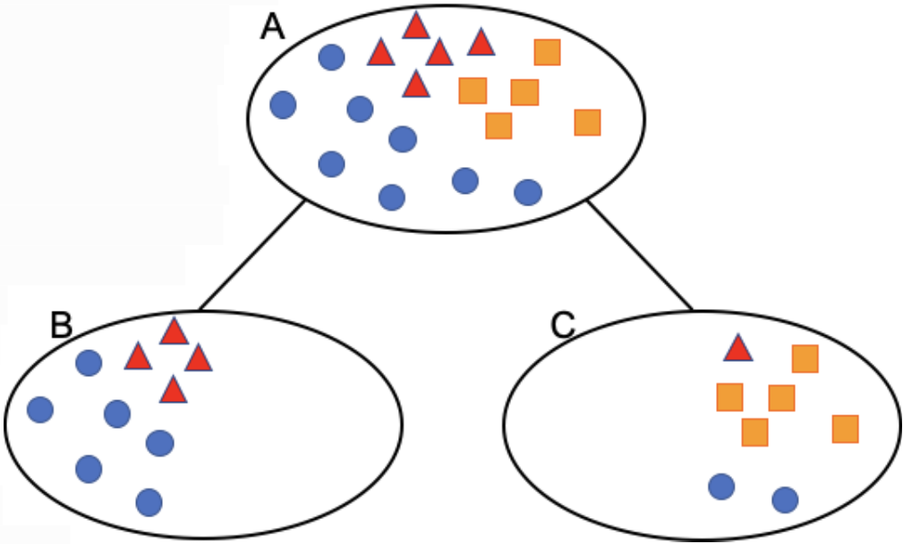
Question 1
Compute the Gini impurity, entropy, misclassification rate for nodes A, B and C, as well as the overall metrics at depth 1 of the decision tree.

Slide 9

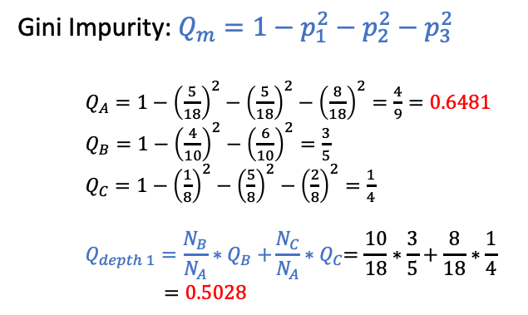

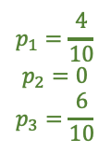


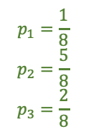
Question 1
▲Class 1 ■Class 2 ●Class 3
$$p_{1}=\frac{5}{18}$$
$$p_{2}=\frac{5}{18}$$
$$p_{3}=\frac{8}{18}$$
Gini Impurity: $Q_{m}=1−p_{1}^{2}−p_{2}^{2}−p_{3}^{2}$
$Q_{A}=1−{\left(\frac{5}{18}\right)}^{2}−{\left(\frac{5}{18}\right)}^{2}−{\left(\frac{8}{18}\right)}^{2}=\frac{4}{9}=0.6481$
$Q_{B}=1−{\left(\frac{4}{10}\right)}^{2}−{\left(\frac{6}{10}\right)}^{2}=\frac{3}{5}$
$Q_{C}=1−{\left(\frac{1}{8}\right)}^{2}−{\left(\frac{5}{8}\right)}^{2}−{\left(\frac{2}{8}\right)}^{2}=\frac{1}{4}$
$$Q_{depth 1}=\frac{N_{B}}{N_{A}}{∗Q}_{B}+\frac{N_{C}}{N_{A}}{∗Q}_{C}=\frac{10}{18}∗\frac{3}{5}+\frac{8}{18}∗\frac{1}{4}$$
$=0.5028$
$$N_{A}=18$$
$$N_{B}=10$$
$$N_{C}=8$$
$$p_{1}=\frac{4}{10}$$
$$p_{2}=0$$
$$p_{3}=\frac{6}{10}$$
$$p_{1}=\frac{1}{8}$$
$$p_{2}=\frac{5}{8}$$
$$p_{3}=\frac{2}{8}$$

Slide 10
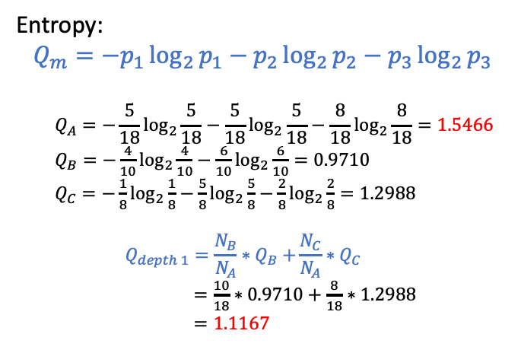
Question 1
▲Class 1 ■Class 2 ●Class 3
$$p_{1}=\frac{5}{18}$$
$$p_{2}=\frac{5}{18}$$
$$p_{3}=\frac{8}{18}$$
Entropy:
$$Q_{m}={−p}_{1}\log_{2}{p_{1}}−p_{2}\log_{2}{p_{2}}−p_{3}\log_{2}{p_{3}}$$
$$Q_{A}=−\frac{5}{18}\log_{2}{\frac{5}{18}}−\frac{5}{18}\log_{2}{\frac{5}{18}}−\frac{8}{18}\log_{2}{\frac{8}{18}}=1.5466$$
$Q_{B}=−\frac{4}{10}\log_{2}{\frac{4}{10}}−\frac{6}{10}\log_{2}{\frac{6}{10}}=0.9710$
$Q_{C}=−\frac{1}{8}\log_{2}{\frac{1}{8}}−\frac{5}{8}\log_{2}{\frac{5}{8}}−\frac{2}{8}\log_{2}{\frac{2}{8}}=1.2988$
$$Q_{depth 1}=\frac{N_{B}}{N_{A}}{∗Q}_{B}+\frac{N_{C}}{N_{A}}{∗Q}_{C}$$
$=\frac{10}{18}∗0.9710+\frac{8}{18}∗1.2988$
$$=1.1167$$
$$N_{A}=18$$
$$N_{B}=10$$
$$N_{C}=8$$
$$p_{1}=\frac{4}{10}$$
$$p_{2}=0$$
$$p_{3}=\frac{6}{10}$$
$$p_{1}=\frac{1}{8}$$
$$p_{2}=\frac{5}{8}$$
$$p_{3}=\frac{2}{8}$$

Slide 11
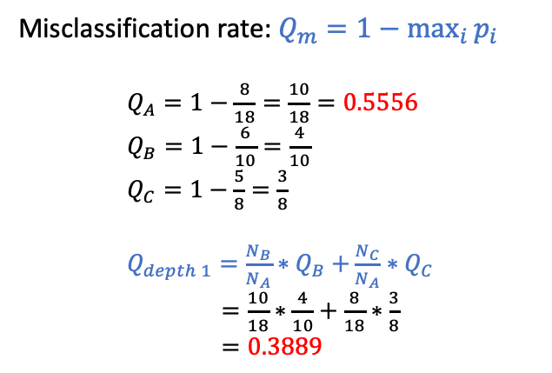
Question 1
▲Class 1 ■Class 2 ●Class 3
$$p_{1}=\frac{5}{18}$$
$$p_{2}=\frac{5}{18}$$
$$p_{3}=\frac{8}{18}$$
Misclassification rate: $Q_{m}=1−\max_{i}{p_{i}}$
$Q_{A}=1−\frac{8}{18}=\frac{10}{18}=0.5556$
$Q_{B}=1−\frac{6}{10}=\frac{4}{10}$
$Q_{C}=1−\frac{5}{8}=\frac{3}{8}$
$Q_{depth 1}=\frac{N_{B}}{N_{A}}{∗Q}_{B}+\frac{N_{C}}{N_{A}}{∗Q}_{C}$
$=\frac{10}{18}∗\frac{4}{10}+\frac{8}{18}∗\frac{3}{8}$
$=0.3889$
$$N_{A}=18$$
$$N_{B}=10$$
$$N_{C}=8$$
$$p_{1}=\frac{4}{10}$$
$$p_{2}=0$$
$$p_{3}=\frac{6}{10}$$
$$p_{1}=\frac{1}{8}$$
$$p_{2}=\frac{5}{8}$$
$$p_{3}=\frac{2}{8}$$

Slide 12
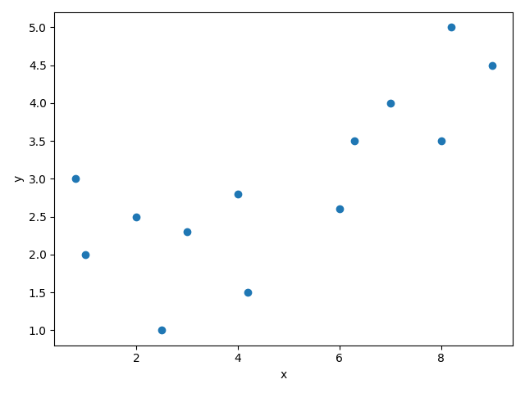


Question 2
x | 1 | 0.8 | 2 | 2.5 | 3 | 4 | 4.2 | 6 | 6.3 | 7 | 8 | 8.2 | 9
y | 2 | 3 | 2.5 | 1 | 2.3 | 2.8 | 1.5 | 2.6 | 3.5 | 4 | 3.5 | 5 | 4.5
Calculate the overall MSE at depth 1 of a regression tree assuming a decision threshold is taken at 𝑥 = 5.0
Root
Given data
Depth 1
$$x≤5$$
$$x>5$$

Slide 13
Question 2
x | 1 | 0.8 | 2 | 2.5 | 3 | 4 | 4.2 | 6 | 6.3 | 7 | 8 | 8.2 | 9
y | 2 | 3 | 2.5 | 1 | 2.3 | 2.8 | 1.5 | 2.6 | 3.5 | 4 | 3.5 | 5 | 4.5
If it is classification problem:
Class 1
Root
Given data
Class 2
Depth 1
$$x≤5$$
$$x>5$$

Slide 14
Question 2
x | 1 | 0.8 | 2 | 2.5 | 3 | 4 | 4.2 | 6 | 6.3 | 7 | 8 | 8.2 | 9
y | 2 | 3 | 2.5 | 1 | 2.3 | 2.8 | 1.5 | 2.6 | 3.5 | 4 | 3.5 | 5 | 4.5
How about regression?
Root
Given data
Depth 1
$$x≤5$$
$$x>5$$

Slide 15


Question 2
x | 1 | 0.8 | 2 | 2.5 | 3 | 4 | 4.2 | 6 | 6.3 | 7 | 8 | 8.2 | 9
y | 2 | 3 | 2.5 | 1 | 2.3 | 2.8 | 1.5 | 2.6 | 3.5 | 4 | 3.5 | 5 | 4.5
How about regression?
$$y_{pred_L}=average\left(y_{L}\right)=2.15$$
$$y_{pred_R}=average\left(y_{R}\right)=3.85$$
Root
Given data
Depth 1
$$x≤5$$
$$x>5$$

Slide 16
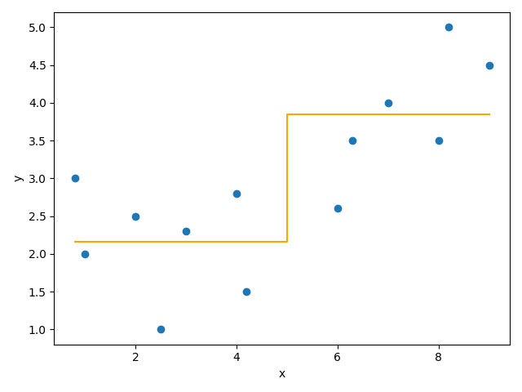
Question 2
x | 1 | 0.8 | 2 | 2.5 | 3 | 4 | 4.2 | 6 | 6.3 | 7 | 8 | 8.2 | 9
y | 2 | 3 | 2.5 | 1 | 2.3 | 2.8 | 1.5 | 2.6 | 3.5 | 4 | 3.5 | 5 | 4.5
How about regression?
x | 1 | 0.8 | 2 | 2.5 | 3 | 4 | 4.2 | 6 | 6.3 | 7 | 8 | 8.2 | 9
y | 2 | 3 | 2.5 | 1 | 2.3 | 2.8 | 1.5 | 2.6 | 3.5 | 4 | 3.5 | 5 | 4.5
$$y_{pred_L}=average\left(y_{L}\right)=2.15$$
$$y_{pred_R}=average\left(y_{R}\right)=3.85$$
Root
Given data
Depth 1
$$x≤5$$
$$x>5$$

Slide 17
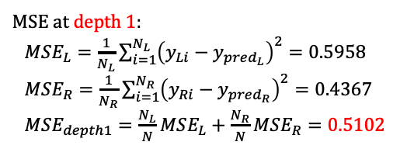
Question 2
x | 1 | 0.8 | 2 | 2.5 | 3 | 4 | 4.2 | 6 | 6.3 | 7 | 8 | 8.2 | 9
y | 2 | 3 | 2.5 | 1 | 2.3 | 2.8 | 1.5 | 2.6 | 3.5 | 4 | 3.5 | 5 | 4.5
How about regression?
$$y_{pred_L}=average\left(y_{L}\right)=2.15$$
$$y_{pred_R}=average\left(y_{R}\right)=3.85$$
MSE at depth 1:
$MSE_{L}=\frac{1}{N_{L}}\sum_{i=1}^{N_{L}}{{\left(y_{Li}−y_{pred_{L}}\right)}^{2}}=0.5958$
$MSE_{R}=\frac{1}{N_{R}}\sum_{i=1}^{N_{R}}{{\left(y_{Ri}−y_{pred_{R}}\right)}^{2}}=0.4367$
$MSE_{depth1}=\frac{N_{L}}{N}MSE_{L}+\frac{N_{R}}{N}MSE_{R}=0.5102$
Root
Given data
Depth 1
$$x≤5$$
$$x>5$$

Slide 18
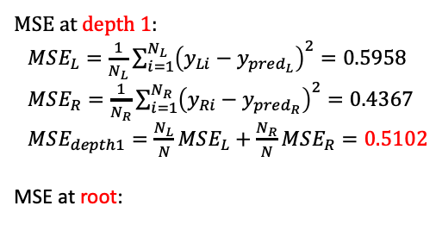
Question 2
x | 1 | 0.8 | 2 | 2.5 | 3 | 4 | 4.2 | 6 | 6.3 | 7 | 8 | 8.2 | 9
y | 2 | 3 | 2.5 | 1 | 2.3 | 2.8 | 1.5 | 2.6 | 3.5 | 4 | 3.5 | 5 | 4.5
$$y_{pred}=average\left(y\right)=2.9385$$
MSE at depth 1:
$MSE_{L}=\frac{1}{N_{L}}\sum_{i=1}^{N_{L}}{{\left(y_{Li}−y_{pred_{L}}\right)}^{2}}=0.5958$
$MSE_{R}=\frac{1}{N_{R}}\sum_{i=1}^{N_{R}}{{\left(y_{Ri}−y_{pred_{R}}\right)}^{2}}=0.4367$
$MSE_{depth1}=\frac{N_{L}}{N}MSE_{L}+\frac{N_{R}}{N}MSE_{R}=0.5102$
MSE at root:
Root
Given data
Depth 1
$$x≤5$$
$$x>5$$

Slide 19
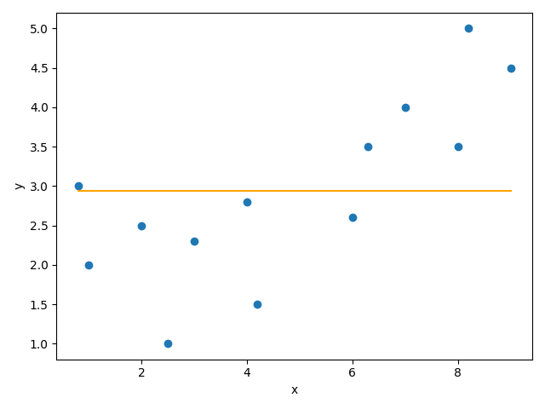
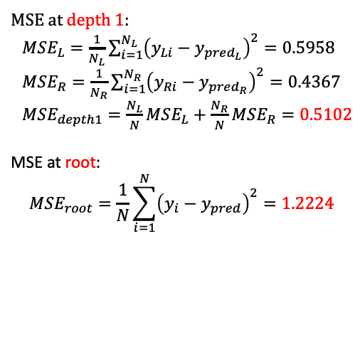

Question 2
x | 1 | 0.8 | 2 | 2.5 | 3 | 4 | 4.2 | 6 | 6.3 | 7 | 8 | 8.2 | 9
y | 2 | 3 | 2.5 | 1 | 2.3 | 2.8 | 1.5 | 2.6 | 3.5 | 4 | 3.5 | 5 | 4.5
$$y_{pred}=average\left(y\right)=2.9385$$
MSE at depth 1:
$MSE_{L}=\frac{1}{N_{L}}\sum_{i=1}^{N_{L}}{{\left(y_{Li}−y_{pred_{L}}\right)}^{2}}=0.5958$
$MSE_{R}=\frac{1}{N_{R}}\sum_{i=1}^{N_{R}}{{\left(y_{Ri}−y_{pred_{R}}\right)}^{2}}=0.4367$
$MSE_{depth1}=\frac{N_{L}}{N}MSE_{L}+\frac{N_{R}}{N}MSE_{R}=0.5102$
MSE at root:
$$MSE_{root}=\frac{1}{N}\sum_{i=1}^{N}{{\left(y_{i}−y_{pred}\right)}^{2}=1.2224}$$
$$MSE_{depth1}<MSE_{root}$$
Root
Given data

Slide 20
Question 3
Import the California Housing dataset
Target: ['MedHouseVal’]
Features: ['MedInc', 'HouseAge', 'AveRooms', 'AveBedrms’,
'Population’, 'AveOccup', 'Latitude', 'Longitude’]
Use “MedInc” as the input feature and “MedHouseVal” as the target output.
Fit a regression tree to depth 2.
Compare your results with results generated by “from sklearn.tree import DecisionTreeRegressor” using the “squared error” criterion.

Slide 21
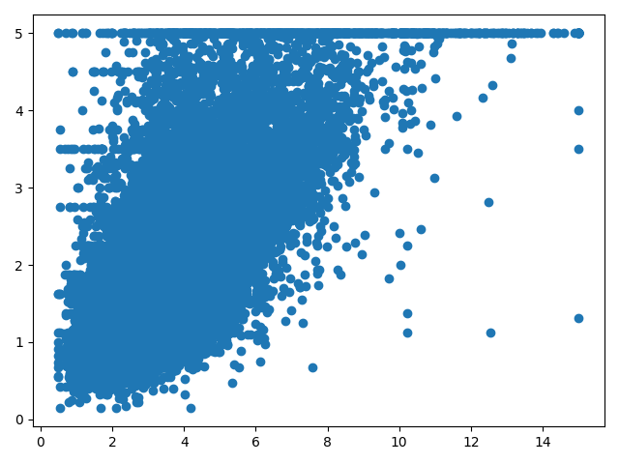










Question 3
Regression tree of depth 2
$$x>x_{M}$$
No
Yes
$$x>x_{L}$$
$$x>x_{R}$$
1
No
Yes
No
Yes
$$y=\overline{y_{LL}}$$
$$y=\overline{y_{LR}}$$
$$y=\overline{y_{RL}}$$
$$y=\overline{y_{RR}}$$
2
$$x_{L}$$
$$x_{M}$$
$$x_{R}$$
Depth

Slide 22
Question 3
How to find the split thresholds?
$$x>x_{M}$$
$$x_{M}$$

Slide 23
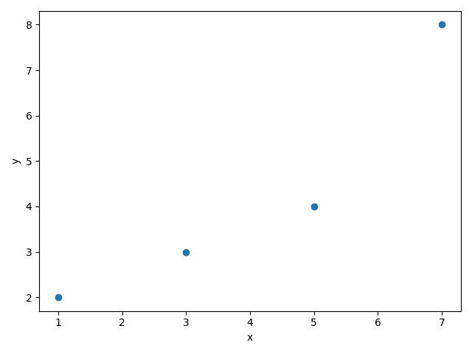
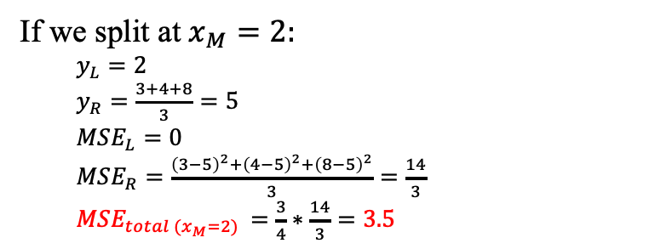
Question 3
Example:
How to find the split thresholds?
$$x>x_{M}$$
If we split at $x_{M}=2:$
$y_{L}=2$
$y_{R}=\frac{3+4+8}{3}=5$
$MSE_{L}=0$
$MSE_{R}=\frac{{\left(3−5\right)}^{2}+{\left(4−5\right)}^{2}+{\left(8−5\right)}^{2}}{3}=\frac{14}{3}$
$MSE_{total (x_{M}=2) }=\frac{3}{4}∗\frac{14}{3}=3.5$

Slide 24
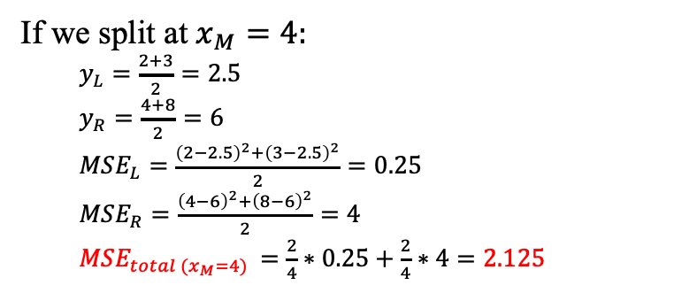
Question 3
Example:
How to find the split thresholds?
$$x>x_{M}$$
If we split at $x_{M}=4:$
$y_{L}=\frac{2+3}{2}=2.5$
$y_{R}=\frac{4+8}{2}=6$
$MSE_{L}=\frac{{\left(2−2.5\right)}^{2}+{\left(3−2.5\right)}^{2}}{2}=0.25$
$MSE_{R}=\frac{{\left(4−6\right)}^{2}+{\left(8−6\right)}^{2}}{2}=4$
$MSE_{total (x_{M}=4) }=\frac{2}{4}∗0.25+\frac{2}{4}∗4=2.125$

Slide 25
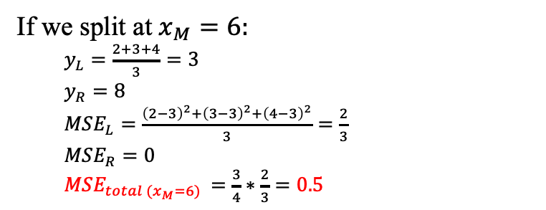
Question 3
Example:
How to find the split thresholds?
$$x>x_{M}$$
If we split at $x_{M}=6:$
$y_{L}=\frac{2+3+4}{3}=3$
$y_{R}=8$
$MSE_{L}=\frac{{\left(2−3\right)}^{2}+{\left(3−3\right)}^{2}+{\left(4−3\right)}^{2}}{3}=\frac{2}{3}$
$MSE_{R}=0$
$MSE_{total (x_{M}=6) }=\frac{3}{4}∗\frac{2}{3}=0.5$

Slide 26
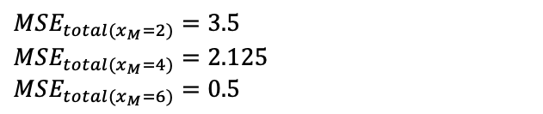
Question 3
Example:
How to find the split thresholds?
$$x>x_{M}$$
$MSE_{total(x_{M}=2)}=3.5$
$MSE_{total(x_{M}=4)}=2.125$
$MSE_{total(x_{M}=6)}=0.5$
Evaluate all possible split thresholds between data points and select the one that yields the lowest MSE.

Slide 27

Question 3
How to find the split thresholds?
$$x>x_{M}$$
Evaluate all possible split thresholds between data points and select the one that yields the lowest MSE.
$$x_{M}$$

Slide 28
Question 4
Get the IRIS dataset and perform the following tasks.
Split the database into two sets: 80% of samples for training, and 20% of samples for testing.
Train a decision tree classifier (tree.DecisionTreeClassifier from sklearn) using the training set with a max depth of 4 based on the “entropy” criterion.
Compute the training and test accuracies. You can use accuracy_score from sklearn.metrics for accuracy computation.
Plot the tree using tree.plot_tree.

Slide 29


Question 4
IRIS data:
4 features: $\left\{\begin{aligned}petal width \\ petal height \\ sedal width \\ sedal height\end{aligned}\right.$
Input
Target
3 classes: $\left\{\begin{aligned}\text{Iris} \text{setosa} \\ \text{Iris} \text{versicolor} \\ \text{Iris} \text{virginica}\end{aligned}\right.$

Slide 30
Question 4
 | Function | Library
Load data | iris_dataset = load_iris() | sklearn.datasets
Split training set and test set | X_train, X_test, y_train, y_test = train_test_split(iris_dataset['data’], iris_dataset['target’], test_size=0.20, random_state=0) | sklearn.model_selection
Train decision tree | dtree = DecisionTreeClassifier(criterion='entropy', max_depth=4) dtree = dtree.fit(X_train, y_train) | sklearn.tree
Predict | dtree.predict(X_test)
Measure accuracy | accuracy_score(y_test, y_pred) | sklearn.metrics
Plot the decision tree | plot_tree(dtree) | sklearn.tree

