Slide 1

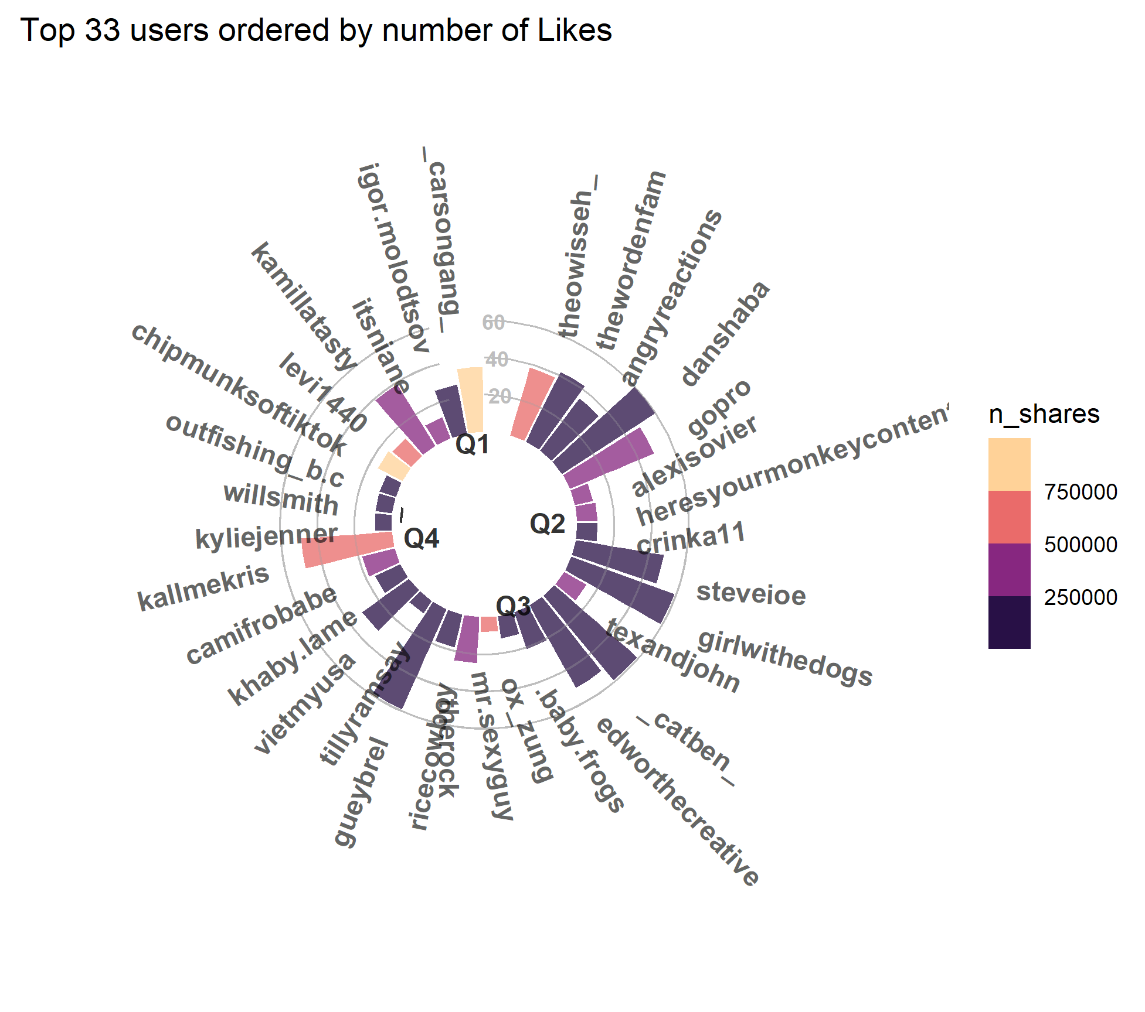
Best Trending Users On TikTok & Their Engagement
Most used words in Descriptions (Top5000)

Slide 2
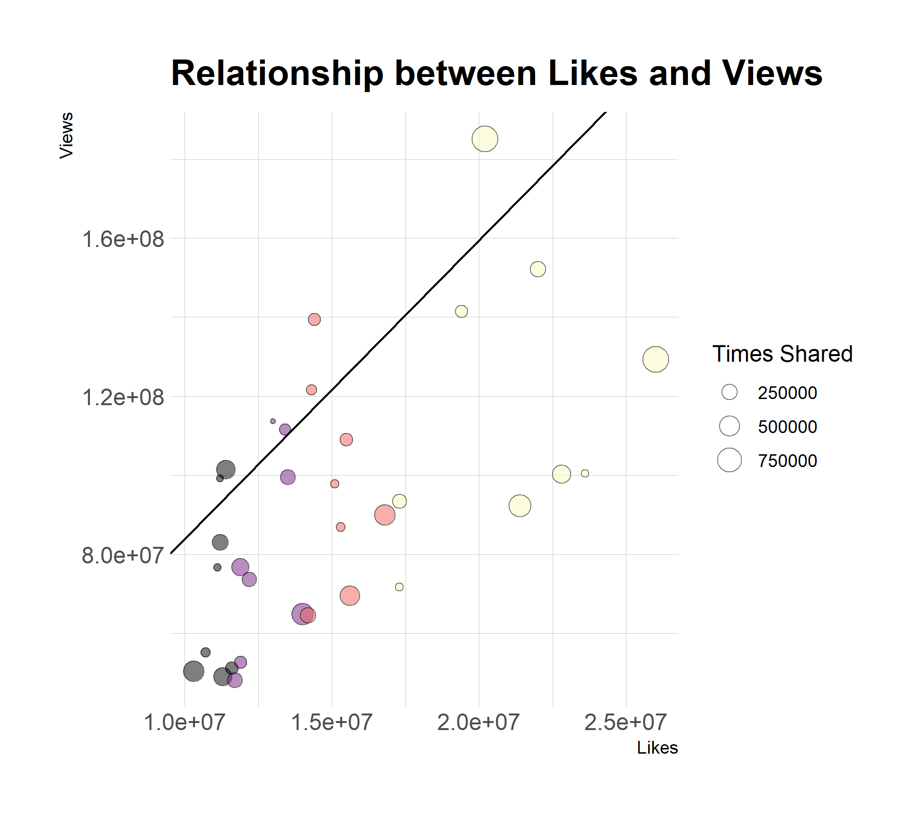
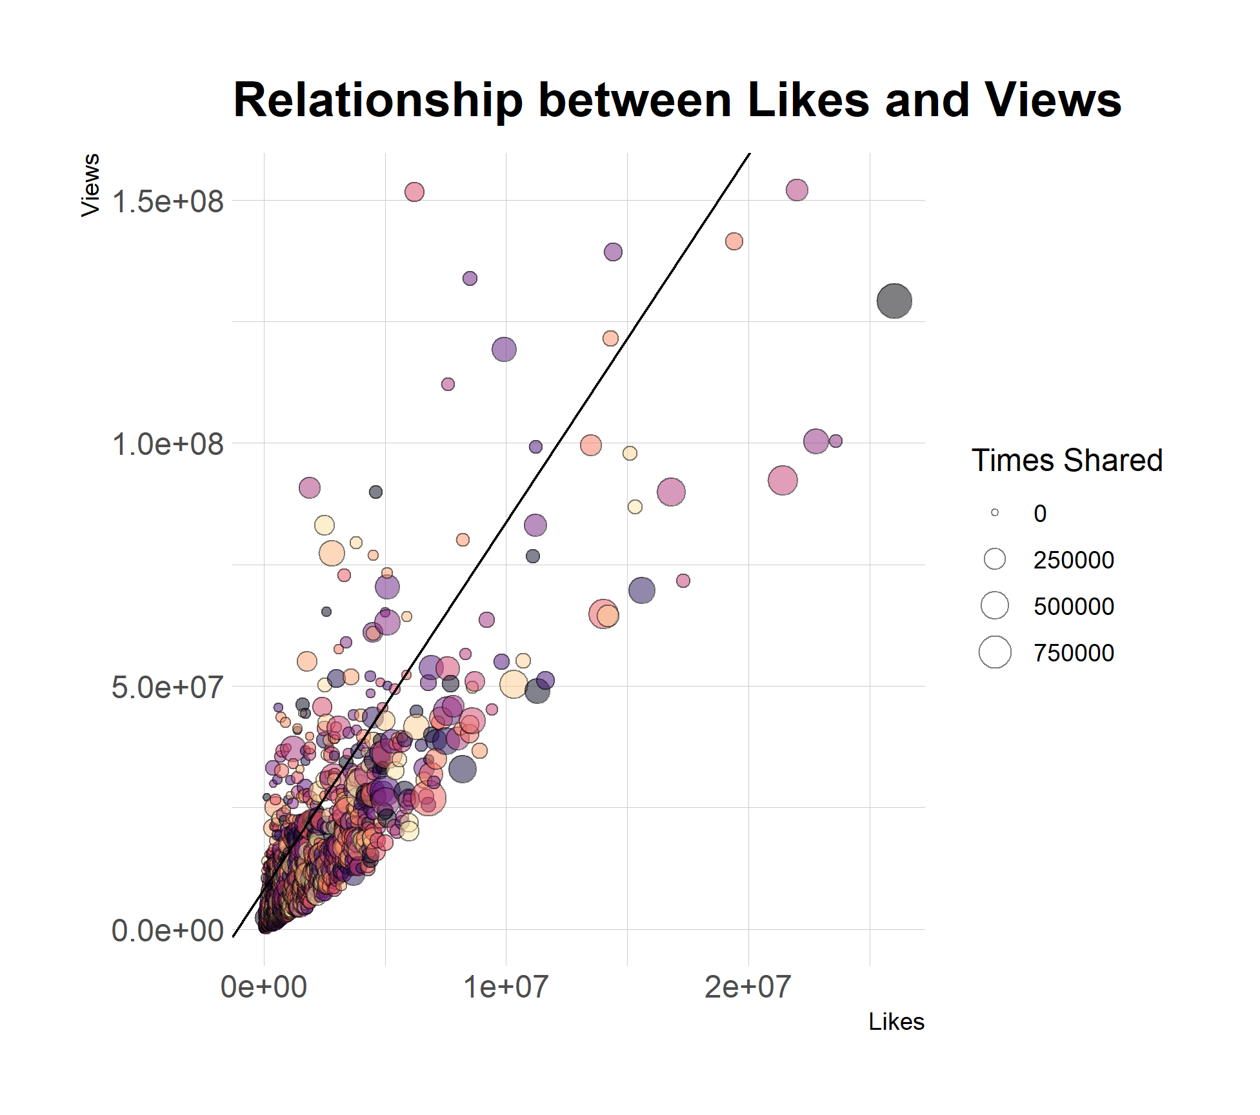
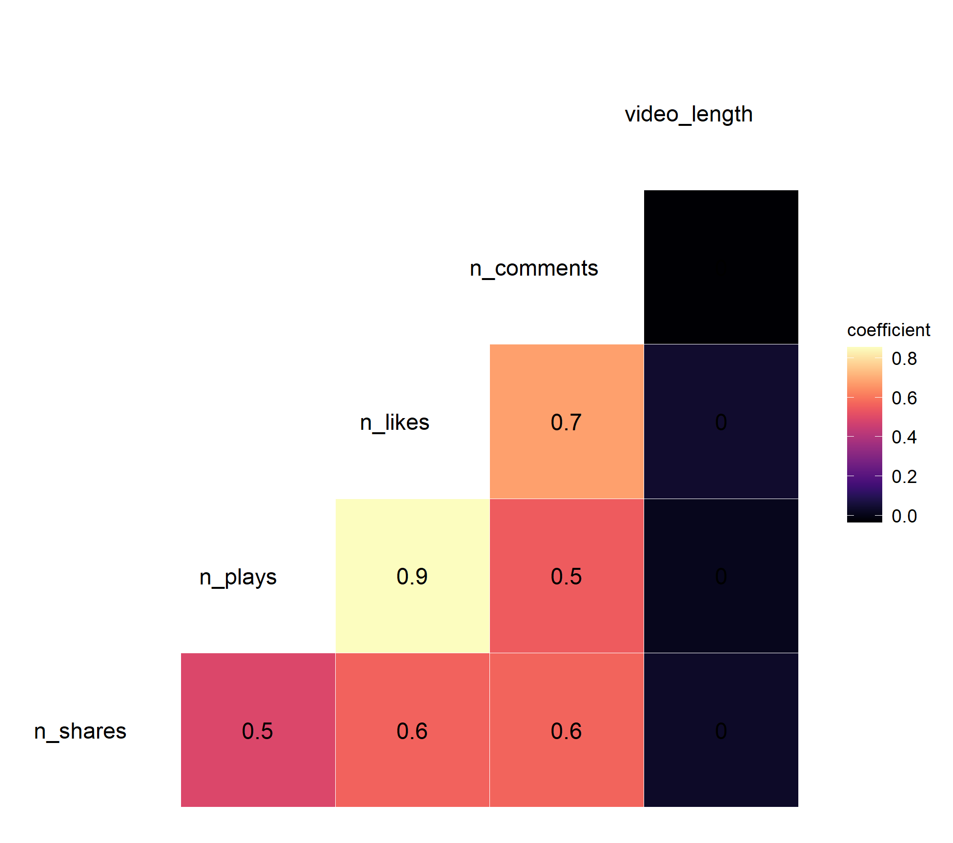
Do Likes and Views Necessarily go together?
TOP 33
TOP 5000

Slide 3
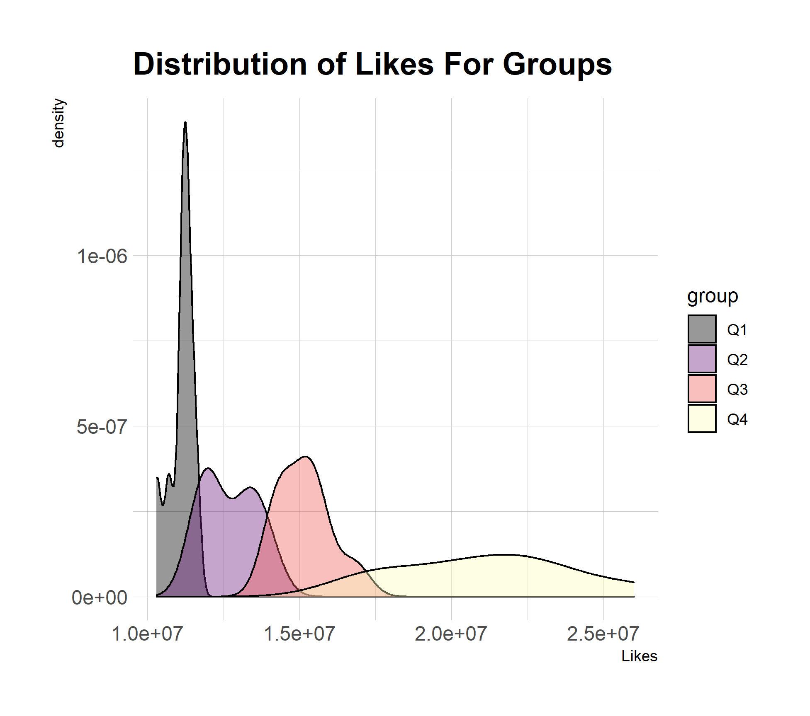
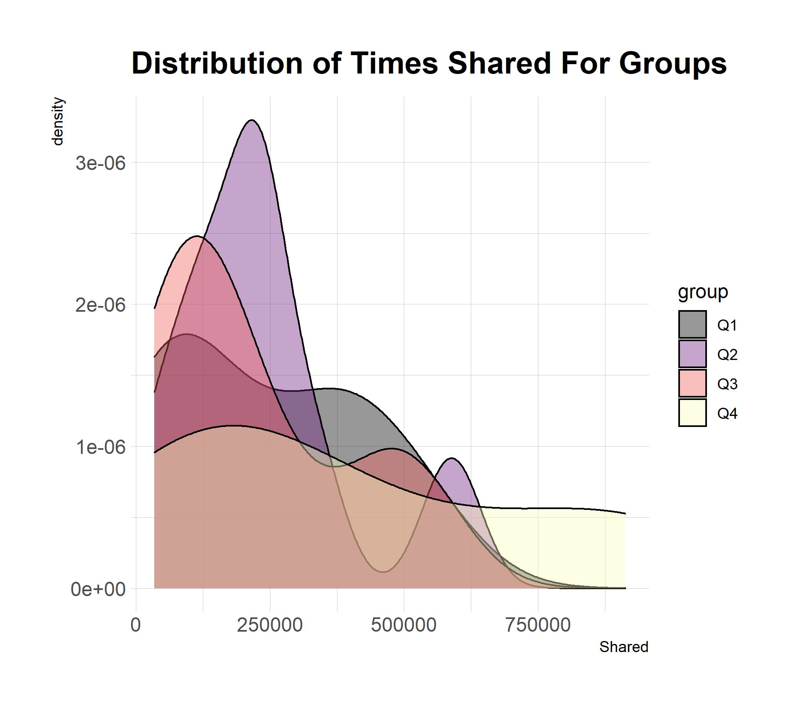
Density Curves Based On Likes and Shares

