Slide 1
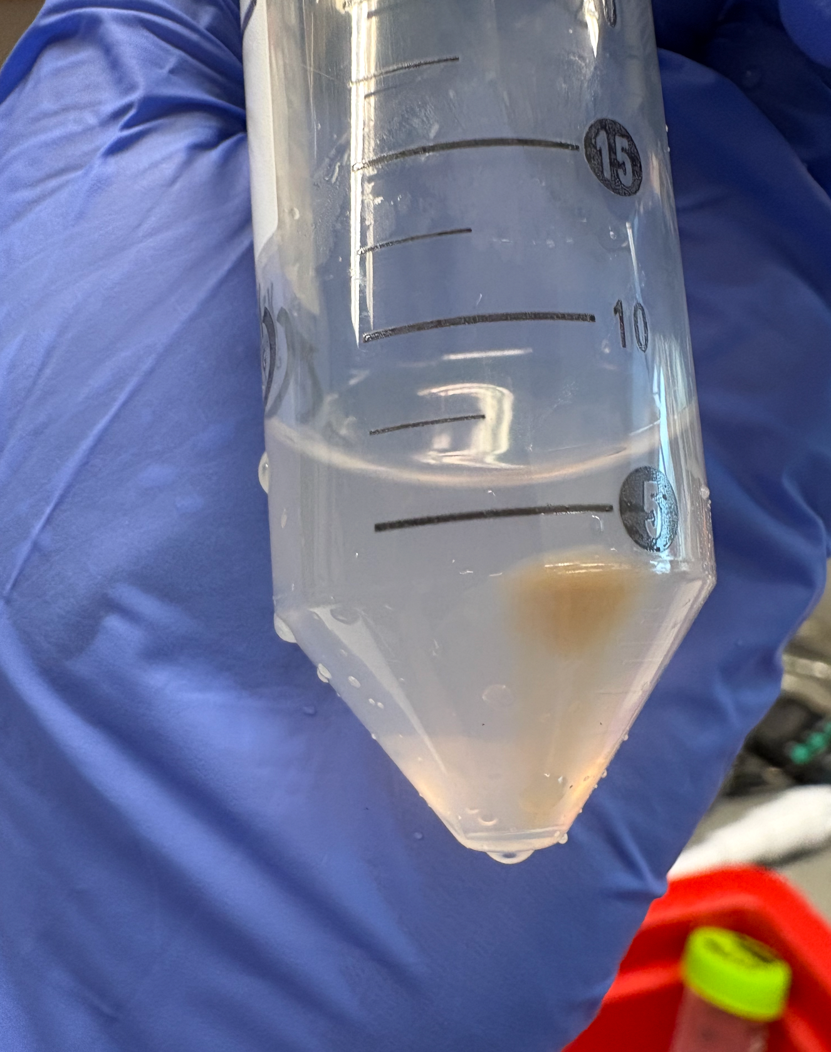
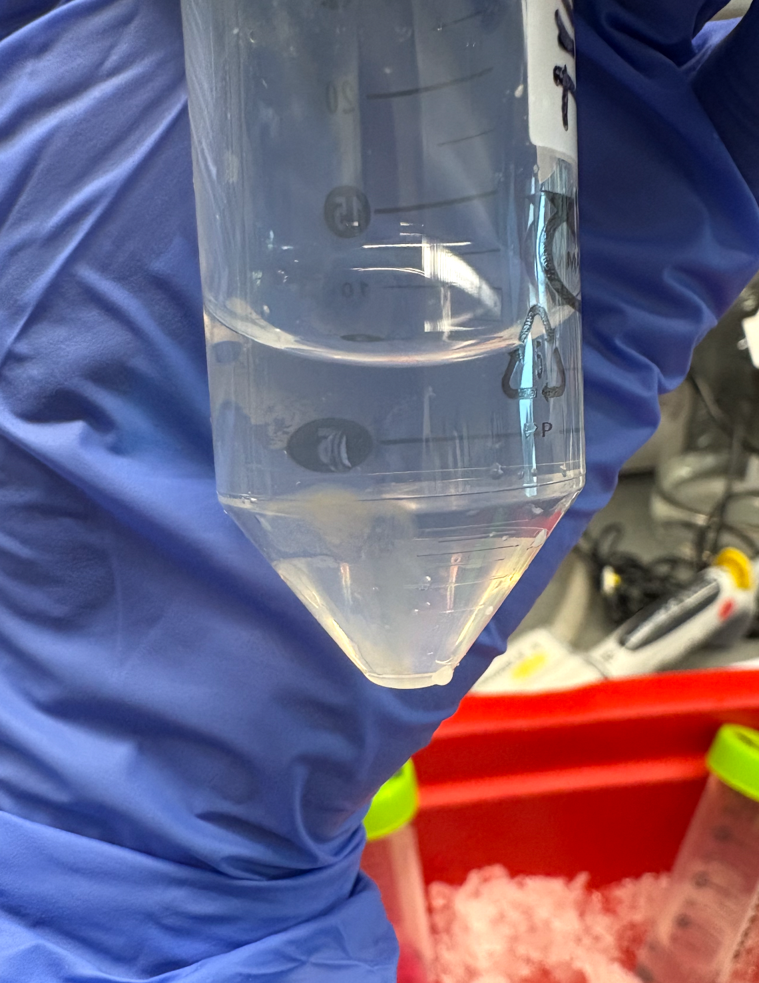
A Novel Approach to Characterizing Mitochondrial Respiration Kinetics: A Proof of Concept Study
Lara Dincer, Ferreira Lab
Duke University School of Medicine: Orthopaedics Department
ABSTRACT
EXPERIMENTAL APPROACH
EXPERIMENTAL APPROACH
EXPERIMENTAL APPROACH
Mitochondrial respiration is often characterized under steady-state conditions using ADP titrations to measure its capacity at different stages, although the system itself is inherently dynamic. Notable, a saturating amount of ADP simulates Stage 3 respiration, characterizing the functional oxidative phosphorylation capacity of the system. In this study, caged ADP is used as an impulse input in combination with high-resolution respirometry to uncover the time-dependent control of oxidative phosphorylation. The ability to simulate ADP addition acutely with isolated mitochondria samples removes the confounding factors of diffusion and allows for measurement of transient increases in oxygen consumption prior to reaching a steady state, which can be compared across samples. Many disease states, such as aging and heart failure, can have preserved maximal capacity but impaired speed and efficiency of the overall system, a phenomenon unrecognizable by current methods. This protocol allows for more precise measurement of mitochondrial function allowing for a better understanding of mitochondrial dysfunction, identifying rate-limiting factors and acute differences in the kinetics across systems.
Overview of Methods:
Mitochondrial Isolation
High-resolution Respirometry
Caged ADP used as a controlled Impulse Output
UV Photolysis Release of ADP Instantly
Novelty of Protocol
Simulates Acute ADP addition, generating a kinematic curve independent to each sample.
Removes diffusion-related confounders
Captures transient oxygen consumption prior to Steady State
Allows for comparison of kinetic responses across samples
Mitochondrial Isolation
Mitochondrial samples are collected from fresh mouse tissue, with care to keep the entire process on ice (for integrity of mitochondria). Buffer B (diH2O, MOPS, KCL, EGTA, MgSO4, with and without BSA), Buffer A (PBS 1X and EDTA), and Trypsin (10X) were used for the isolation, along with a teflon homogenizer and swinging bucket-centrifuge. The isolated mitochondria should be pellet form at the end of the isolation, which will then be quantified for concentration and then run accordingly on the O2K. Examples of resultant pellets are shown below.
High-Resolution Respirometry (Oroboros O2k)
Following isolation, mitochondrial samples will be immediately transferred to the Oroboros O2k high-resolution respirometry for assessment of oxygen consumption. Chambers will be calibrated according to the manufacturers specifications and maintained at 37 Degrees Celsius in Respiration Buffer under continual stirring to ensure homogenous distribution of oxygen and substrate. First pyruvate and malate will be added to support Complex I respiration, generating NADH through the TCA cycle, establishing LEAK respiration in the absence of ADP. This will establish basal electron transport activity. Next Caged ADP will be added and given time to fully diffuse throughout the chamber. Upon delivery of controlled UV pulse, ADP will photo release instantaneously, producing an acute and saturating ADP Impulse measuring Stage 3 respiration. The saturated amount will allow for assessment of maximal oxidative phosphorylation capacity, and give Steady State Values of Respiration (as have past experiments) along with more kinetically nuanced data.
Down-Stream Analysis
Oxygen Flux will be recorded continuously at high resolution. The immediate increase in oxygen consumption following photo release will be further analyzed, as well as various other characteristics of mitochondrial sample, providing insights into:
The Speed of ADP Phosphorylation
Coupling Efficiency of Oxidative Phosphorylation
Potential Kinetic impairments not detectable under steady-state ADP titrations
Additionally, flux will be normalized to mitochondrial concentration so analysis can be done accurately across samples. Raw data will be exported as .csv files from Datlab and processed via a Python-based analysis workflow, which will later be published on Github. The workflow will include automated baseline detection (and normalization), slope calculation, transient peak identification, and standard O2k respiratory state analysis.
As this proof of concept experiment progresses, the goal is to generate novel kinetic data and interpret it using computational and mathematical modeling approaches. Potential strategies include Michaelis-Menten-type saturation modeling (with peak flux and ADP availability), First-Order and Multi-Exponential Kinetic Fitting, Ordinary Differential Equation based modeling, etc. Overall, analysis will allow for quantification of kinetic control of the mitochondria and detection of impairments or differences across samples that may not be observable under steady-state conditions.
CONCLUSIONS
Mitochondrial Oxidative Phosphorylation is inherently dynamic and the traditional Steady-State ADP titration methods solely assess maximal capacity, and ignore system kinematics.
Acute Photo-release of caged ADP combined with high-resolution respirometry provides a controlled acute impulse input that enables direct measurement of transient respiratory kinetic responses.
The approach will allow for quantification of kinetic parameters, such as time to peak respiration, rate of activation, etc —not captured by current protocols.
Disease states such as aging and heart failure may preserve maximal oxidative capacity while exhibiting impaired responsiveness or reduced efficiency, which Steady-State Measurements cannot resolve.
Overall, this protocol establishes a framework for dynamic assessment of mitochondrial function, with improved sensitivity and more nuanced data on mitochondrial kinetics
OBJECTIVE
To develop and apply a dynamic method to measure transient mitochondrial respiration kinetics using caged ADP. This is under the hypothesis that acute photo release of ADP will reveal kinetic differences in oxidative phosphorylation across mitochondria
REFERENCES
[1] Ferguson, E. J., Bureau, J., Stokes, T., Nyman, D., Seigel, J., Gandhi, S., Delfinis, L. J., Gurd, B. J., Perry, C. G. R., & McGlory, C. (2024). Quantifying variability associated with high-resolution respirometry in human permeabilized skeletal muscle fibers. Advanced Exercise and Health Science, 1(3), 170–177. https://doi.org/10.1016/j.aehs.2024.05.006
Jedlička, J., Tůma, Z., Razak, K., Kunc, R., Kala, A., Proskauer Pena, S., Lerchner, T., Ježek, K., & Kuncová, J. (2022).
[2] Impact of aging on mitochondrial respiration in various organs. Physiological Research, 71(S2), S227–S236. https://doi.org/10.33549/physiolres.934995
[3] Siasos, G., Tsigkou, V., Kosmopoulos, M., Theodosiadis, D., Simantiris, S., Tagkou, N. M., Tsimpiktsioglou, A., Stampouloglou, P. K., Oikonomou, E., Mourouzis, K., Philippou, A., Vavuranakis, M., Stefanadis, C., Tousoulis, D., & Papavassiliou, A. G. (2018). Mitochondria and cardiovascular diseases—From pathophysiology to treatment. Annals of Translational Medicine, 6(12), 256. https://doi.org/10.21037/atm.2018.06.21
[4] Walsh, M. A., Musci, R. V., Jacobs, R. A., & Hamilton, K. L. (2023). A practical perspective on how to develop, implement, execute, and reproduce high-resolution respirometry experiments: The physiologist's guide to an Oroboros O2k. FASEB journal : official publication of the Federation of American Societies for Experimental Biology, 37(12), e23280. https://doi.org/10.1096/fj.202301644RR
[5] Tomczak, J.M. and Węglarz-Tomczak, E. (2019), Estimating kinetic constants in the Michaelis–Menten model from one enzymatic assay using Approximate Bayesian Computation. FEBS Lett, 593: 2742-2750. https://doi.org/10.1002/1873-3468.13531
Isolated Mitochondria from Liver
Isolated Mitochondria from Gastrocnemius

