Slide 1
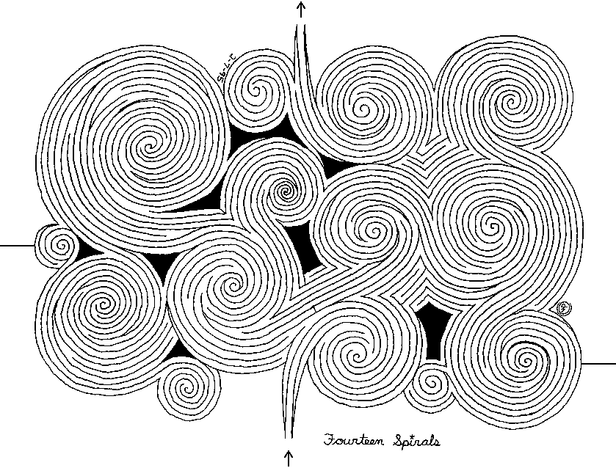
DEMAZE

Slide 2
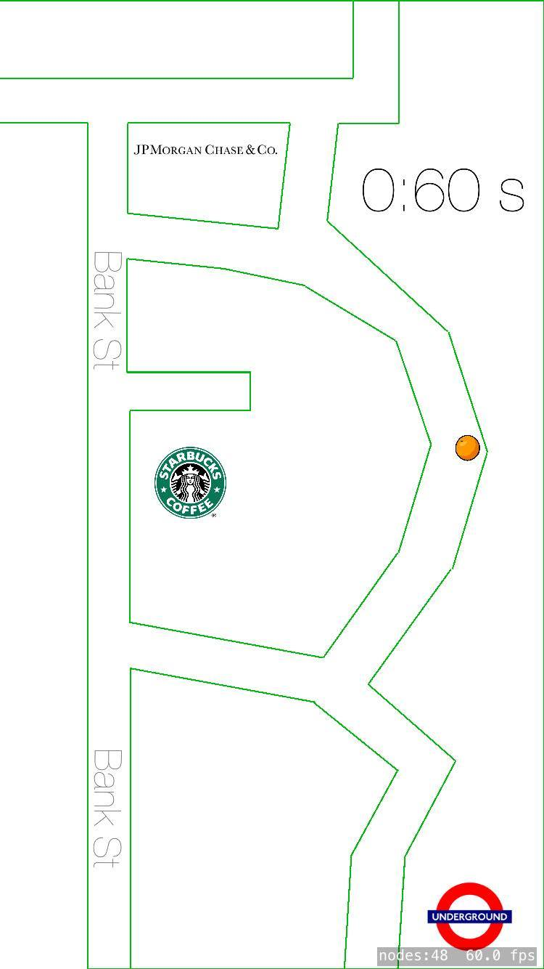
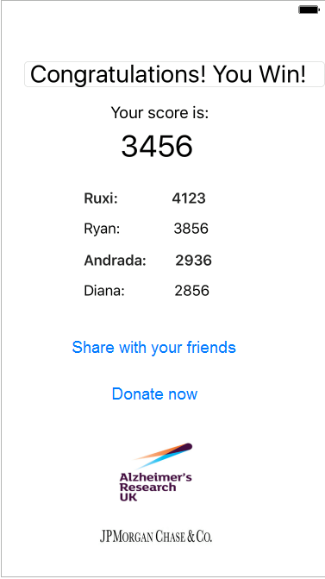

Slide 3
Symptoms
Disorientation
Memory Loss
Difficulty Walking
Fainting and Falling
Visual Hallucinations

Slide 4
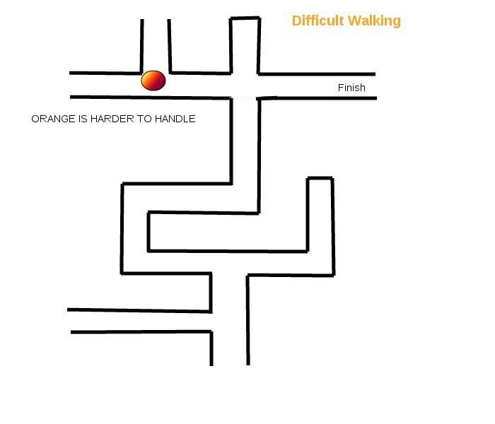

Slide 5
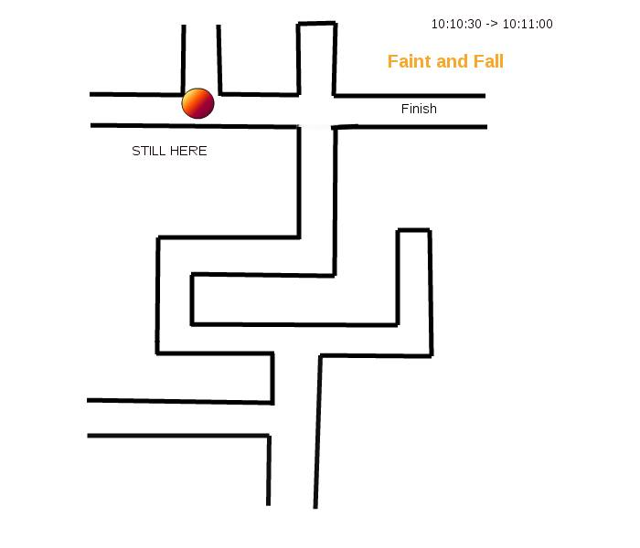

Slide 6
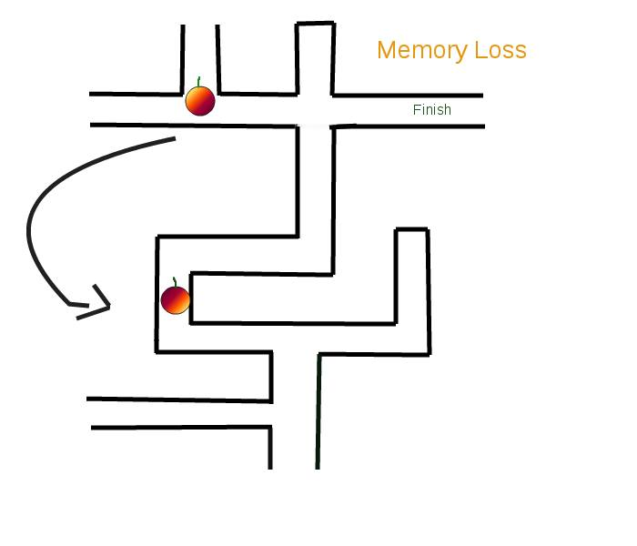

Slide 7
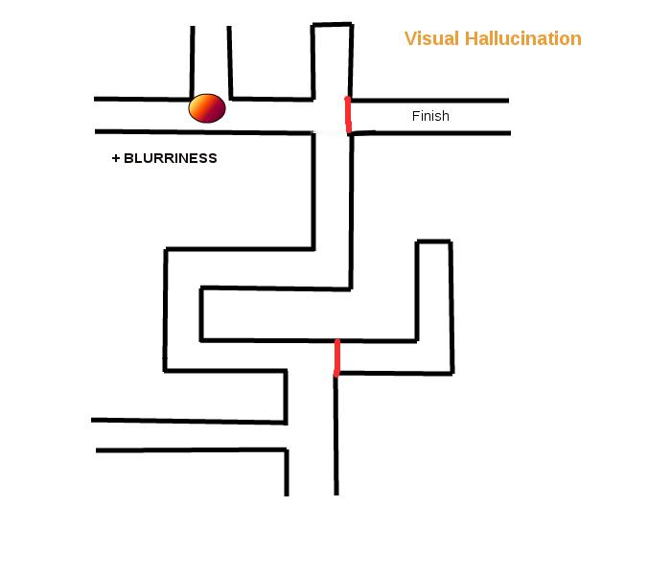

Slide 8



Future

Slide 9
Thank you for your attention!

