Slide 1
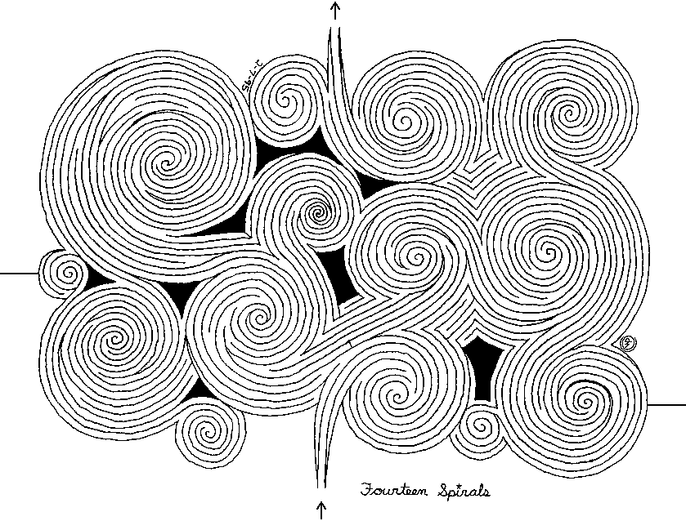
DEMAZE

Slide 2
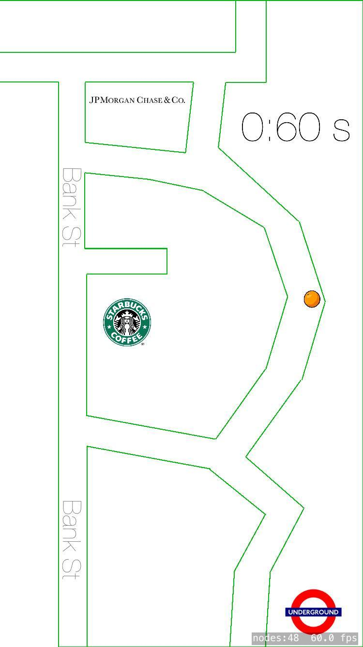
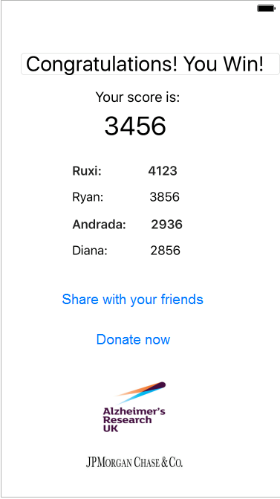

Slide 3
Symptoms
Disorientation
Memory Loss
Difficulty Walking
Fainting and Falling
Visual Hallucinations

Slide 4
Demo

Slide 5
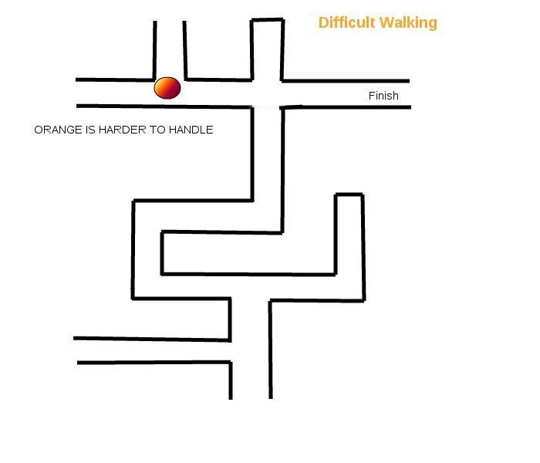

Slide 6
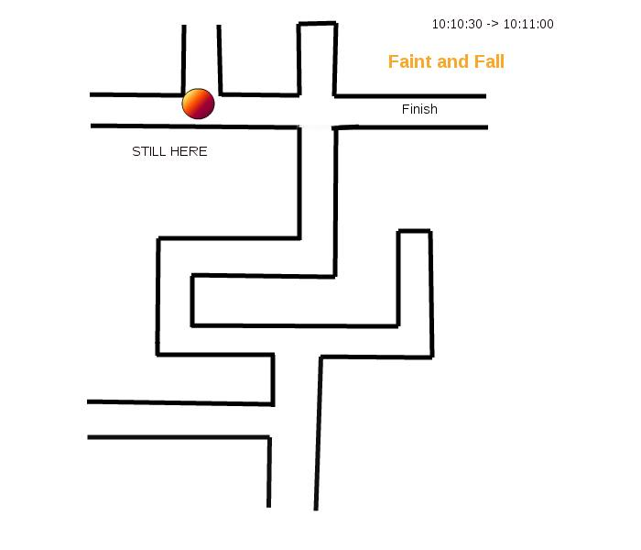

Slide 7
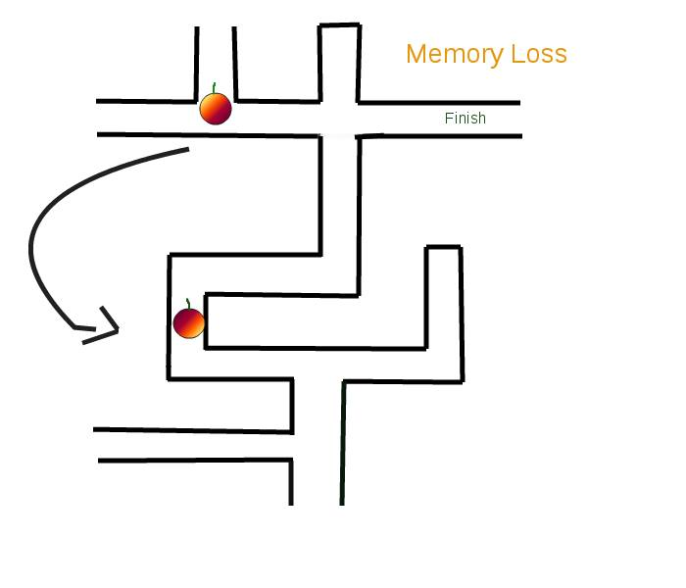

Slide 8
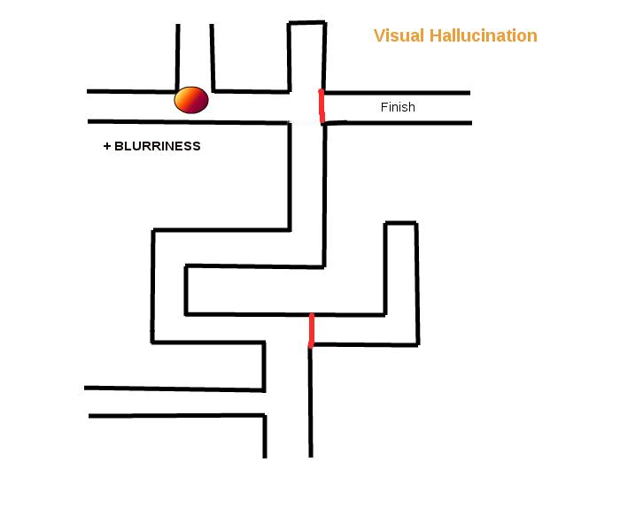

Slide 9
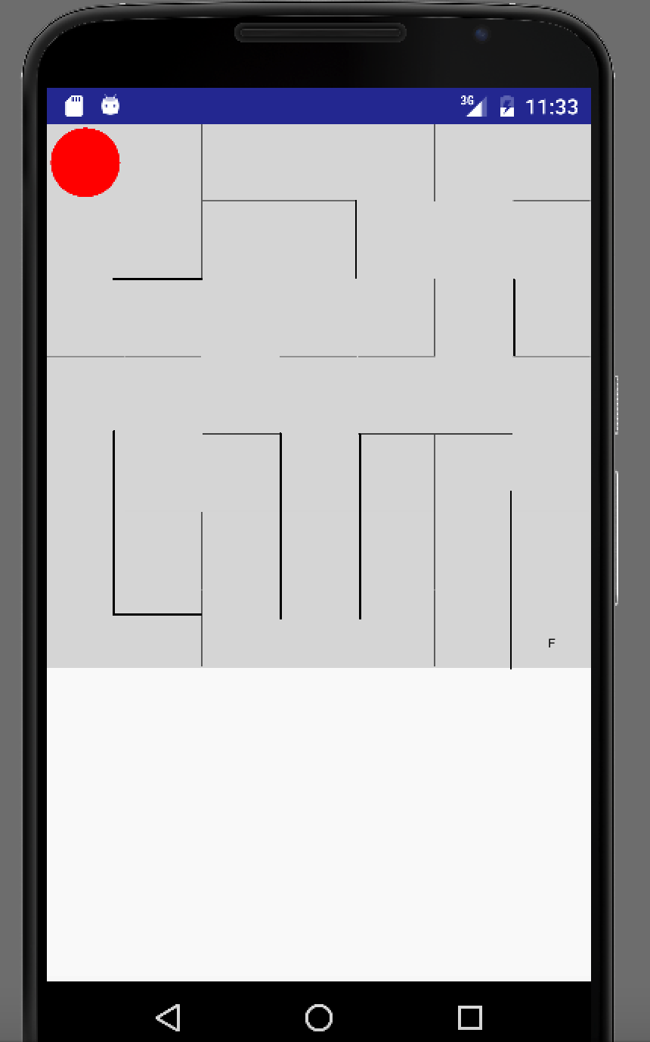
An Android Alternative

Slide 10



Future

Slide 11
Thank you for your attention!

