Slide 1

Group 19 - Edulution

Slide 2
Timeline of Events
18:00-00:30 – Ideas, information gathering, setting up Amazon server
00:30-02:00 – Attempted to use KALite files with API. Server breaks at 01:30
02:00-04:00 – Gave up on attempting to integrate KALite remotely. At 04:00 given new server.
04:00-06:00 – Switch to localhost server. Begin work on algorithms using local database
06:00 –12:00 Algorithm working and demo created.

Slide 3
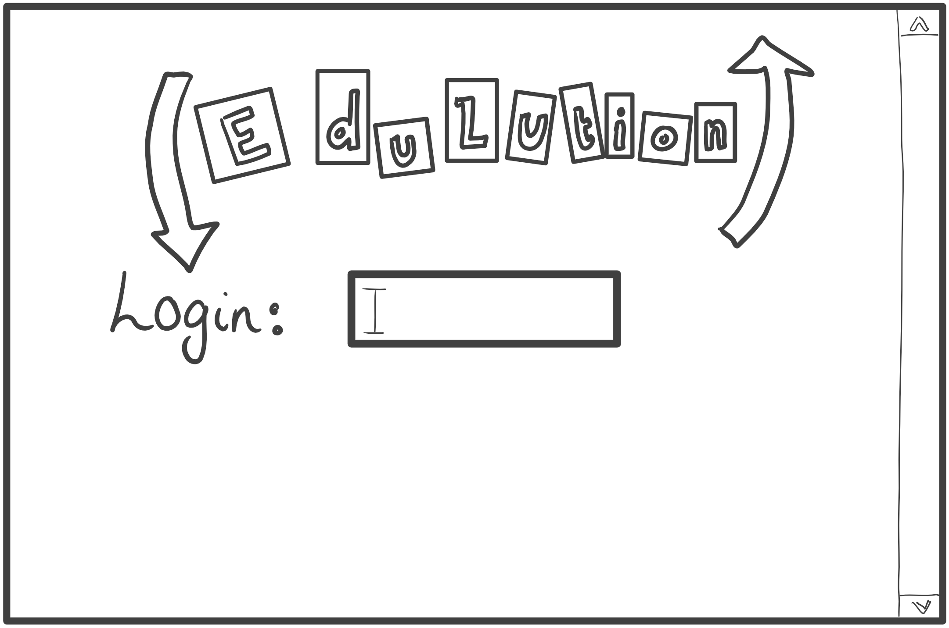
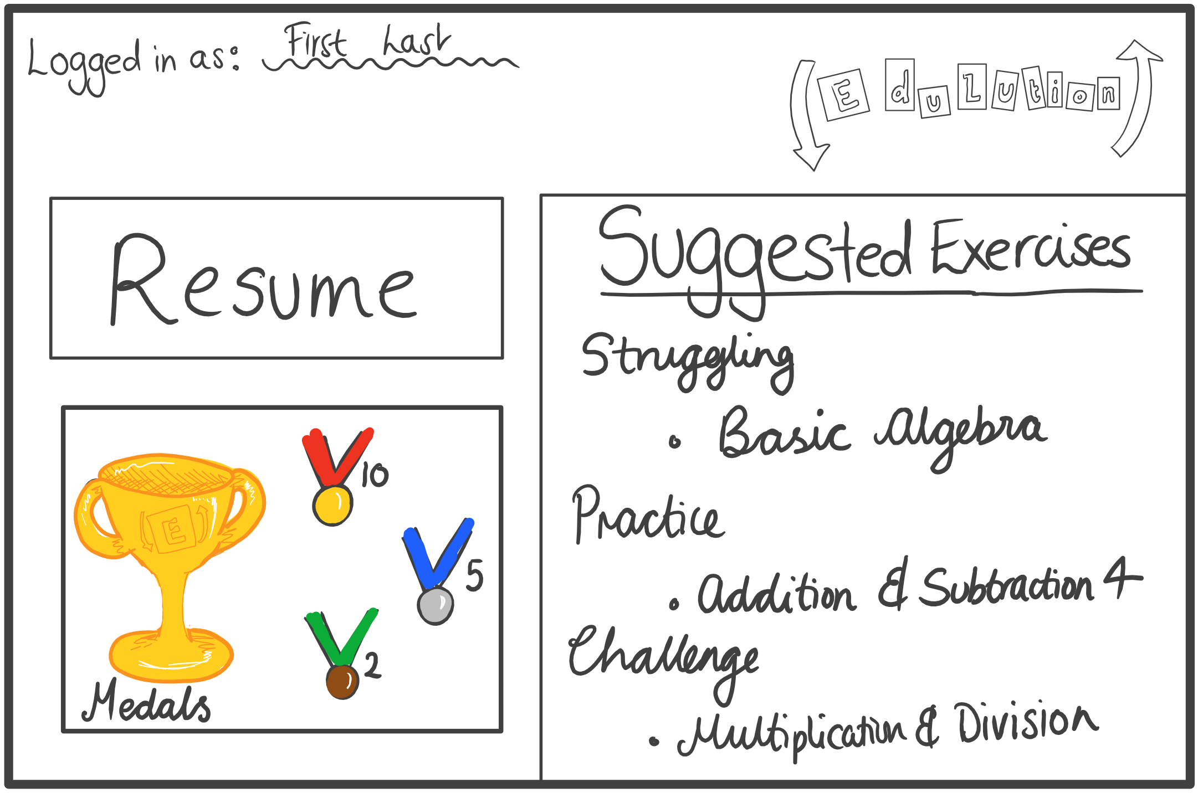

Slide 4
The Initial Ideas
Usability KALite navigation (finding exercises) - too much English/words(children do not know …….how to read properly as of yet) There’s no visible reward system. Application goes to the KALite system instead of running exercises in the application. | Data Tracking No Personalised course progression content: - Recommendations for next exercises Recommendations for easier exercises on failure of an exercise. No history of completed/attempted exercises. Student who is excelling is finding content of playlist too long. Student who is struggling is finding content of playlist too short, they want to increase the number of exercises.

Slide 5
What we created
Excel database was exported into a MySQL database
MySQL database then accessed using PHP.
PHP then used to write data onto the webpage.
Webpage uses a login to show what exercises should be recommended for a student. CAN BE USED BY THE COACH FOR TAILORED LEARNING
Notes:
Talk about how it adds value to their organisation !!!!!

