Slide 1

Group 19 - Edulution

Slide 2
Problem Breakdown
Usability There’s no visible reward system. | Data Tracking No Personalised course progression content: - Recommendations for next exercises Recommendations for easier exercises on failure of an exercise.

Slide 3
What we created
Excel data was exported into a MySQL database
MySQL database then accessed using PHP.
PHP then used to write data onto the webpage.
Webpage uses a login to show what exercises should be recommended for a student. Can be used by coach for tailored recommendations
Notes:
Talk about how it adds value to their organisation !!!!!

Slide 4
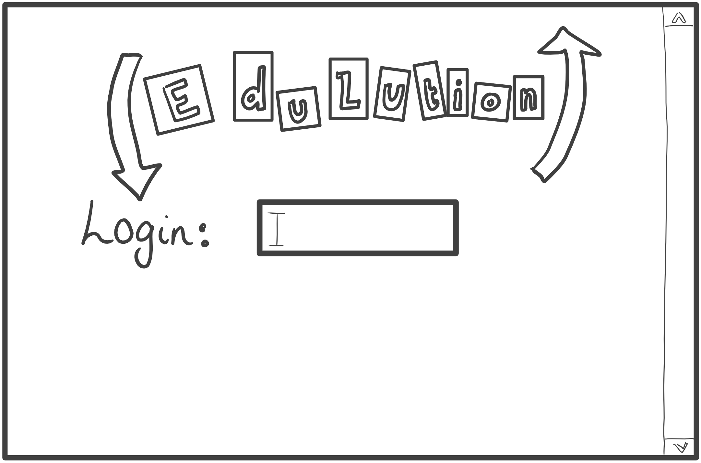
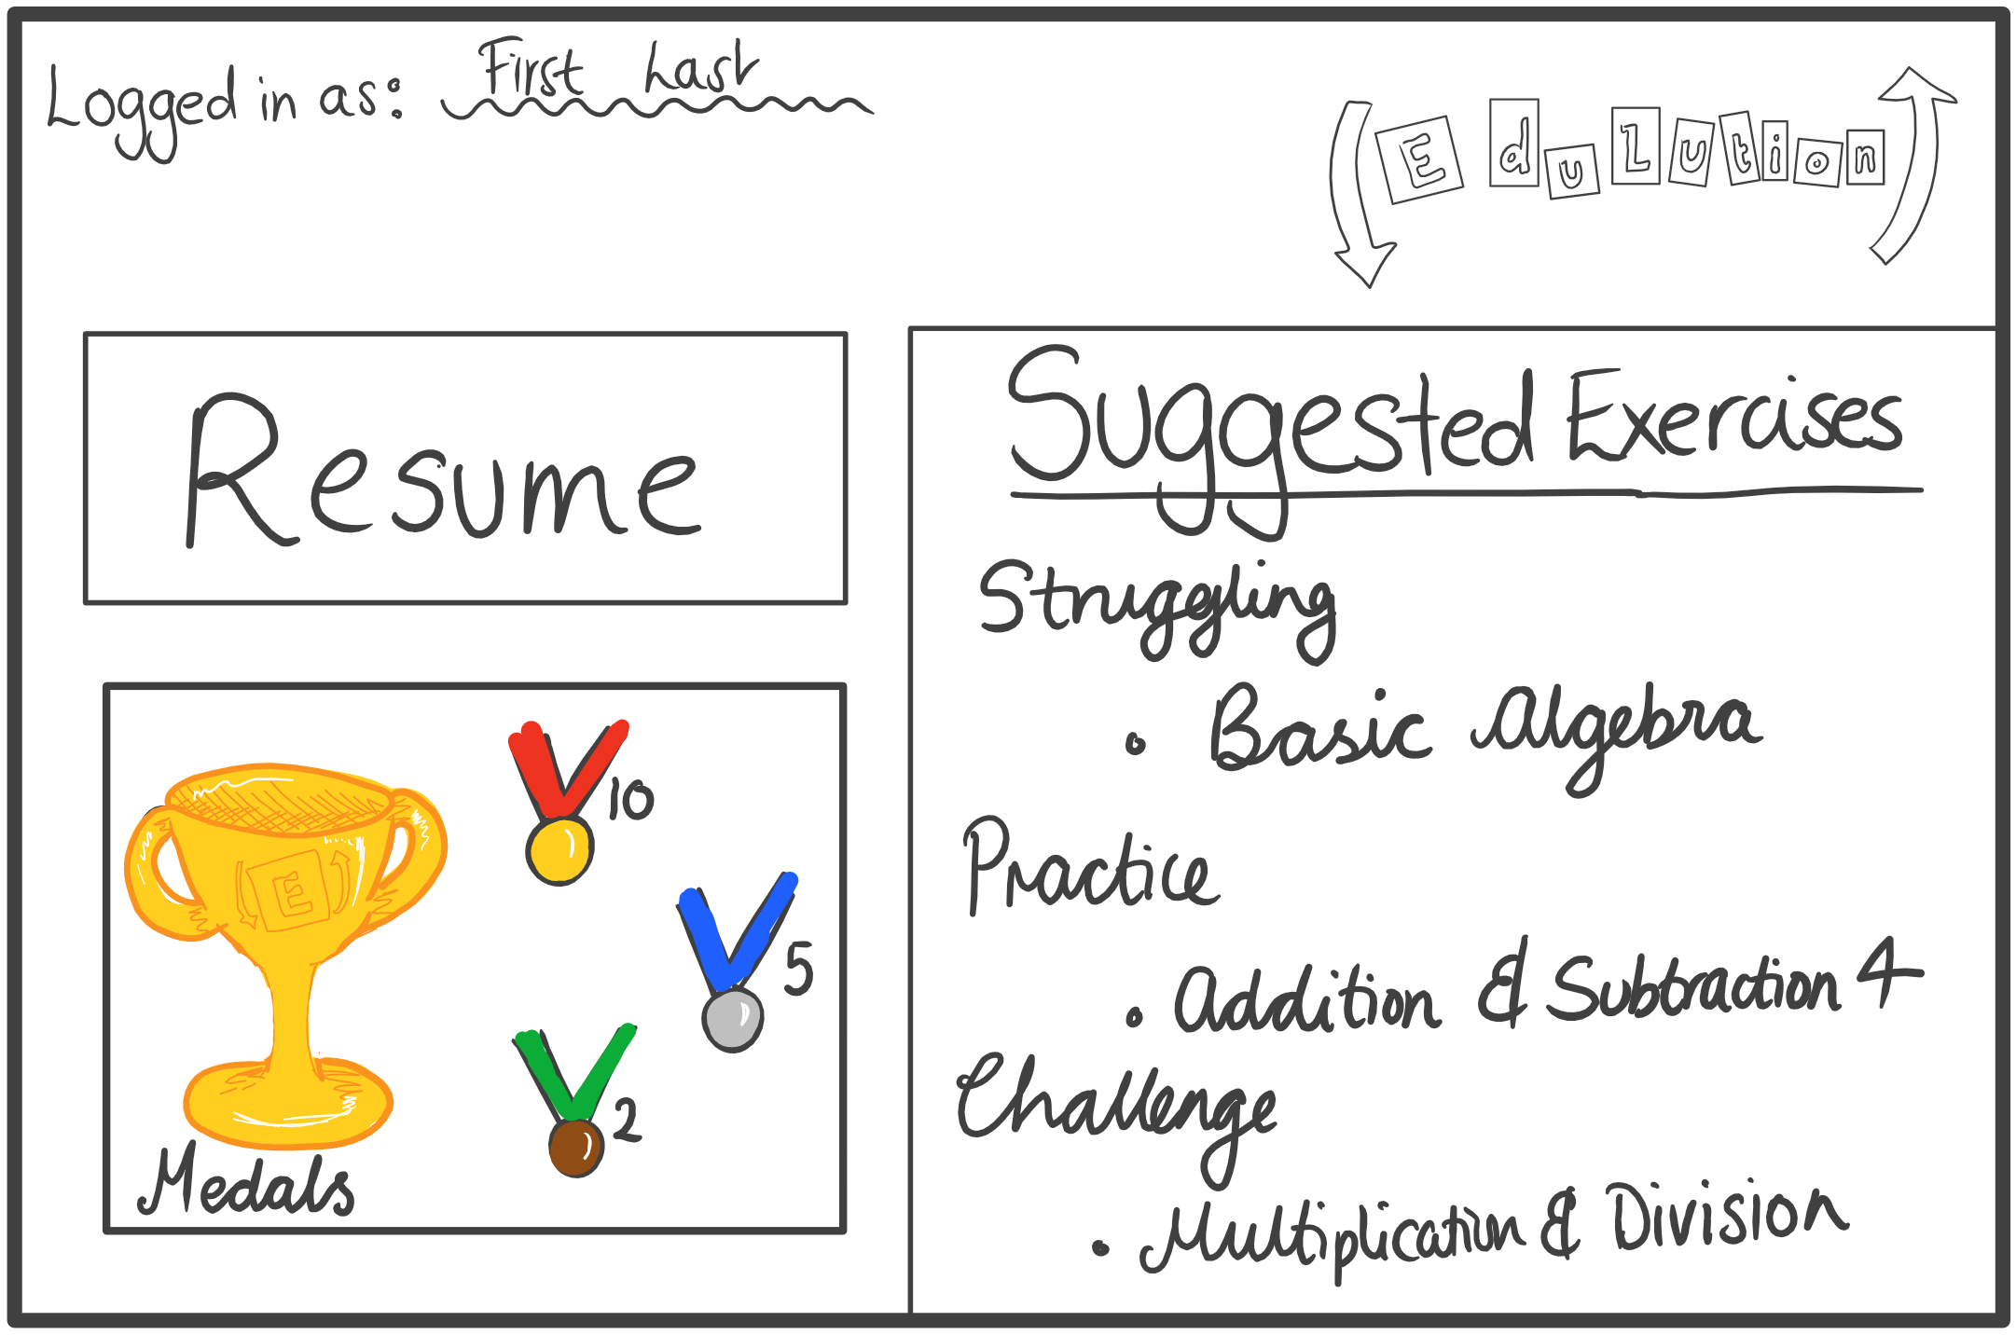

Slide 5
Timeline of Events
18:00-00:30 – Ideas, information gathering, setting up Amazon server
00:30-02:00 – Attempted to use KALite files with API. Server breaks at 01:30
02:00-04:00 – Gave up on attempting to integrate KALite remotely. At 04:00 given new server.
04:00-06:00 – Switch to localhost server. Begin work on demo page using local database
06:00-12:00 – demo finalised.

Slide 6
Future Improvements
Usability:
KALite navigation (finding exercises)- too much English/words(children do not know how to read properly as of yet)
Application goes to the KALite system instead of running exercises in the application.
Data Tracking:
No history of completed/attempted exercises.
Student who is excelling is finding content of playlist too long.
Student who is struggling is finding content of playlist too short, they want to increase the number of exercises.

