Slide 1



Slide 2
The Application

Slide 3
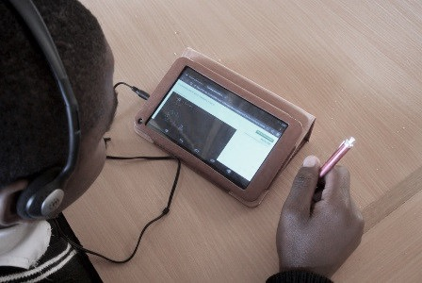
Rewards
Studying

Slide 4

Intuitive User Interface

Slide 5
DEMO

Slide 6
Potential Extensions

Slide 7
Advanced Scoring System
Reward System
Suggested Playlists

