Slide 1
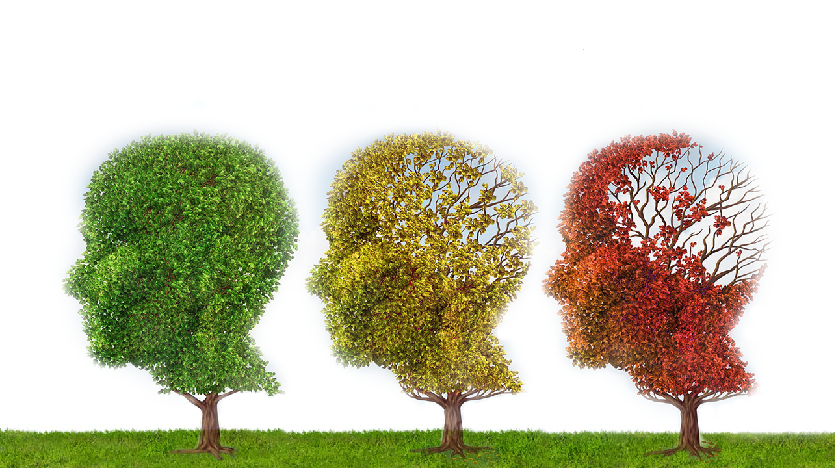


Code for Good – Team 8 Alzheimer’s Research UK Challenge

Slide 2

Team Members
Ivaylo Lafchiev
Maximilian Morell
Mantas Skackauskas
David Skillman
Anton Todorov
Ivan Valkov

Slide 3
Problem Statement

Slide 4
Solution

Slide 5
Demo
No need to leave Facebook
Emotional involvement
Misconceptions cleared up
Short

