Slide 1
PlantSEED Workshop
In-depth Analysis of Genome Annotation

Slide 2
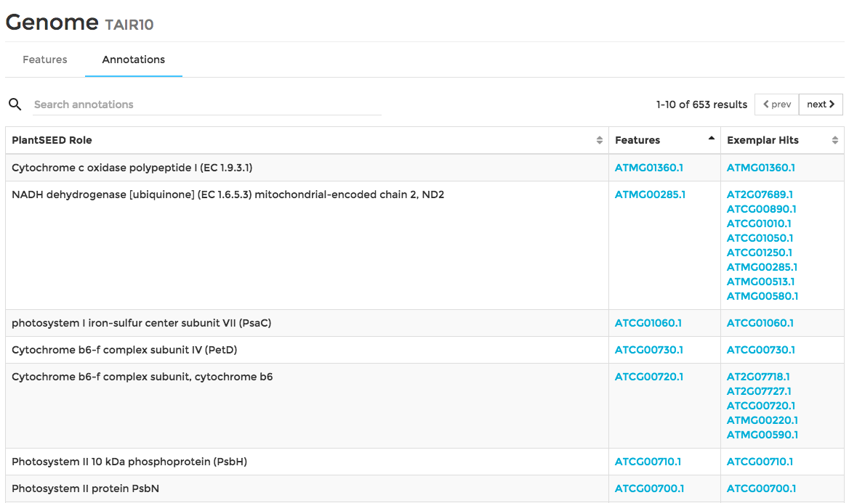
Viewing a User’s Annotation

Slide 3
Viewing a Feature

Slide 4
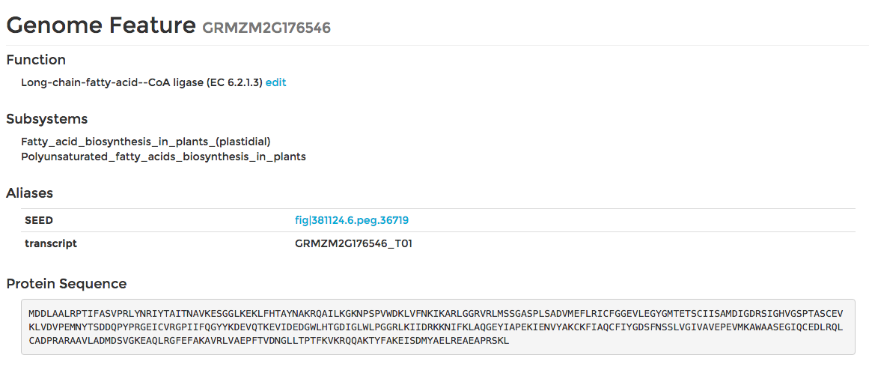
Viewing a Feature

Slide 5
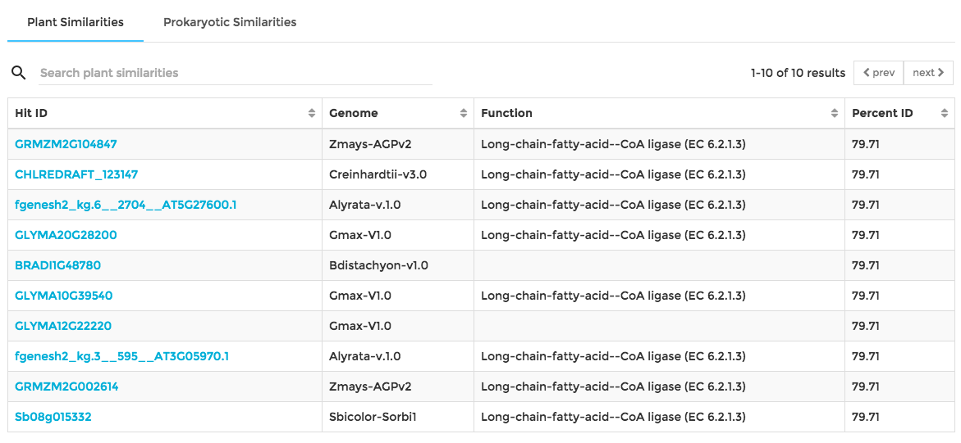
Viewing a Feature

Slide 6
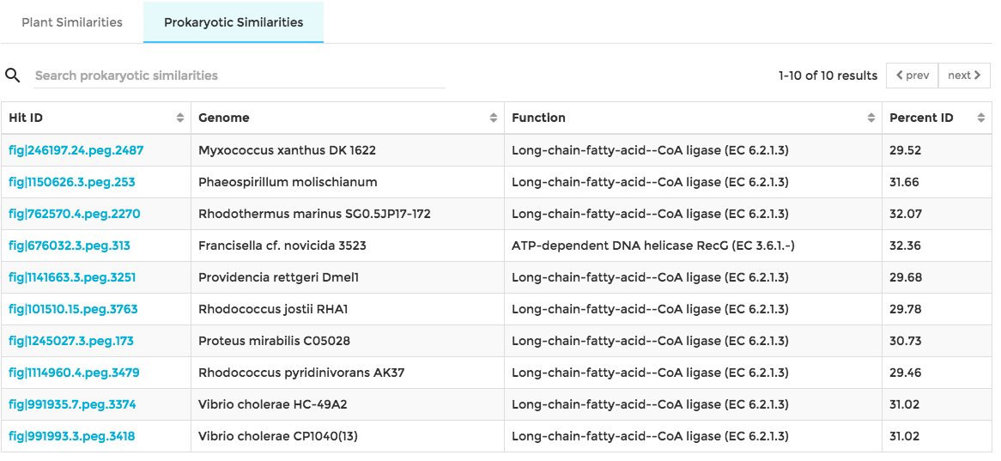
Viewing a Feature

Slide 7
Assessing Annotation (True positives)
One means by which one can evaluate annotation assigned using Kmers is by using BLAST
The “Exemplar Hits” column contains the list of features which had a BLAST ‘hit’ with a curated Arabidopsis gene
We can consider the annotation of a feature, via a K-mer, to be good, if there is a match in the “Exemplar Hits” column.

Slide 8
Assessing Annotation (False negatives)
A false negative occurs if a PlantSEED Functional Role was not assigned to any features, but there are “Exemplar Hits”.
You may browse the “Exemplar Hits” and look at the Plant similarities for each feature.
If you believe that the functional role can be assigned to any of these features, you can edit a feature’s function

Slide 9
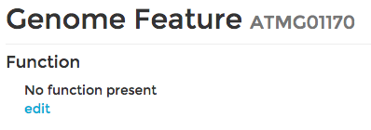
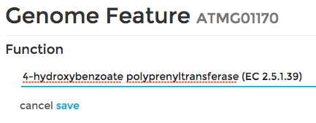
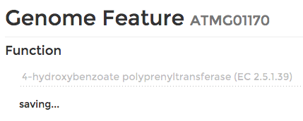
Assessing Annotation (False negatives)

Slide 10
Assessing Annotation (False positives)
A false positive occurs if a PlantSEED Functional Role was assigned to any features, but there are zero “Exemplar Hits”.
You may look at the Plant similarities for these features.
If you believe that the functional role should not belong to the feature, you may edit the function so that it is an empty string.

Slide 11
Assessing Annotation (Tasks)
Look through every functional role in Central Carbon Metabolism
Glycolysis, TCA Cycle, PPP
Does your genome have feature(s) annotated with each function?
For missing roles, can you find and edit features?
Tip: Use two tabs/pages
One for master list of PlantSEED annotation
One for annotation of User’s genome

