Slide 1
PlantSEED Workshop
Overview of PlantSEED curation, subsystems, and K-mers

Slide 2
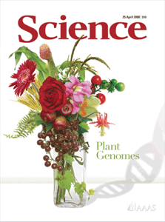
PlantSEED Workflow
Genome
Annotated Genome
Database of
Plant
K-mers
Draft Metabolic Model
Database of
Plant
Reactions
Working Metabolic Model

Slide 3
Plant K-mers
A K-mer is a short (8 AAs) peptide sequence
It is a unique representation of a protein function:
MTIRNQRF
Ubiquinol--cytochrome c reductase, cytochrome B subunit (EC 1.10.2.2)
K-mers are generated via FigFams/Subsystems
K-mers are utilized via RAST
Rapid Annotation using Subsystem Technology

Slide 4
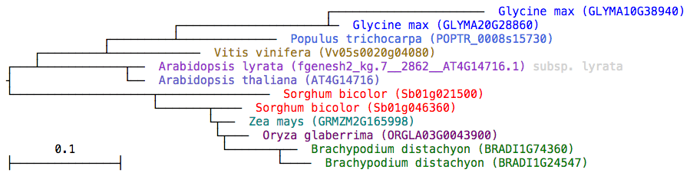
Plant FigFams
A set of isofunctional protein sequences
1, 2-dihydroxy-3-keto-5-methylthiopentene dioxygenase (EC 1.13.11.54)

Slide 5
Plant FigFams
A set of isofunctional protein sequences
A k-mer is a unique signature of a FigFam
It is not found in other FigFams

Slide 6
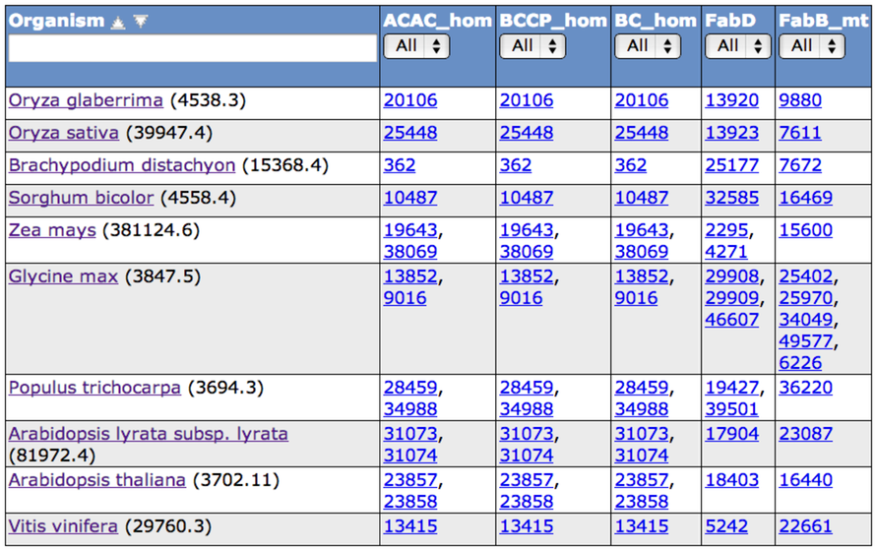
Plant Subsystems
(Acetyl-CoA carboxylase complexes)

Slide 7
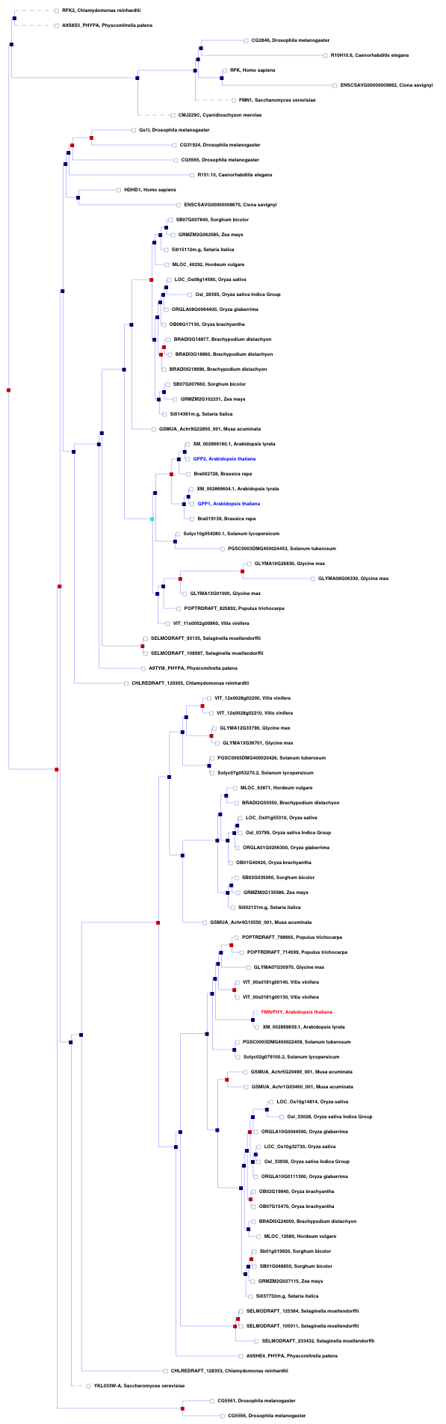
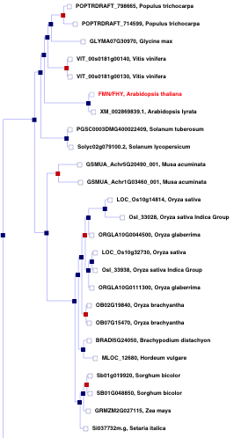
Plant Protein Families
Gramene.org

Slide 8
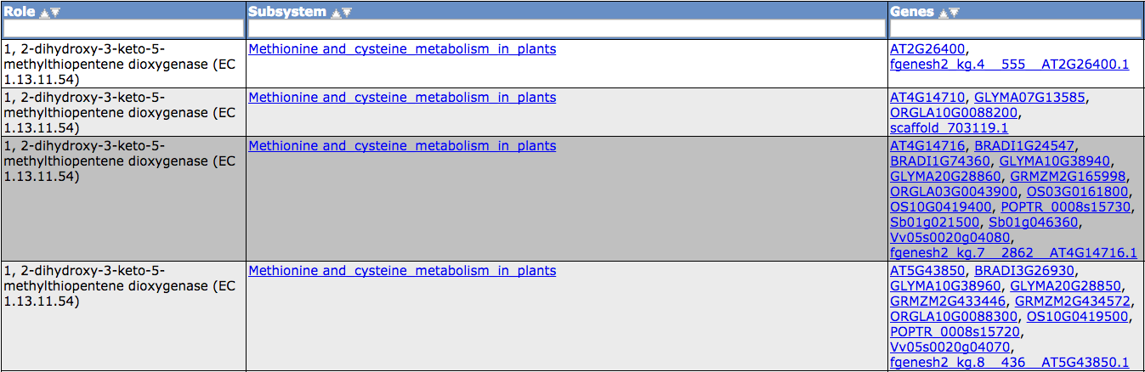
Plant Protein Families
Conservative use will result in ‘splitting families’
Reduces over-annotation

Slide 9
Curation of plant primary metabolism
Gene – reaction associations available in many places:
KEGG
AraCyc
MetaCyc
BRENDA
UniProt
Gramene
Phytozome

Slide 10

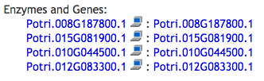
Curation of plant primary metabolism
Most gene-reaction associations are predictions
AraCyc:
9,715/12,447 (78%)
PoplarCyc:
14,154/14,162 (99.9%)
Lack of Transparency

Slide 11
Curation of plant primary metabolism
We intensively curated:
361 pathways of primary metabolism pathways
~100 Subsystems
~2,400 Genes
~1,300 Reactions

Slide 12
Curation of plant primary metabolism
Riboflavin kinase (EC 2.7.1.26)
AT1G56500
AT2G38740
AT3G48420
AT4G25840
AT4G11570
AT4G39970
AT4G21470
AT5G57440
AT1G56500
AT2G38740
AT3G48420
AT4G25840
AT4G11570
AT4G39970
AT4G21470
AT5G57440

Slide 13
Propagation of plant primary metabolism

Slide 14
Propagation of plant primary metabolism
684
687
661
0.91
673
688
747
747
713
0.97
722
725

Slide 15
Propagation of plant primary metabolism

Slide 16
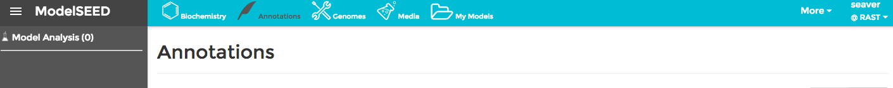
Viewing PlantSEED Annotation
Master List of Subsystems:
http://plantseed.theseed.org
PlantSEED Annotation
http://plants.theseed.org

Slide 17
Viewing PlantSEED Annotation
Subsystems
linked to SEED
Pathways
linked to AraCyc
Features
linked to curated Arabidopsis genes
Reactions
can be found in Biochemistry
will be seen in metabolic reconstruction

Slide 18
Viewing User Annotation
Nota Bene:
The annotation of the public PlantSEED genomes was done using FigFams
The annotation of the user genomes was done using K-mers
Annotation and BLAST runs were done ahead of time
In the near future, we plan to have these available as part of the PlantSEED pipeline

Slide 19
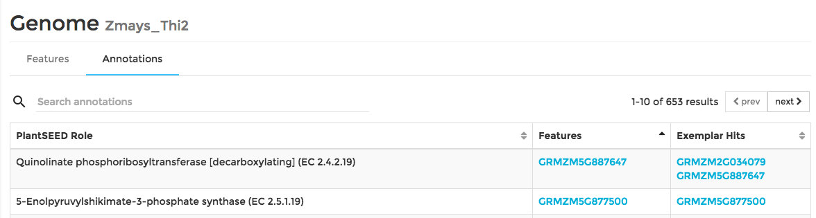
Viewing User Annotation
Features
Result of K-mer annotation process (2 minutes)
Exemplar hits
Result of running BLAST against curated Arabidopsis genes (1/2 day – 2 days)

Slide 20
Viewing User Annotation
Look through every functional role in Central Carbon Metabolism
Glycolysis, TCA Cycle, PPP
Does your genome have feature(s) annotated with each function?
Tip: Use two tabs/pages
One for master list of PlantSEED annotation
One for annotation of User’s genome
Do the same for a subsystem of choice

