Slide 1
PlantSEED Workshop
Future of PlantSEED

Slide 2
Website
Additional functionality will be added to the website
Upload
Specific file types and data
Annotation
K-mer (fast) and BLAST (slow)
Download
Various formats
Genome and Model Editing
Provenance
Additional Functionality

Slide 3
PlantSEED v2.0
Improve coverage of plant primary metabolism
Train and test an improved set of K-mers
Improve compartmentalization
Organellar genomes
Model Reconstruction Rules
Respiration & Photosynthesis
Introduce Algae
Growing interest in metabolic engineering
Publicly available annotation process

Slide 4
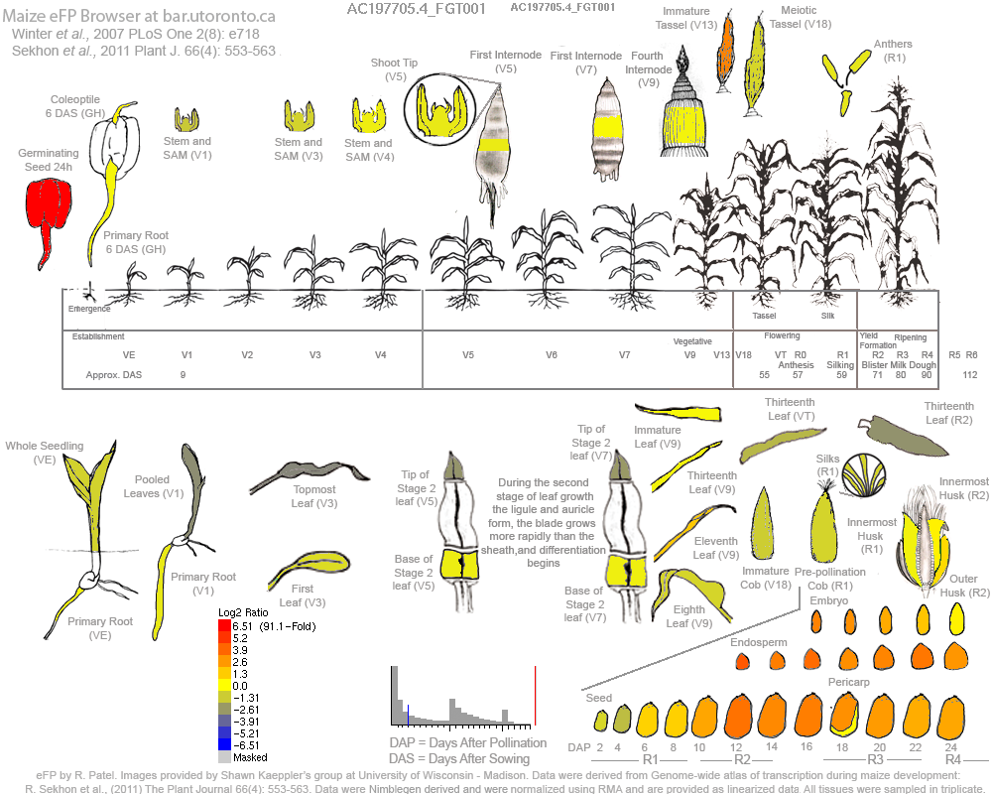
Refining models using transcriptomics

Slide 5
Variation of plant primary metabolism

Slide 6
Refining models using transcriptomics
The refinement of a tissue-specific model should be functionally oriented
Primary function: Biosynthesize biomass
Curated for leaf, embryo, and endosperm
Secondary functions
Simultaneous Transcriptome-based Gapfilling
Simultaneously
Biosynthesize biomass
Activates “high” reactions
Deactivates “low” reactions

Slide 7
Validation of tissue-specific model
Species | Model Type | Reactions | Gene-Reaction Associations | Endosperm (¹⁴C data) | Embryo (¹⁴C data)
Arabidopsis thaliana | Full | 6,399 | 16,577 | - | -
Arabidopsis thaliana | Evidenced | 2,801 | 4,262 | - | -
Zea mays | Full | 6,458 | 35,226 | 0.99 | 0.99
Zea mays | Evidenced | 2,629 | 5,540 | 0.99 | 0.83
Zea mays | Leaf | 2,322 | 4,656 | - | -
Zea mays | Embryo | 2,304 | 4,680 | - | 0.83
Zea mays | Endosperm | 2,280 | 4,602 | 0.99 | -
Zea mays | iRS1562 | 1,962 | - | 0.69 | 0.43
Seaver et al. (2015) Improved evidence-based genome-scale metabolic models for maize leaf,
embryo, and endosperm. doi: 10.3389/fpls.2015.00142

Slide 8
Plant-Microbial Interactions
The refinement of a tissue-specific model should be functionally oriented
Primary function: Biosynthesize biomass
Curated for leaf, embryo, and endosperm
Secondary functions
Simultaneous Transcriptome-based Gapfilling
Simultaneously
Biosynthesize biomass
Activates “high” reactions
Deactivates “low” reactions

Slide 9
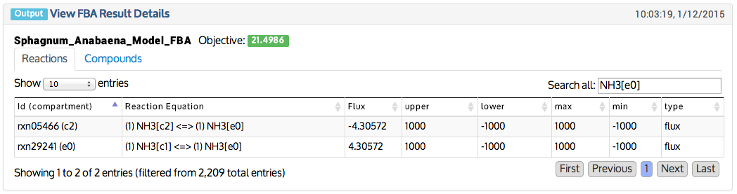
Plant-Microbial Interactions
The nitrogen provided for the biomass of a Sphagnum moss is fixed by a cyanobacteria
NH₃
N₂

Slide 10
Secondary Metabolism
Some pathways are available in PlantSEED but a couple are specific to Arabidopsis
Highly diversified pathways present a unique challenge
Idea of Last Common Metabolite (LCM) for a phylogenetic family.
K-mers?

Slide 11
Thank You!
Comments?
Don’t forget the feedback form.

