Slide 1
PlantSEED Workshop
Tour of PlantSEED Subsystems, Protein Families, and K-mers

Slide 2
Introduction

Slide 3
Introduction
Over-arching goal of our work:
In silico generation of novel hypotheses in plant primary metabolism via species, tissues, and abiotic/biotic conditions.
Involves:
Curation of plant primary metabolism
Propagation to other plant species
Simulation with -omics data

Slide 4
Curation (Biochemistry)
Mass-balance via InChI strings
Database of ~23,000 mass-balanced reactions
Publicly available
https://github.com/ModelSEED/ModelSEEDDatabase
C00022 InChI=1S/C3H4O3/c1-2(4)3(5)6/h1H3,(H,5,6)
PYRUVATE InChI=1S/C3H4O3/c1-2(4)3(5)6/h1H3,(H,5,6)
(1) ADP + (1) Phosphoenolpyruvate + (1) H+ => (1) ATP + (1) Pyruvate

Slide 5
Curation (Localization)

Slide 6
Curation (Pathways)
~350 AraCyc pathways
~100 subsystems
“Alanine, serine, glycine metabolism in plants”
~2,400 genes
~750 metabolic functions
~1,200 biochemical reactions
Data aggregated as a template for plants

Slide 7
Curation (Pathways)
Riboflavin kinase (EC 2.7.1.26)
AT1G56500
AT2G38740
AT3G48420
AT4G25840
AT4G11570
AT4G39970
AT4G21470
AT5G57440
AT1G56500
AT2G38740
AT3G48420
AT4G25840
AT4G11570
AT4G39970
AT4G21470
AT5G57440

Slide 8
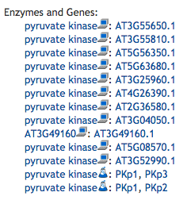
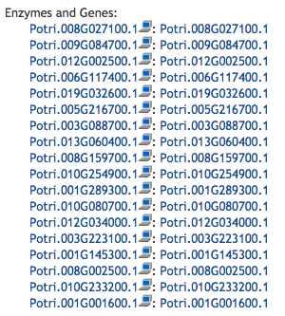
Propagation (Challenge)
Universally implemented
SwissProt
KEGG
BioCyc / AraCyc
Reactome
Variety of approaches
Little transparency

Slide 9
Propagation (Protein Families)
~40 Genomes from Phytozome
~28K families by OrthoFinder (Emms and Kelly 2015)
Convenient but:
Multi-functional or uncurated
Undesired homologs
Conservatively split using sequence identity

Slide 10
Propagation
NADH dehydrogenase
[ubiquinone] (EC 1.6.5.3)
NAD(P)H-plastoquinone
oxidoreductase (EC 1.6.5.-)
NAD(P)H-plastoquinone
oxidoreductase (EC 1.6.5.-)

Slide 11
Propagation

Slide 12
Propagation

Slide 13
Propagation

Slide 14
Propagation

Slide 15
Propagation (Results)
Across 43 Phytozome genomes
30 Eudicots: 75%
58% - 95%
5 Monocots: 82%
8 Algae: 70%

Slide 16
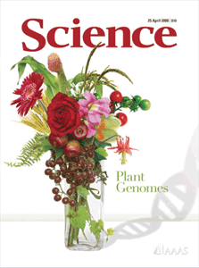
PlantSEED Workflow
Genome
Annotated Genome
Database of
Plant
K-mers
Draft Metabolic Model
Database of
Plant
Reactions
Working Metabolic Model

Slide 17
Plant K-mers
A K-mer is a short (8 AAs) peptide sequence
It is a unique representation of a protein function:
MTIRNQRF
Ubiquinol--cytochrome c reductase, cytochrome B subunit (EC 1.10.2.2)
K-mers are generated from OrthoFinder/PlantSEED protein families
~700K K-mers generated for plant primary metabolism

Slide 18
Viewing User Annotation
Look through every functional role in Central Carbon Metabolism
Glycolysis, TCA Cycle, PPP
Does your genome have feature(s) annotated with each function?
Tip: Use two tabs/pages
One for master list of PlantSEED annotation
One for annotation of User’s genome
Do the same for a subsystem of choice

