Slide 1
PlantSEED Workshop
Overview of Sandbox Model

Slide 2
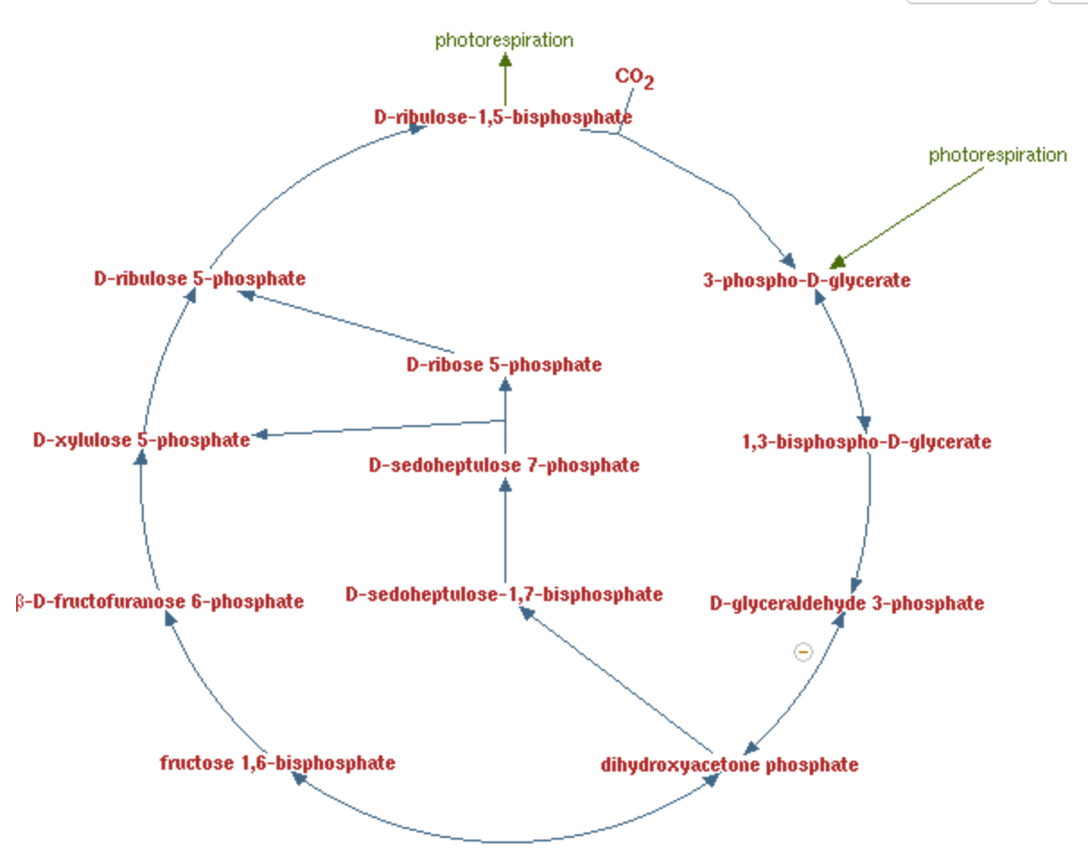
Calvin Cycle
rxn01111
rxn00018
rxn00777
rxn01116
rxn01100
rxn01200
rxn15271
rxn01345
rxn00782
rxn15494
rxn01334
rxn00747
rxn15116

