Slide 1
Wireless options (NB: Wireless is weak)
eduroam
If you use this at your home institution, you can use it here
UF Guest Network
https://net-services.ufl.edu/provided-services/wireless/UF-guest-wireless.html

Slide 2
PlantSEED Workshop
Introduction / Overview

Slide 3

Introductions and Sponsors
Sponsors:
National Science Foundation
Argonne National Laboratory
University of Florida
Institute of Food and Agricultural Sciences
NSF Project:
The B vitamin/cofactor network: command and control of metabolism in changing conditions
PI: Andrew Hanson
Co-Pis: Christopher Henry, Donald McCarty, Jess Gregory

Slide 4
Workshop Schedule
Day 1:
Overview
Sandbox
Group Photo
Flux Balance Analysis
Unconstrained
Transcript-constrained
Day 2:
Overview
Participation Goals
Annotation and Reconstruction
Future and DOE Knowledge-Base

Slide 5
PlantSEED Team and Contributors
Chris Henry (ANL)
Sam Seaver, Neal Conrad, Arman Mikaili
Andrew Hanson & Valerie de Crecy-Lagard (UF)
Claudia Lerma-Ortiz, Oceane Frelin, Louis Bradbury, Thomas Neihaus, Ghulam Hasnain, Basma El Yacoubi, Remi Zallot
Ross Overbeek (ANL/FIG/PATRIC)
Gordon Pusch, Robert Olson
Svetlana Gerdes (FIG)

Slide 6
History of SEED
1980: Ross Overbeek joins ANL
Series of Bioinformatics Systems developed:
1994: PUMA
1996: WIT
1998: ERGO
2003: SEED
2003: Fellowship of Genomes
“Project To Annotate 1000 Genomes”
2010: ModelSEED published
2014: PlantSEED published

Slide 7
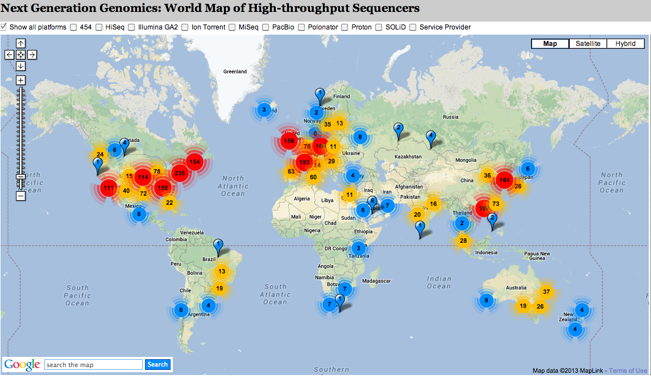
Growth in Next Generation Sequencing for Plants
Genomes Online: 6000+ sequencing projects in Viridiplantae

Slide 8
Goals
Over-arching goal of our work:
In silico generation of novel hypotheses in plant primary metabolism in species, tissues, and experimental conditions.
Involves:
Curation of plant primary metabolism
Propagation to other plant species
Integration and Simulation with -omics data

Slide 9
PlantSEED Websites
‘Published’ site:
http://plantseed.theseed.org
http://www.ncbi.nlm.nih.gov/pubmed/24927599
Workshop site:
http://modelseed.org/events/plantseed2017/
Will be updated after workshop
Repository:
https://github.com/ModelSEED/PlantSEED/Workshops
New PlantSEED Web Interface:
http://modelseed.org

Slide 10
Logging in
http://140.221.65.31/
Can you log in?
Break

