Slide 1
PlantSEED Workshop
Overview of Website,
Reference Data, and Sandbox

Slide 2
Questions to Guide (Website; http://140.221.65.31/ )
How many:
Reference Data Models?
Roles in a subsystem that involves Serine?
Media that have the word ’Plant’

Slide 3
Questions to Guide (Reference Data)
Can you find:
S. tuberosum?
Plastidial sandbox?
In any Reference Model:
How many reactions utilize ATP?
How many plastidial reactions utilize NADPH?
In any Plant media:
Can you identify the possible sources of carbon?

Slide 4
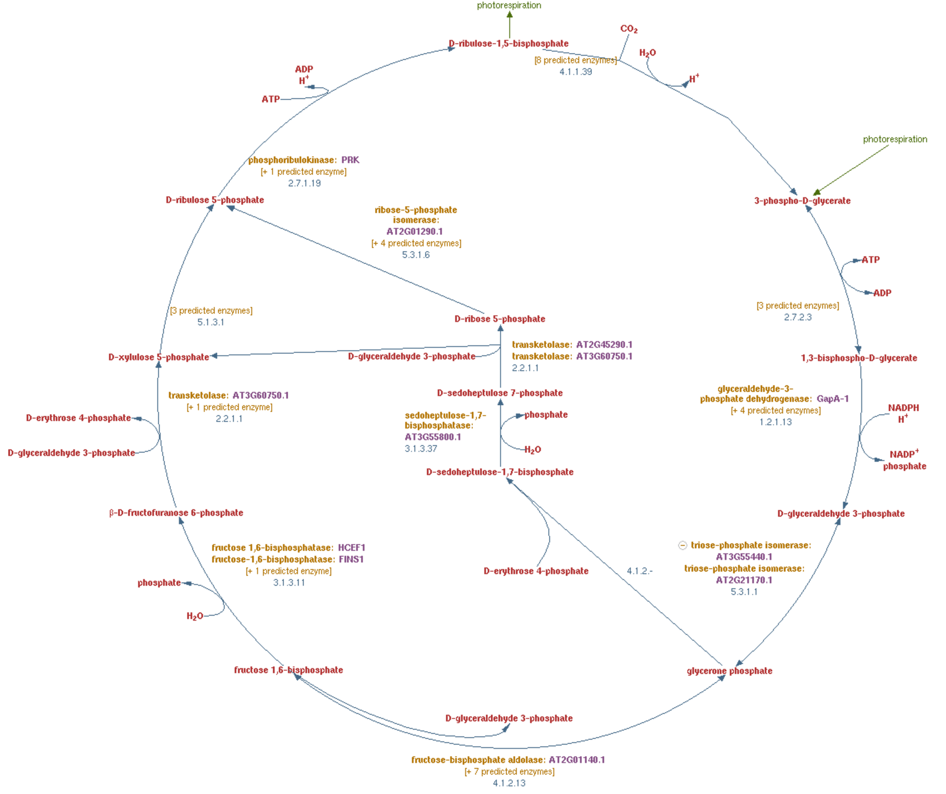
Sandbox Pathways (Calvin Cycle)
pmn.plantcyc.org

Slide 5
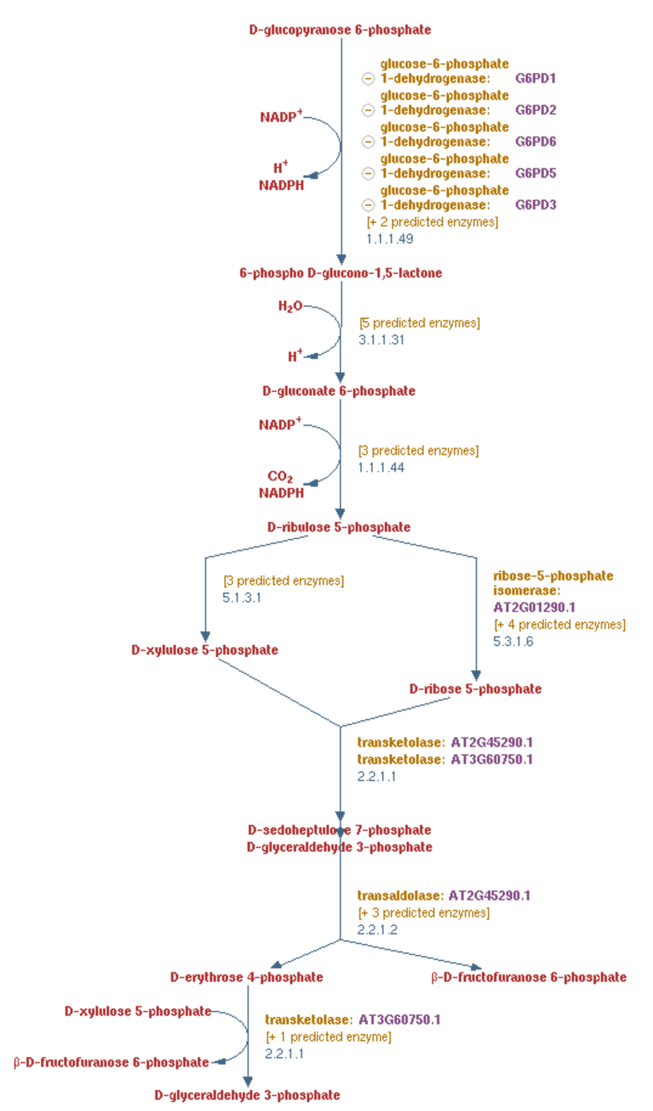
Sandbox Pathways (Pentose Phosphate Pathway)
pmn.plantcyc.org

Slide 6
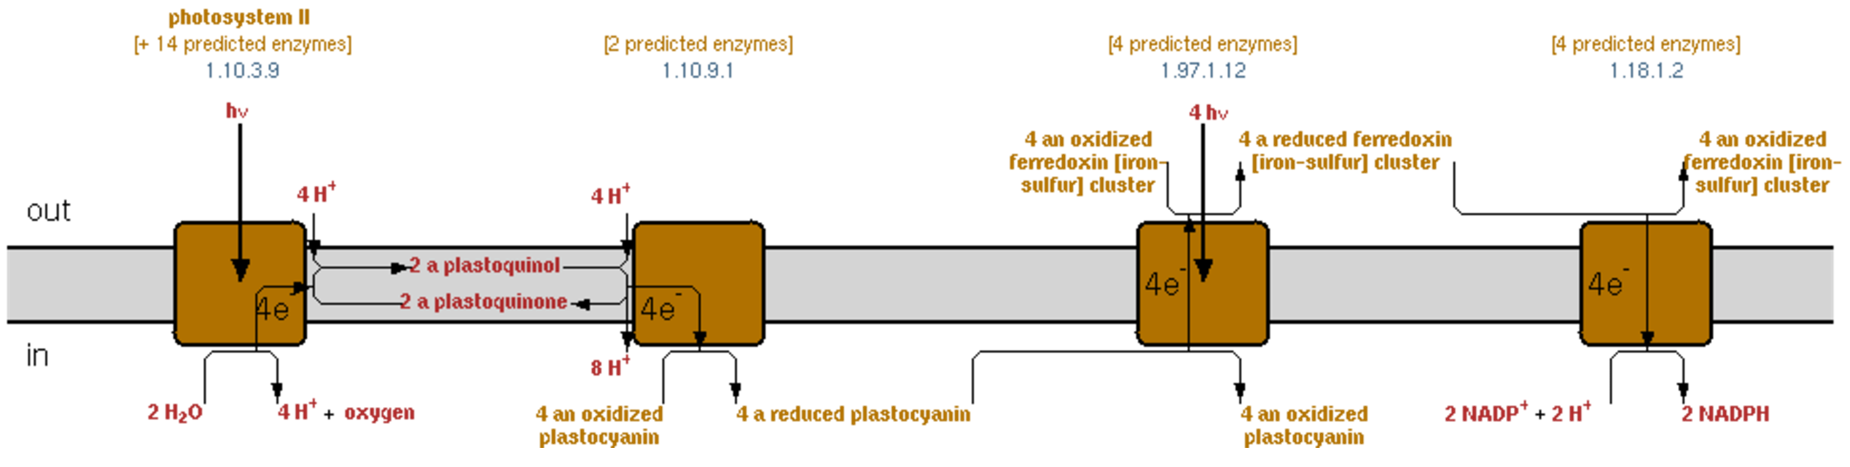
Sandbox Pathways (Photosynthesis)
pmn.plantcyc.org

Slide 7
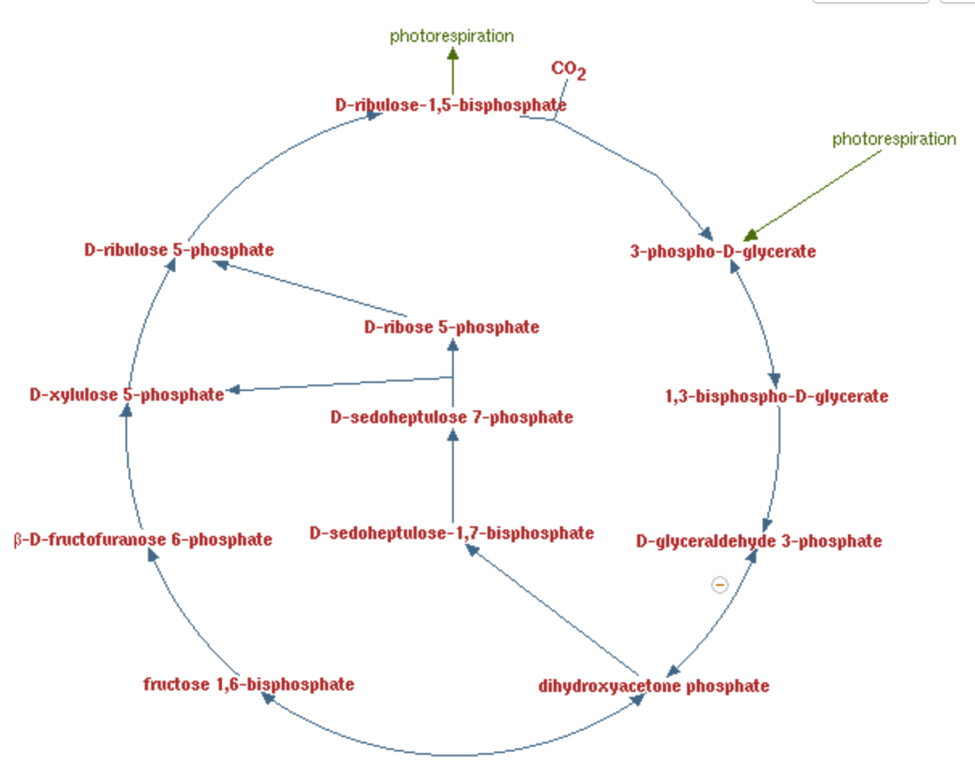
Sandbox Pathways (Calvin Cycle Reactions)
rxn01111
rxn00018
rxn00777
rxn01116
rxn01100
rxn01200
rxn15271
rxn01345
rxn00782
rxn15494
rxn01334
rxn00747
rxn15116

