Slide 1
Introduction to Flux Balance Analysis:
Flux balance analysis (FBA) is a method of systems biology
The ultimate goal is to build a realistic model that encompasses the entire metabolic potential of an organism
That goal has largely been achieved in tractable microbial systems, e.g. E. coli.
In other systems, less ambitious goals are feasible. i.e. modeling of metabolic subsystems and metabolic reconstruction based on genome annotations.
Metabolic reconstruction seeks to build the metabolic network of an organism from its sequenced genome. In plants, FBA and metabolic reconstruction are important tools for evaluating quality and completeness of genome annotations for metabolic functions.
Reference: Orth, Thiele and Palsson (2010) What is Flux Balance Analysis? Nature Biotech. 28: 245–248. doi:10.1038/nbt.1614

Slide 2
Advantages:
Critically, FBA does not require knowledge of kinetic parameters (Km’s and Vm’s) for metabolic enzymes
In principle, all that’s needed is a “parts list” for the system of interest:
1. a complete list of metabolic reactions catalyzed by enzymes included in the
system of interest, plus some reasonable constraints on fluxes and reversibility
2. a list of compounds (substrates and products of the reactions)
3. a suitable boundary that defines the system of interest; e.g. an entire
organism, a single cell, an organelle, or a metabolic pathway or sub-system.
4. a “biomass equation” that describes the biomass composition the model has to
make, usually this is highly simplified
5. An “objective function” that specifies processes the model will seek to
optimize, e.g. biomass production, minimize ATP consumption, etc
FBA modeling takes advantage of very fast and efficient linear programming algorithms
Disadvantages:
FBA does not predict concentrations of intermediates
FBA models are usually at best in qualitative agreement with experimental data
Obtaining an accurate and complete list of metabolic reactions for an organism is easier said than done! (Hence, FBA is an important tool for evaluating and improving genome annotations)

Slide 3
Systems biology: building models from “parts lists”

Slide 4
Systems biology: building models from “parts lists”
r5
D
Metabolic map of metabolic reactions that act on compounds
media
r6
A
B
C
F
r2
r3
r7
biomass
r4
r1
E

Slide 5
Systems biology: building models from “parts lists”
r5
D
Metabolic map of metabolic reactions that act on compounds
A boundary that defines the part of the system we want to model
media
r6
A
B
C
F
r2
r3
r7
biomass
r4
r1
E

Slide 6
Systems biology: building models from “parts lists”
r5
D
Metabolic map of metabolic reactions that act on compounds
A boundary that defines the part of the system we want to model
3. Reactions (arrows) that cross the boundary define inputs and outputs; e.g. compounds taken up from the media that are converted to other compounds (products) that accumulate as biomass.
media
r6
A
B
C
F
r2
r3
r7
biomass
r4
r1
E

Slide 7
Systems biology: building models from “parts lists”
r5
D
Metabolic map of metabolic reactions that act on compounds
A boundary that defines the part of the system we want to model
3. Reactions (arrows) that cross the boundary define inputs and outputs; e.g. compounds taken up from the media that are converted to other compounds (products) that accumulate as biomass.
4. A biomass objective: we want our model to account for the rate and composition of biomass formed over time; i.e. defined here as r1
media
r6
A
B
C
F
r2
r3
r7
biomass
r4
r1
E
Biomass composition: 0.5 E+ 0.5 F

Slide 8
Systems biology: building models from “parts lists”
r5
Compound list :
A
B
C
D
E
F
D
media
r6
A
B
C
F
r2
r3
r7
biomass
r4
r1
E
Biomass composition: 0.5 E+ 0.5 F
Reaction list:
r1: 1 E + 1 F -> 1 biomass
r2: 1 A (external) <-> 1 A (in cell)
r3: 1 A <-> 1B
r4: 1 B + 1 C <-> 1 E
r5: 1 D (external) <-> 1 D (in cell)
r6: 1 D <-> 1 C
r7: 1 C <-> 1 F

Slide 9
Systems biology: building models from “parts lists”
r5
Compound list :
A
B
C
D
E
F
D
media
r6
A
B
C
F
r2
r3
r7
biomass
r4
r1
E
Biomass composition: 0.5 E+ 0.5 F
reaction fluxes:
(unknowns we want our model to predict)
Reaction list:
r1: 1 E + 1 F -> 1 biomass
r2: 1 A (external) <-> 1 A (in cell)
r3: 1 A <-> 1B
r4: 1 B + 1 C <-> 1 E
r5: 1 D (external) <-> 1 D (in cell)
r6: 1 D <-> 1 C
r7: 1 C <-> 1 F
v1
v2
v3
v4
v5
v6
v7
v1 = flux through r1
v2 = flux through r2
etc…

Slide 10
Systems biology: building models from “parts lists”
r5
Reaction list:
D
r1: 1 E + 1 F -> 1 biomass
r2: 1 A (external) <-> 1 A (in cell)
r3: 1 A <-> 1B
r4: 1 B + 1 C <-> 1 E
r5: 1 D (external) <-> 1 D (in cell)
r6: 1 D <-> 1 C
r7: 1 C <-> 1 F
media
r6
A
B
C
F
r2
r3
r7
biomass
r4
r1
E
Biomass composition: 0.5 E+ 0.5 F
Reactions:
r1 r2 r3 r4 r5 r6 r7
A
B
C
D
E
F
0
0
0
0
-1
-1
1
0
0
0
0
0
-1
1
0
0
0
0
0
-1
-1
0
1
0
0
0
0
1
0
0
0
0
1
-1
0
0
0
0
-1
0
0
1
Compounds
stoichiometry matrix

Slide 11
Systems biology: building models from “parts lists”
r5
Reaction list:
D
r1: 1 E + 1 F -> 1 biomass
r2: 1 A (external) <-> 1 A (in cell)
r3: 1 A <-> 1B
r4: 1 B + 1 C <-> 1 E
r5: 1 D (external) <-> 1 D (in cell)
r6: 1 D <-> 1 C
r7: 1 C <-> 1 F
media
r6
A
B
C
F
r2
r3
r7
biomass
r4
r1
E
Biomass composition: 0.5 E+ 0.5 F
Reactions:
r4: -1 B -1 C -> +1 E
r1 r2 r3 r4 r5 r6 r7
r4: one molecule of B and one molecule of C are consumed to create one molecule of E
A
B
C
D
E
F
0
0
0
0
-1
-1
1
0
0
0
0
0
-1
1
0
0
0
0
0
-1
-1
0
1
0
0
0
0
1
0
0
0
0
1
-1
0
0
0
0
-1
0
0
1
Compounds
stoichiometry matrix

Slide 12
Systems biology: building models from “parts lists”
r5
Reaction list:
D
r1: 1 E + 1 F -> 1 biomass
r2: 1 A (external) <-> 1 A (in cell)
r3: 1 A <-> 1B
r4: 1 B + 1 C <-> 1 E
r5: 1 D (external) <-> 1 D (in cell)
r6: 1 D <-> 1 C
r7: 1 C <-> 1 F
media
r6
A
B
C
F
r2
r3
r7
biomass
r4
r1
E
Biomass composition: 0.5 E+ 0.5 F
Reactions:
r1 r2 r3 r4 r5 r6 r7
A
B
C
D
E
F
0
0
0
0
-1
-1
1
0
0
0
0
0
-1
1
0
0
0
0
0
-1
-1
0
1
0
0
0
0
1
0
0
0
0
1
-1
0
0
0
0
-1
0
0
1
C is formed by r6 and consumed by reactions r4 and r7
Compounds
stoichiometry matrix

Slide 13
At steady-state concentrations of intermediates are constant. Therefore the fluxes of the reactions that create and consume each compound must sum to 0.
r5
flux list (unknowns)
D
r6
v1
v2
v3
v4
v5
v6
v7
media
uptake of A
A
B
C
F
r2
r3
r7
consumption of A
r4
r1
biomass
E
Reactions:
r1 r2 r3 r4 r5 r6 r7
A
B
C
D
E
F
0
0
0
0
-1
-1
1
0
0
0
0
0
-1
1
0
0
0
0
0
-1
-1
0
1
0
0
0
0
1
0
0
0
0
1
-1
0
0
0
0
-1
0
0
1
A: +v2 – v3 =0
Compounds
stoichiometry matrix

Slide 14
At steady-state concentrations of intermediates are constant. Therefore the fluxes of the reactions that create and consume each compound must sum to 0.
r5
flux list (unknowns)
D
r6
v1
v2
v3
v4
v5
v6
v7
media
A
B
C
F
creation of B
r2
r3
r7
biomass
r4
r1
consumption of B
E
Reactions:
r1 r2 r3 r4 r5 r6 r7
A
B
C
D
E
F
0
0
0
0
-1
-1
1
0
0
0
0
0
-1
1
0
0
0
0
0
-1
-1
0
1
0
0
0
0
1
0
0
0
0
1
-1
0
0
0
0
-1
0
0
1
A: +v2 – v3 =0
B: +v3 - v4 =0
Compounds
note that the sign of each flux is determined by the signs in the corresponding row of matrix S
stoichiometry matrix

Slide 15
At steady-state concentrations of intermediates are constant. Therefore the fluxes of the reactions that create and consume each compound must sum to 0.
r5
flux list (unknowns)
D
r6
v1
v2
v3
v4
v5
v6
v7
media
A
B
C
F
r2
r3
r7
biomass
r4
r1
E
Reactions:
r1 r2 r3 r4 r5 r6 r7
A
B
C
D
E
F
0
0
0
0
-1
-1
1
0
0
0
0
0
-1
1
0
0
0
0
0
-1
-1
0
1
0
0
0
0
1
0
0
0
0
1
-1
0
0
0
0
-1
0
0
1
A: +v2 – v3 =0
B: +v3 - v4 =0
C: - v4 +v6 - v7 =0
etc…
Compounds
note that the sign of each flux is determined by the signs in the corresponding row of matrix S
stoichiometry matrix

Slide 16
Flux balance equations using linear algebra:
Reactions:
flux vector (unknowns)
r1 r2 r3 r4 r5 r6 r7
v1
v2
v3
v4
v5
v6
v7
A
B
C
D
E
F
0
0
0
0
-1
-1
1
0
0
0
0
0
-1
1
0
0
0
0
0
-1
-1
0
1
0
0
0
0
1
0
0
0
0
1
-1
0
0
0
0
-1
0
0
1
v =
Compounds
stoichiometry matrix S
each flux balance equation is the dot product of the row vector for a given compound and the flux vector v
A row
0 1 -1 0 0 0 0
v1
v2
v3
v4
v5
v6
v7
x
=
(0*v1 + 1*v2 -1*v3+ 0*v4 +0*v5 +0*v6 +0*v7)
= 0
v2 – v3 = 0
v

Slide 17
Flux balance equations using linear algebra:
Reactions:
flux vector (unknowns)
r1 r2 r3 r4 r5 r6 r7
A
B
C
D
E
F
0
0
0
0
-1
-1
1
0
0
0
0
0
-1
1
0
0
0
0
0
-1
-1
0
1
0
0
0
0
1
0
0
0
0
1
-1
0
0
0
0
-1
0
0
1
v1
v2
v3
v4
v5
v6
v7
= S
v =
Compounds
stoichiometry matrix
we can think of S as a stack of row vectors, one for each compound
v1
v2
v3
v4
v5
v6
v7
This matrix equation says that at steady-state each of the six dot products formed from a row and v must equal 0
0
0
0
0
-1
-1
1
0
0
0
0
0
-1
1
0
0
0
0
0
-1
-1
0
1
0
0
0
0
1
0
0
0
0
1
-1
0
0
0
0
-1
0
0
1
0
0
0
0
0
0
Sv = 0
X
=

Slide 18
Flux balance equations using linear algebra:
Reactions:
flux vector (unknowns)
r1 r2 r3 r4 r5 r6 r7
A
B
C
D
E
F
0
0
0
0
-1
-1
1
0
0
0
0
0
-1
1
0
0
0
0
0
-1
-1
0
1
0
0
0
0
1
0
0
0
0
1
-1
0
0
0
0
-1
0
0
1
v1
v2
v3
v4
v5
v6
v7
= S
v =
Compounds
stoichiometry matrix
we can think of S as a stack of row vectors, one for each compound
v1
v2
v3
v4
v5
v6
v7
There is a problem!
We have seven unknowns, but
only six equations
0
0
0
0
-1
-1
1
0
0
0
0
0
-1
1
0
0
0
0
0
-1
-1
0
1
0
0
0
0
1
0
0
0
0
1
-1
0
0
0
0
-1
0
0
1
0
0
0
0
0
0
Sv = 0
X
=

Slide 19
In metabolic systems the number of reactions is greater than the number of compounds.
Hence, S is not a square matrix and the system of equations is said to be “underdetermined”.
0
0
0
0
-1
-1
1
0
0
0
0
0
-1
1
0
0
0
0
0
-1
-1
0
1
0
0
0
0
1
0
0
0
0
1
-1
0
0
0
0
-1
0
0
1
v1
v2
v3
v4
v5
v6
v7
0
0
0
0
0
0
There is a problem!
We have seven unknowns, but
only six equations
Sv = 0
X
=
There is not a unique solution, there is an infinite number of solutions

Slide 20
In metabolic systems the number of reactions is greater than the number of compounds.
Hence, S is not a square matrix and the system of equations is said to be “underdetermined”.
Suppose we shrink the boundary, to include only 1 compound and 2 reactions:
A
r2 r3

Slide 21
In metabolic systems the number of reactions is greater than the number of compounds.
Hence, S is not a square matrix and the system of equations is said to be “underdetermined”.
Suppose we shrink the boundary, to include only 1 compound and 2 reactions:
A
r2 r3
v2 – v3 =0;
at steady-state

Slide 22
In metabolic systems the number of reactions is greater than the number of compounds.
Hence, S is not a square matrix and the system of equations is said to be “underdetermined”.
Suppose we shrink the boundary, to include only 1 compound and 2 reactions:
A
r2 r3
v2 – v3 =0;
v2 = v3
v3
at steady-state
possible solutions
v2

Slide 23
In metabolic systems the number of reactions is greater than the number of compounds.
Hence, S is not a square matrix and the system of equations is said to be “underdetermined”.
possible solutions
form a “convex cone”
in an n-dimensional
abstract space
the region of possible solutions is also called the “null space” because the system of simultaneous equations is set equal to 0
v2
v3
v1

Slide 24
In metabolic systems the number of reactions is greater than the number of compounds.
Hence, S is not a square matrix and the system of equations is said to be “underdetermined”.
max v2
possible solutions
form a “convex cone”
in an n-dimensional
abstract space
v2
v3
v1
max v1
linear programming techniques are used to find an optimum solution using constraints that limit the number of allowable solutions

Slide 25
In metabolic systems the number of reactions is greater than the number of compounds.
Hence, S is not a square matrix and the system of equations is said to be “underdetermined”.
max v2
possible solutions
form a “convex cone”
in an n-dimensional
abstract space
constraints on fluxes truncate the convex cone
v2
v3
v1
max v1
linear programming techniques are used to find an optimum solution using constraints that limit the number of allowable solutions

Slide 26
In metabolic systems the number of reactions is greater than the number of compounds.
Hence, S is not a square matrix and the system of equations is said to be “underdetermined”.
max v2
possible solutions
form a “convex cone”
in an n-dimensional
abstract space
v2
v3
v1
max v1
linear programming techniques are used to find an optimum solution using constraints that limit the number of allowable solutions
… but optimized for what?

Slide 27
A common choice is to maximize flux of the “biomass” equation:
i.e. find the solution that gives the largest value for v1
r5
Reaction list:
D
media
r6
r1: 1 E + 1 F -> 1 biomass
r2: 1 A (external) <-> 1 A (in cell)
r3: 1 A <-> 1B
r4: 1 B + 1 C <-> 1 E
r5: 1 D (external) <-> 1 D (in cell)
r6: 1 D <-> 1 C
r7: 1 C <-> 1 F
A
B
C
F
r2
r3
r7
biomass
r4
r1
E
Biomass composition: 0.5 E+ 0.5 F
Reactions:
flux vector (unknowns)
r1 r2 r3 r4 r5 r6 r7
A
B
C
D
E
F
0
0
0
0
-1
-1
1
0
0
0
0
0
-1
1
0
0
0
0
0
-1
-1
0
1
0
0
0
0
1
0
0
0
0
1
-1
0
0
0
0
-1
0
0
1
v1
v2
v3
v4
v5
v6
v7
= S
v =
Compounds
stoichiometry matrix

Slide 28
The linear programming algorithm maximizes a so-called objective function Z
Z is a number defined as a dot product of two vectors, a utility vector c and our flux vector v
Z = c∙v
c is a vector that assigns a weight to each flux in v
E.g.
c
1 0 0 0 0 0 0
v1
v2
v3
v4
v5
v6
v7
c is a device for selecting fluxes from the “menu” listed in v that are to be added up to calculate Z
Z =
x
= v1
v
If all we care about is biomass production, then v1 is assigned weight 1 and the rest are weighted 0. In that case, v1 (flux to biomass) will be maximized. Alternatively, we are free to assign a mix of weights in c.

Slide 29
The objective function allows a single flux or weighted sum of fluxes to be maximized
Z = c∙v
Typically other constraints must be added:
Individual fluxes are restricted to ranges of realistic values.
Thermodynamic considerations are used to identify irreversible reactions (e.g. ATP consuming reactions typically are allowed to have flux only in the forward direction.)
Flux constraints enable hypothesis testing; i.e. setting O₂ uptake flux to 0 might be used to simulate anaerobic metabolism.

Slide 30
Constraints, extensions to FBA, and beyond…
Chris and Sam

Slide 31
FBA: What is it used for?
metabolic reconstruction
gap filling
phenotype prediction
-target genes for knockouts
-test whether the model agrees with results
-interpretation and modeling of transcriptome data
-formulation of testable hypotheses

Slide 32
Metabolic reconstruction: mapping the gene list for an organism to the reaction list
Gene list -> Reaction list
In principle, the complete list of metabolic reactions an organism is capable of performing (its metabolic potential) can be determined from its genome sequence. That is most of what we need to build an FBA model.

Slide 33
Metabolic reconstruction: mapping the gene list for an organism to the reaction list
Gene list -> Reaction list
In principle, the complete list of metabolic reactions an organism is capable of performing (its metabolic potential) can be determined from its genome sequence. That is most of what we need to build an FBA model.
In practice, there will be many gaps and mis-annotated genes.
However, FBA can be used to test whether the genome annotation is consistent with the known metabolic potential of the organism.
For example, we know that green plants should be capable of photosynthesis (e.g. the Calvin cycle). We can test whether an FBA model constructed from the annotated gene list includes flux through the Calvin cycle. If it does not, then one or more genes (enzymes) are likely missing from the list. Gap-filling methods are then used to find the missing genes.

Slide 34
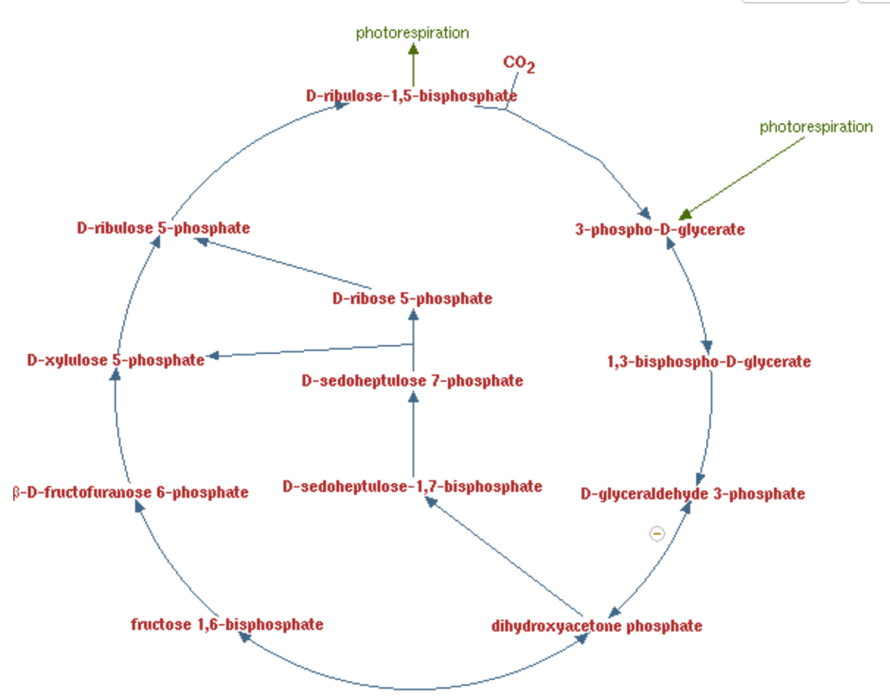
Plastidial sandbox
biomass: 3-PGA
Media inputs:
rxn01111
rxn00018
CO₂
O₂
H₂O
H+
ATP
ADP
NADPH
NADP
Phosphate
2-P-glycolate
rxn00777
rxn01116
rxn01100
rxn01200
rxn15271
rxn01345
rxn00782
rxn15494
rxn01334
rxn00747
rxn15116

Slide 35
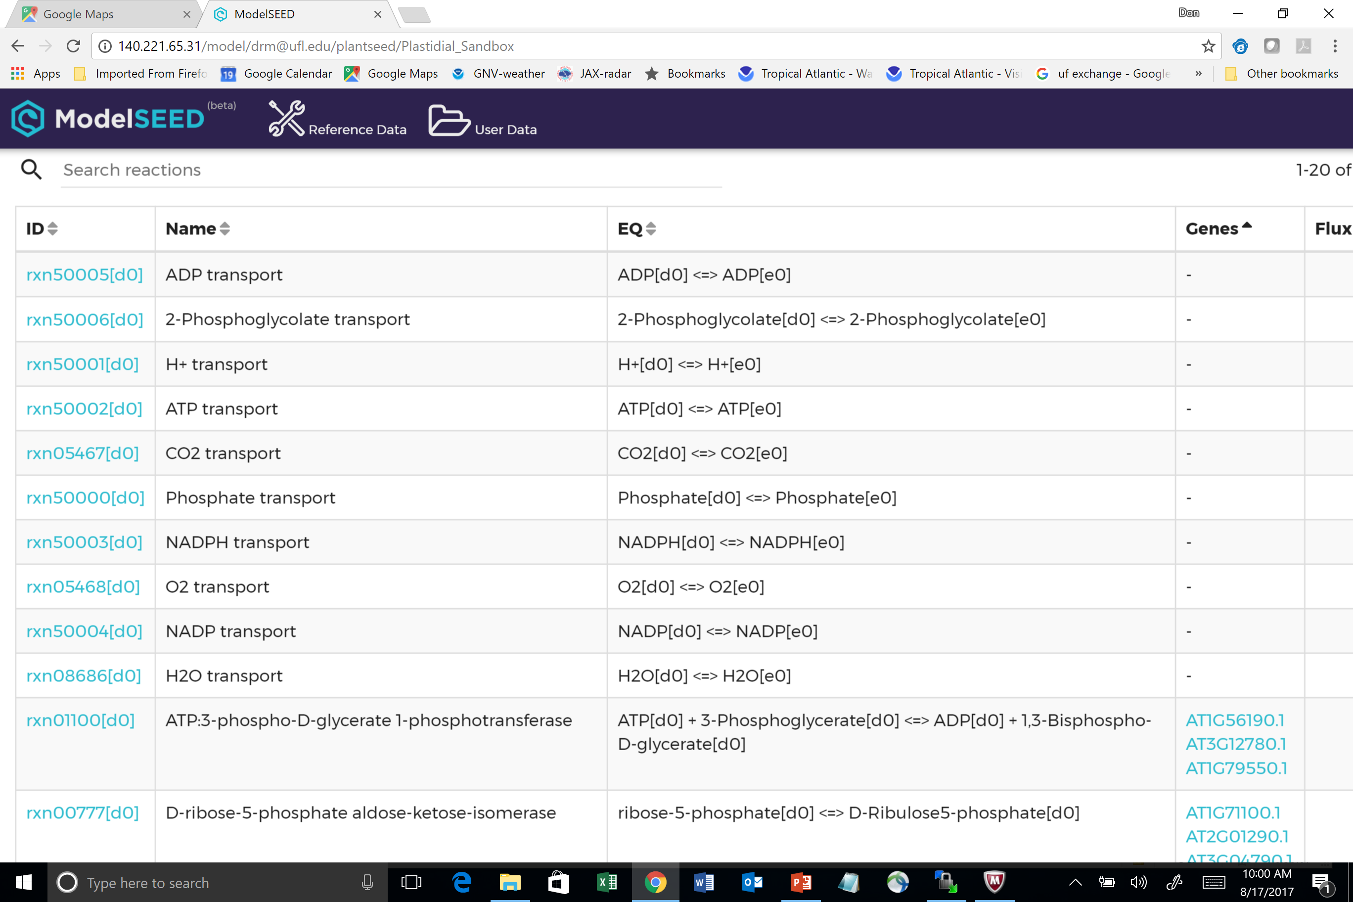

Slide 36
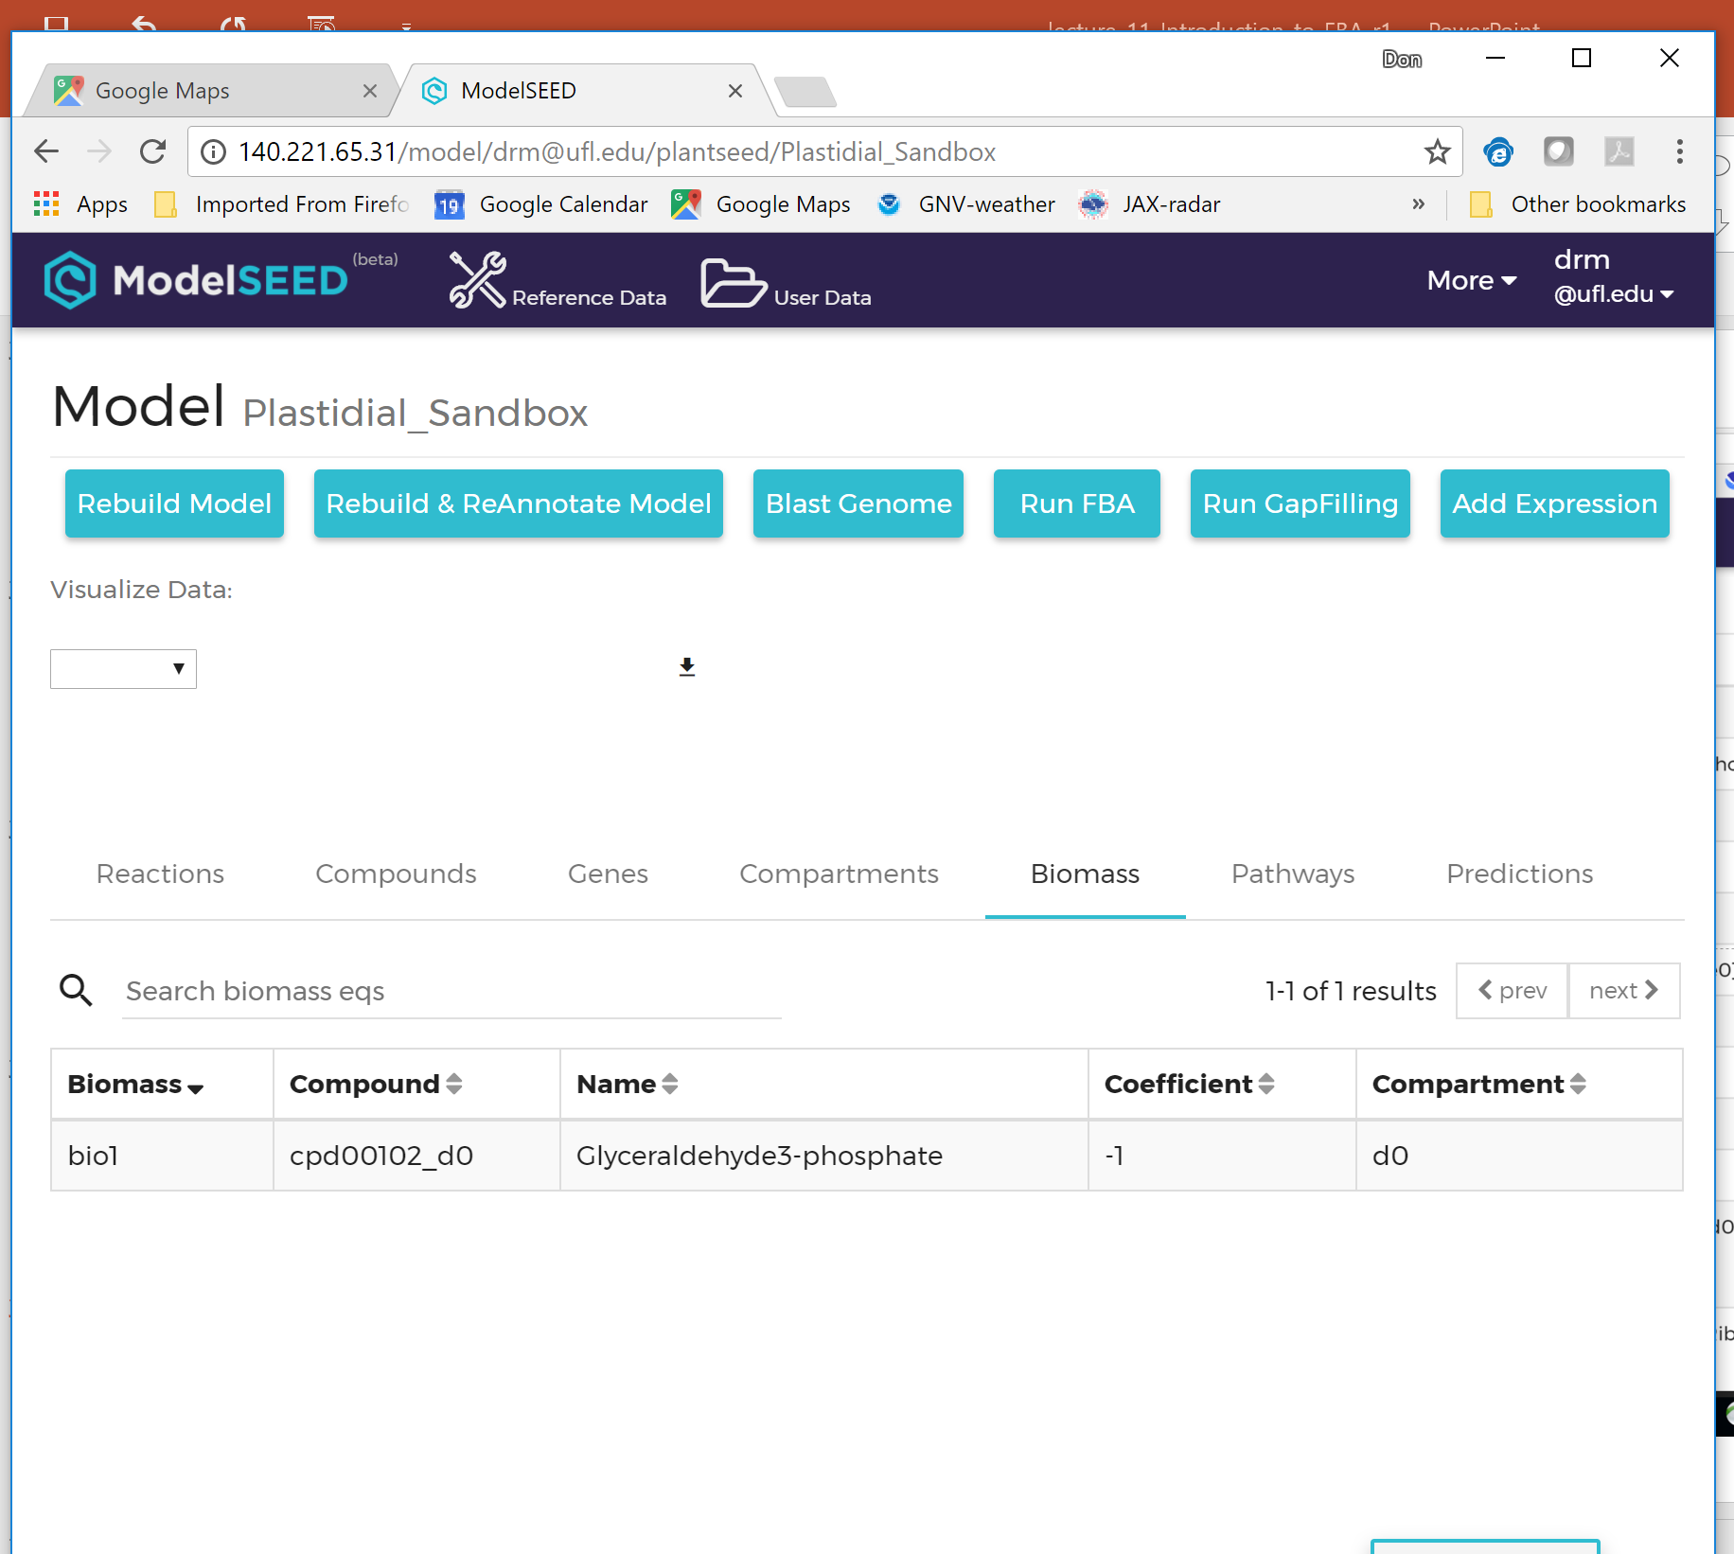

Slide 37
http://140.221.65.31/model/plantseed/plantseed/Plastidial_Sandbox

Slide 38
Resources for genome based metabolic modeling
www.theseed.org
genome annotation based on high quality, manually curated metabolic subsystems
enables curation of user defined subsystems
enables comparative genomics using well-documented bacterial systems
includes ModelSEED, a web-based portal for construction of genome based metabolic models, FBA and gap-filling
Plant SEED workshop: contact Claudia Lerma Ortiz (clerma@ufl.edu)
www.plantcyc.org
species specific metabolic annotations for plant genomes
broad coverage, but less accurate than SEED subsystems

