Slide 1
PlantSEED Workshop
Transcript-constrained FBA

Slide 2
Test Expression File
Available at
http://bioseed.mcs.anl.gov/~seaver/Files/PlantSEED_Workshop_2018/

Slide 4
Goal: To compare behavior of the same metabolic network for different:
Species
Cells/Tissues/Organs
Experimental Conditions
biotic
abiotic
Notes:
Why standardize the construction of models? In order to standardize the analysis of the results across species, tissues, and environments.

Slide 5
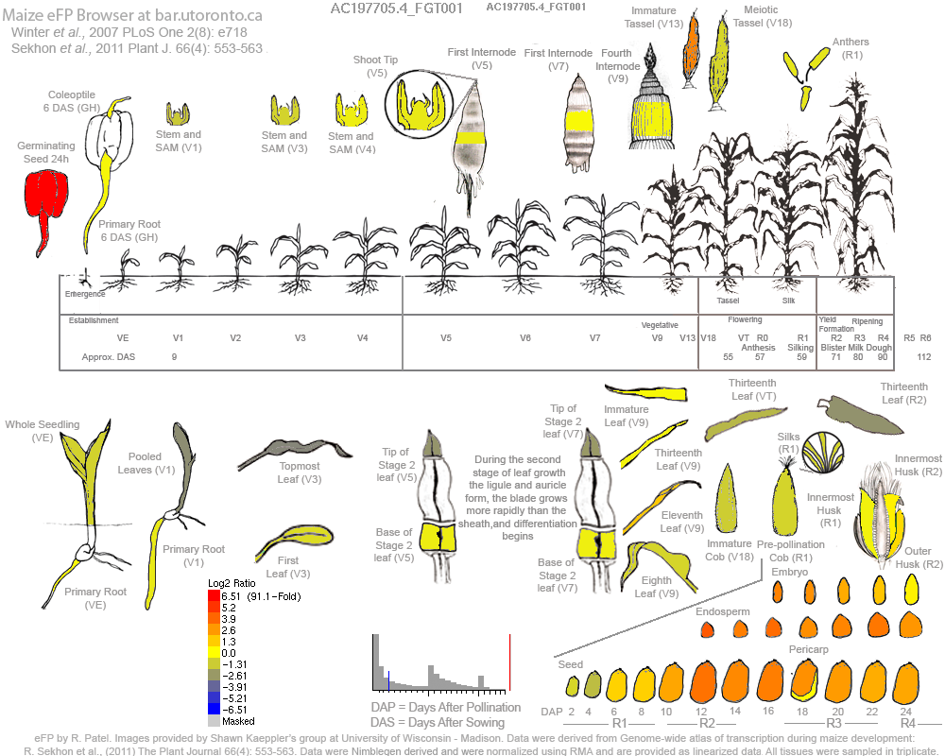

Slide 6
Expression Data and Reaction Expression Score
Spreadsheet of values
Datum for individual features, but multiple features assigned to individual reactions
Reaction Expression Score:
Use Max. expression value
Protein complexes (~20 curated in PlantSEED):
Use Min. expression value

Slide 7
Active Reactions?

Slide 8
Applying Data to Model
Two methods:
Transcriptomics-based gapfilling
Reduce number of reactions in model
Transcriptomics-based flux balance analysis
Simulate behavior

Slide 9
Applying Data to Model
Functionally oriented:
Primary function: Biosynthesize biomass
Secondary functions
Simultaneously
Biosynthesize biomass
Activates “high” reactions
Deactivates “low” reactions

Slide 10
Tissue-reduced models
Species | Model Type | Reactions | Gene-Reaction Associations | Endosperm (¹⁴C data) | Embryo (¹⁴C data)
Arabidopsis thaliana | Full | 6,399 | 16,577 | - | -
Arabidopsis thaliana | Evidenced | 2,801 | 4,262 | - | -
Zea mays | Full | 6,458 | 35,226 | 0.99 | 0.99
Zea mays | Evidenced | 2,629 | 5,540 | 0.99 | 0.83
Zea mays | Leaf | 2,322 | 4,656 | - | -
Zea mays | Embryo | 2,304 | 4,680 | - | 0.83
Zea mays | Endosperm | 2,280 | 4,602 | 0.99 | -
Zea mays | iRS1562 | 1,962 | - | 0.69 | 0.43
Seaver et al. (2015) Improved evidence-based genome-scale metabolic models for maize leaf,
embryo, and endosperm. doi: 10.3389/fpls.2015.00142

Slide 11
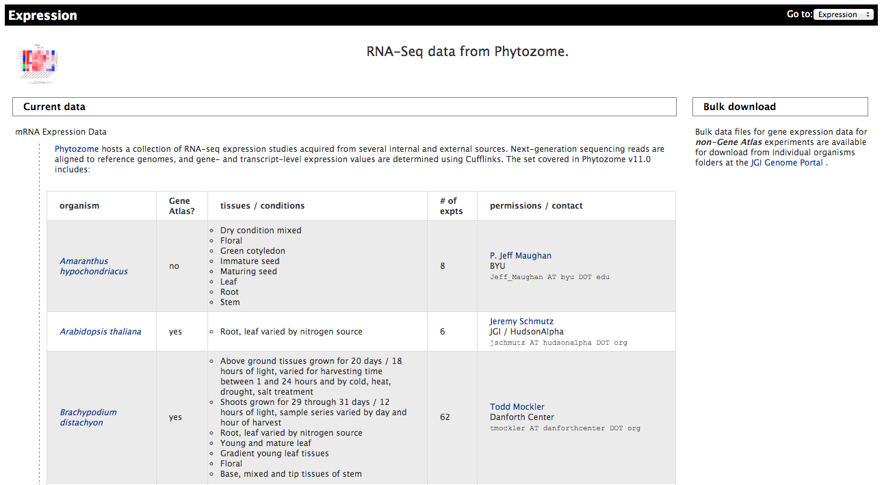
Transcriptomics Data
JGI Gene Atlas
https://phytozome.jgi.doe.gov/phytomine/aspect.do?name=Expression

Slide 12
Case Study
Data for root tissues for:
A. thaliana
G. max
P. trichocarpa
M. truncatula
Species grown on:
Ammonia
Nitrate
Urea

Slide 13

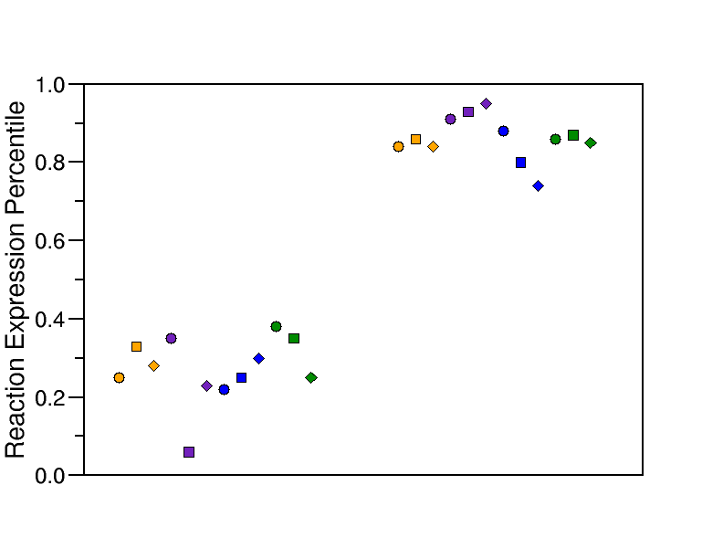
Example Result: Phosphoglycerate mutase

Slide 14
Example Result: Phosphoglycerate mutase
Plastid
Cytosol

Slide 15
Example Result: Phosphoglycerate mutase
Plastid
Cytosol

Slide 16
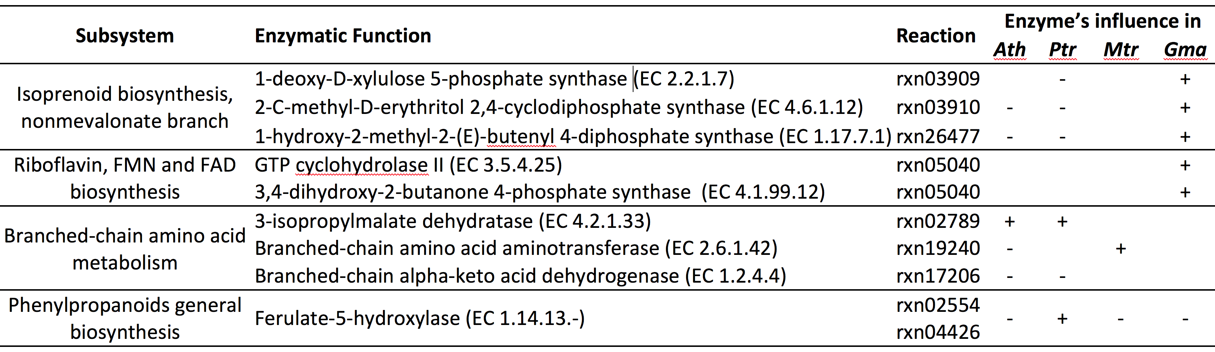
Data Integration Nitrogen case study

Slide 17
Data Integration Peat moss environmental conditions

