Slide 1
PlantSEED Workshop
Annotation and Reconstruction

Slide 2
PlantSEED Annotation and Reconstruction Workflow
Genome
Plant
K-mers
Annotated Genome
Metabolic Reconstruction
Plant Reactions

Slide 3
PlantSEED Foundation
Plant Reactions
Curation of plant primary metabolism
Integration of plant biochemistry
Plant K-mers
Integration of plant protein families
Generation of plant k-mers
Annotation with plant k-mers

Slide 4
PlantSEED Foundation
Plant Reactions
Curation of plant primary metabolism
Integration of plant biochemistry
Plant K-mers
Integration of plant protein families
Generation of plant k-mers
Annotation with plant k-mers

Slide 5
Curation of Plant Primary Metabolism
~175 AraCyc pathways
~65 subsystems
“Alanine, serine, glycine metabolism in plants”
~1000 genes
~650 metabolic functions
~650 biochemical reactions
11 compartments
>1,000 compartmentalized reactions
Data aggregated as a template for plants

Slide 6
Curation of Plant Primary Metabolism
Riboflavin kinase (EC 2.7.1.26)
AT1G56500
AT2G38740
AT3G48420
AT4G25840
AT4G11570
AT4G39970
AT4G21470
AT5G57440
AT1G56500
AT2G38740
AT3G48420
AT4G25840
AT4G11570
AT4G39970
AT4G21470
AT5G57440

Slide 7
Curation of Plant Primary Metabolism

Slide 8
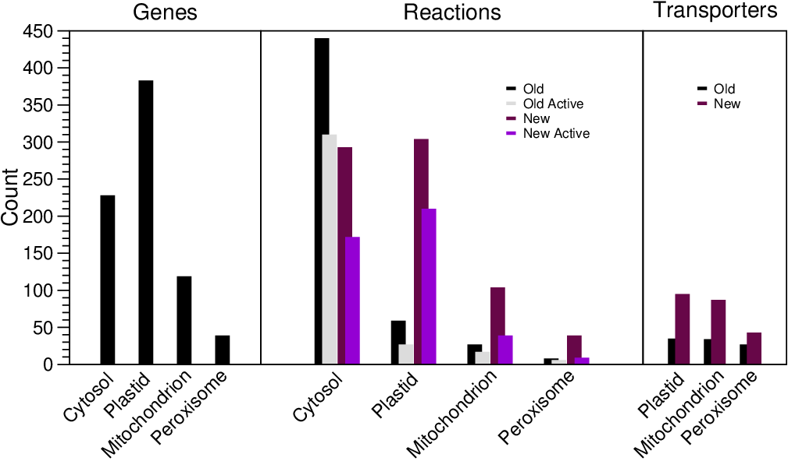
Curation of Plant Primary Metabolism

Slide 9
Integration of Plant Biochemistry
Mass-balance via InChI strings
Database of ~23,000 mass-balanced reactions
Publicly available
https://github.com/ModelSEED/ModelSEEDDatabase
C00022 InChI=1S/C3H4O3/c1-2(4)3(5)6/h1H3,(H,5,6)
PYRUVATE InChI=1S/C3H4O3/c1-2(4)3(5)6/h1H3,(H,5,6)
(1) ADP + (1) Phosphoenolpyruvate + (1) H+ => (1) ATP + (1) Pyruvate

Slide 10
PlantSEED Foundation
Plant Reactions
Curation of plant primary metabolism
Integration of plant biochemistry
Plant K-mers
Integration of plant protein families
Generation of plant k-mers
Annotation with plant k-mers

Slide 11
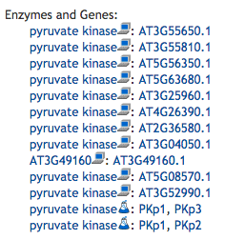
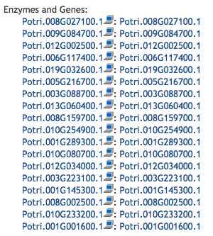
Integration of Plant Protein Families
Enzymatic propagation is universally implemented:
SwissProt
KEGG
BioCyc / PlantCyc
Reactome
JGI
SEED
Enzymatic propagation is inconsistent and opaque

Slide 12
Integration of Plant Protein Families
Aim: To propagate plant primary metabolism from Arabidopsis thaliana to other plant species in a clear, consistent, and transparent manner
Genomes assembled for 39 species in Phytozome
Plant Protein Families generated by OrthoFinder
(Emms and Kelly 2015)
Convenient but:
Multi-functional or uncurated
Undesired homologs
Protein Families conservatively split into clusters using sequence identity

Slide 13
Integration of Plant Protein Families
NADH dehydrogenase
[ubiquinone] (EC 1.6.5.3)
NAD(P)H-plastoquinone
oxidoreductase (EC 1.6.5.-)
NAD(P)H-plastoquinone
oxidoreductase (EC 1.6.5.-)

Slide 14
Integration of Plant Protein Families

Slide 15
Integration of Plant Protein Families

Slide 16
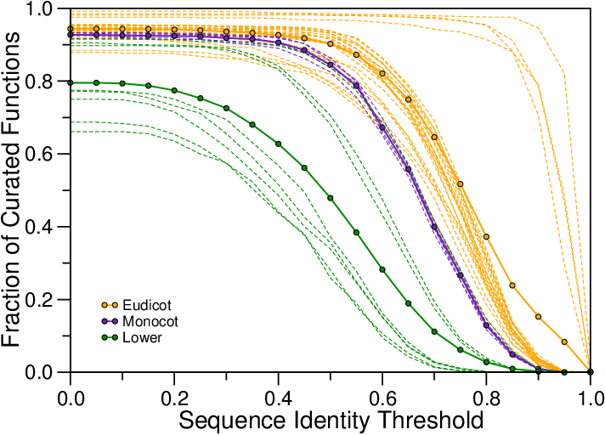
Integration of Plant Protein Families

Slide 17
Integration of Plant Protein Families

Slide 18
Integration of Plant Protein Families
Across 39 Phytozome genomes
30 Eudicots: 89%
78% - 99%
5 Monocots: 85%
8 Lower Plants: 79%
Notably several Eudicots scored lower than Monocots

Slide 19
Generation of Plant K-mers
A K-mer is a short (8 AAs) peptide sequence
It is a unique representation of a protein function:
MTIRNQRF
Ubiquinol--cytochrome c reductase, cytochrome B subunit (EC 1.10.2.2)
K-mers are generated from each protein cluster
K-mers are eliminated if they are found anywhere else in the 39 genomes
~700K Signature K-mers generated for plant primary metabolism

Slide 20
Annotation with Plant K-mers
Each transcript in a FASTA file is scanned
Scores are generated for each metabolic function which scores a hit in the sequence
The transcript is assigned the highest scoring function

Slide 21
Testing of Plant K-mers
Three Eudicots:
Carica papaya (Papaya)
Fragaria vesca (Strawberry)
Solanum tuberosum (Potato)
Report sensitivity:
TP / TP + FN

Slide 22
Testing of Plant K-mers
Using BLAST as a proxy
Three Eudicots:
Carica papaya (Papaya) = 0.86
Fragaria vesca (Strawberry) = 0.80
Solanum tuberosum (Potato) = 0.73

Slide 23
Viewing Your Annotation
Predictions generated via K-mers are “Original”.
False positives and false negatives are found by comparing with BLAST predictions.
Try to find an example of a false positive or a false negative in your two sets of predictions.

Slide 24
Annotation
View Blast-Predictions in “Predictions” tab
Click on a predicted gene
Look at Plant Similarities in gene page
If “similar”, copy the predicted function
Click on “edit” for function
Paste function, and save it → annotated gene
Check in “Genes” tab

