Slide 1
PlantSEED Workshop
Future of PlantSEED

Slide 2
Iterative Improvements
PlantSEED Data:
Annotations
Biochemistry
Compartmentalization
Propagation (Gene Trees)
PlantSEED Simulation
new FBA approaches

Slide 3
Secondary Metabolism
Highly diversified pathways present a unique challenge
Idea of Last Common Metabolite (LCM) to represent a base secondary metabolic structure biosynthesized by a plant family.

Slide 4
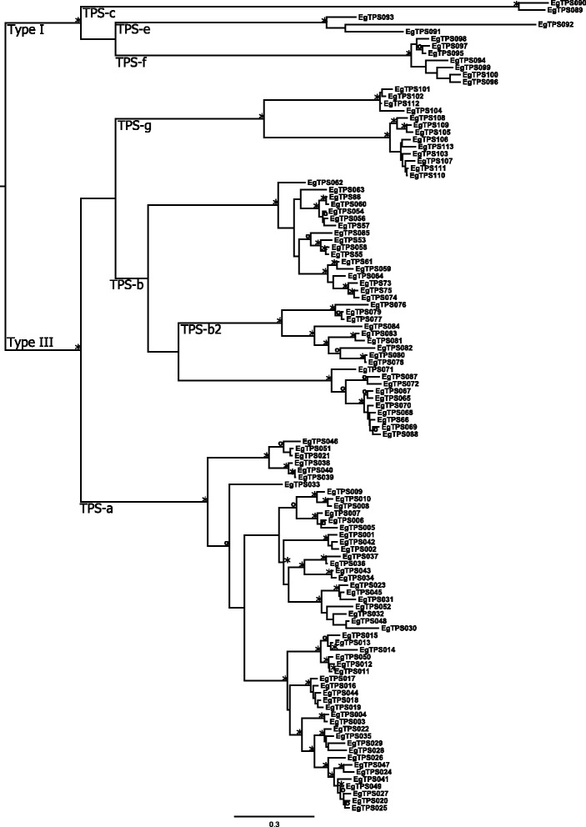
Secondary Metabolism
Terpene Synthases:
Arabidopsis and Poplar have ~ 40
Eucalyptus has ~120
https://www.ncbi.nlm.nih.gov/pubmed/26062733

Slide 5
Taxonomy
Currently, single template representing primary metabolism of flowering plants
Additional templates:
Algae
Carbon-concentrating mechanisms
C4, CAM, Pyrenoids

Slide 6
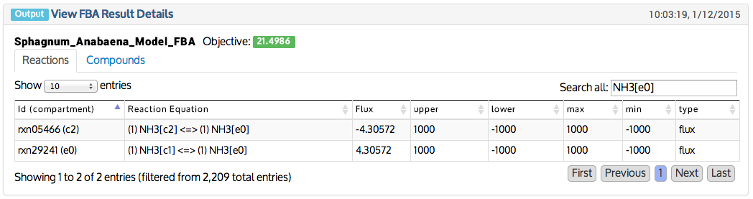
Community models
The nitrogen provided for the biomass of a Sphagnum moss is fixed by a cyanobacteria
NH₃
N₂

