Slide 1
Wireless options
eduroam
If you use this at your home institution, you can use it here
Guest-Northwestern
List “Christopher Henry” as your sponsor
http://www.it.northwestern.edu/oncampus/guest-wireless/index.html

Slide 2
PlantSEED Workshop
Introduction / Overview

Slide 3

Introductions and Sponsors
Sponsors:
National Science Foundation
Argonne National Laboratory
University of Florida
Institute of Food and Agricultural Sciences
NSF Project:
The B vitamin/cofactor network: command and control of metabolism in changing conditions
PI: Andrew Hanson
Co-Pis: Christopher Henry, Donald McCarty, Jess Gregory

Slide 4
Workshop Schedule
Day 1:
Overview and Login
File upload and Genome Annotation
Group Photo
Metabolic Reconstruction
Flux Balance Analysis
Day 2:
Overview
Participation Goals
DOE RNA-Seq Pipeline
Transcriptomics FBA
Future of PlantSEED
Feedback

Slide 5
PlantSEED Team and Contributors
Chris Henry (ANL)
Sam Seaver, Neal Conrad
Andrew Hanson & Valerie de Crecy-Lagard (UF)
Claudia Lerma-Ortiz, Oceane Frelin, Louis Bradbury, Thomas Neihaus, Ghulam Hasnain, Basma El Yacoubi, Remi Zallot
Ross Overbeek (ANL/FIG)
Gordon Pusch, Robert Olson
Svetlana Gerdes (FIG)

Slide 6
History of SEED
1980: Ross Overbeek joins ANL
Series of Bioinformatics Systems developed:
1994: PUMA
1996: WIT
1998: ERGO
2003: SEED
2003: Fellowship of Genomes
“Project To Annotate 1000 Genomes”
2010: ModelSEED published
2014: PlantSEED published

Slide 7
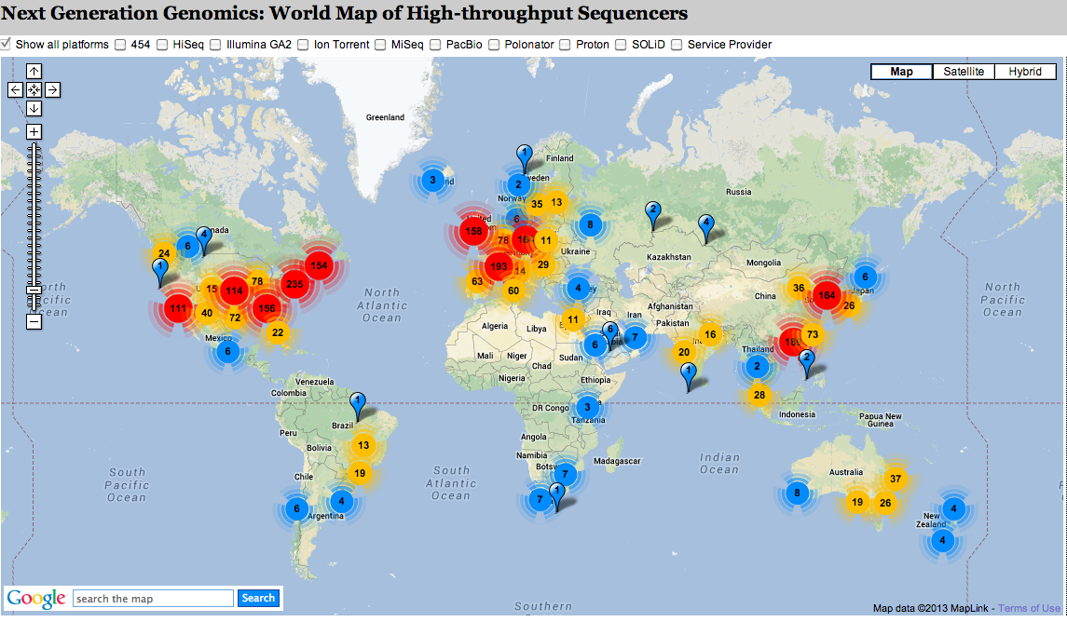
Growth in Next Generation Sequencing for Plants
Genomes Online: 6000+ sequencing projects in Viridiplantae

Slide 8

PlantSEED Workflow
Genome
Annotated Genome
Database of
Plant
K-mers
Draft Metabolic Model
Database of
Plant
Reactions
Working Metabolic Model

Slide 9
Goals
Over-arching goal of our work:
In silico generation of novel hypotheses in plant primary metabolism via species, tissues, and abiotic/biotic conditions.
Involves:
Curation of plant primary metabolism
Propagation to other plant species
Simulation with -omics data

Slide 10
PlantSEED Websites
‘Published’ site:
http://plantseed.theseed.org
http://www.ncbi.nlm.nih.gov/pubmed/24927599
Workshop site:
http://http://modelseed.org/events/plantseed2016/
Will be updated
Repository:
https://github.com/ModelSEED/PlantSEED/Workshops
Modeling and Annotation Interface:
http://modelseed.org

Slide 11
PlantSEED Login and Annotation

