Slide 1
PlantSEED Workshop
Future of PlantSEED

Slide 2
PlantSEED Data
Iterative improvements:
Annotations
Metabolic functions
K-mers
Biochemistry
Mass-balance
Pathways
Compartmentalization

Slide 3
Secondary Metabolism
Highly diversified pathways present a unique challenge
Idea of Last Common Metabolite (LCM) for a phylogenetic family.
K-mers?

Slide 4
Templates
Currently, single template representing primary metabolism of flowering plants
Additional templates:
Algae
Carbon-concentrating mechanisms
C4, CAM, Pyrenoids

Slide 5
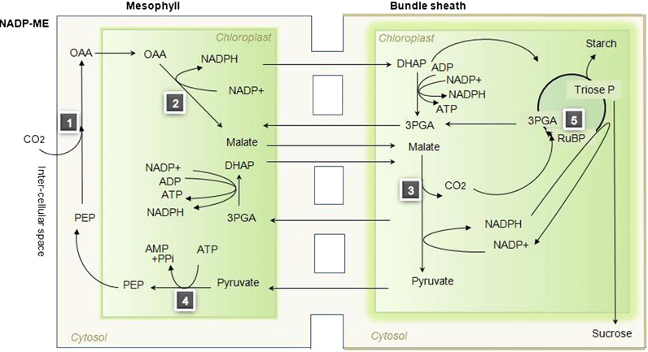
Community models

Slide 6
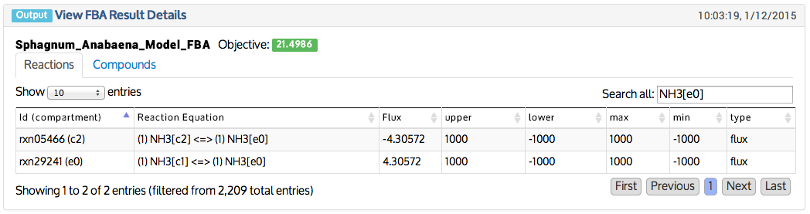
Community models
The nitrogen provided for the biomass of a Sphagnum moss is fixed by a cyanobacteria
NH₃
N₂

Slide 7
Website
Functionality:
Genome and Model editing
Comparative approaches
Download
Visualization
Expression
Pathways

Slide 8
Thank You!
Comments?
Don’t forget the feedback form.

