Slide 1
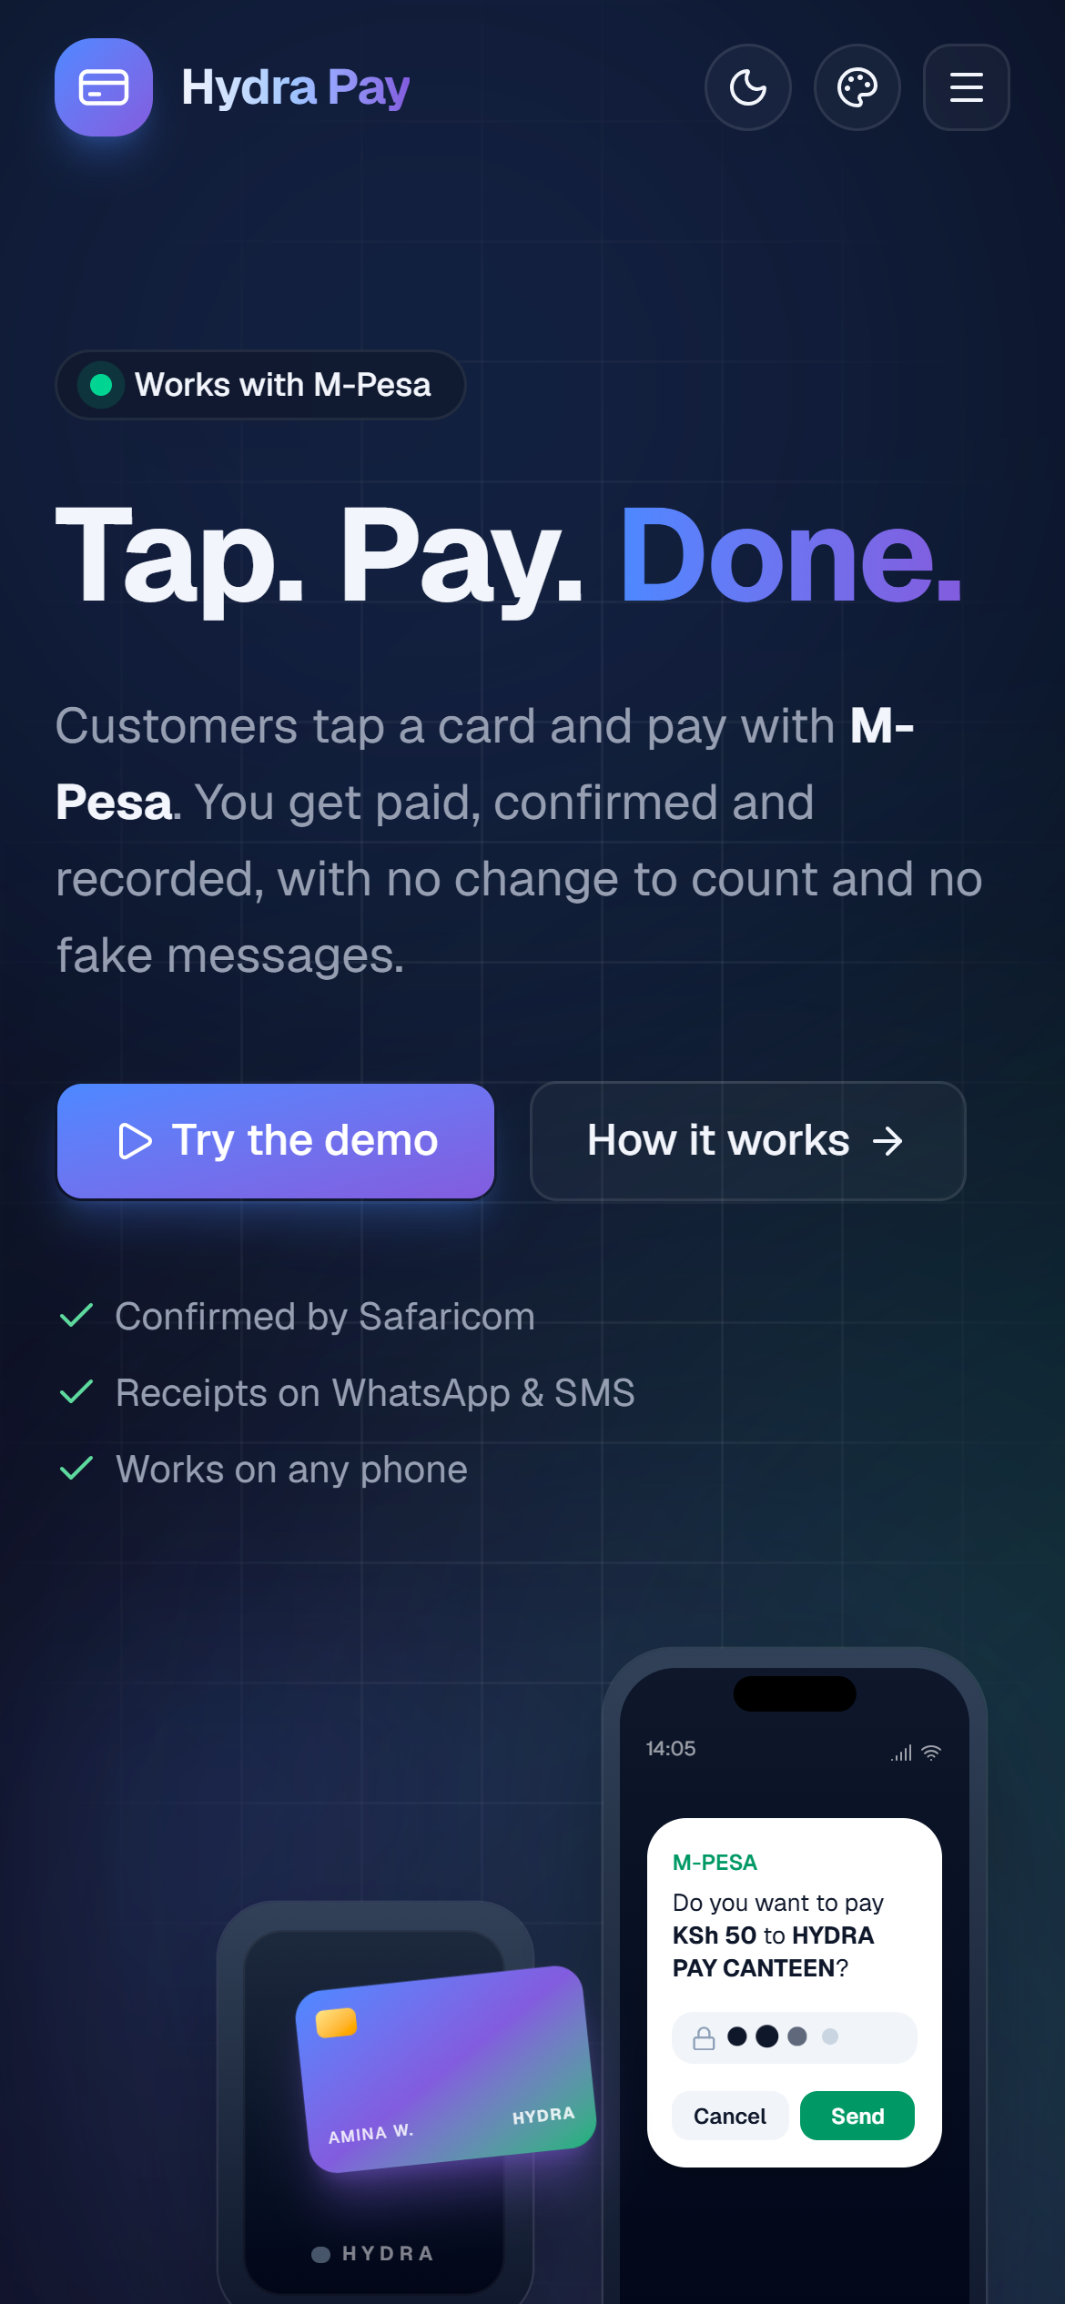
● Works with M-Pesa
Tap. Pay. Done.
Hydra Pay is a low-cost tap-to-pay system for busy small businesses. Customers tap a card and pay with M-Pesa. Every payment is confirmed by Safaricom and recorded automatically.
Faster queues
Verified payments
Clear records
Team HYDRA-PAY
Technical University of Kenya
Live: hydra-pay.vercel.app
Notes:
Good morning. We are Team HYDRA-PAY from the Technical University of Kenya. Hydra Pay lets a customer tap a card and pay with M-Pesa in seconds. The business gets paid, the payment is confirmed by Safaricom, and every sale is recorded automatically.

Slide 2
THE PROBLEM
Busy small businesses lose time and money at the till
1
2
3
Cash slows everything
Mobile money disputes
Records don't add up
Counting money and finding change at every sale builds queues. Cash leaves no record and is a target for theft.
Fake confirmation SMSs, screenshots, reversals and "I've sent it" arguments. Checking each payment holds up the queue.
Sales sit in a notebook, the till and a phone inbox. At the end of the day owners can't tell what they earned.
Owners need an affordable way to accept, verify and record payments without slowing down.
Hydra Pay · Team HYDRA-PAY · Technical University of Kenya
2
Notes:
Picture a canteen at lunch hour or a matatu at the stage. Cash means counting and change. M-Pesa means typing a till number, then arguing over fake SMSs and screenshots. And at the end of the day the owner has a notebook, a till and a phone inbox that don't add up.

Slide 3
MARKET EVIDENCE
Cash and M-Pesa live side by side
99%
86%
Both
of surveyed small businesses run
partly or wholly in cash
accepted digital payments
by June 2023
mobile money is everywhere, but cash
is still how many get paid
Sources: FinAccess MSE Tracker Survey 2023; World Bank analysis of Kenya's mobile money market.
Hydra Pay works with the M-Pesa habits people already have. The opportunity is making every transaction faster and easier to track.
Hydra Pay · Team HYDRA-PAY · Technical University of Kenya
3
Notes:
Nearly every small business in Kenya still handles cash, but most already accept digital payments. So the opportunity isn't to replace M-Pesa. It's to make M-Pesa faster at the counter and to record every sale automatically, using the habits people already have.

Slide 4
OUR SOLUTION
One tap: pay, verify and record in one flow
1
2
3
4
Tap
M-Pesa prompt
Verify
Record
The customer taps a card, key tag or wristband on the reader.
The price pops up on the customer's phone, paid to the business till.
They enter their PIN. Paid only when Safaricom confirms.
Saved with amount, time and M-Pesa code. Receipt by WhatsApp or SMS.
Pay each time
Prepaid card
Every tap sends one M-Pesa prompt for the price. Nothing to set up for customers.
Regulars top up once with M-Pesa or cash. Each tap deducts instantly, with no PIN needed.
Hydra Pay · Team HYDRA-PAY · Technical University of Kenya
4
Notes:
Here is the whole flow. The customer taps a card, key tag or wristband. The price is sent to their phone as an M-Pesa prompt. They enter their PIN, and Hydra Pay marks the sale paid only when Safaricom confirms it. The sale is saved with its M-Pesa code, and the customer gets a receipt on WhatsApp or SMS. Businesses choose pay-per-tap, or a prepaid card for regulars, which needs no PIN at all.

Slide 5
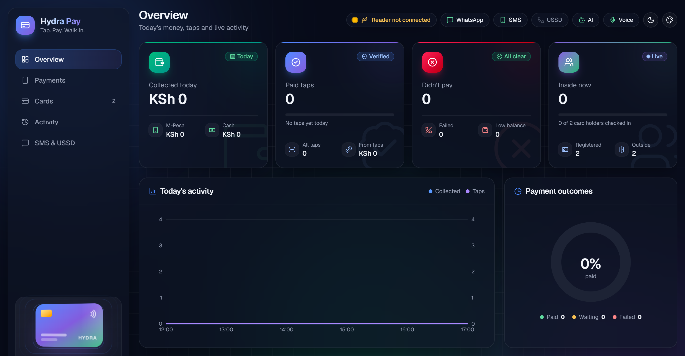
THE PRODUCT
A live dashboard for the owner, a website for customers
• Live totals: money collected, paid and unpaid taps, who is inside.
• Live feed: every tap and payment the moment it happens.
• Card management: register, top up, block or move a lost card.
• Works on any screen: phone, tablet or desktop, light or dark, six colour themes.
• Exports: daily records to Excel (CSV).
• Public website: hydra-pay.vercel.app with a try-it-yourself demo.
Hydra Pay · Team HYDRA-PAY · Technical University of Kenya
5
Notes:
This is the real product, not a mock-up. The owner's dashboard shows money collected today, paid and unpaid taps, who is inside, and a live feed of every tap and payment. It works on a phone, a tablet or a big screen. Customers and partners can see how it works and try a demo on our public website.

Slide 6
HOW IT'S BUILT
Simple, low-cost hardware with verified money behind it
Card reader
Hydra Pay server
Safaricom M-Pesa
ESP32 + RC522
low-cost parts
Python · tap logic,
payments, dashboard
Daraja STK push
+ status check
WhatsApp
SMS
USSD
Records
receipts, bot,
AI in 3 languages
receipts and alerts
via ThriveVAS
menu for any phone,
no smartphone needed
cards, taps and payments,
nothing deleted
• Verified money: paid only on Safaricom's answer, recorded exactly once, even if the confirmation arrives twice.
• Reliable reads: the reader filters double taps and retries half-read cards; it reconnects by itself if unplugged.
• Auditable: an undo is a new reversal entry, so the full history is always kept.
• Protected: every change, including sending a payment prompt, needs the owner's admin PIN.
Hydra Pay · Team HYDRA-PAY · Technical University of Kenya
6
Notes:
The reader is an ESP32 with an RC522 RFID module, which are cheap, off-the-shelf parts. It sends each card ID to our Python server, which runs the payment logic and the dashboard. Payments go through Safaricom's Daraja API, receipts through WhatsApp and SMS, and a USSD menu works on any phone. The key engineering choice: a payment is only marked paid on Safaricom's answer, and it is recorded exactly once.

Slide 7
PROOF OF WORK
It works today, and you can try it
27
10
15
Working today
✓ Card and key-tag taps logged as IN / OUT
✓ M-Pesa prompt to the customer's phone for the price
✓ Receipts with the M-Pesa code on WhatsApp and SMS
✓ Prepaid wallet with M-Pesa or cash top-ups
✓ WhatsApp bot and AI help in English, Kiswahili and Sheng
✓ Live dashboard on phone and desktop, with CSV export
✓ Lost card: move the account to a new card in one click
✓ USSD menu for phones without internet
✓ Public website and demo: hydra-pay.vercel.app
M-Pesa prompts
sent
confirmed paid
by Safaricom
declined or unanswered,
correctly NOT paid
Daraja sandbox test runs, 22–23 October 2026.
Live demo at our table
Tap a card: watch the M-Pesa prompt arrive, the dashboard update and the receipt land.
Hydra Pay · Team HYDRA-PAY · Technical University of Kenya
7
Notes:
We tested the full payment flow on Safaricom's Daraja sandbox: 27 prompts sent, 10 confirmed as paid, and 15 that were declined or not answered, all correctly marked as not paid. None was wrongly counted as paid. On the right is what works today.

Slide 8
TARGET MARKET
Businesses where every second counts
PILOT FIRST
PILOT FIRST
NEXT
Canteens & cafés
Shops & market stalls
Matatus & transport
Lunch-hour rush, fixed prices, regular customers.
Mixed cash and M-Pesa every day.
Many small fares under time pressure. Tap IN to board.
Need: shorter checkout and accurate sales records.
Need: easy payment tracking without expensive software.
Need: fast fare collection and clear daily takings.
Customer: the business owner or operator. Users: the person paying and the person receiving. We start where we can observe and measure, then move to matatus.
Hydra Pay · Team HYDRA-PAY · Technical University of Kenya
8
Notes:
We start with canteens and market traders, where we can watch the queue and measure the difference. Then we move to matatus, where fares are small, frequent and time-critical. Our customer is the business owner; the users are the person paying and the person receiving.

Slide 9
WHY HYDRA PAY
Better than cash, a till number or a notebook
 | Hydra Pay | Cash | Till number | Notebook | Card machine
No change, nothing to type | ✓ | ✗ | ~ | ✗ | ~
Payment checked with Safaricom | ✓ | ✗ | ~ | ✗ | ✓
Every sale saved automatically | ✓ | ✗ | ~ | ✗ | ✓
Daily totals ready | ✓ | ✗ | ~ | ~ | ~
Receipt for the customer | ✓ | ✗ | ✓ | ✗ | ✓
Works without a smartphone | ✓ | ✓ | ✓ | ✓ | ~
No cut taken from each sale | ✓ | ✓ | ~ | ✓ | ✗
✓ yes ~ partly ✗ no · Standard M-Pesa charges still apply.
Hydra Pay · Team HYDRA-PAY · Technical University of Kenya
9
Notes:
Compared with what businesses use today: cash has no record and needs change. A till number means typing and fake SMSs. A notebook is manual. A card machine is expensive and takes a cut of every sale. Hydra Pay is the only option that is fast, verified, automatic and takes no cut. Standard M-Pesa charges still apply.

Slide 10
BUSINESS MODEL
Affordable for the seller, sustainable for us
1
2
3
4
Freemium
Subscription
Business packages
Partnerships
Basic transaction recording free; advanced reports and features paid.
An affordable weekly or monthly fee per reader.
Fleet and multi-stall dashboards for SACCOs and larger vendors.
Matatu SACCOs, market managers, canteen operators and business associations.
No cut of each sale: low-value, high-volume sellers keep their margin. We'll test willingness to pay in the pilot before fixing prices.
Hydra Pay · Team HYDRA-PAY · Technical University of Kenya
10
Notes:
We don't take a cut of each sale, because our customers sell many low-value items and every shilling of margin matters. Instead: a free basic tier, a small subscription per reader, packages for SACCOs and larger vendors, and partnerships with associations that bring many businesses at once. We will test willingness to pay in the pilot before fixing prices.

Slide 11
FEASIBILITY & SECURITY
Risks we've designed for
Challenge | How Hydra Pay handles it
Fake confirmations | Status comes only from Safaricom's Daraja API. An unconfirmed payment is never shown as paid.
Reversals & disputes | Every payment keeps its M-Pesa code, status and time in a history that is never deleted.
Slow checkout | Tap, then PIN. No typing. Checkout time will be measured in the pilot.
Poor network | Pending is kept separate from paid and never marked failed too early. Offline tap queue is next.
Tight budgets | Off-the-shelf ESP32 + RC522, no POS terminal, no per-sale fee.
Misuse & data | Admin PIN for every change; keys kept out of code; minimal data, aligned with Kenya's Data Protection Act.
Hydra Pay · Team HYDRA-PAY · Technical University of Kenya
11
Notes:
The biggest risk in mobile payments is trust, so we designed for it. Payment status comes only from Safaricom. Every record keeps its M-Pesa code. Pending is never confused with paid. And every change, including sending a payment request, needs the owner's PIN.

Slide 12
ROADMAP & VALIDATION
From working prototype to real businesses
DONE
NEXT
NEXT
PILOT
LATER
Prototype
Discovery
Go live
Controlled pilot
Expand
Reader, M-Pesa, verification, records, WhatsApp, SMS and USSD. Dashboard and website online.
10–20 interviews with vendors and conductors about payments, disputes and records.
Live Safaricom till, live USSD short code, offline reader that syncs later.
A few canteens and traders, measured against a before baseline.
Matatu SACCOs, then more payment options. The owner always gets KES.
We'll measure: transaction time · queue time at peak · % recorded correctly · verification success · reconciliation errors · merchant satisfaction and willingness to pay. Targets are set after the baseline.
Hydra Pay · Team HYDRA-PAY · Technical University of Kenya
12
Notes:
The prototype is done and online. Next we interview 10 to 20 vendors and conductors, move to a live Safaricom till and USSD short code, and run a controlled pilot in a few canteens and shops, measured against a before baseline. Then matatu SACCOs.

Slide 13
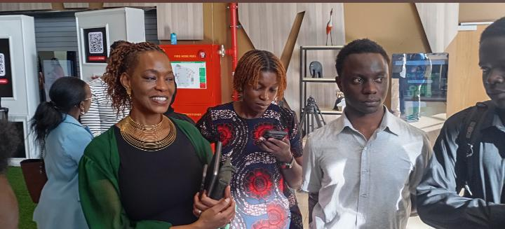
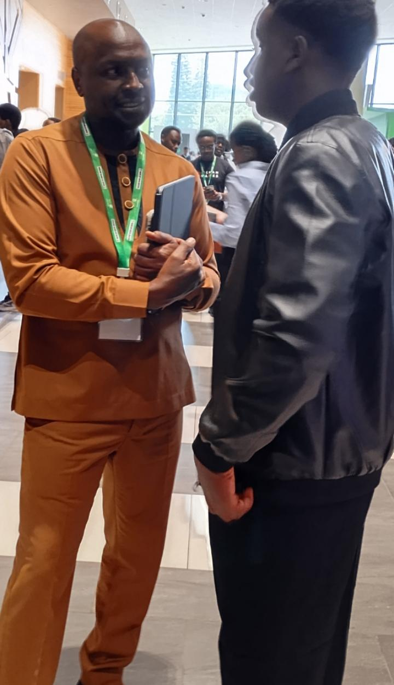
INDUSTRY ENGAGEMENT
Meeting Safaricom leadership
With Safaricom's former Chief Financial Services Officer
With Safaricom's Chief Technology & Information Officer
Hydra Pay · Team HYDRA-PAY · Technical University of Kenya
13
Notes:
We presented Hydra Pay to Safaricom leadership, including the former Chief Financial Services Officer and the Chief Technology & Information Officer.

Slide 14
THE ASK
Help us take Hydra Pay from prototype to pilot
We are asking for
[ %]
Hardware
Readers, cards and tags for pilot businesses
KSh [amount]
[ %]
Go live
[Grant / prize / investment / partnership, and what it unlocks, e.g. 20 readers in 10 businesses for a 3-month pilot.]
Live Safaricom till, USSD short code, SMS credit, hosting
[ %]
Pilot
Onboarding, support and measuring results
[ %]
Team
Build the offline reader and multi-stall dashboard
Hydra Pay · Team HYDRA-PAY · Technical University of Kenya
14
Notes:
FILL IN BEFORE PRESENTING: the amount you are asking for, and how it splits across hardware, going live, the pilot and the team. Say exactly what the money or support unlocks, for example: 20 readers in 10 businesses for 3 months.

Slide 15
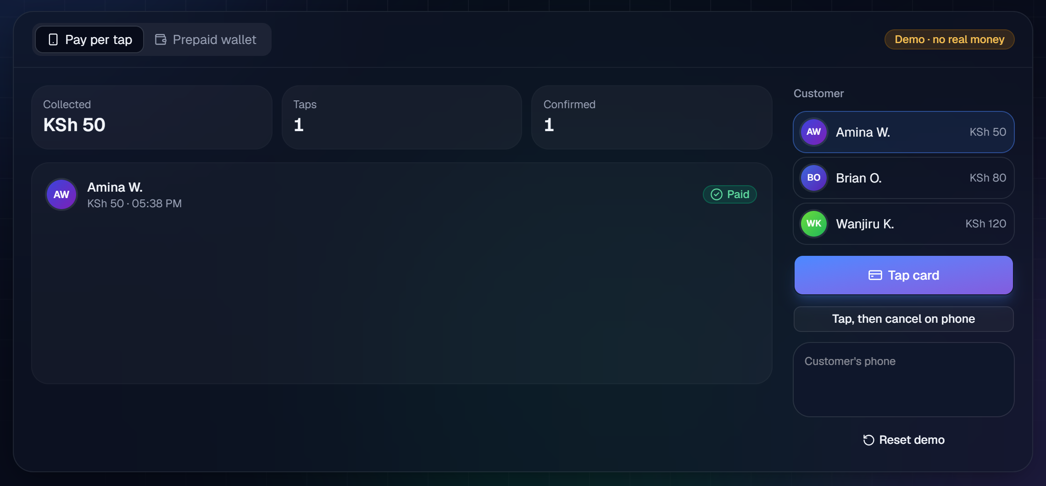

Tap.
Pay.
Done.
Fast payments, safer transactions, clearer records.
The try-it demo on our website
Scan to try the demo
hydra-pay.vercel.app
Questions? Come tap a real card at our table.
Hydra Pay · Team HYDRA-PAY · Technical University of Kenya
15
Notes:
Hydra Pay: fast payments, safer transactions, clearer records. Scan the code to try the demo on your phone, or come to our table and tap a real card. Thank you, we're happy to take questions.

