Slide 1


SLOGAN
view work

Slide 2
Home
Project
Teams
Contact
Schubertstrasse. 3
Neu-Isenburg 63263
Tel. +491423 123123
View Map
Work with us
info@mail

Slide 3
Game Development
New media R&D
AR / VR Contents IP
Development SI

Slide 4
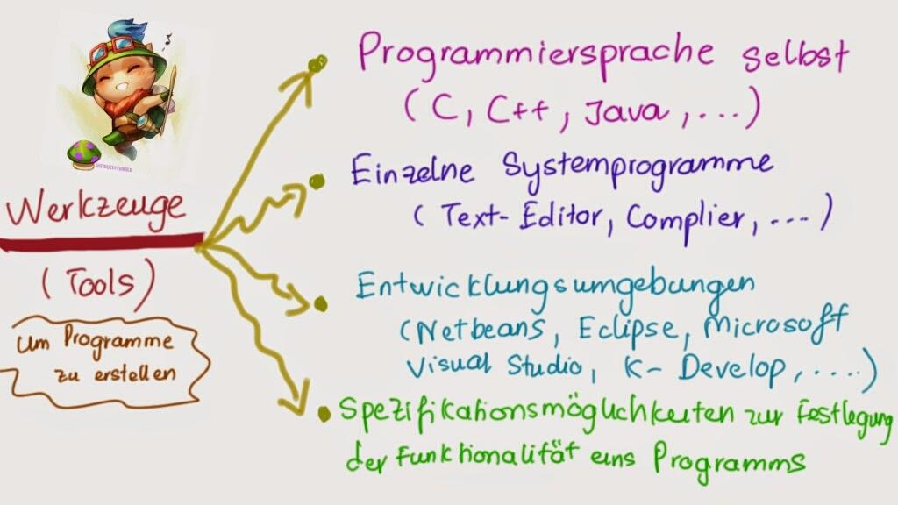
Project

Slide 5
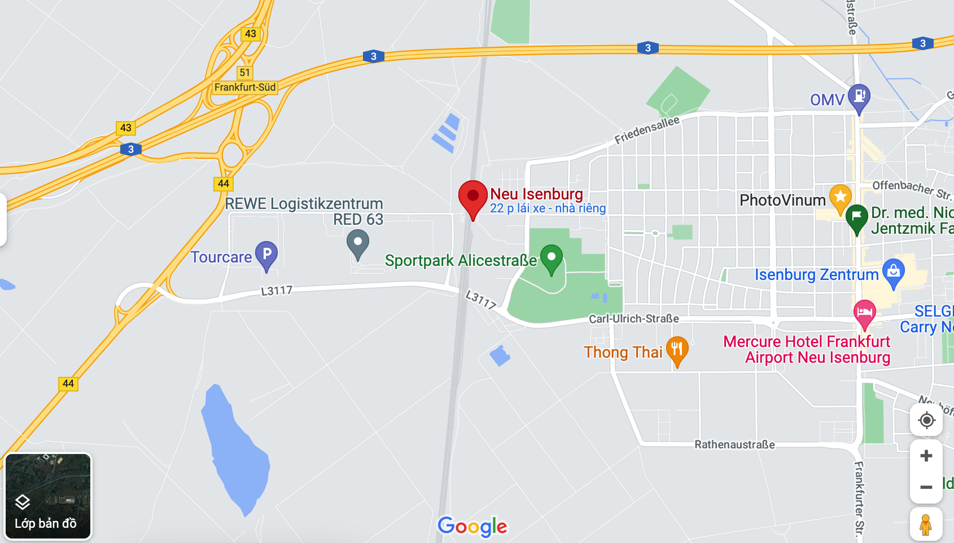
Contact
Neu-Isenburg, Deutschland
63263
Work with us
info@mail

