Slide 1
A TOOL FOR CREATING STUDY EVENTS
The project was done by:
TH class student
Turov Aleksey
Dmitrievich
Scientific supervisors:
Merzlyakov Andrey Fedorovich
Oksana Dmitrievna Pochtoeva
Perm 2023

Slide 2

Relevance
In modern education, educational activities are not conducted as efficiently as they could be. Creators of educational events have to spend a lot of time checking learners' answers, making ratings, and analyzing results. If there is some tool that solves the problems listed above, organizers can significantly save time on work that can be automated and focus on something more important.

Slide 3

Novelty
The most important advantages of our tool that differentiate it from other similar projects are:
1. Rating according to the rules of the selected event 2. Flexibility to customize the event 3. Ability to create events that include tasks that differ from the classic ones

Slide 4
Aims and tasks of the project
Project aim: to develop an effective educational tool for creating and conducting study events.
Tasks:
1. To make a technical description of the project 2. To study the classification of websites 3. To conduct a study of the technology stack for coding the backend and frontend of the site 4. Realize the project in the form of a website

Slide 5

Practical meaning of the project
The project has practical meaning, as it can be used in schools and other educational organizations, as well as in extracurricular events

Slide 6



Функционал инструмента для пользователей
The tool consists of the following main functional blocks:
1. Registration, authentication, authorization; 2. Functionality for the event organizer; 3. Functionality for the participant of events; 4. Functionality for users who are neither organizers nor participants at the moment.

Slide 7
Types of events
Test
Control work
Mixed type of event
The test includes the following functionalities:
● The number of answers can be no more than 1000;
● Answers are checked automatically.
The control work includes the following functionalities:
● Automatic checking;
● Manual checking.
A mixed type of event (test + control) is an event that includes a combination of all event features.

Slide 8
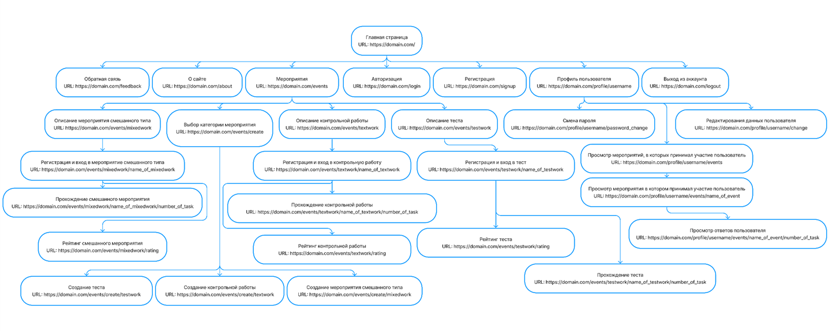
Website tree

Slide 9






Used technology stack
● Backend:
○ Python (Django);
○ Database SQLite,
● Frontend:
○ HTML;
○ CSS;
○ JS;
○ Bootstrap.

Slide 10
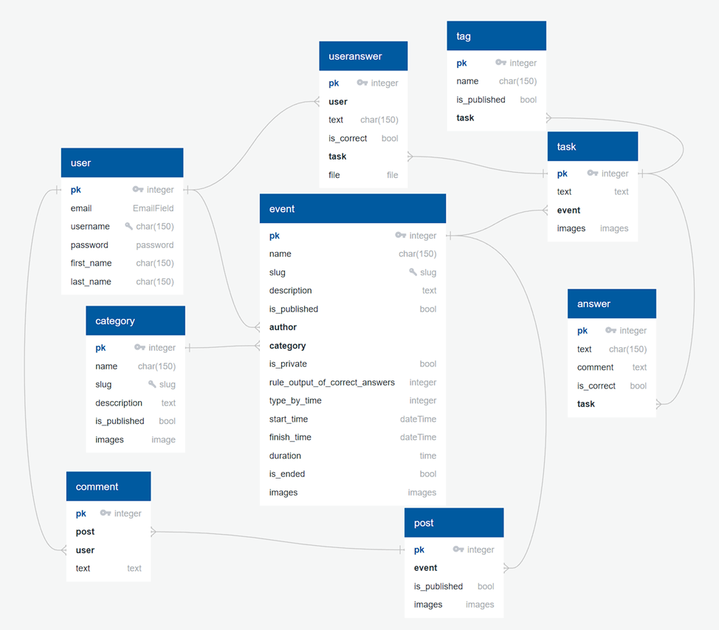
ER database diagram

Slide 11

What is a website?
Site - a set of electronic documents (files) of a private person or organization in a computer network, united under one address (domain name or IP-address).

Slide 12

Classification of the tool by site type
My project refers to a web application in terms of functionality.
By responsive design my project refers to the adaptive layout.
By the way of content formation my project refers to a dynamic type of site.
By type of content my project refers to educational resources.

Slide 13

What is Django?
Django is a powerful Python web framework that provides extensive features for building complex websites and web applications. It consists of a set of components that solve common web development problems, and these components are loosely coupled, allowing you to manage them independently and separate the responsibilities of the different layers of the web framework.

Slide 14



Justification for choosing Django
When choosing a tool for the backend of the site, the following Python frameworks were considered: Django, Flask, FastAPI.
Django is preferred for this project because of its stability, experience of use and large community of developers.

Slide 15
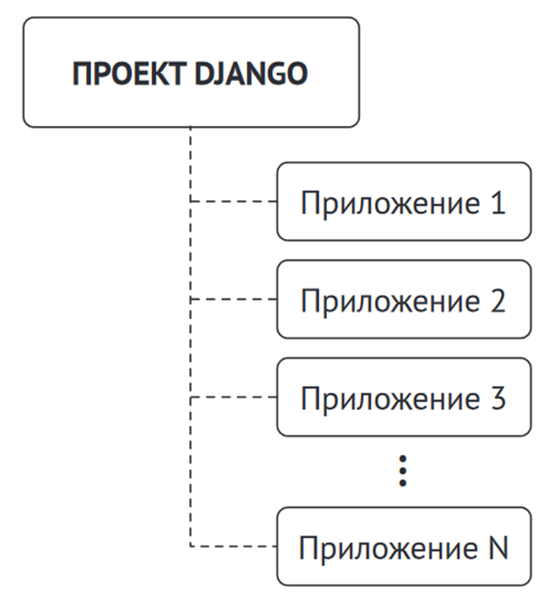
Projects and applications
One of the basic principles of the framework is DRY. Django web systems are built from one or more applications, which are recommended to be alienated and pluggable.

Slide 16
Web framework components
● Model - defines the logical structure of the data and is the data handler between the database and its representation;
● Template - is the layer of the view. Django uses a text template system that stores everything the browser draws on pages;
● View - interacts with the database through the model and passes data to the template to draw and view it.

Slide 17
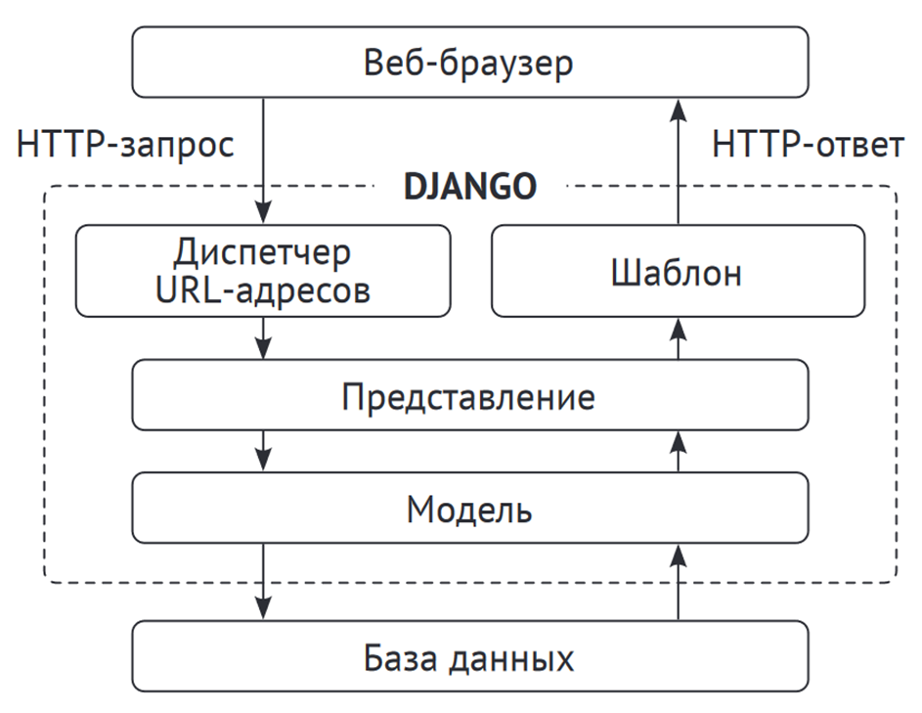
Django architecture

Slide 18

What is Bootstrap?
Bootstrap is a set of tools for developing websites and web applications. The toolkit includes HTML, CSS and JavaScript templates and components such as menus, forms, buttons, etc. Bootstrap is designed to speed up the website development process and enable developers to create modern and responsive websites. Bootstrap also provides the ability to create responsive websites that display optimally on different mobile devices, tablets and desktops.

Slide 19
Justification for choosing Bootstrap
Reasons for choosing Bootstrap:
Adaptability;
Wide range of components;
Ability to style and customize themes;
Extensive documentation;
Active developer community.
Thanks to these advantages, it is possible to quickly and efficiently develop high-quality web pages and modern user interfaces, which plays a key role in the development of our project.

Slide 20
Thank you for attention!

