Slide 1
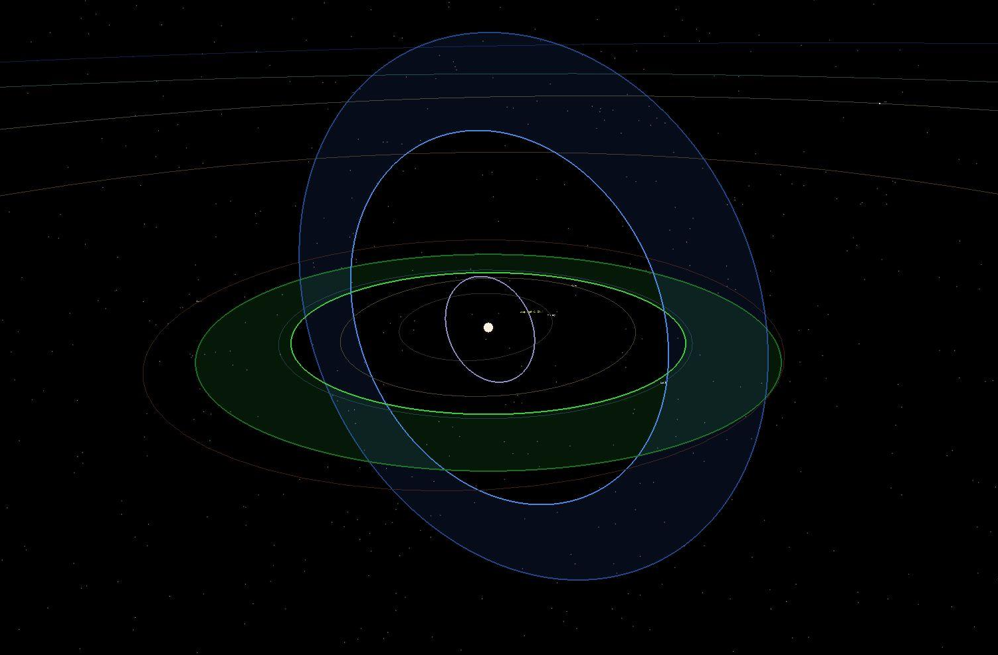

SPES NOVA
Challenge: A World Away: Hunting for Exoplanets with AI
TEAM: URSA CRUX B

Slide 2
PROBLEM
SOLUTION
Ever since the first exoplanets were discovered a few decades ago, interest on them and their characteristics relative to Earth's has been on the rise.
As the amount of possible exoplanet sightings increases, a faster method than manual analysis becomes necessary to keep up with the amount of new data produced.
With the advent of different models of Artificial Intelligence, there appears the possibility to develop and algorithm capable of interpreting the available data to judge an actual exoplanet within a list of candidates. Our solution consists of:
1. An AI model capable of detecting and classifying exoplanets with high precision in very little time.
2. Software that can interpret the physical properties of exoplanets and their stars and display them in an interactive GUI, bringing this information closer to the average citizen.

Slide 3
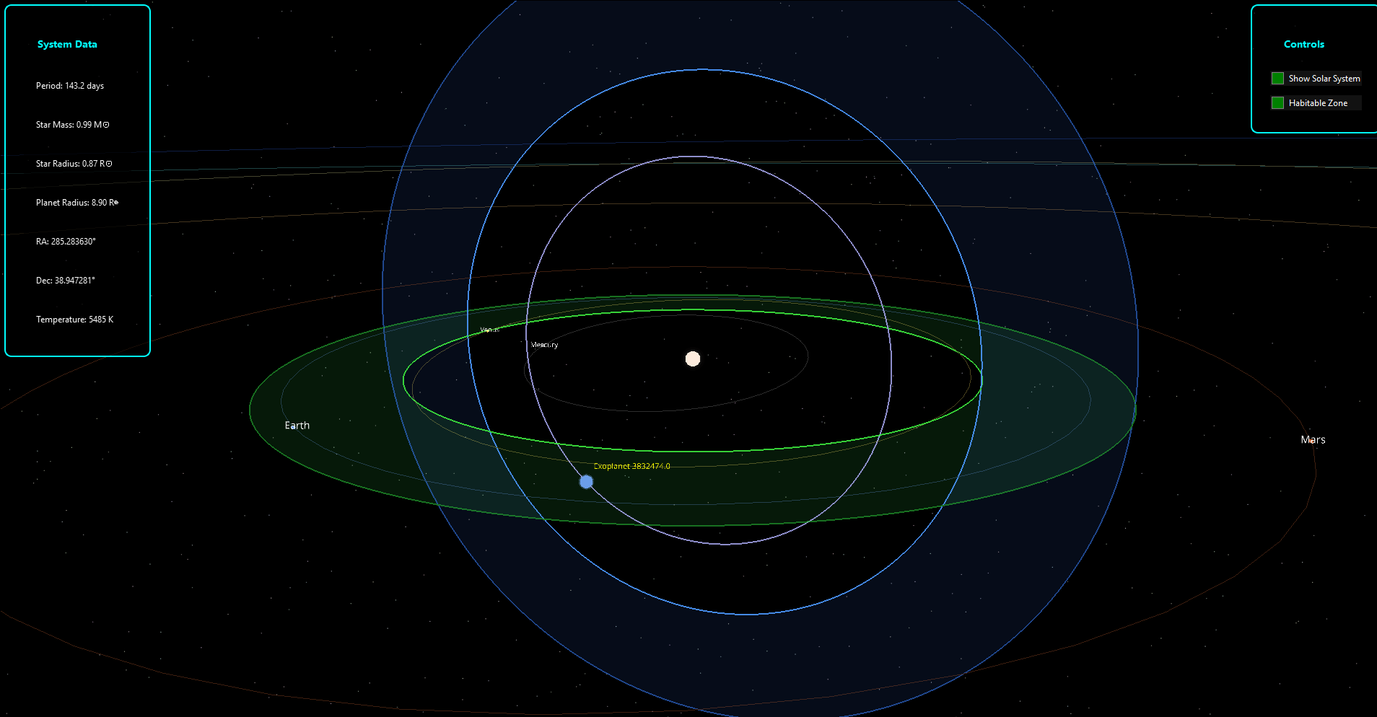
SOFTWARE
Shows a selected exoplanet orbiting its star, and compares it with the orbits of our solar system for scale purposes. It also calculates and shows the habitable zone of the star in both the plane of our solar system and the orbit of the exoplanet
https://exoplanetarchive.ipac.caltech.edu/cgi-bin/TblView/nph-tblView?app=ExoTbls&config=cumulative

Slide 4
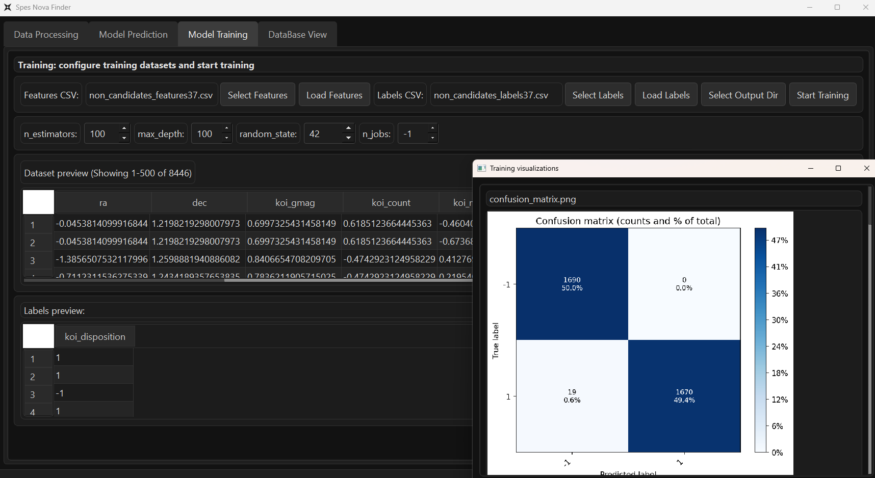
In this screen, you can upload the features and labels to use for train/testing. After training, it shows an additional window showing the results of the training and multiple graphs showcasing metrics pertinent to the model’s accuracy.

Slide 5
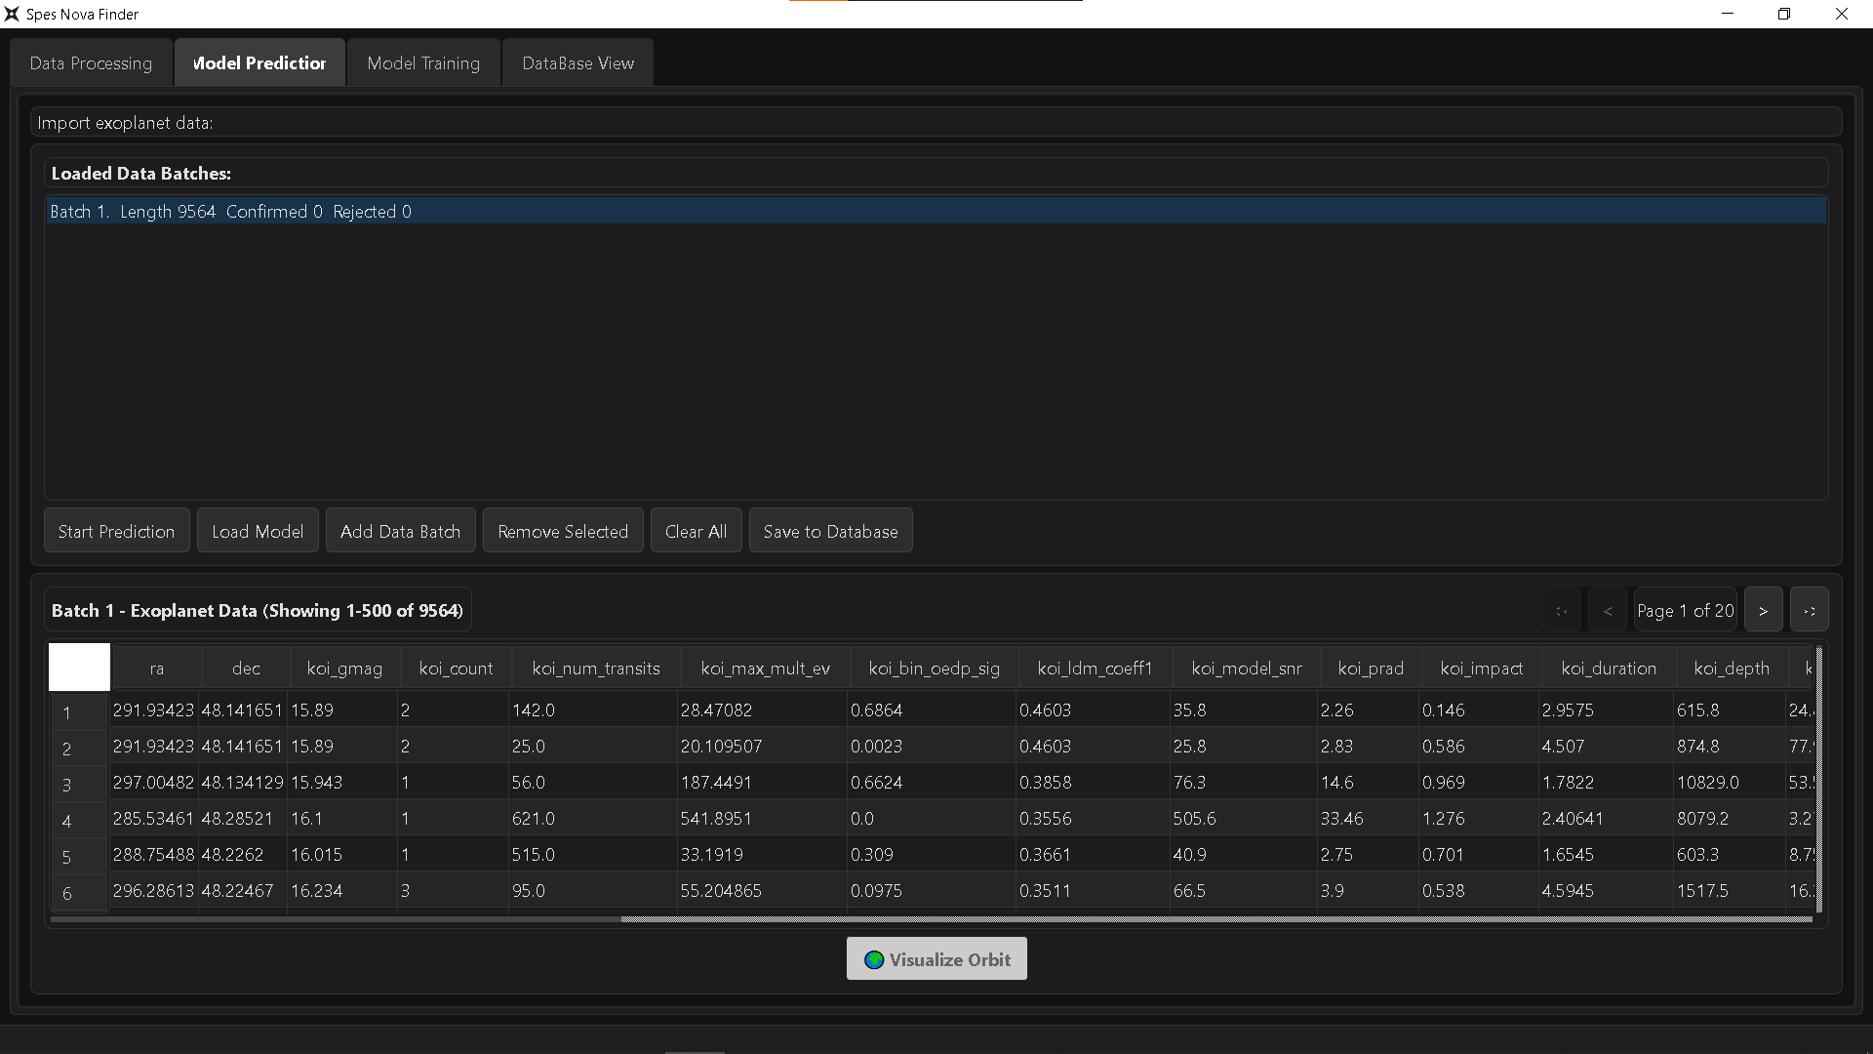
In this screen, you can use the model generated in the training for predicting whether the candidates in another dataset will be exoplanets or not. It is also here you can access the exoplanet viewer

Slide 6
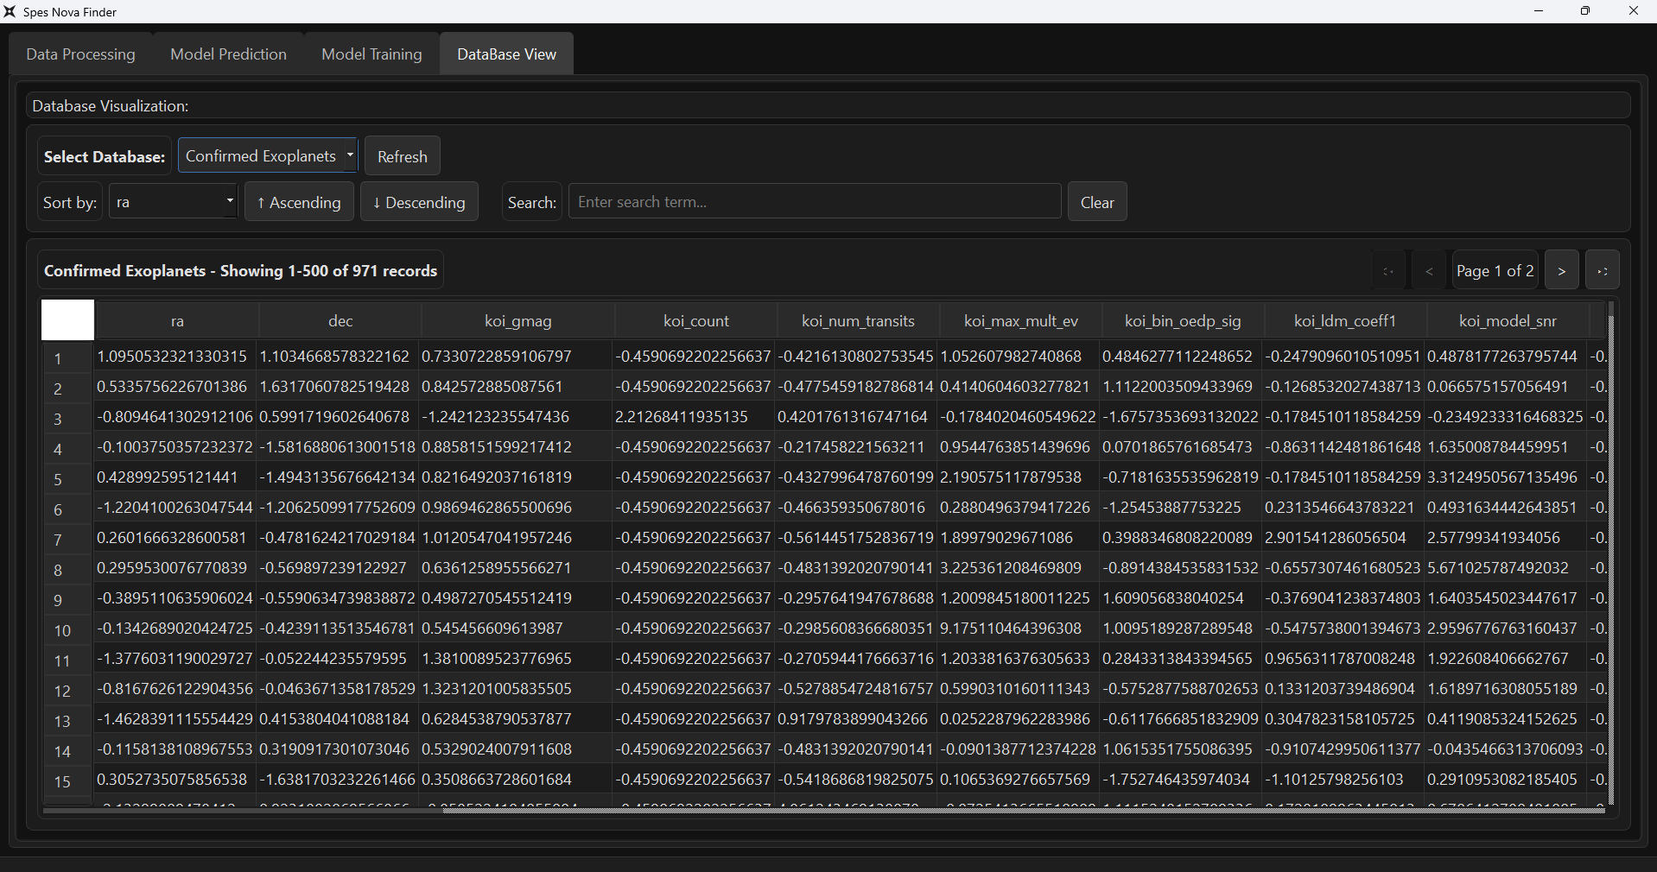
Here, you can visualize the entirety of a given database in the form of a table. The table enables you to sort by categories and search for data.

