Slide 1
MPLS VPN AND SEGMENT ROUTING

Slide 2
Outline
MPLS
MPLV VPN
SEGMENT ROUTING
HOW DOES SEGMENT ROUTING REPLACE MPLS VPN

Slide 3
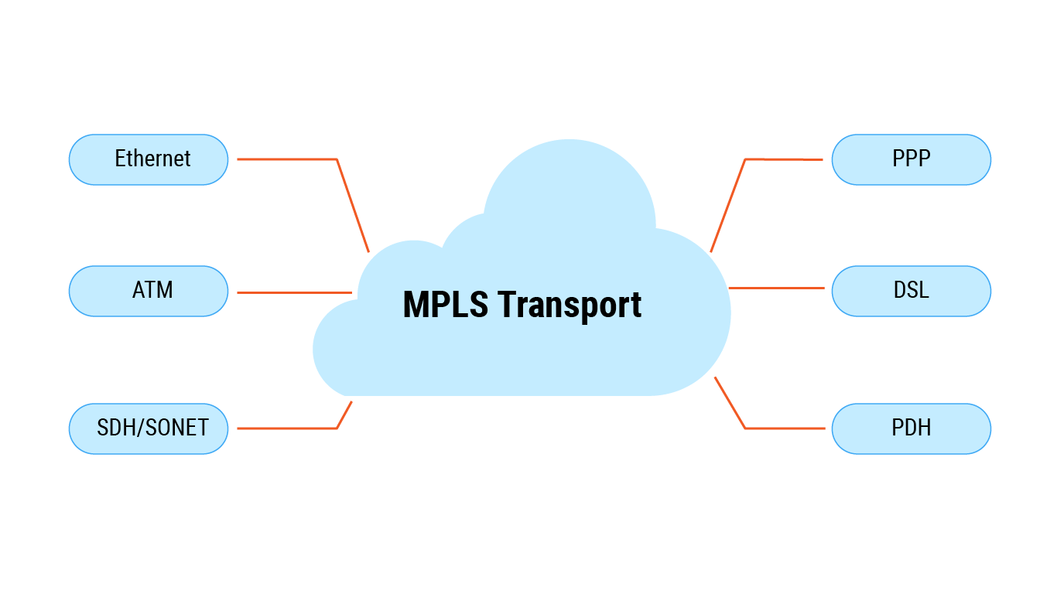
MPLS
MPLS (Multiprotocol Label Switching) a networking technology that routes traffic using the shortest path based on “labels,” rather than network addresses. Unlike other protocols that route data based on network addresses, MPLS routes traffic using labelled paths for forwarding over private WANs.

Slide 4
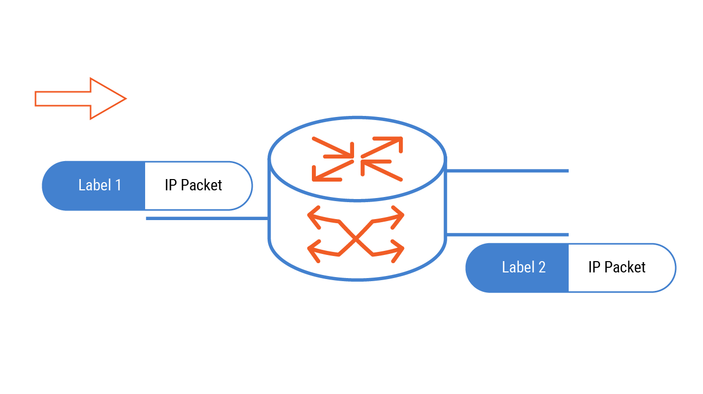
MPLS
Packets in mpls networks will be labeled before transmission.

Slide 5
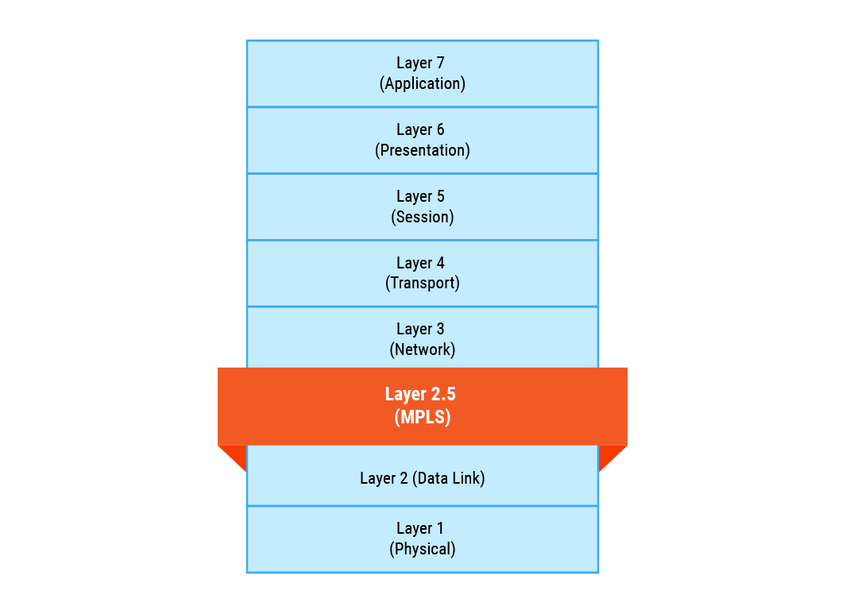
MPLS
MPLS is referred to as a 2.5-layer protocol because of its location between Layer 2 (Data Link) and Layer 3 (Network) in the OSI model.

Slide 6
MPLS
Component | Detail
LER (Label Edge Router) | Entry/exit point of the MPLS network. Ingress and egress are performed at this node.
LSR (Label Switch Router) | Core routers in MPLS networks, forward packets by swapping labels.
LSP (Label Switched Path) | Pre-established label switching paths in MPLS networks
LFIB (Label Forwarding Information Base) | Input label mapping table with output labels and ports.
LDP (Label Distribution Protocol) | Protocol for distributing label mappings between routers
FEC (Forwarding Equivalence Class) | Groups of packets that are processed and forwarded in the same way.

Slide 7
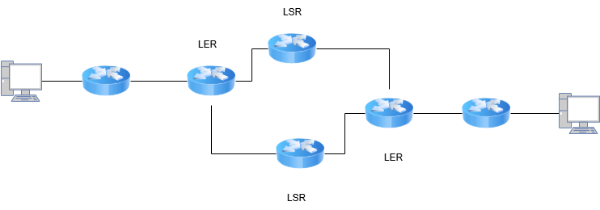
How does MPLS work?
IP
L

Slide 8
How does MPLS work?
IP
L

Slide 9
How does MPLS work?
IP
L

Slide 10
How does MPLS work?
IP
L

Slide 11
How does MPLS work?
IP
L
Penultimate Hop

Slide 12
How does MPLS work?
IP
L

Slide 13
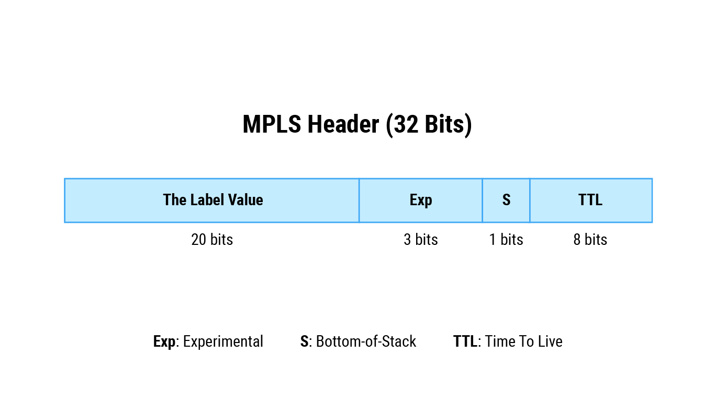
MPLS Header
First 20 bits – The Label Value:
The label contains all the information MPLS routers need to decide where to forward the packet.
Next 3 bits – Experimental:
Experimental bits are used to determine the labeled packet’s priority and explicit congestion notification (ECN) under Quality of Service (QoS).
Next 1 bit – Bottom-of-Stack:
Bottom-of-Stack notifies that the packet has reached the end of the MPLS network route, and there are no more labels to worry about. Typically, this indcates that the router is an egress router.
Last 8 bits – Time To Live (TTL):
This indicates the maximum number of hops a packet can make before being discarded.

Slide 14
MPLS VPN
Based on MPLS and integrate with VPN to secure data transfer between 2 site.
Each VPN has a VPN routing and forwarding (VRF) instance

Slide 15
VRF
VRF (Virtual Routing and Forwarding) is a technology which allows to have more than one routing table on a single router. The concept of VRFs on routers is similar to VLANs on switches. VRFs are typically used in combination with MPLS VPNs. VRFs without MPLS is called VRF lite.

Slide 16
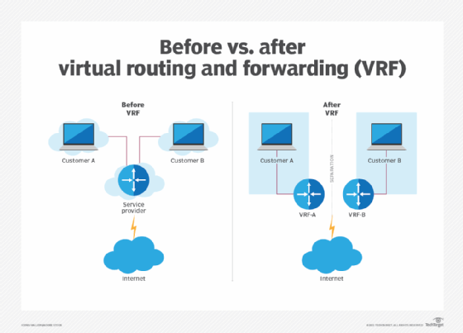
VRF
VRF ensures that data is secure, and sites cannot see each other's data.

