Slide 2
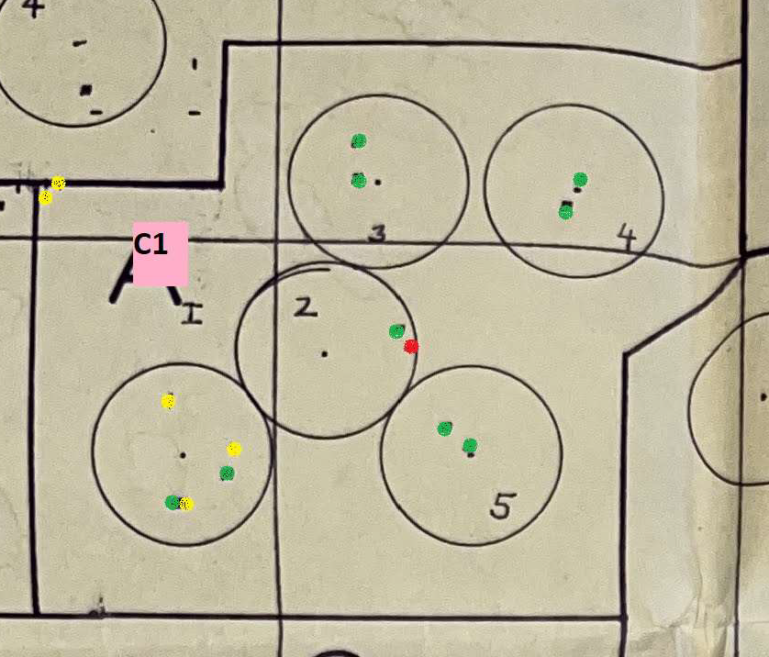
Old stump | Dead >10y | Dead <10y | Alive, symptoms | Alive, postharvest detect
0 | 1 | 5 | 0 | 9
Proposed proportion of disease area:
20% (0.05 acres)

Slide 3
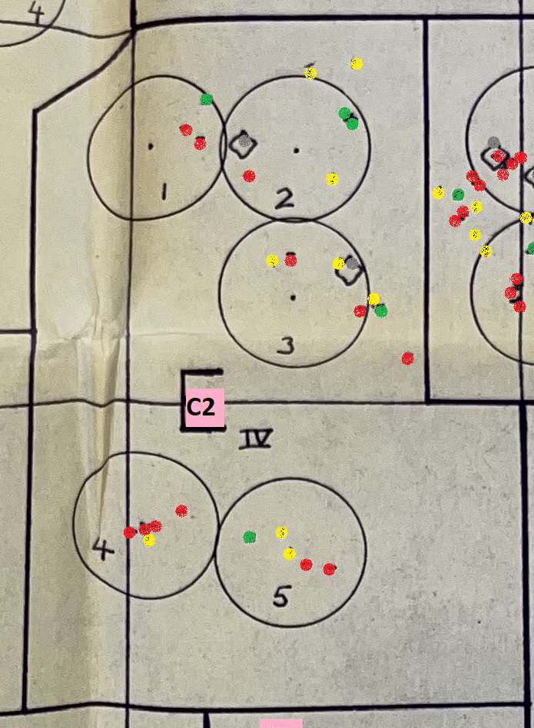
Old stump | Dead >10y | Dead <10y | Alive, symptoms | Alive, postharvest detect
2 | 12 | 9 | 0 | 5
Proposed proportion of disease area:
40% (0.1 acres)

Slide 4
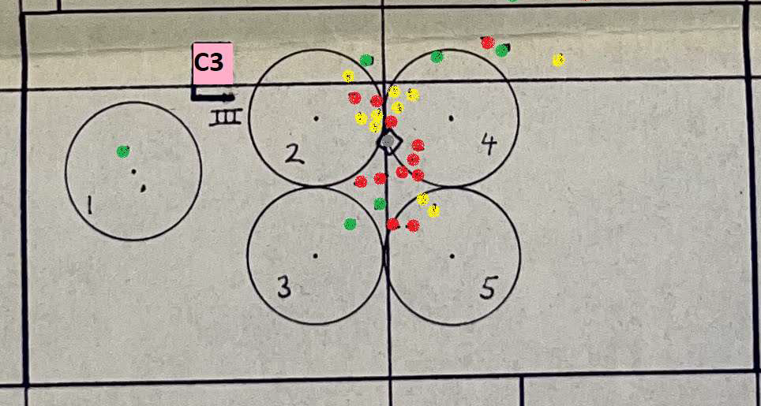
Old stump | Dead >10y | Dead <10y | Alive, symptoms | Alive, postharvest detect
1 | 12 | 10 | 0 | 6
Proposed proportion of disease area:
30% (0.15 acres)

Slide 5
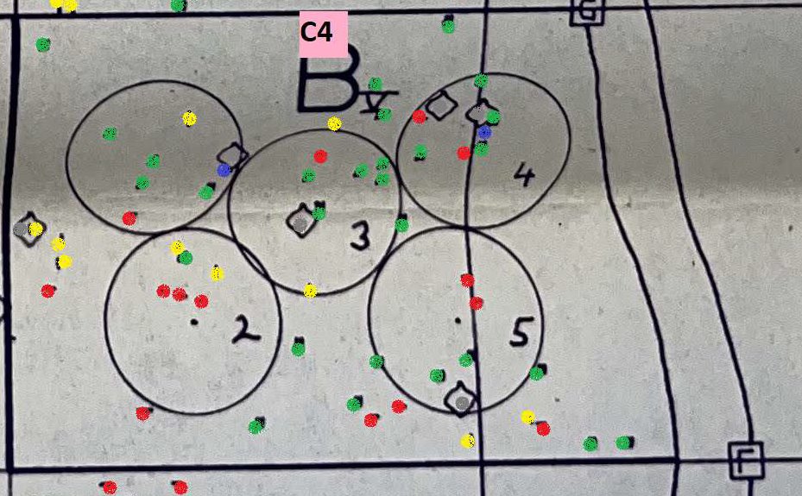
Old stump | Dead >10y | Dead <10y | Alive, symptoms | Alive, postharvest detect
6 | 14 | 10 | 2 | 28
Proposed proportion of disease area:
40% (0.15 acres)

Slide 6
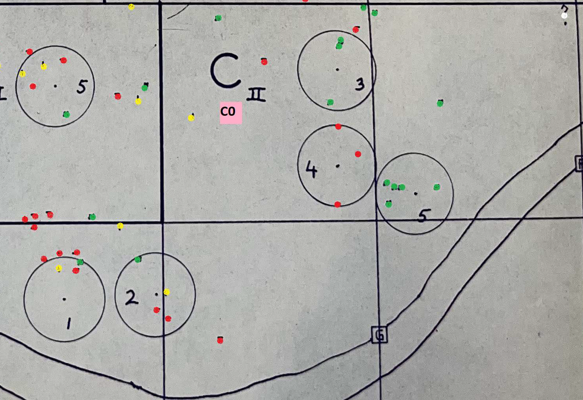
Old stump | Dead >10y | Dead <10y | Alive, symptoms | Alive, postharvest detect
0 | 13 | 4 | 0 | 14
Proposed proportion of disease area:
50% (0.125 acres)

