Slide 1
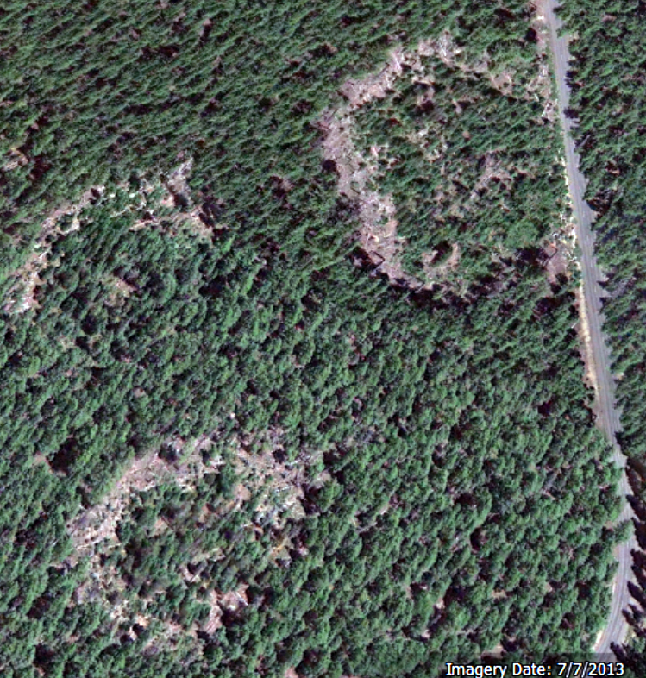
Thinning, hardwood rotation, and
laminated root rot in Douglas fir
David Showalter, Shawn McMurtrey, Anna Leon, John Browning, Michael McWilliams, Blakey Lockman, Everett Hansen, Jared LeBoldus

Slide 2
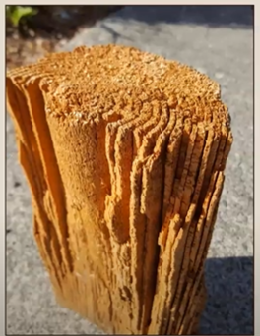
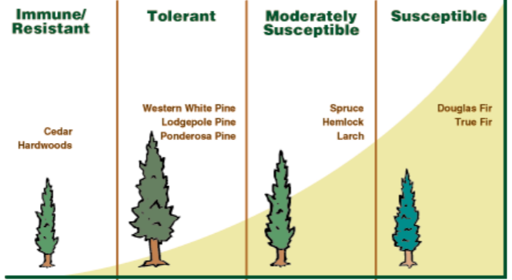
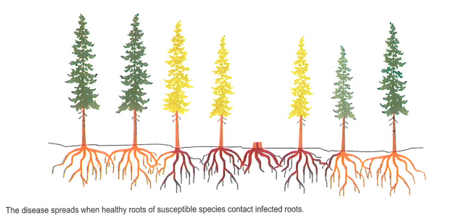
Laminated Root Rot (LRR)
Coniferiporia sulphurascens (Basidiomycota:Agaricomycetes)
Several coniferous hosts
Both saprophytic and parasitic
Spread through root to root contact between trees and/or stumps
Disease of the site, for 50 years (Hansen, 1976)
Root rot pockets
Kevin Zobrist
Dr. Richard Hamelin & Dr. Allan Carroll
Sturrock & Garbutt, 1994

Slide 3
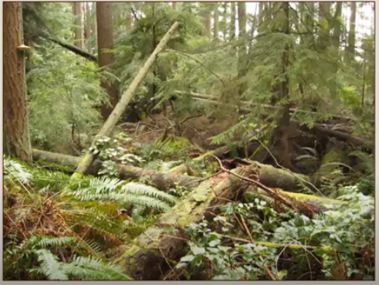
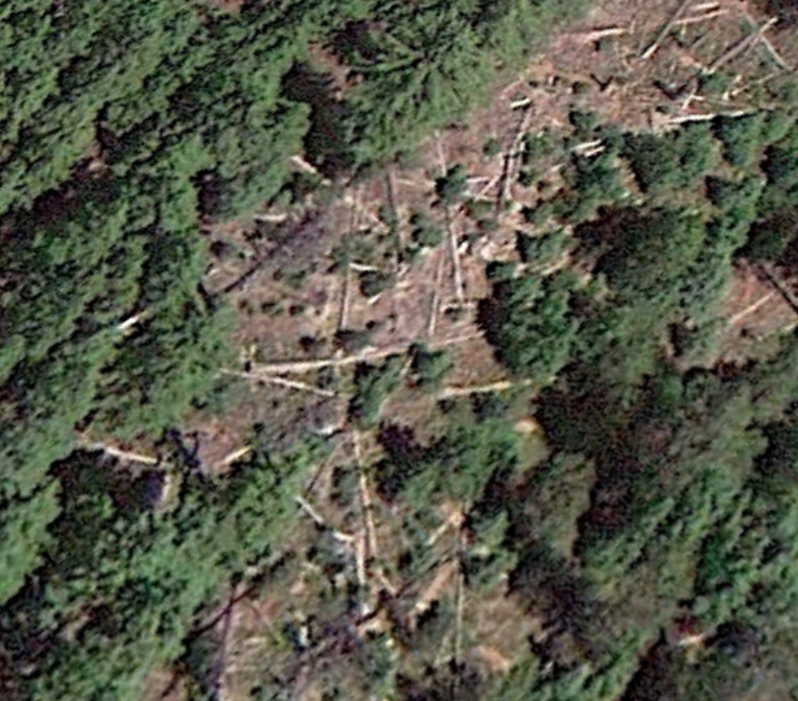
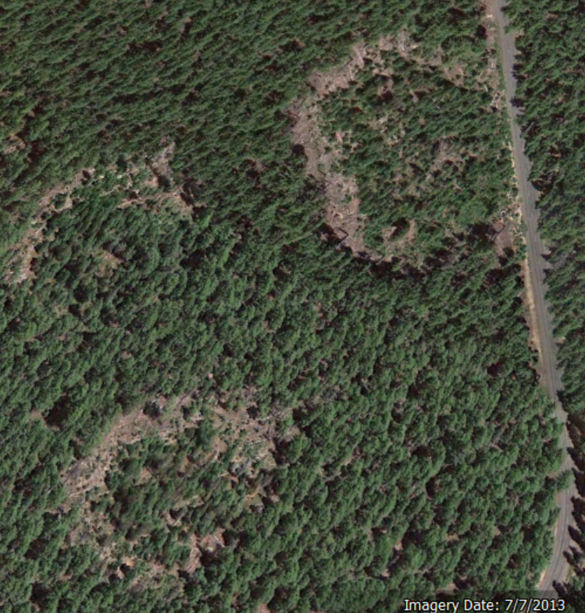
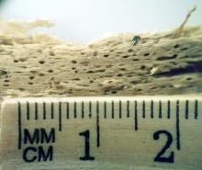
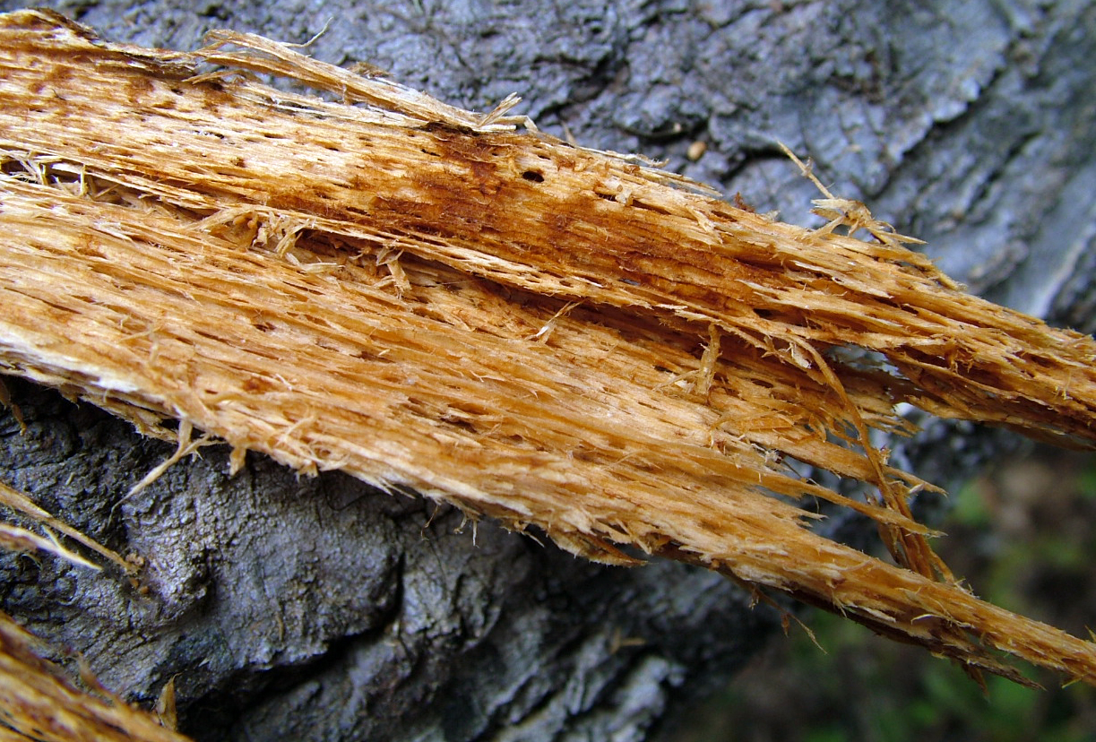
Signs and Symptoms
Kevin Zobrist
Near Waldo Lake, OR
David Shaw, pnwhandbooks.org

Slide 4
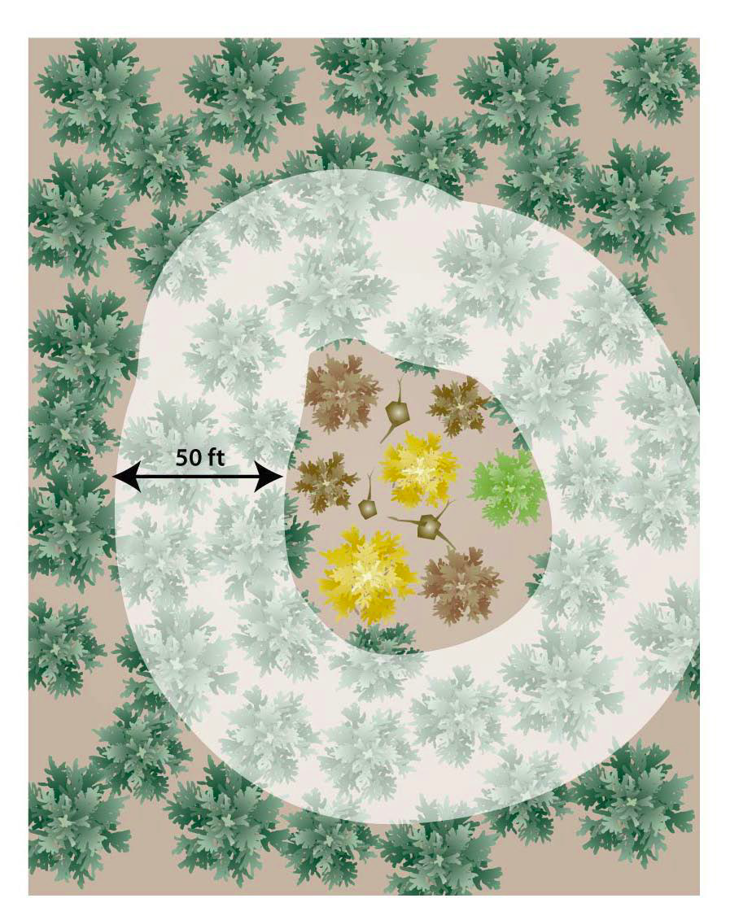
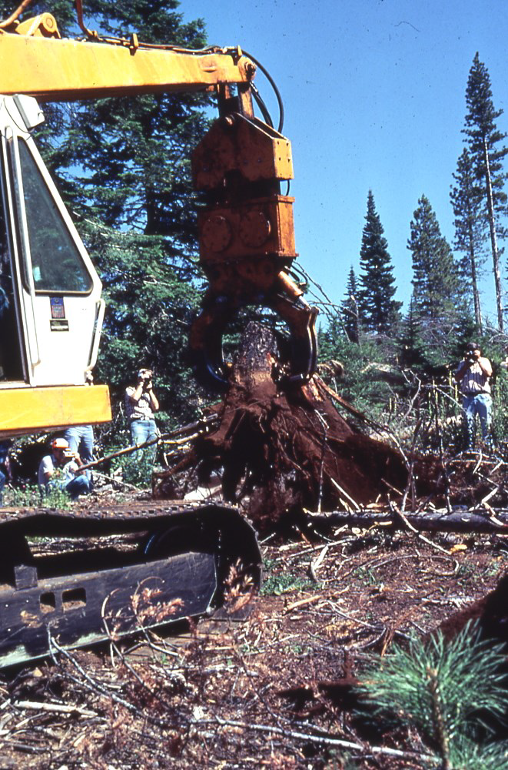
Impacts
Most damaging root rot of Pseudotsuga menziesii in PNW.
Infected sites result in a 40% - 70% reduction in wood volume
Oregon timber industry, $12 billion annually, over 58,000 jobs
Management
Buffer cutting, thinning
Inoculum removal (stumping)
Rotating less suceptible host

Slide 5
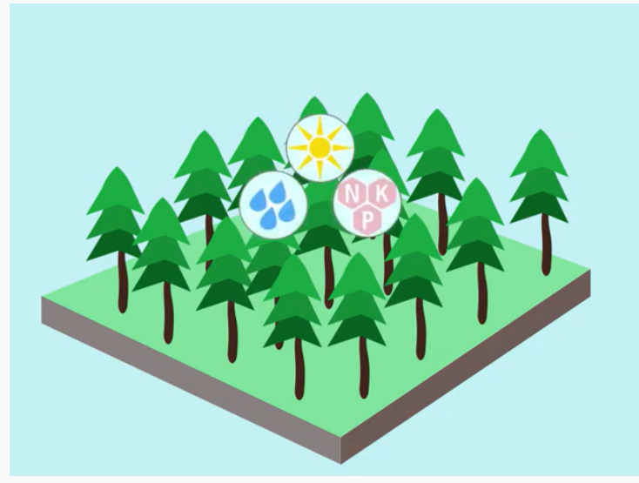
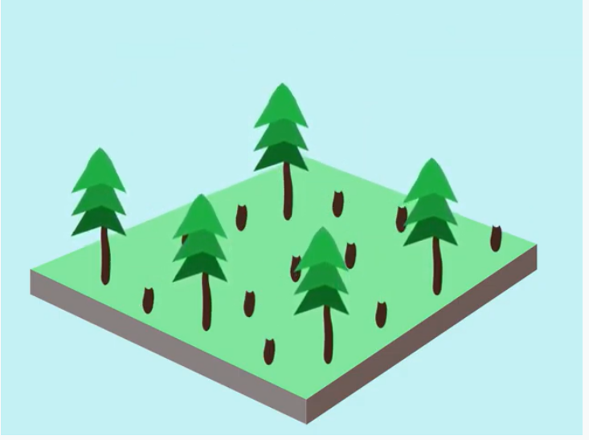
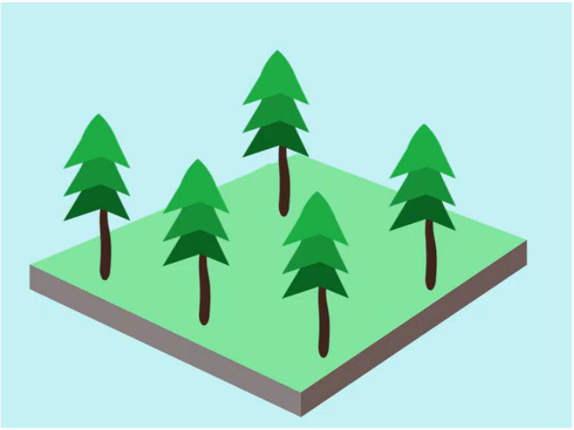
Thinning
Benefits the local economy and wildlife.
Help prevent fire spreading to crowns of larger trees.
Increase health and reduces some disease threats.
Improve vegetation diversity of the forest floor.
Increase tree growth and vigor of remaining trees.
Source and illustrations: US Forest Service, 2020

Slide 6
Research Questions
Do thinning treatments in mature stands with high incidence of laminated root rot increase tree growth and/or reduce mortality?
Do rotations of non-host hardwood species in areas with high LRR incidence increase growth and reduce mortality in subsequent Douglas fir plantings?
How well do the Forest Vegetation Similator and its Western Root Disease Model variant predict long term growth in these stands?

Slide 7
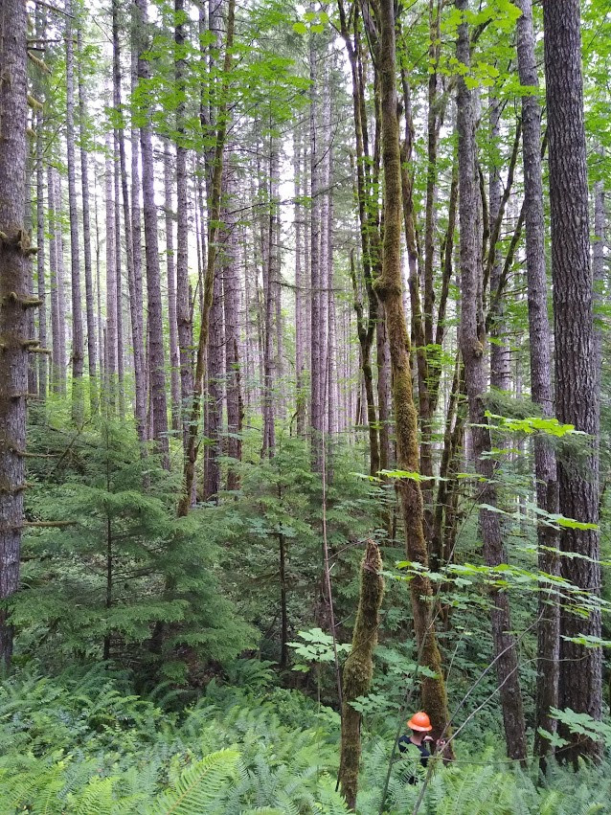
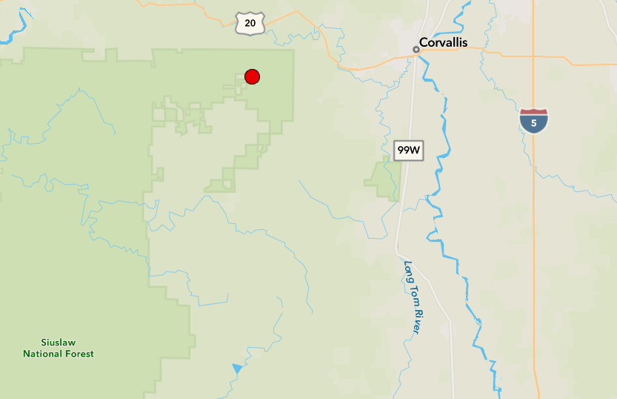
Siuslaw National Forest
Unique ecosystem for surveying of LRR.
Study area was clear cut between 1910
and 1920.
Area burned after reharvest, reestablished
from seed (Tkacz & Hansen, 1982).
Study area is ~400 acres.
Study site
Adam Carson

Slide 8
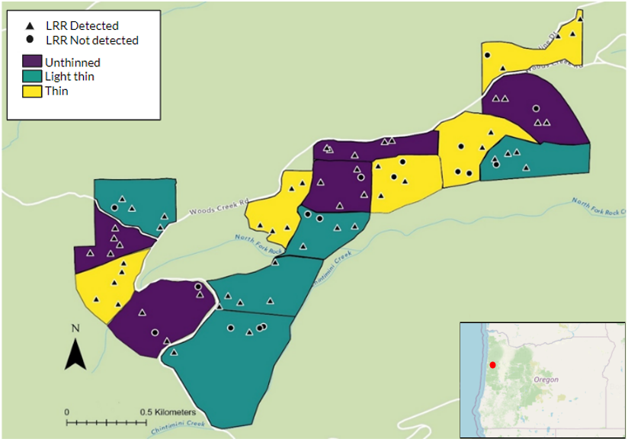
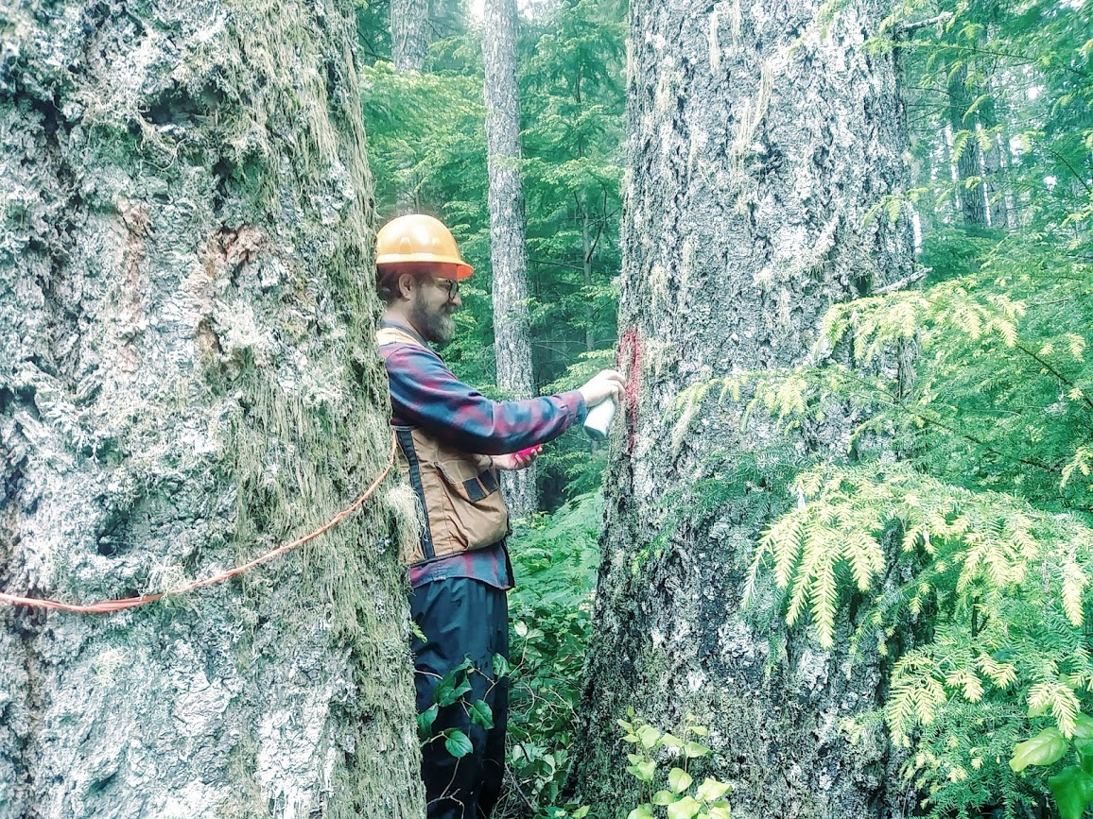
Woods Creek Study Area
Mature mixed Douglas fir forest, ~65y old at establishment in 1985. High LRR incidence
Network of 15 stands and 75 plots over 162 hectares
Thinning treatments applied to stands
ranging from ~6-14 hectares.
Circular 1/25 hectare sample plot ,
11.3 m radius.
Measured aprox. every 5-10 years
Data recorded was species, diameter at
breast height (DBH), and tree health
condition.

Slide 9
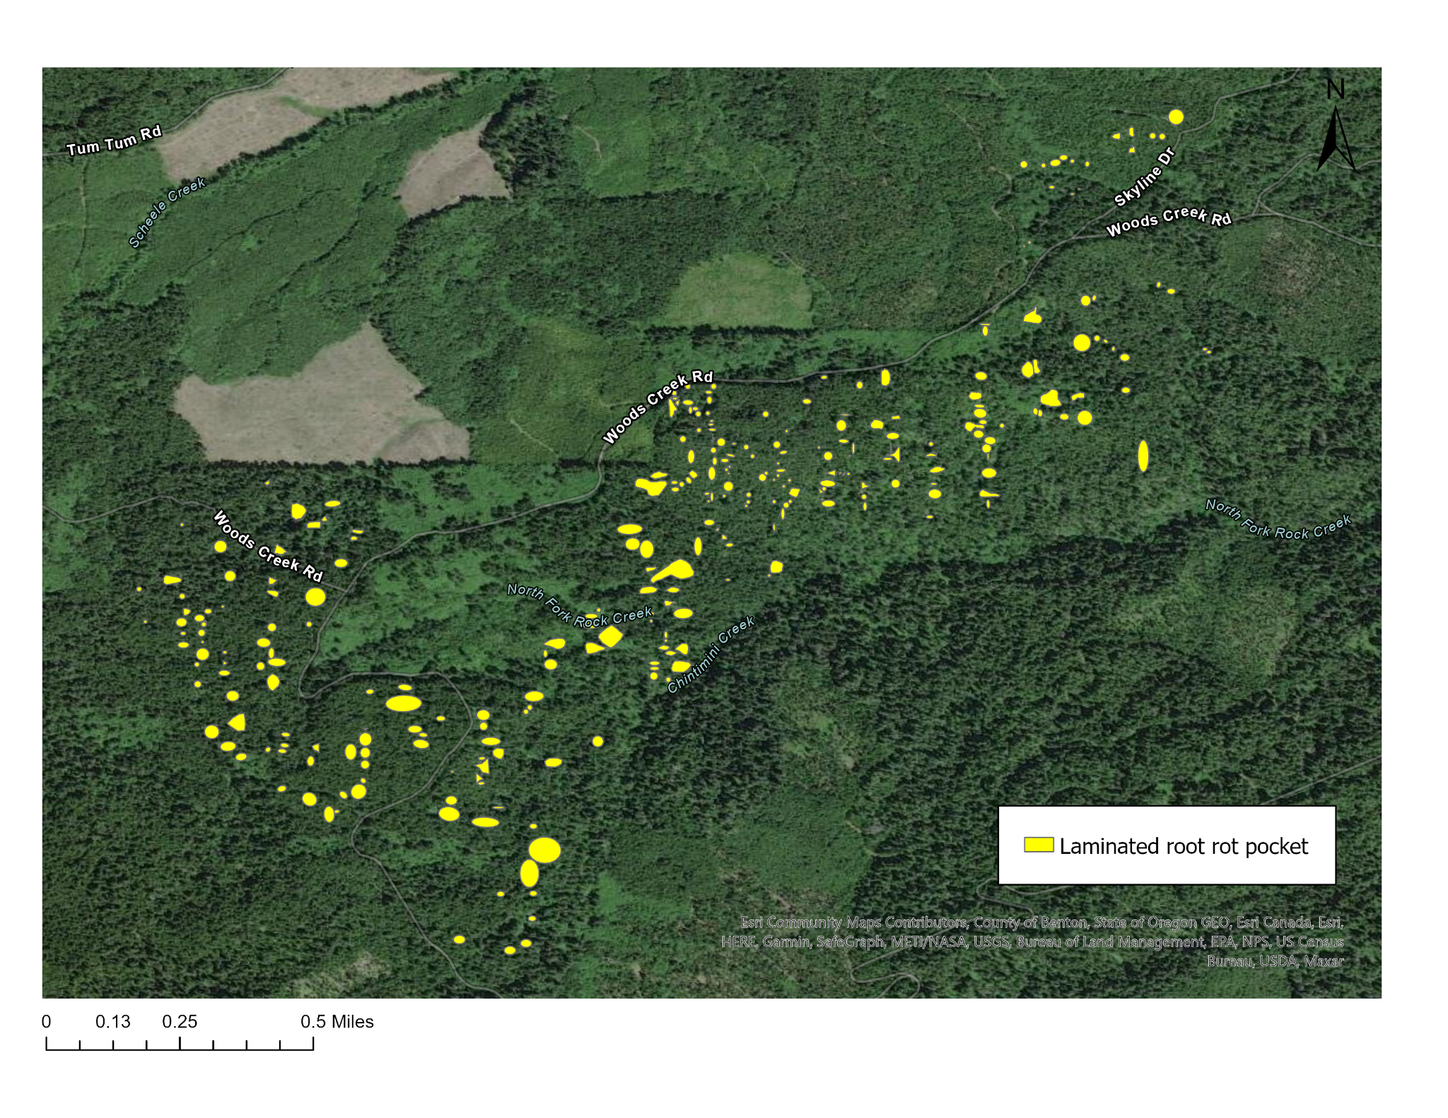
(Hansen, 1978. Line intercept survey. Bloomberg et al., 1980.)

Slide 10
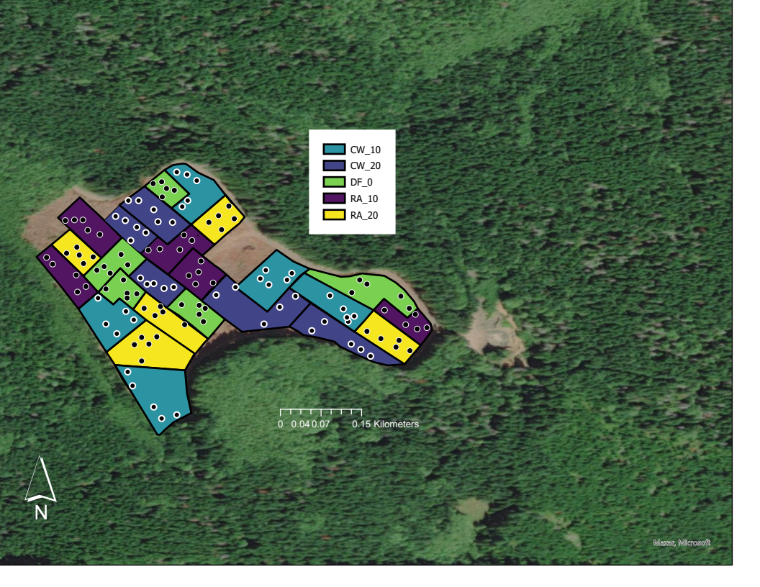
Apiary Study Area
Newly planted Douglas fir following clearcut
of mixed Douglas fir forest
with high LRR incidence
Network of 25 stands and 125 plots
over 14 hectares in Columbia County
in far NW Oregon
Roation treatments applied to stands
Stands blocked by initial LRR incidence
Circular 1/50 hectare sample plot ,
8 m radius.
Measured sporatically, every 8-24 years
Data recorded was diameter at
breast height (DBH), and tree health
condition.

Slide 11
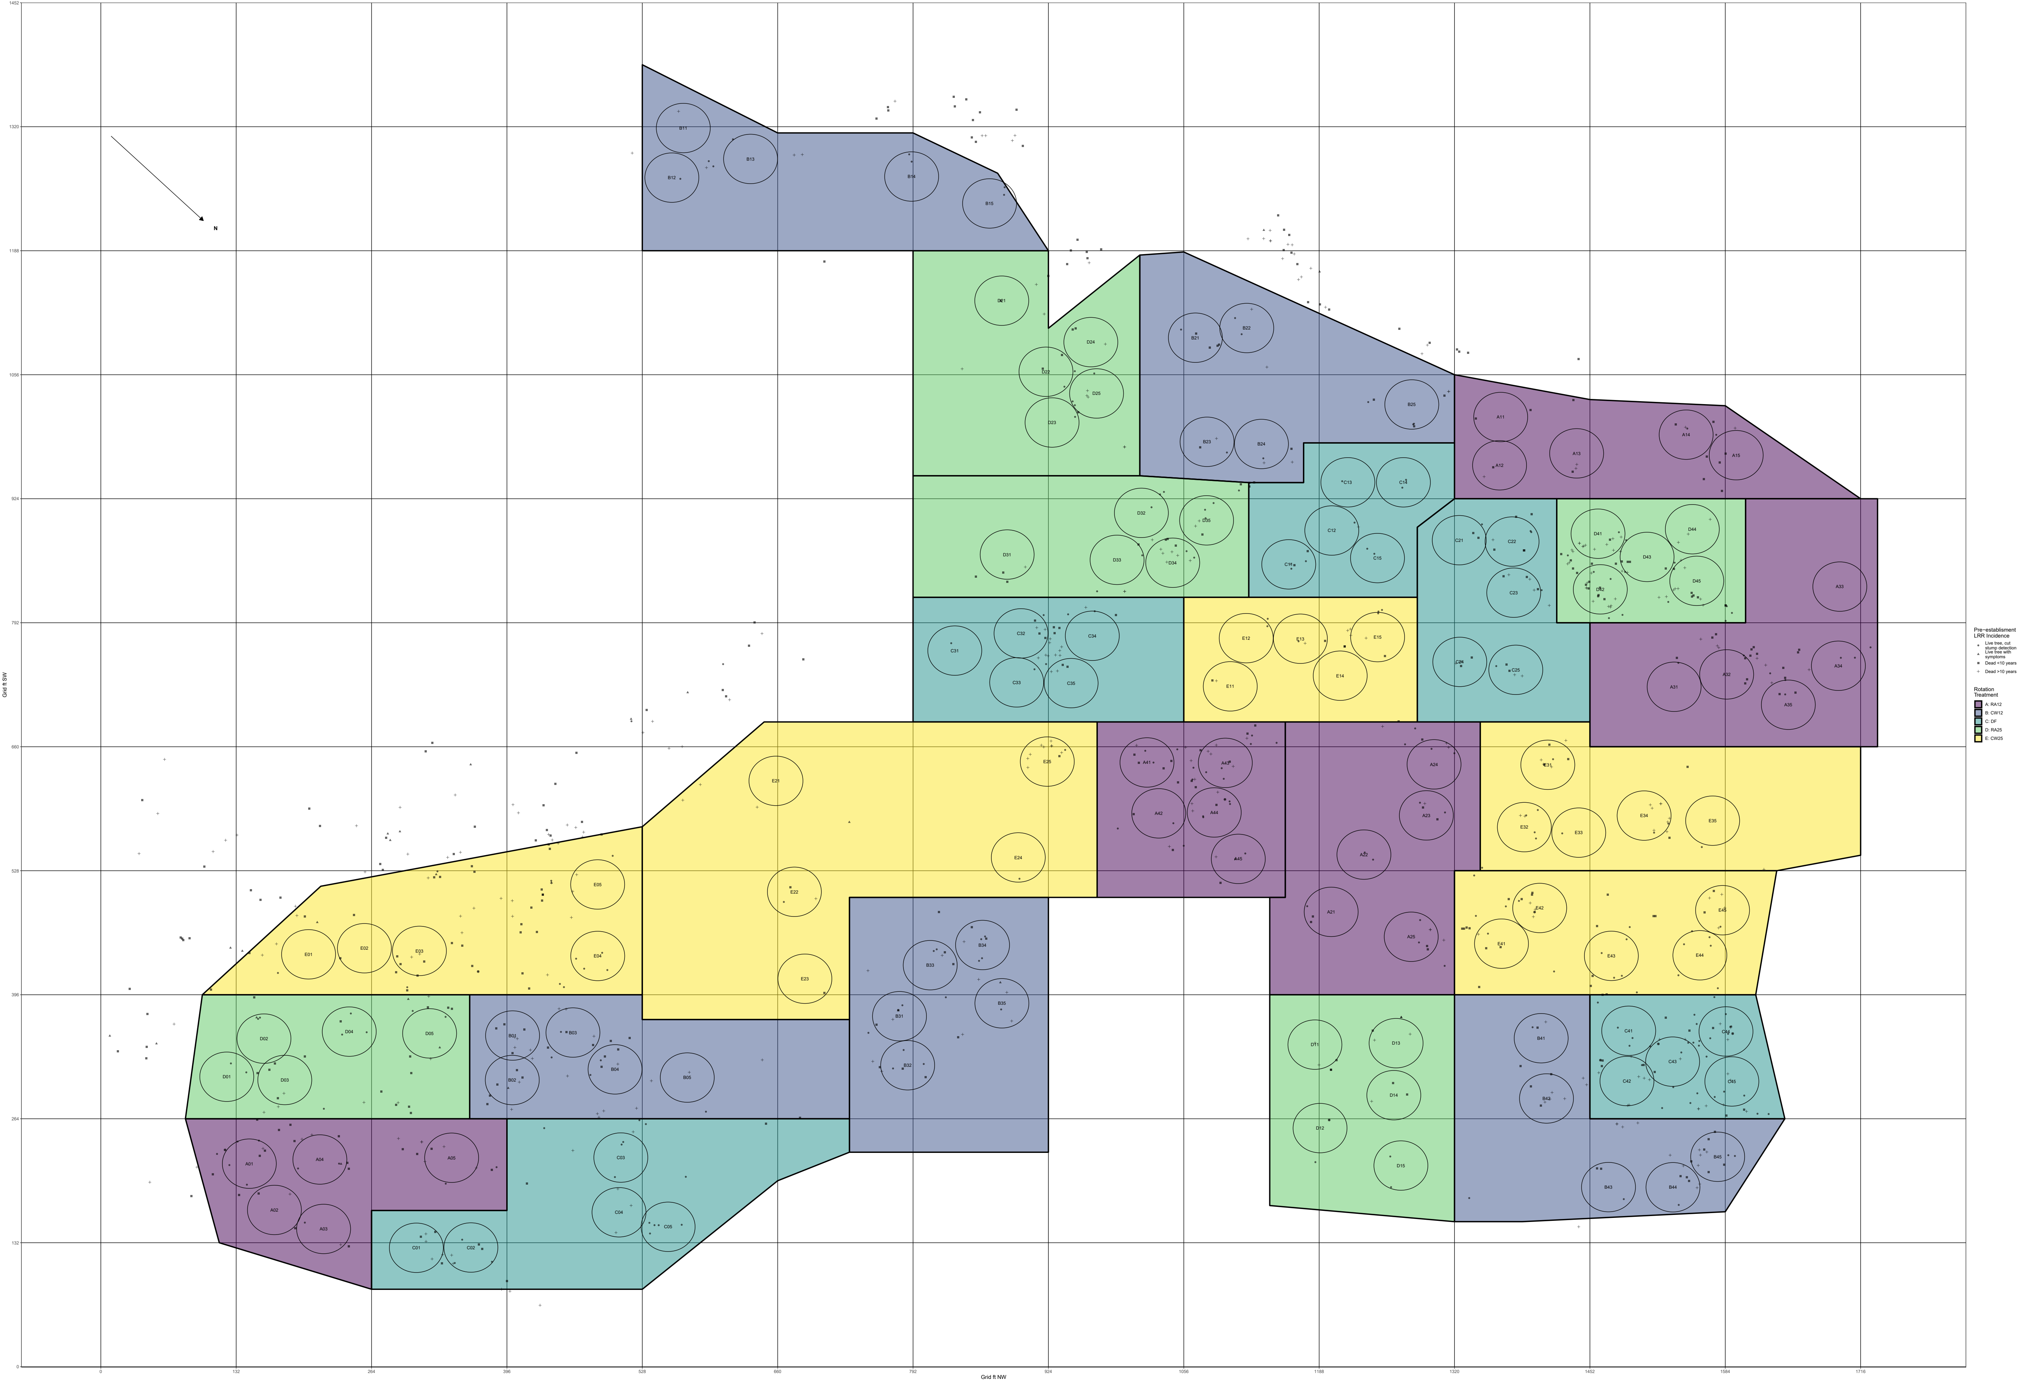

Slide 12
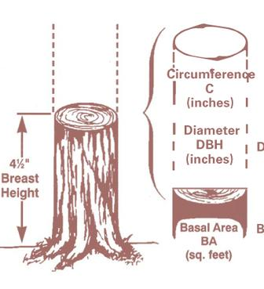
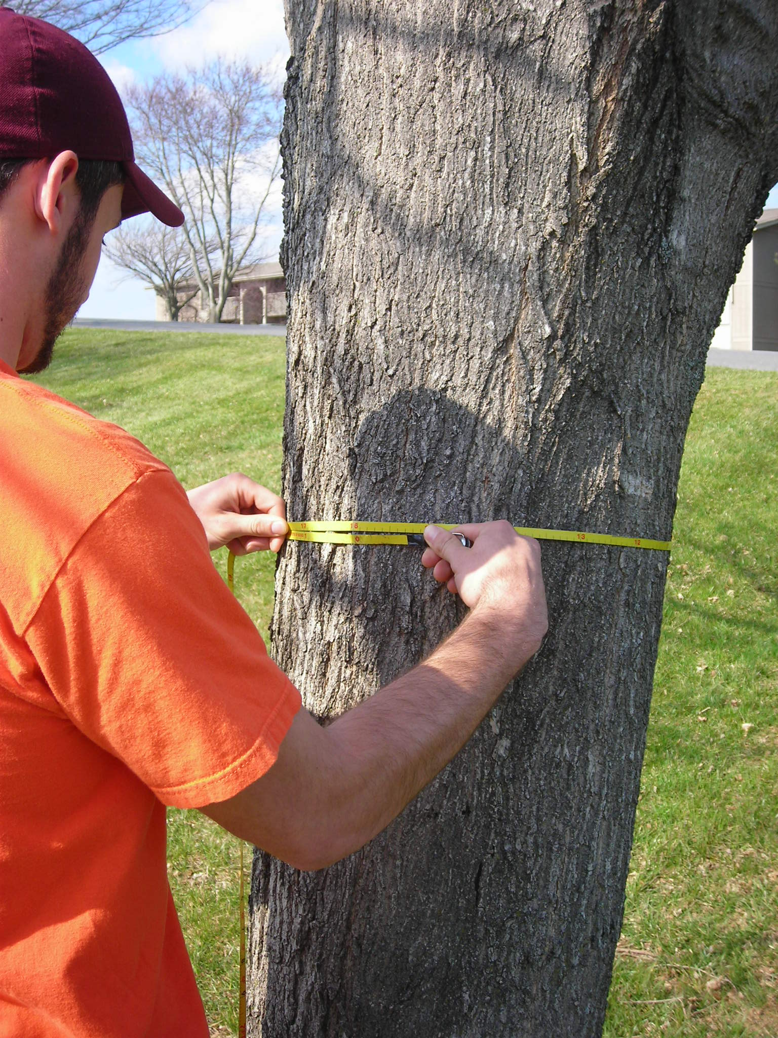
Forestry Biometrics 101
Diameter at breast height (DBH)
(cm or in)
1-dimesional ~ distance
Tree basal area (BA)
(m² or ft²)
2-D ~ area

Slide 13
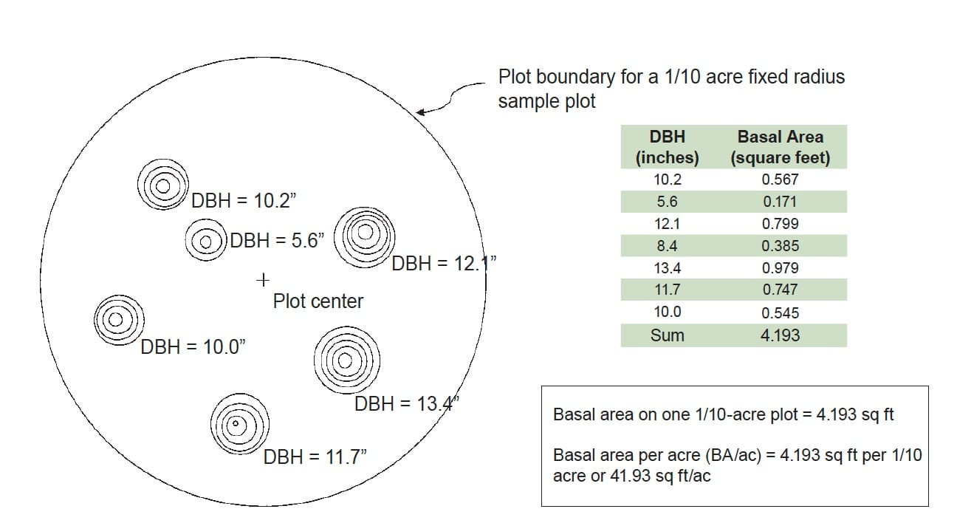
Stand basal area (BA)
(m²/hectare or ft²/acre)
2-D ~ density
Stand > plot

Slide 14
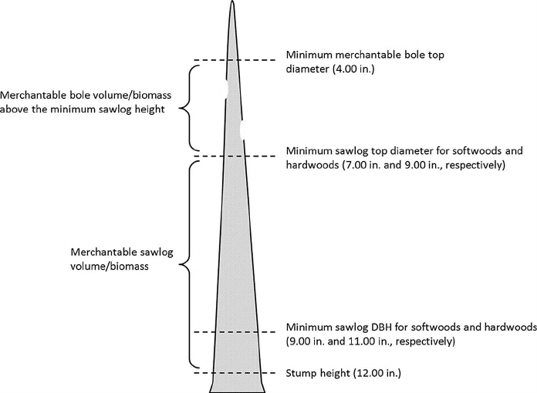
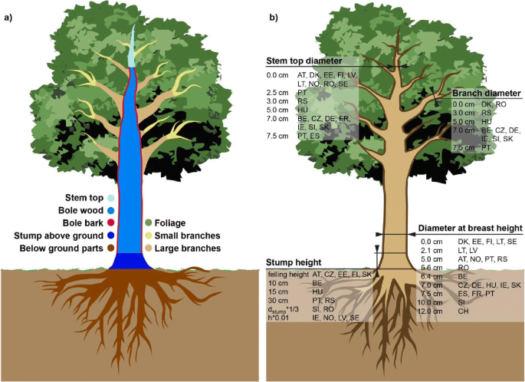
Wood Volume
(m³ or ft³)
3-D

Slide 15
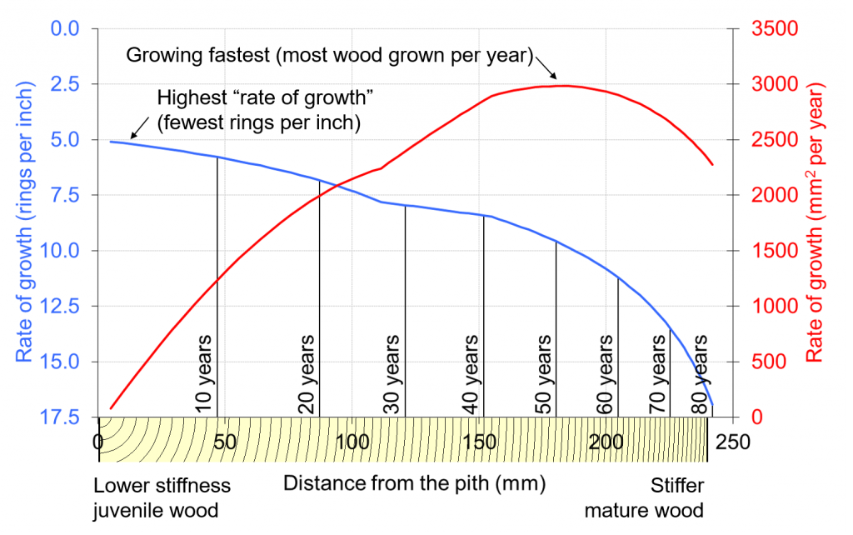
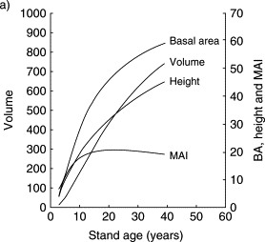
Relationships beween different metrics
(DBH, height, BA, volume, age, increments)
are context dependent, and active areas of research
Increment
(metric/time)
rate or slope ~ growth
ΔDBH/year
ΔBA/year
t1
t2
ΔBA2
ΔBA1

Slide 16
WOODS CREEK
Max tree age
Year
Measurement
Heavy Thin
Growth
Thin
75
1990
80
1995
85
2000
94
2009
105
2020
Treatment
Growth
75
1990
80
1995
85
2000
94
2009
105
2020
Light Thin
Thin
Unthinned
Growth
75
1990
80
1995
85
2000
94
2009
105
2020
ca. 1915
‘80
‘85
‘90
‘95
2000
‘05
‘10
‘15
‘20
Year
Clearcut and
seed DF
Large old trees, mixed age and species

Slide 17
APIARY
DF age
Year
Measurement
RA 25y
Hardwood growth
11
2011
20
2020
CW 25y
Hardwood growth
11
2011
20
2020
Treatment
RA 12y
Hardwood growth
8
1995
24
2011
33
2020
CW 12y
Hardwood growth
8
1995
24
2011
33
2020
DF 0y
12
1987
36
2011
45
2020
1975
‘80
‘85
‘90
‘95
2000
‘05
‘10
‘15
‘20
LRR survey, clearcut,
plant
12y trts
clearcut,
plant DF
Year
25y trts
clearcut,
plant DF
Small Douglas fir, even* age

Slide 18
APIARY
DF age
Year
Measurement
RA 25
11
2011
20
2020
CW 25
11
2011
20
2020
Treatment
RA 12
8
1995
24
2011
33
2020
CW 12
8
1995
24
2011
33
2020
DF 0
12
1987
36
2011
45
2020
0
5
10
15
20
25
30
35
40
45
Douglas Fir Stand Age (years)

Slide 19
t1
t2
APIARY
EARLY
ΔBA2
RA 25
11
2011
20
2020
ΔBA1
CW 25
11
2011
20
2020
Treatment
RA 12
8
1995
24
2011
33
2020
CW 12
8
1995
24
2011
33
2020
DF 0
12
1987
36
2011
45
2020
0
5
10
15
20
25
30
35
40
45
MIDDLE
LATE
Age-matching treatments
Age

Slide 20
Results : Thinning → Mortality
Long term mortality:
(LRR Dead 2020 – LRR Dead 1990)/ Total
Treatment | Net Dead | Total | %
Unthinned | 92 | 361 | 25.4
Light Thin | 72 | 195 | 36.9
Thin | 60 | 172 | 34.8
PLOT over time?
stand mean +/- SE?
Mortalitiy is sparse
F2,12=0.484
p=0.629

Slide 21
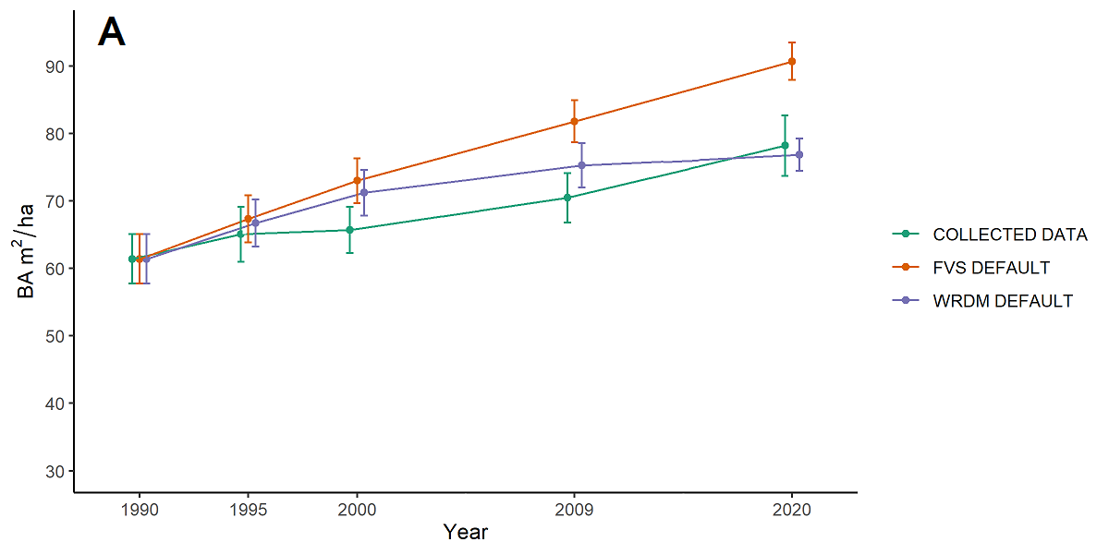
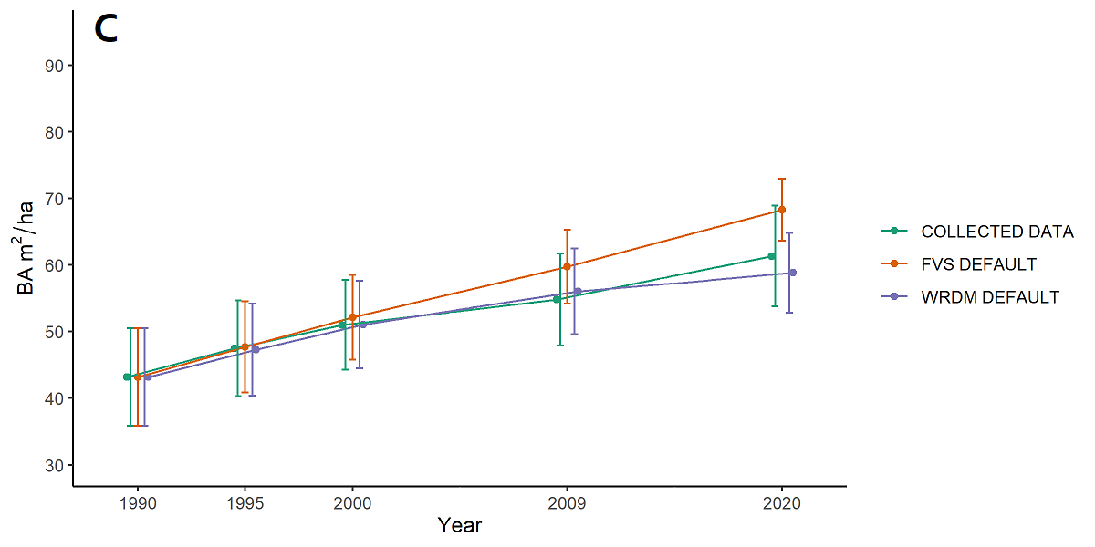
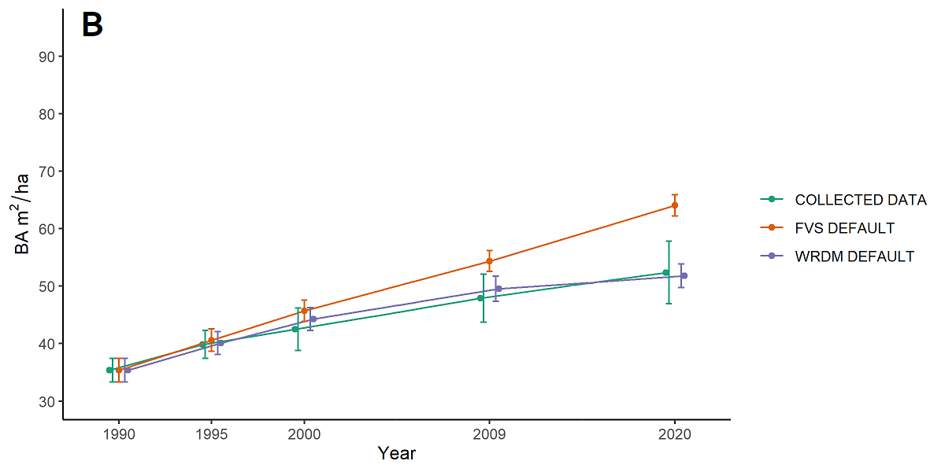
Results : Thinning → Growth and FVS
Unthinned
Light thin
Thin

Slide 22
Woods Creek Results : THM
No observed effect of thinning on long-term rate of mortality
As yet unknown effect of thinning on basal area increments
FVS Western Root Disease Model very accurately predicts stand level basal area over the course of the experiment.

Slide 23

Woods Creek Results : Clarifications or Edits
make a BA x time plot with all treatments
make a mort x time plot with all treatments?
Calculate BA annual increments?
Tree size distribution (see example to right)
or like Apiary histograms?
Growth by LRR status (later) and ROC

Slide 24
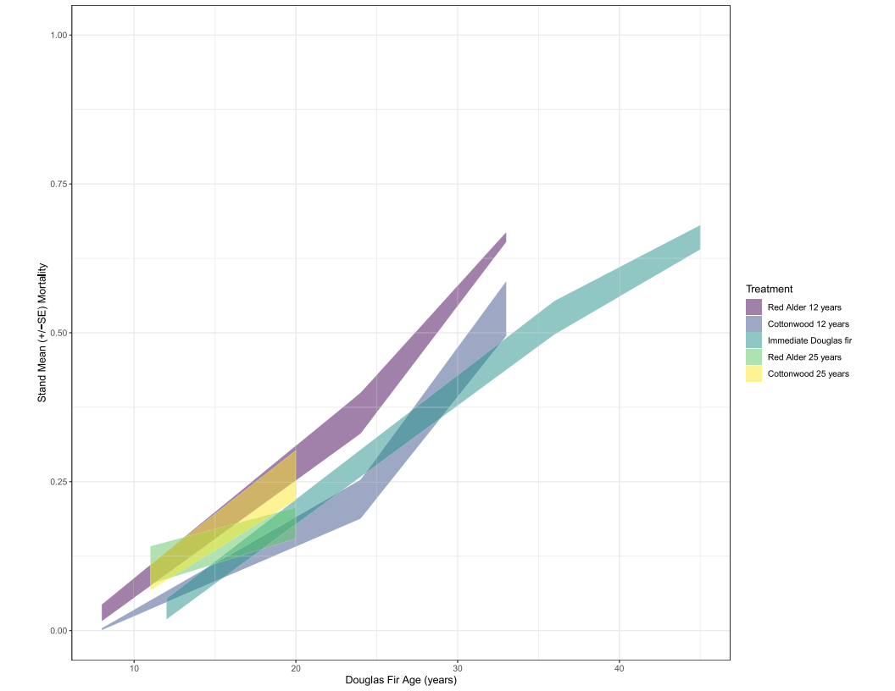
Results : Rotation → Mortality
Mortality increases across the study
Variation within treatments approximately equal to variation between treatments
Rate of mortality appears variable

Slide 25
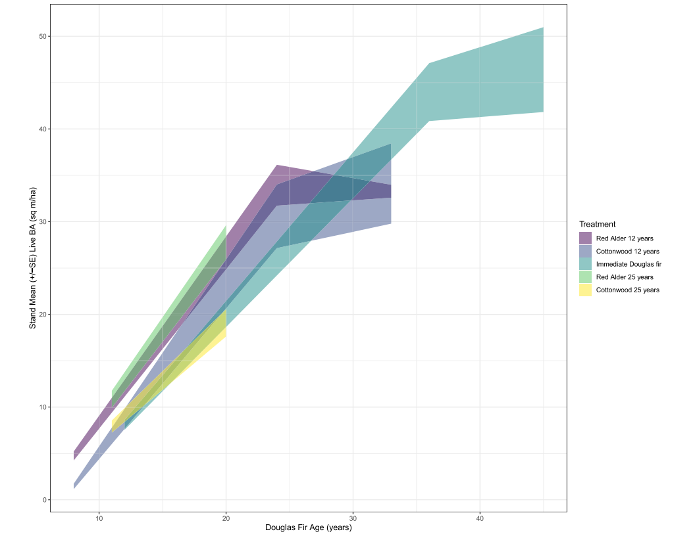
Results : Rotation → Growth
Growth measured as stand basal area increases sharply early in the study and more slowly later on
Variation within treatments approximately equal to variation between treatments
Rate of growth is variable

Slide 26
t1
t2
APIARY
EARLY
ΔBA2
RA 25
11
2011
20
2020
ΔBA1
CW 25
11
2011
20
2020
Treatment
RA 12
8
1995
24
2011
33
2020
CW 12
8
1995
24
2011
33
2020
DF 0
12
1987
36
2011
45
2020
0
5
10
15
20
25
30
35
40
45
MIDDLE
LATE
Age-matching treatments
Age

Slide 27
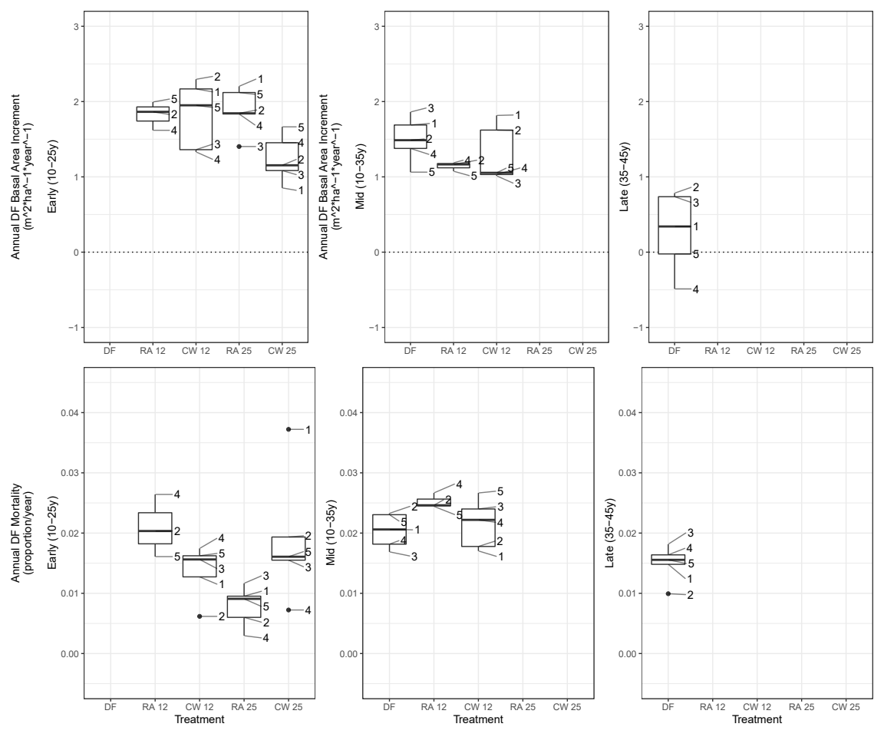
Results : Rotation → Increments
BA growth increment within timeframes does not significantly vary between treatments
High LRR severity blocks appear to have reduced growth and increased mortality after early phase
Growth declines or even becomes negative in later stages, especially in severe blocks

Slide 28
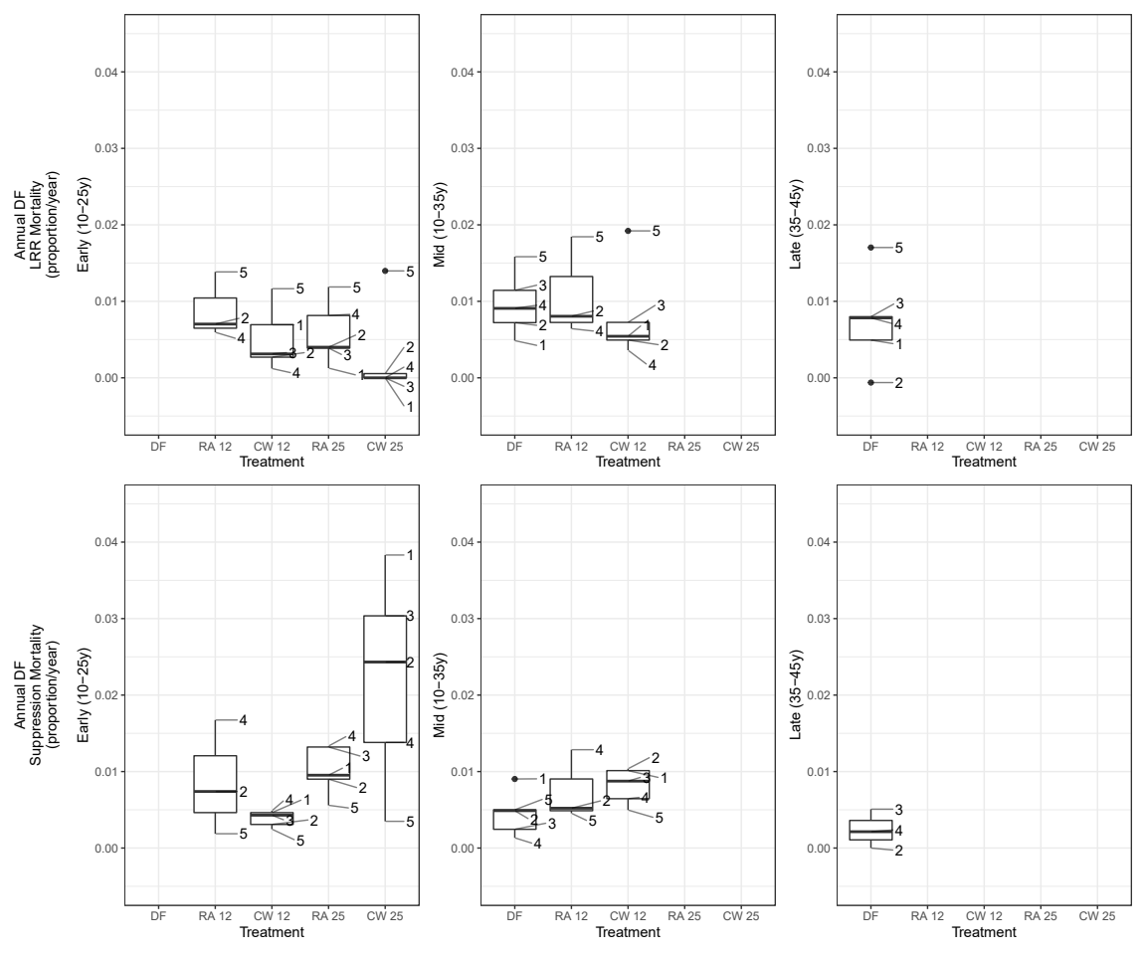
Results : Rotation → Increments by cause
Suppression by hardwood regeneration may offset LRR mortality reduction
Initial LRR severity inffluences LRR mortality

Slide 29
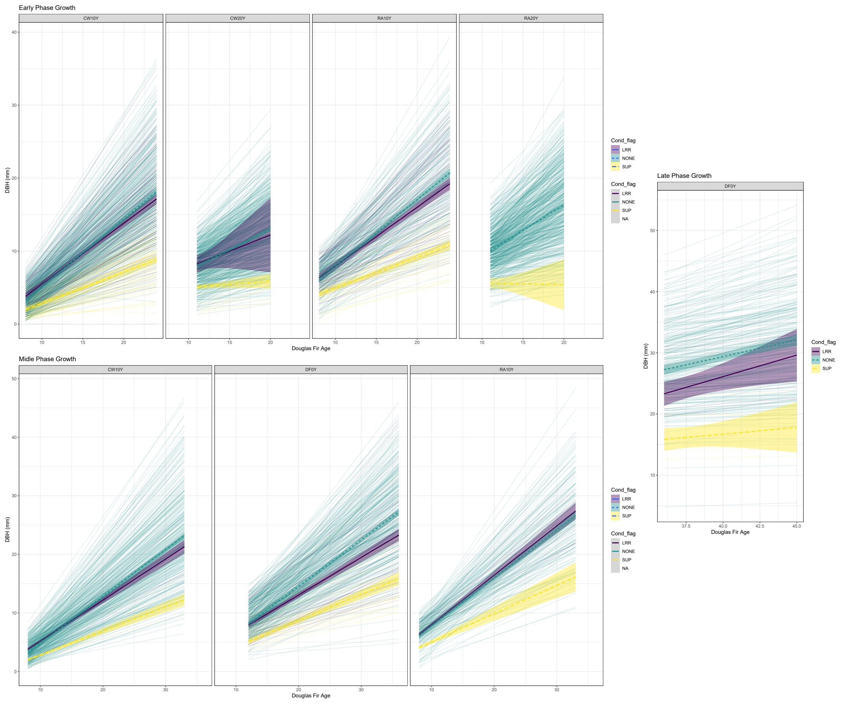
Results : LRR → DBH increment
Trees binned “ever SUPP”, “ever LRR”, or “not”. Only living DBH used

Slide 30
Apiary Results : THM
Suppression by hardwood regeneration may offset LRR mortality reduction, resprout management important
LRR may have sublethal effects on growth

Slide 31
Apiary Results : Clarifications or Edits
ROC ever LRR vs not
Tree size distribution?
FVS of continuous DF treatment

