Slide 1



CineSense
Decoding Audience Insights, Shaping Better Films
Business & Project Management
Martina Fabiani
Tommaso Falaschi
Rossana Antonella Sacco
21 February 2025

Slide 2

Overview
Introduction
Application
The problem
Results
Our Goals
Conclusions
The innovation

Slide 3

Introduction
The Need
In an industry where audience reception can make or break a movie, under- standing viewer sentiment is crucial. CineSense processes large volumes of user- generated feedback, identifying trends, strengths, and potential weaknesses.
The Idea
By integrating advanced Large Language Models (LLMs) and sentiment analysis techniques, CineSense analyzes audience reviews to extract valuable insights into the key factors that drive a film’s success, tailored to its specific genre.

Slide 4

The Problem
While similar methodologies have been developed, their practical application remains limited in real-world scenarios.
Failure Cases
The failures of tones of projects highlight how a lack of audience understanding and ineffective strategic planning can significantly contribute to a film’s downfall.

Slide 5

Our Goal
Our goal is to develop a solution that helps prevent pitfalls by equipping industry professionals with AI-driven tools to optimize decision-making. By leveraging advanced sentiment analysis and feedback interpretation techniques, our approach ensures that films are not only creatively compelling but also strategically aligned with audience preferences, increasing their chances of success.

Slide 6


The Innovation
CineSense revolutionizes audience analysis by leveraging cutting-edge AI and Natural Language Processing (NLP) to decode movie reviews with precision.
From Data to Actionable Insights
Gemini-1.5-Flash
Utilizing the Gemini Long Context API, CineSense processes vast datasets efficiently, maintaining context over extended reviews and delivering deep and strategic insights.
🔹 High-speed, cost-effective large-scale analysis
🔹Context-aware processing for nuanced sentiment detection
🔹 Enhanced decision-making for filmmakers and marketers
Traditional methods struggle to interpret large-scale audience feedback effectively.
CineSense bridges this gap by integrating:
✅ Sentiment Analysis – Capturing emotional responses with high accuracy
✅ Topic Extraction – Identifying key themes and concerns in reviews
✅ Marketing Insights - Turning sentiment analysis, keyword extraction, and topic modeling into actionable strategies.
Notes:
Now let’s take a look at the core innovation behind CineSense.
CineSense revolutionizes audience analysis by leveraging advanced AI and Natural Language Processing (NLP) to decode movie reviews with remarkable precision.
1- One of the biggest challenges in the film industry is interpreting large-scale audience feedback effectively. Traditional methods fall short, but CineSense bridges this gap by integrating:
Sentiment Analysis – Capturing emotional responses with high accuracy, allowing us to understand the audience’s true feelings.
Topic Extraction – Identifying key themes and concerns within reviews, giving us a clear picture of what resonates with viewers.
And Marketing Insights – Transforming sentiment analysis, keyword extraction, and topic modeling into actionable strategies that drive decision-making.
2- To achieve this, we leverage Gemini-1.5-Flash, powered by the Gemini Long Context API. This technology enables us to:
Process vast datasets efficiently, maintaining context across extensive reviews for deep and strategic insights.
Detect nuanced sentiment with context-aware processing, ensuring a more accurate understanding of audience reactions.
At last Enhance decision-making for filmmakers and marketers by providing data-driven insights.
By combining these advanced techniques, CineSense turns complex audience feedback into actionable intelligence, enabling the film industry to make informed creative and marketing decisions.
Let’s continue to explore the dataset

Slide 7
Dataset
🗂️
🛠️
Dataset Overview
Dataset Processing
The dataset contains user reviews from three major film genres: Action , Drama , and Comedy .
Each review is enriched with metadata: creation date, sentiment score, film title, runtime, genre, and language.
Data was merged with film metadata to ensure each review was correctly categorized by genre.
Data Cleaning
Removal of special characters, emojis, and foreign letters.
Standardization of text by replacing abbreviations and internet slang.
Tokenization
Transformation of reviews into structured word tokens for further analysis.
Processed tokens were used to generate word cloud visualizations.

Slide 8
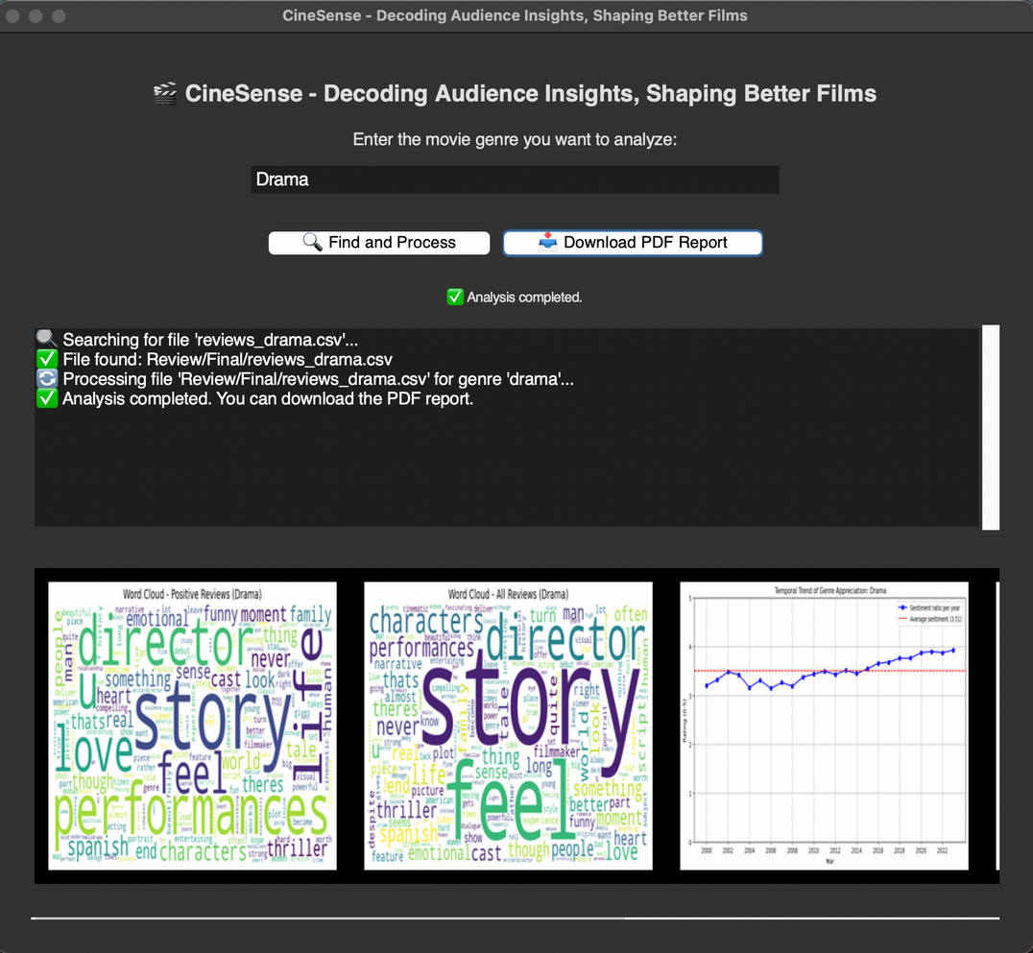
The Application
Notes:
This is the user interface of our application, designed to provide an intuitive experience for analyzing audience feedback.
At the top, users can input the movie genre they want to analyze. In this example, we’ve selected “Drama.” This allows us to focus on genre-specific insights, ensuring more relevant and actionable feedback.
By clicking on “Find and Process,” the application automatically searches for the corresponding dataset, as shown by the progress log on the left. It displays real-time updates, including:
- File discovery and loading confirmation.
- Processing status.
- Notification when the analysis is complete.
Once the analysis is done, users can download a detailed PDF report by clicking the corresponding button. This report contains in-depth insights, including sentiment trends, key topics, and audience concerns, providing strategic guidance for filmmakers and marketers.
At the bottom, we provide visualizations, like:
- Word Clouds: Displaying the most frequently mentioned words in positive and negative reviews, giving a clear view of what resonates—or doesn’t—with the audience.
- Also we can see the Sentiment Trend Chart: it showing how audience sentiment for the selected genre has evolved over time, helping users identify emerging trends and shifts in viewer preferences.
This user-friendly interface empowers filmmakers, producers, and marketers to make data-driven decisions by transforming complex audience feedback into clear, actionable insights.

Slide 9

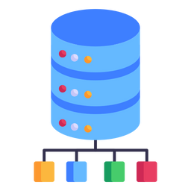
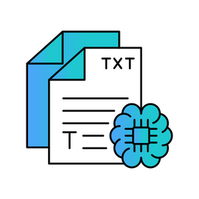





Workflow
First Impact Graphs
Movie Genre Input
Text Preprocessing
PDF download
Recovery Reviews
Gemini API
Report
Notes:
This slide illustrates the step-by-step process that powers our application, from the initial input to the final output.
1-It all begins with the user entering the movie genre they wish to analyze. (This allows us to focus on genre-specific insights, ensuring more relevant and actionable feedback.)
2- Once the genre is selected, CineSense retrieves audience reviews from our extensive database.
3- Before analyzing the data, we perform text preprocessing. This involves:
- Cleaning the text and
Tokenizing the reviews into words or phrases
4- After preprocessing, we generate first impact graphs to provide an initial overview of the data. These visualizations give a quick snapshot of the audience’s overall sentiment and highlight key themes.
5- Next, we leverage the power of the Gemini API.
Using advanced Natural Language Processing (NLP) and Machine Learning, the API conducts in-depth sentiment analysis and topic extraction.
It maintains contextual coherence across long reviews, ensuring accurate and nuanced sentiment detection.
6- The extracted insights are then compiled into a comprehensive report that includes:
- Detailed sentiment analysis.
- Topic modeling results to identify key themes.
- and Strategic recommendations tailored to the selected genre.
7- Finally, users can download a detailed PDF report, which serves as a strategic guide for filmmakers and marketers, helping them make informed, data-driven decisions.

Slide 10
Results
🎯
📑
🎬
Our sentiment analysis, powered by Gemini AI, achieved high accuracy: 93% for Drama, 97% for Comedy, and 89% for Action. The model effectively captures audience sentiment across different genres.
Topic extraction revealed key insights: Drama reviews focus on emotional depth and pacing, Action movies on intensity vs. predictability, and Comedy films on humor consistency. These findings help studios refine storytelling, marketing, and audience engagement.
CineSense analyzes audience sentiment and key themes in reviews, helping filmmakers refine storytelling, enhance production, and tailor marketing strategies. With AI-driven sentiment analysis and topic modeling, it provides data-driven insights to optimize a film’s success.

Slide 11
Conclusions
1
2
3
AI-Driven Sentiment Analysis
Topic Extraction & Strategic Insights
Business & Marketing Impact
CineSense leverages advanced LLMs to accurately analyze audience sentiment across different film genres, achieving high validation accuracy and providing filmmakers with valuable insights into audience perception.
By identifying key discussion topics in reviews, CineSense helps studios understand what resonates with viewers and what needs improvement, supporting better storytelling and production choices.
The AI-generated reports offer data-driven recommendations that enable filmmakers, producers, and marketers to refine their marketing strategies, optimize audience engagement, and maximize a film’s commercial success.

Slide 12
Business & Project Management
21 February 2025
Thank you
Martina Fabiani
Tommaso Falaschi
Rossana Antonella Sacco

