Slide 1
Java: A Beginer’s Guide for intermediate students

Slide 2
Introduction to programming
Chapter -1

Slide 3
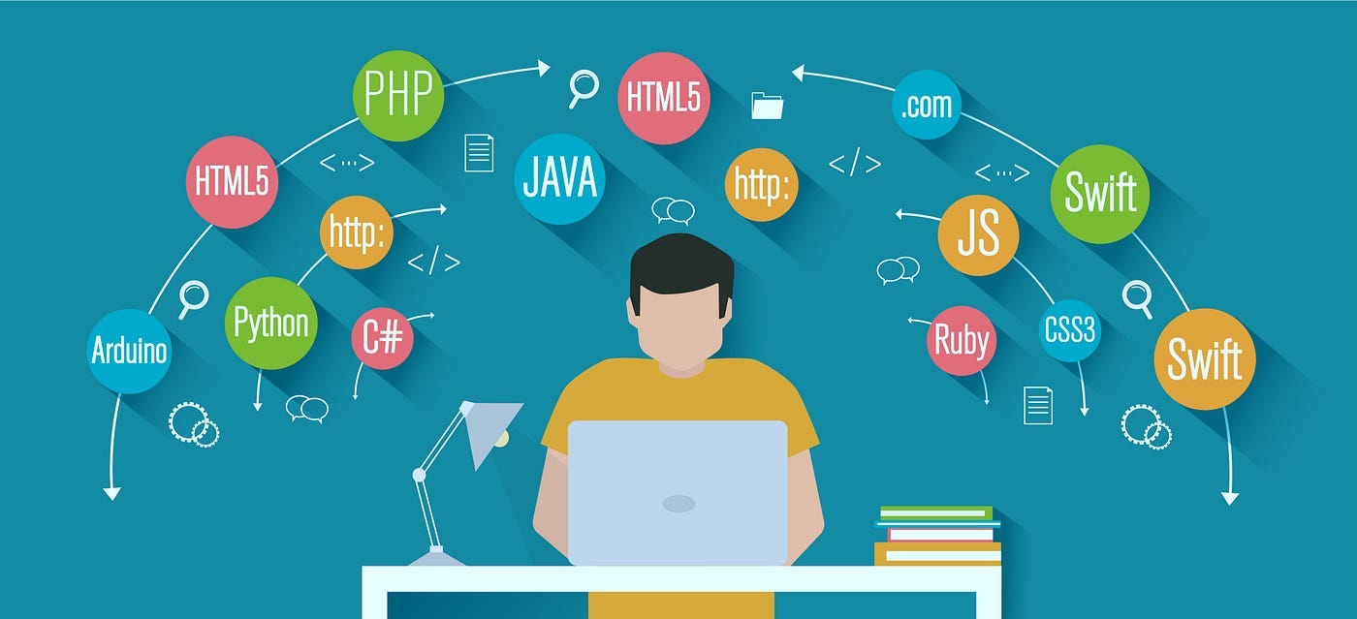
Programming Definition:- Programming Is Writing Computer Code To Create A Program, To Solve A Problem. Programs Are Created To Implement Algorithms . Algorithms Can Be Represented As Pseudocode Or A Flowchart , And Programming Is The Translation Of These Into A Computer Program.
What is a Programming Language?
A programming language is a computer language that is used by programmers (developers) to communicate with computers. It is a set of instructions written in any specific language ( C, C++, Java, Python) to perform a specific task.
A programming language is mainly used to
develop desktop applications, websites,
and mobile applications.
There are many different programming languages
Ex :-
Python , Java , C ,C++, R, Ruby etc.

Slide 4
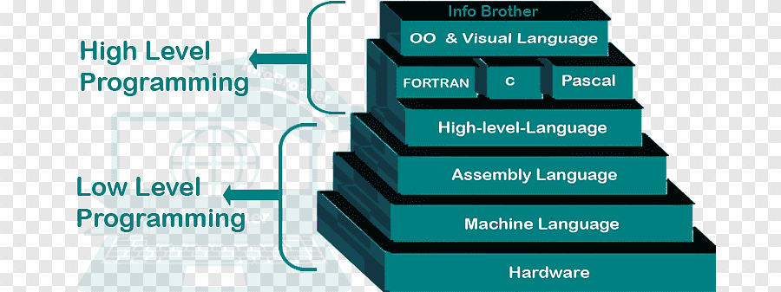
Types of programming language
1. Low-level programming language
Low-level language is machine-dependent (0s and 1s) programming language. The processor runs low- level programs directly without the need of a compiler or interpreter, so the programs written in low-level language can be run very fast.
2. High-level programming language
High-level programming language (HLL) is designed for developing user-friendly software programs and websites. This programming language requires a compiler or interpreter to translate the program into machine language (execute the program).
The main advantage of a high-level language is that it is easy to read, write, and maintain.
High-level programming language includes Python, Java, JavaScript, PHP, C#, C++, Objective C, Cobol, Perl, Pascal, LISP, FORTRAN, and Swift programming language.

Slide 5

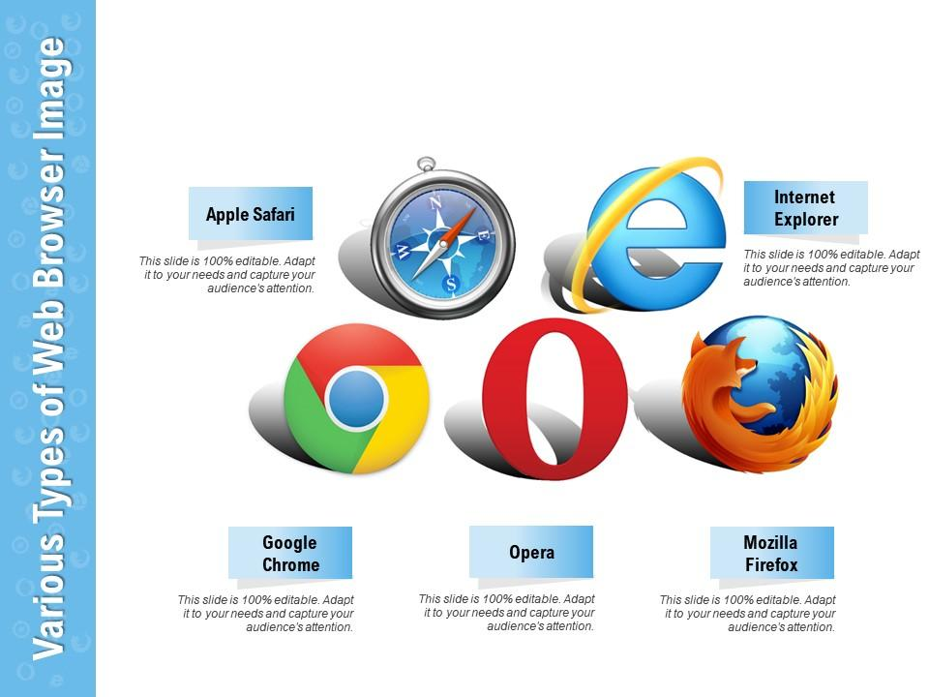
Importance of programming
How Programming is used in daily life
Programming is used in numerous ways in our daily lives, often without us even realizing it. Here are some common examples of how programming impacts our daily lives:
Mobile Apps:
The mobile apps we use for communication, social media, entertainment, productivity, fitness, and more are developed through programming. Programmers write code to create these apps and ensure their functionality.
Web Browsing:
When we browse the internet, programming languages like HTML, CSS, and JavaScript are used to create websites and web pages. Programming enables I nteractive web features, online shopping, streaming services, and information retrieval

Slide 6

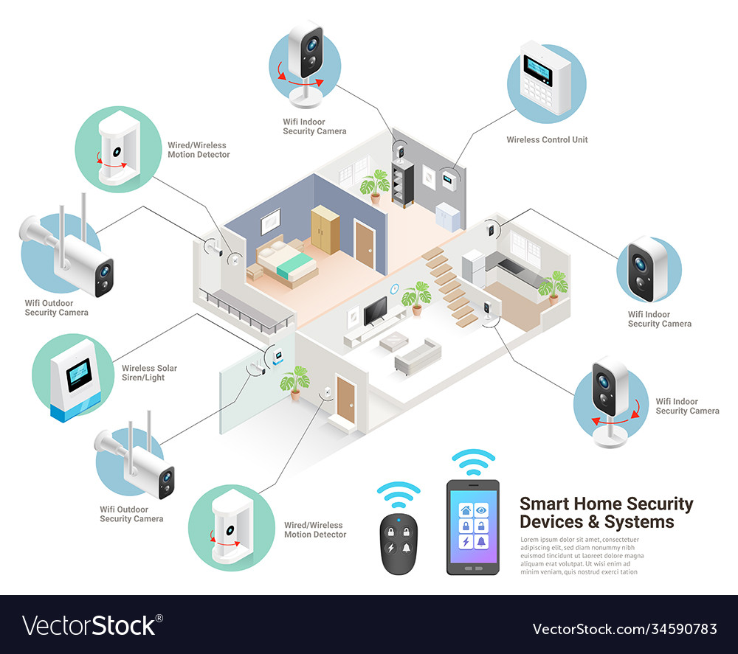
Online Services:
Online services such as email, online banking, e-commerce platforms, and cloud storage rely on programming to provide secure and reliable functionalities. Programmers develop and maintain the backend systems that power these services.
Smart Home Devices:
Programming enables the automation and control of smart home devices like thermostats, lights, security systems, and voice assistants. These devices are programmed to respond to specific commands or triggers.

Slide 7

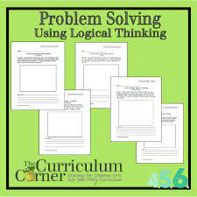

Why we have to learn Programming languages
Building software and applications: Programming languages are the primary tools used to create software and applications. They provide the means to write instructions that a computer can understand and execute. By learning programming languages, you gain the ability to develop your own programs and bring your ideas to life.
2.Problem-solving and logical thinking: Programming languages encourage and develop problem-solving skills. They teach you how to break down complex problems into smaller, manageable tasks and devise logical solutions. This analytical thinking can be valuable in various areas of life, not just in programming
3.Automation and efficiency: Programming languages allow you to automate repetitive tasks and increase efficiency. By writing scripts or programs, you can automate processes, such as data analysis, file manipulation, or system administration, which would otherwise require manual effort. This can save time and improve productivity in many domains.

Slide 8
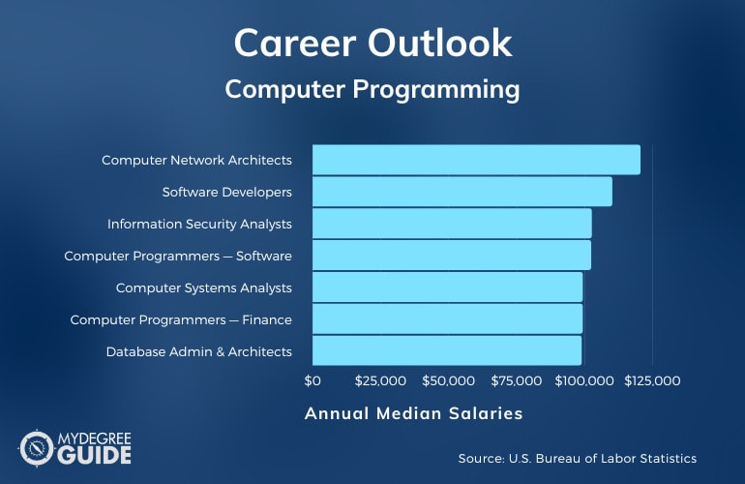
4.Career opportunities: Programming skills are highly sought after in today's job market. Many industries, including technology, finance, healthcare, and entertainment, require professionals with programming knowledge. Learning programming languages can open doors to a wide range of career opportunities and enhance your employability.
5.Understanding technology: Programming languages are the backbone of modern technology. By learning how to code, you gain a deeper understanding of how computers and software work. This knowledge enables you to make informed decisions when using technology and equips you with the skills to adapt to new technologies as they emerge.
6.Collaboration and communication: Programming languages provide a common language for developers to communicate and collaborate. When working on team projects, knowing a programming language allows you to understand and contribute to the codebase effectively. It facilitates effective communication with other developers, leading to better teamwork and more efficient development processes.
7.Creativity and innovation: Programming languages provide a creative outlet, allowing you to bring your ideas to fruition. They enable you to create new tools, applications, or even artistic projects. Learning programming languages empowers you to express your creativity and explore innovative solutions to problems.

Slide 9
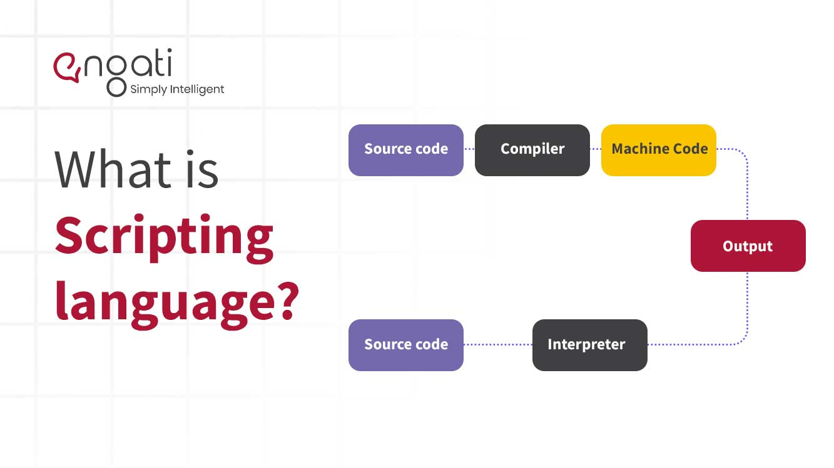
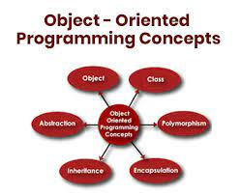
Different Types of Progrmming languages
There are numerous programming languages available, each designed with specific purposes and varying levels of popularity. Here are some of the different types of programming languages:
Scripting Languages: Scripting languages are used for automating tasks and writing scripts to control software applications. They are often interpreted rather than compiled. Examples include Python, Perl, Ruby, and PowerShell.
Object-Oriented Programming (OOP) Languages: Object-oriented programming languages focus on organizing code around objects, which are instances of classes that encapsulate data and behavior. Examples include Java, C++, Python, and Ruby.

Slide 10
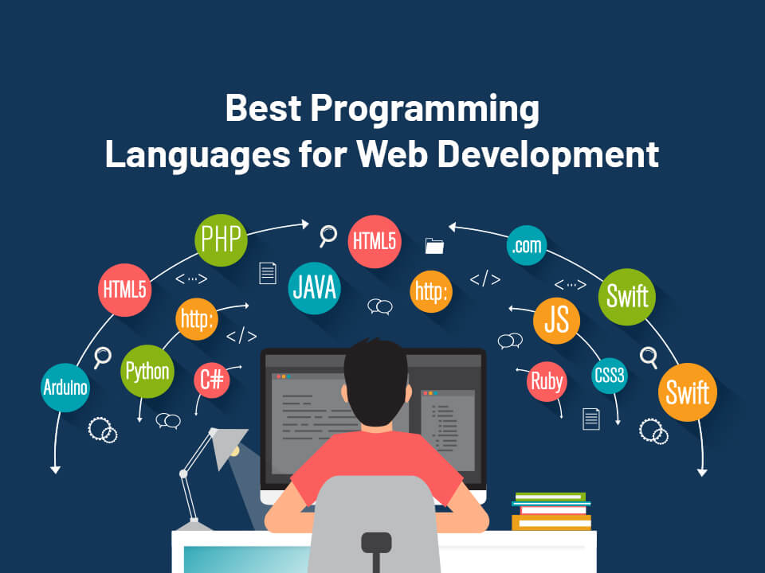
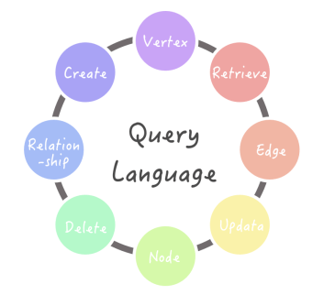
Procedural Programming Languages: Procedural languages emphasize a step-by-step approach to problem-solving, with code organized into procedures or functions. Examples include C, Pascal, Fortran, and BASIC.
Web Development Languages: These languages are specifically designed for web development, including creating websites, web applications, and web services. Examples include HTML, CSS, JavaScript, PHP, and Ruby (with Ruby on Rails).
Database Query Languages: Database query languages are used to interact with and retrieve data from databases. SQL (Structured Query Language) is the most common query language, used with relational databases.

Slide 11
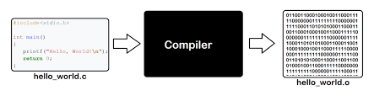
COMPILER AND EDITOR
Compiler:
A compiler is a software program that translates source code written in a programming language into a lower-level language or machine code that can be executed directly by a computer.
Examples of different compilers
C/C++:
- GCC (GNU Compiler Collection)
- Clang
Java:
- Java Development Kit (JDK) compiler (javac)
Python:
- CPython (the reference implementation)
- PyPy
- Cython
JavaScript:
- Google Closure Compiler
Babel
C#:
- Microsoft Visual C# Compiler (part of .NET Framework)
Swift:
Swift Compiler (part of Xcode)
PHP:
- Zend Engine (interpreter)
- HipHop Virtual Machine (HHVM

Slide 12
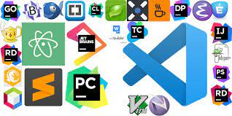
Editor:
An editor is a software tool used for creating and modifying source code files. It provides an interface for developers to write, edit, and manage their code efficiently. Code editors often come with features like syntax highlighting, auto-indentation, code completion, and debugging capabilities.
Examples of different Editors:
.Visual studio code
Sublime text
Atom
Visual Studio
IntellijJ IDEA
Pycharm
Eclipse
Xcode
NetBeans
Vim

