Slide 1
INTORDUCTION TO JAVA PROGRAMMING
CHAPTER - 2

Slide 2
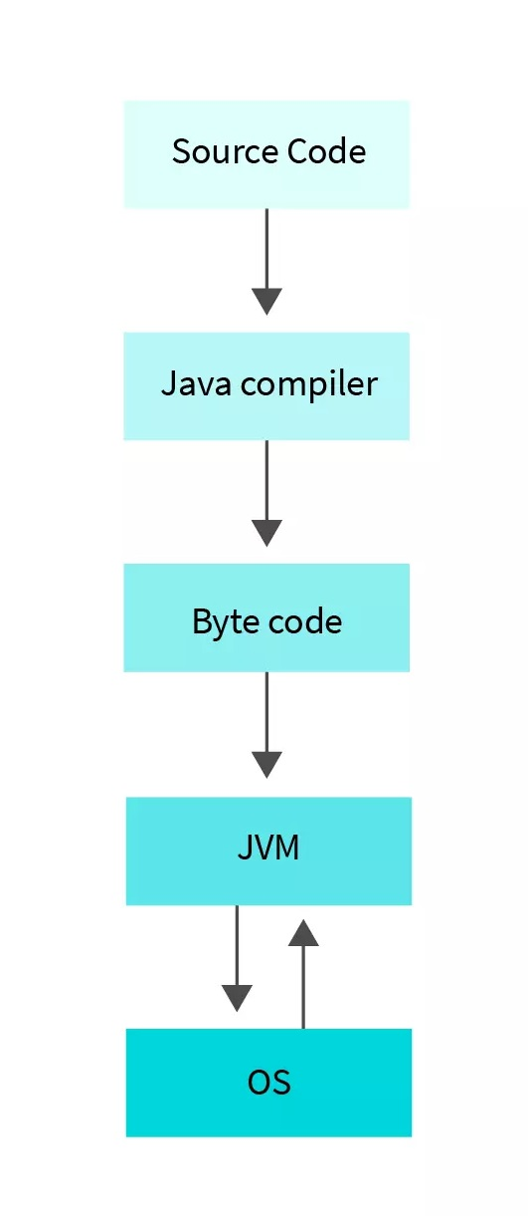
Introduction
Java is a high-level, general-purpose programming language developed by Sun Microsystems (now owned by Oracle Corporation).
It was first released in 1995 and has since become one of the most popular programming languages worldwide.
Object-oriented and platform-independent Widely used for developing various applications While most modern
Java applications combine the Java runtime and application together, there are still many applications and even some websites that will not function unless you have a desktop Java installed.
Java.com, this website, is intended for consumers who may still require Java for their desktop applications – specifically applications targeting Java 8.

Slide 3
Purpose of Java
Platform Independence: One of the primary purposes of Java is its ability to run on different platforms without requiring modifications.
Object-Oriented Programming: Java promotes the use of object-oriented programming (OOP) principles, such as encapsulation, inheritance, and polymorphism.
Robust and Secure Software: Java emphasizes reliability, robustness, and security in software development. The language includes features such as exception handling, strong type checking, and automatic memory.
Scalability and Performance: Java is designed to support the development of scalable applications. The Java Virtual Machine optimizes code execution,

Slide 4
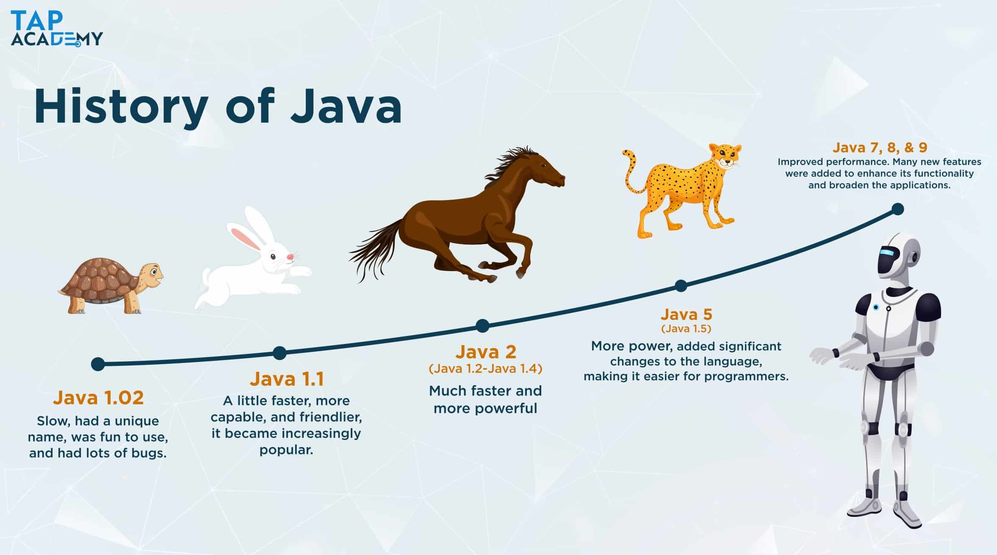
HISTORY OF JAVA
Development: Java was initially developed by James Gosling and his team at Sun Microsystems (later acquired by Oracle Corporation) in the early 1990s.
The project, initially named "Oak," aimed to create a programming language for consumer electronics. However, it later shifted focus to internet programming.

Slide 5
Public Release: The first public release of Java, called Java 1.0, took place in 1996.
Java Standard Edition (Java SE): Sun Microsystems introduced the Java SE platform, initially called Java 2 Standard Edition (J2SE), as a major upgrade in 1998.
Java Enterprise Edition (Java EE): In 1999, Java EE (previously known as Java 2 Enterprise Edition or J2EE) was introduced, targeting enterprise-level application development.
Open Sourcing: In 2006, Sun Microsystems released the Java Development Kit (JDK) under the GNU General Public License (GPL) as an open-source project known as OpenJDK.

Slide 6
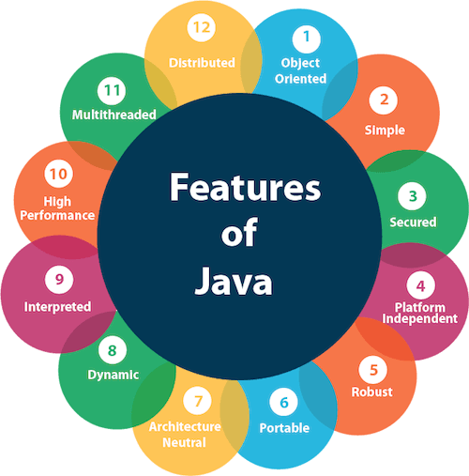
Features of Java
The primary objective of Java programming language creation was to make it portable, simple and secure programming language. Apart from this, there are also some excellent features which play an important role in the popularity of this language. The features of Java are also known as Java buzzwords.

Slide 7
Simple
Object Oriented
Java is very easy to learn, and its syntax is simple, clean and easy to understand. According to Sun Microsystem, Java language is a simple programming language because:
Java syntax is based on C++ (so easier for programmers to learn it after C++).
Java has removed many complicated and rarely-used features, for example, explicit pointers, operator overloading, etc.
There is no need to remove unreferenced objects because there is an Automatic Garbage Collection in Java
Java is an object-oriented programming language. Everything in Java is an object. Object-oriented means we organize our software as a combination of different types of objects that incorporate both data and behavior.
Object-oriented programming (OOPs) is a methodology that simplifies software development and maintenance by providing some rules.
Basic concepts of OOPs are:
Object
Class
Inheritance
Polymorphism
Abstraction
Encapsulation

Slide 8
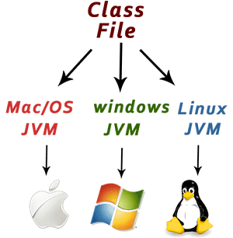
Platform Independent
Java is platform independent because it is different from other languages like C, C++, etc. which are compiled into platform specific machines while Java is a write once, run anywhere language. A platform is the hardware or software environment in which a program runs.

Slide 9
Secured
Java is best known for its security. With Java, we can develop virus-free systems. Java is secured because:
No explicit pointer
Java Programs run inside a virtual machine sandbox
Robust
The English mining of Robust is strong. Java is robust because:
It uses strong memory management.
There is a lack of pointers that avoids security problems.
Java provides automatic garbage collection which runs on the Java Virtual Machine to get rid of objects which are not being used by a Java application anymore.
There are exception handling and the type checking mechanism in Java. All these points make Java robust.

Slide 10
Architecture-neutral
Java is architecture neutral because there are no implementation dependent features, for example, the size of primitive types is fixed.
In C programming, int data type occupies 2 bytes of memory for 32-bit architecture and 4 bytes of memory for 64-bit architecture. However, it occupies 4 bytes of memory for both 32 and 64-bit architectures in Java
Portable
Java is portable because it facilitates you to carry the Java bytecode to any platform. It doesn't require any implementation.
High-performance
Java is faster than other traditional interpreted programming languages because Java bytecode is "close" to native code. It is still a little bit slower than a compiled language (e.g., C++). Java is an interpreted language that is why it is slower than compiled languages, e.g., C, C++, etc.

