Slide 1


Android Basics

Slide 2
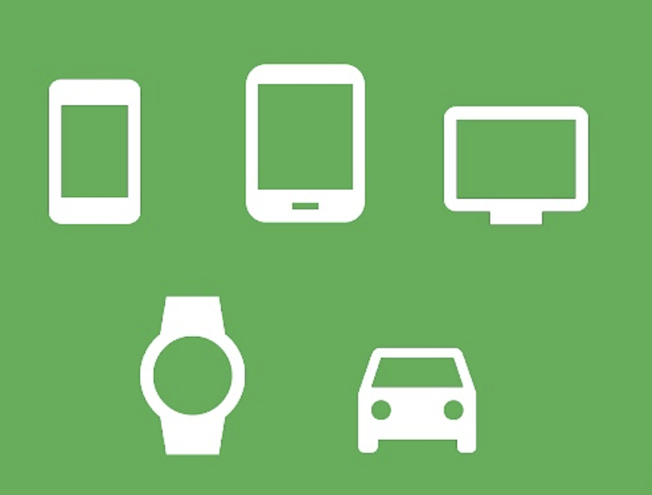
Intro – Android
What is Android?
A mobile operating system based on a modified Linux kernel and other open-source software, designed primarily for touchscreen mobile devices such as smartphones and tablets
Free & open-source software; its source code is known as the Android Open Source Project (AOSP), licensed under the Apache License
Variants of Android on a range of other electronics have been developed, such as game consoles, digital cameras, portable media players, PCs and others, each with a specialized user interface
Well known derivatives: Android TV, Wear OS (wearables), Android Auto, Android Things (IOT), all developed by Google.
Notes:
1
1
1

Slide 3
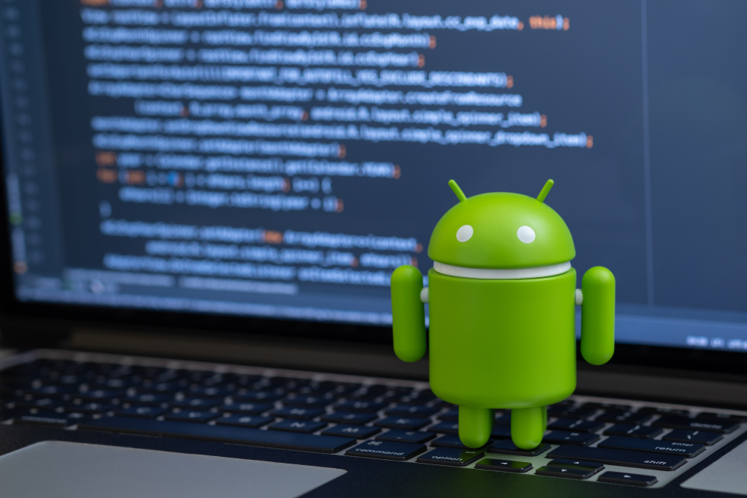
Intro – Android
Why develop for Android?
Best-selling OS worldwide on smartphones since 2011 and on tablets since 2013
As of May 2017, it has over two billion monthly active users, the largest installed base of any operating system
As of January 2021, the Google Play Store features over 3 million apps
The Android SDK includes various software libraries, a debugger, a device emulator, documentation and sample code, making it easy to create apps that look great and take advantage of hardware capabilities
Notes:
2
2
2

Slide 4
Intro – Android
The challenges
The real world is multi-screen
Devices come in different sizes and shapes, which affects how you design the screens and UI elements in your apps
Device manufacturers may add their own UI elements, styles, and colors to differentiate their products
App performance matters
Performance = how fast it runs, how easily it connects to the network and how well it manages battery and memory usage
Some features you design for your app may cause performance problems for users
Compatibility
Android continues to improve and provide new features you can add to your apps
Ensure that your app can still run on devices with older versions of Android
Not feasible to focus only on the most recent Android version, fragmentation is still an issue
Notes:
3
3
3

Slide 5

Intro – IDE
Meet Android Studio
Android Studio is the official Integrated Development Environment (IDE) for Android app development, based on IntelliJ IDEA. Features include:
A flexible Gradle-based build system
A fast and feature-rich emulator
A unified environment where you can develop for all Android devices
Code templates
Extensive testing tools and frameworks
Lint tools to catch performance, usability, version compatibility, and other problems
C++ and NDK support
Notes:
4
4
4

Slide 6

Intro – Build
The Android build system
The Android build system compiles app resources and source code, and packages them into APKs that you can test, deploy, sign, and distribute
Android Studio uses Gradle to automate and manage the build process
Gradle is a build automation tool for multi-language software development
Gradle operates based on a series of build tasks that can run serially or in parallel
Notes:
5
5
5

Slide 7
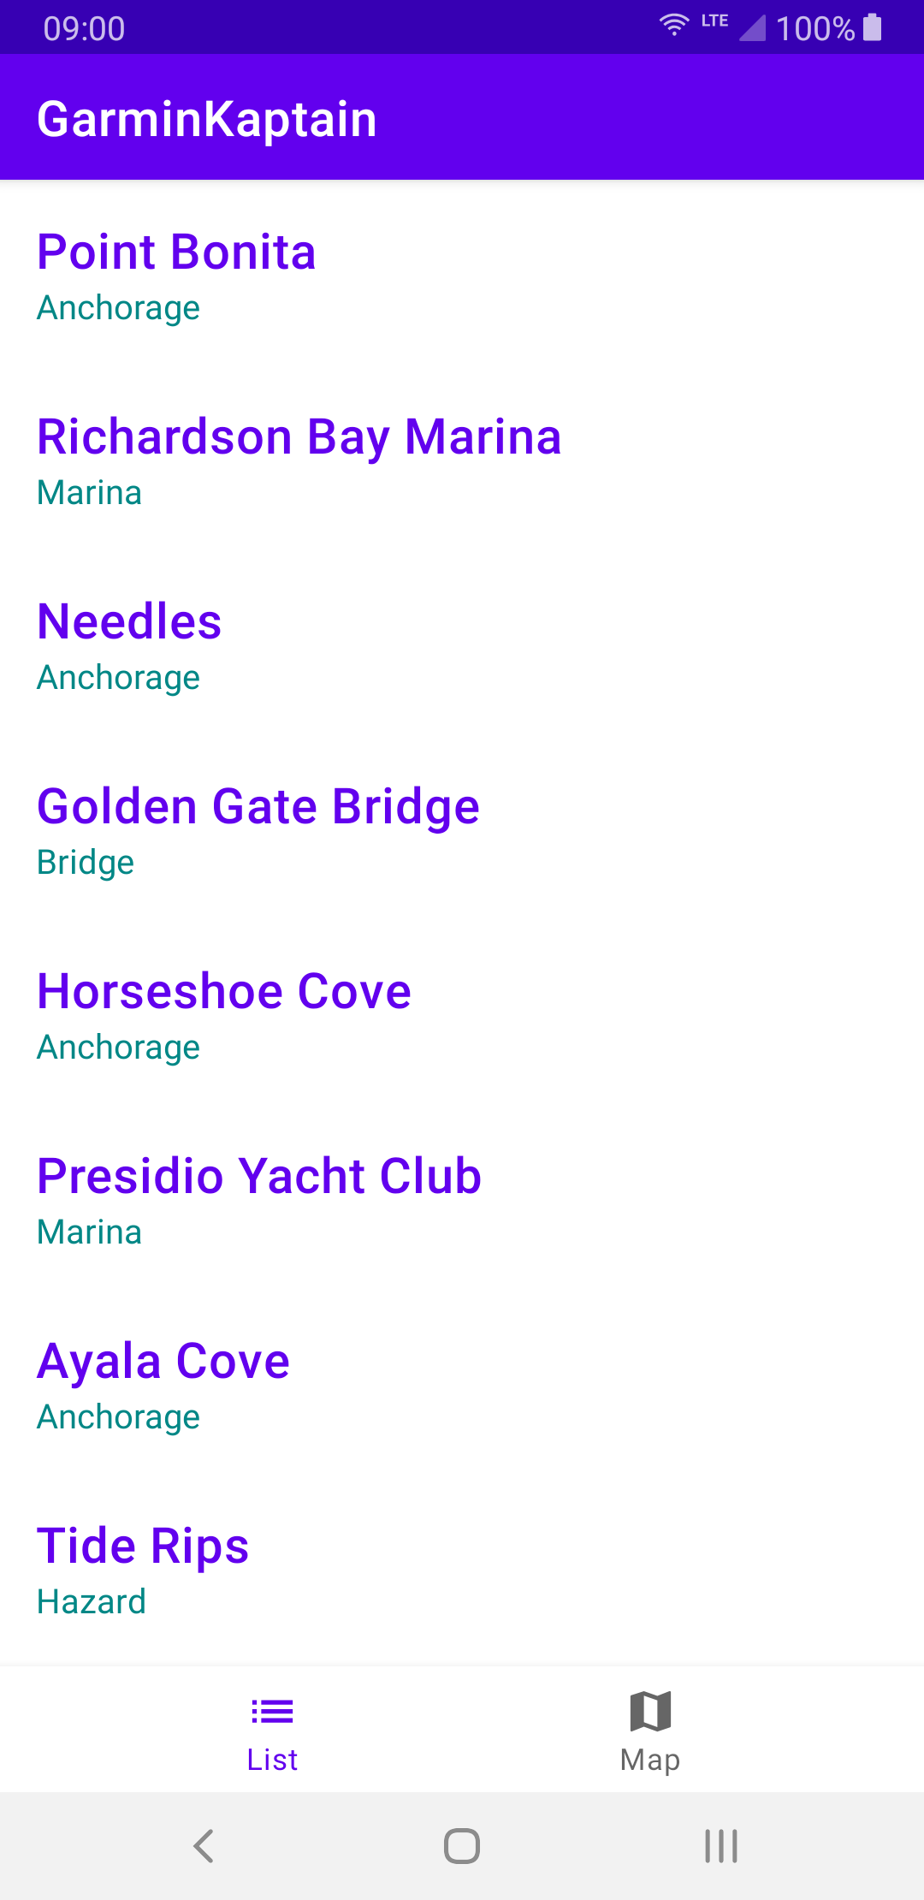
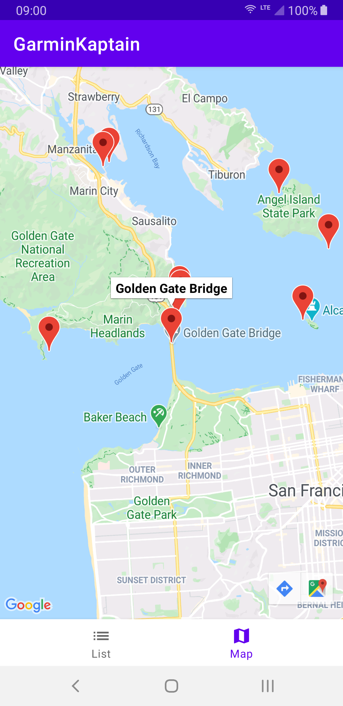
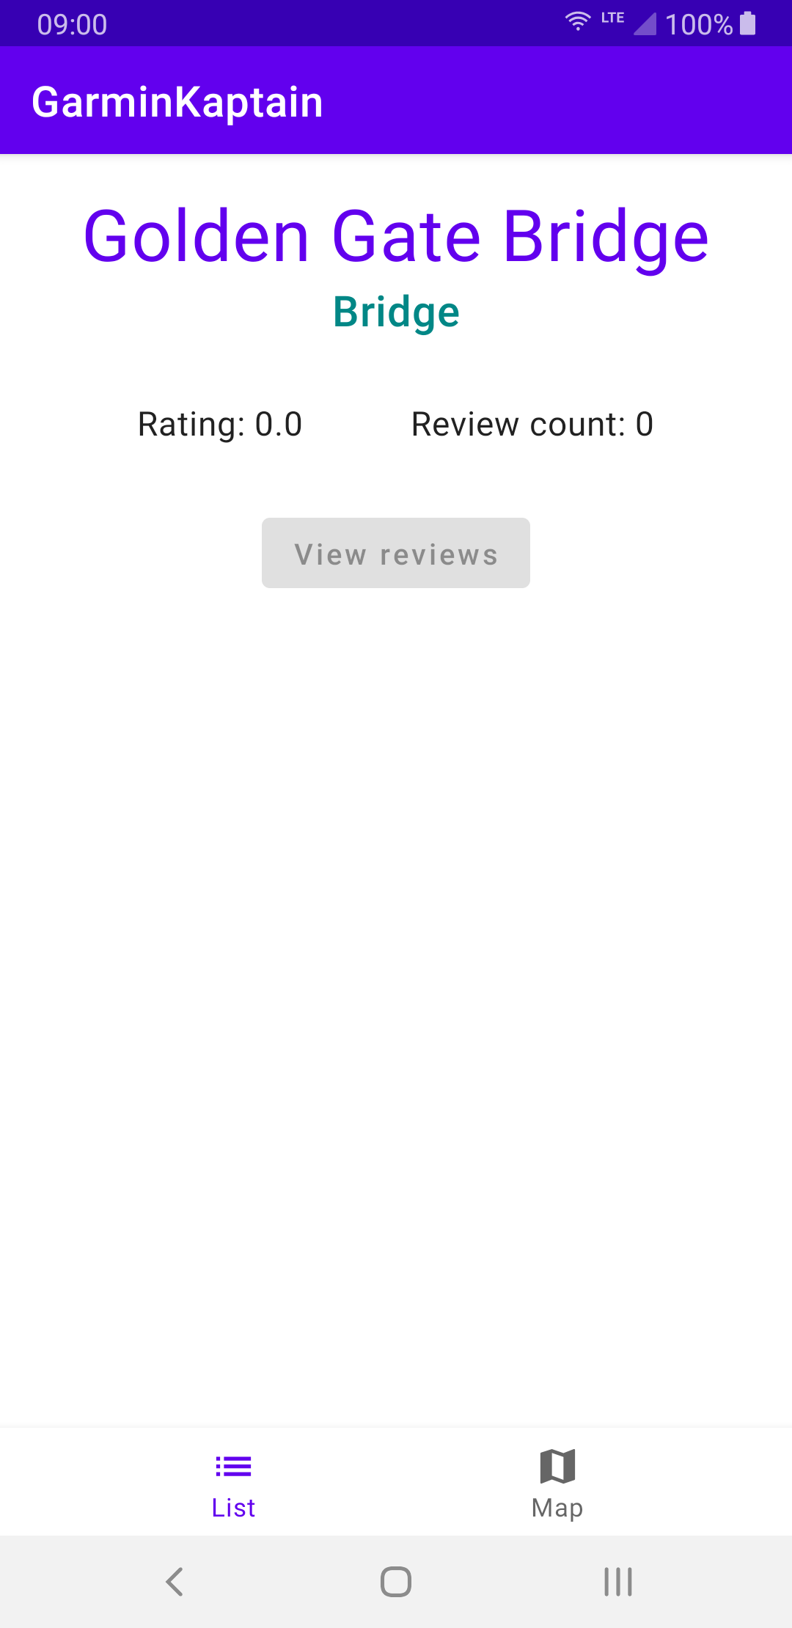
Intro – GarminKaptain
Meet “GarminKaptain”
A simple app allowing users to discover different points of interest (POIs).
POIs displayed in both a List and Map view
Details of each POI in a dedicated screen
Notes:
6
6
6

Slide 8
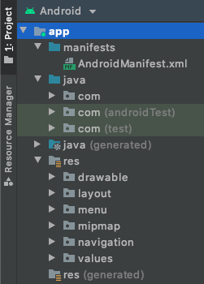
Intro – Project
Android Project Structure
Each project in Android Studio contains one/more modules with source code files and resource files. Module types:
Android app modules
Library modules
By default, Android Studio displays your project files in the Android project view which is organized by modules to provide quick access to your project's key source files
Each app module contains the following folders:
manifests: Contains the AndroidManifest.xml file which describes essential information about your app to the Android build tools, the Android operating system and Google Play
java: Contains the Java/Kotlin source code files + JUnit test code
res: Contains all non-code resources, such as XML layouts, UI strings and bitmap images
Notes:
7
7
7

Slide 9
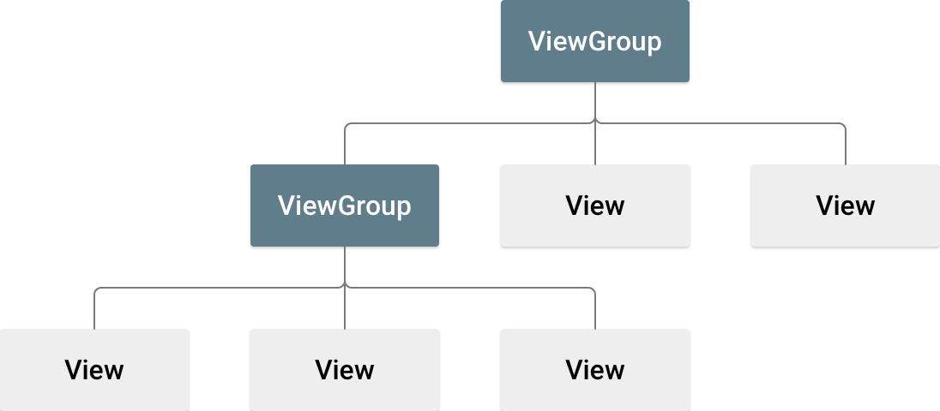
UI – Views
Views
The UI for an Android app consists of a hierarchy of objects called views — every element of the screen is a View
View = basic building block for all UI components; base class for classes that provide interactive UI components (buttons, checkboxes, text entry fields)
A View has a location (left and top coordinates) and two dimensions (width and height). The unit for location and dimensions is the density-independent pixel (dp).
Hundreds of predefined View subclasses:
TextView (displaying text)
EditText (editing text)
Button (interactive behavior)
ImageView (displaying images)
View elements (children) can be grouped inside a ViewGroup (parent), which acts as a container:
ConstraintLayout: places UI elements using constraint connections to other elements and to the layout edges
RecyclerView: contains a list of other View elements or ViewGroup groups and enables scrolling them by adding and removing View elements dynamically from the screen
Notes:
8
8
8

Slide 10

UI – Layouts
Layout files
Layout files are used to define the UI structure by building a hierarchy of View objects
You usually declare layouts in XML, allowing you to separate the presentation of your app from the code that controls its behavior
Each layout file must contain exactly one root element, which must be a View
Once you've defined the root element, you can add additional layout objects or widgets as child elements to gradually build a View hierarchy that defines your layout.
At compilation, each XML layout file is compiled into a View - you load the layout resource from your app code
Every View and ViewGroup object supports their own variety of XML attributes
LinearLayout
ViewGroup that aligns all children in a single direction, vertically or horizontally
You specify the layout direction with the android:orientation attribute
Notes:
9
9
9

Slide 11
UI – Activity & Fragment
Introduction to Activities and Fragments
The Activity class is a crucial component of an Android app
An activity represents a single screen in your app with an interface the user can interact with
Unlike programming paradigms in which apps are launched with a main() method, the Android system initiates code in an Activity instance by invoking specific callback methods
Typically, one activity in an app is specified as the main activity, which is the first screen to appear when the user launches the app
A Fragment represents a reusable portion of your app's UI
Fragments cannot live on their own--they must be hosted by an activity (or another fragment)
The fragment’s view hierarchy becomes part of, or attaches to, the host’s view hierarchy
Activities are an ideal place to put global elements around your app's user interface (such as a bottom nav)
Fragments are better suited to define and manage the UI of a single screen (or portion of a screen).
Notes:
10
10
10

Slide 12
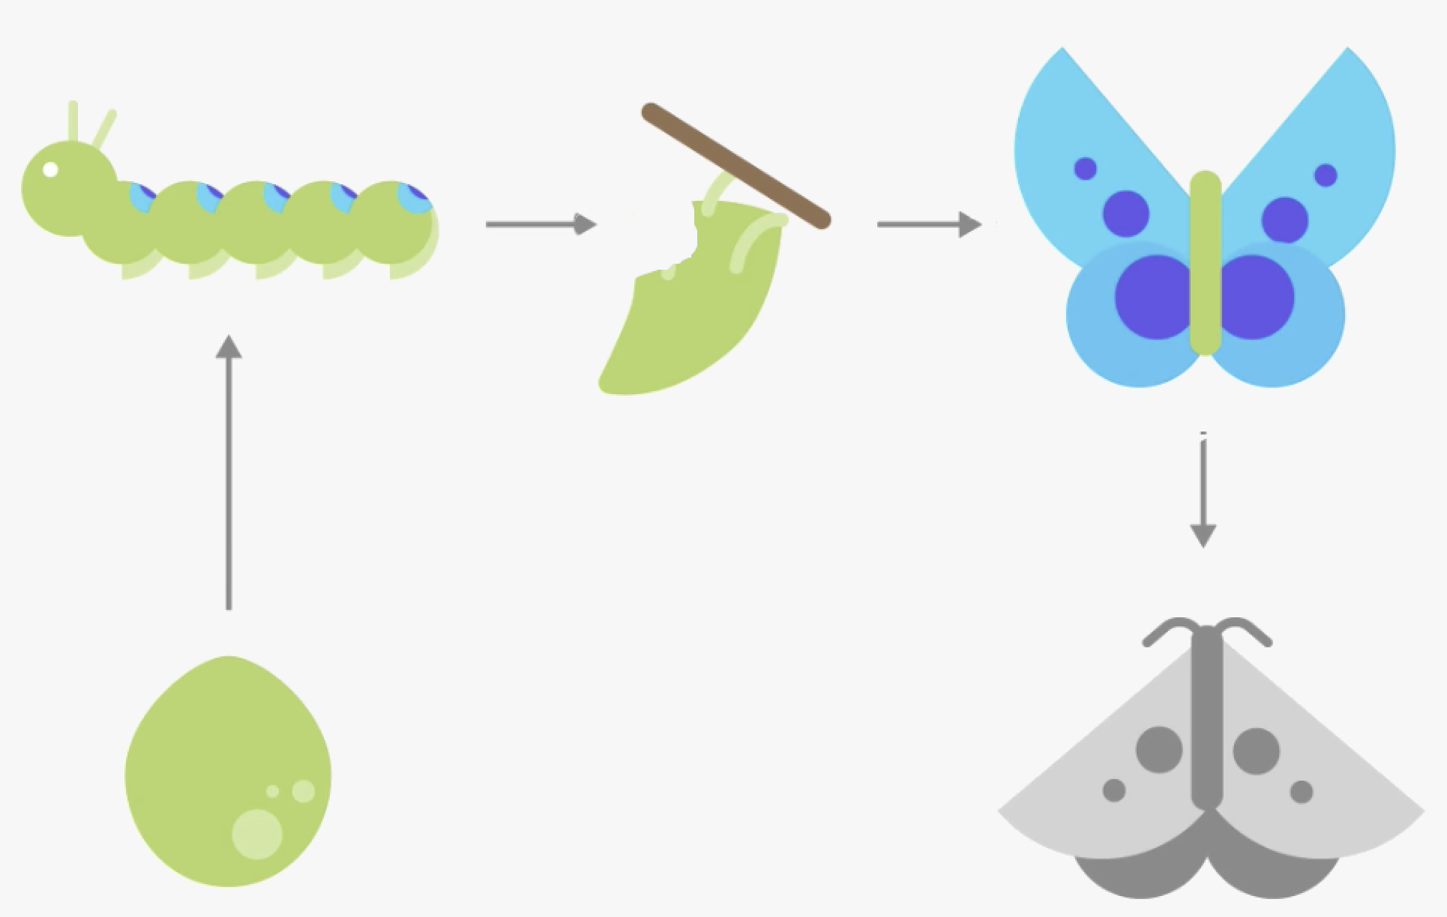
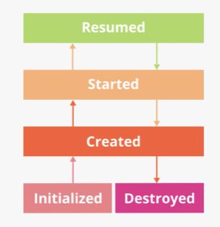
UI – Activity Lifecycle
What is the Activity Lifecycle?
Every activity (and fragment) has what is known as a lifecycle
This is an allusion to animal lifecycles, like the lifecycle of a butterfly - the different states of the butterfly show its growth from birth to fully formed adulthood to death
Similarly, the activity lifecycle is made up of the different states that an activity can go through, from when the activity is first initialized to when it is finally destroyed and its memory reclaimed by the system
As the user starts your app, navigates between activities, navigates inside and outside of your app, and leaves your app, the activity changes state
Notes:
11
11
11

Slide 13
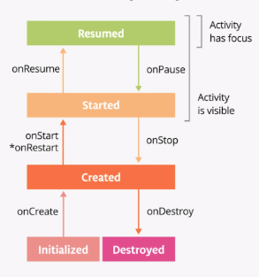
UI – Activity Lifecycle
Exploring the Activity Lifecycle
Often, you want to run some code when the activity lifecycle state changes
The Activity class implements a set of lifecycle callback methods, invoked by Android when the activity moves from one state to another
You can override those methods in your own activities to perform tasks in response to those lifecycle state changes
onCreate(): called once, just after the activity is initialized (new Activity object is created in memory)
onStart(): your activity is visible on the screen (can be called many times in the lifecycle of your activity)
onResume(): the activity gains the user focus, and is fully on-screen
onPause(): the activity loses focus
onStop(): your activity is no longer visible on the screen
onDestroy(): the activity was fully shut down and can be garbage-collected (called once during the lifetime of a single activity, just like onCreate())
Notes:
12
12
12

Slide 14
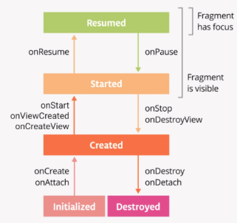
UI – Fragment Lifecycle
Exploring the Fragment Lifecycle
The Android fragment lifecycle is similar to the Activity lifecycle, plus several specific methods:
onAttach(): called when the fragment is associated with its owner activity
onCreate(): similar to the activity, it is called to do initial fragment creation (other than layout)
onCreateView(): called to inflate the fragment's layout
onViewCreated(): called immediately after onCreateView()
onStart(): called when the fragment becomes visible; parallel to the activity's onStart()
onResume(): the fragment gains the user focus (parallel to the activity's onResume())
onPause(): the fragment loses the user focus
onStop(): the fragment is no longer visible
onDestroyView(): the fragment's view is no longer needed (view resource cleanup)
onDestroy(): reached the end of its lifecycle
onDetach(): fragment detached from its host
Notes:
13
13
13

Slide 15
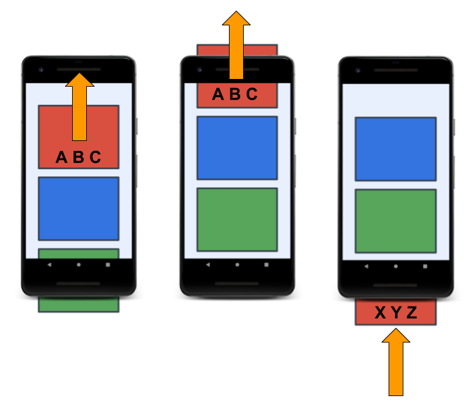
UI – RecyclerView
Why RecyclerView?
Almost every single app has at least one list (call history screen, contacts app, social media app)
Some apps display a simple list of words or phrases, where others display more complex items such as cards that include text and images
No matter what the content is, displaying a list of data is one of the most common UI tasks in Android
For this, Android provides the RecyclerView, which is very efficient, even with large lists, by reusing (recycling) the views that have scrolled off the screen
When a list item is scrolled off the screen, RecyclerView reuses that view for the next list item about to be displayed
Notes:
14
14
14

Slide 16
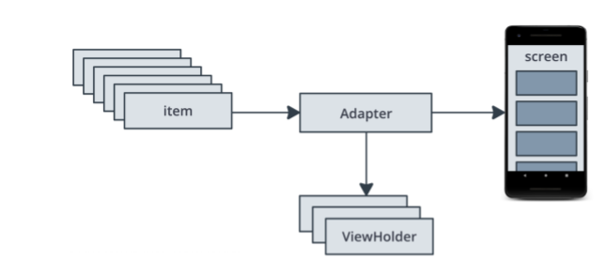
UI – RecyclerView
RecyclerView components
There are a number of pieces involved in creating and using a RecyclerView
Think of them as a division of labor:
Item - one data item of the list to display
Adapter – takes data and prepares it for RecyclerView to display
ViewHolders - a pool of views for RecyclerView to use and reuse to display items
RecyclerView - views on screen
Notes:
15
15
15

Slide 17
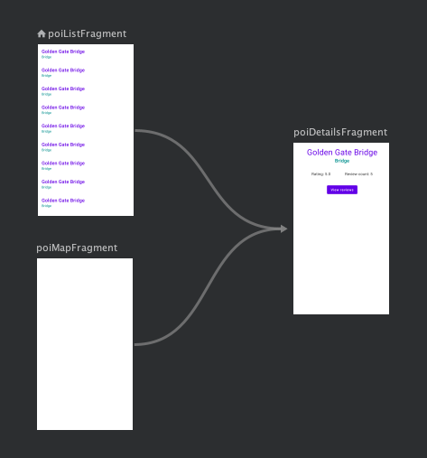
UI – Navigation
Meet Navigation Component
Navigation refers to the interactions that allow users to navigate across, into, and back out from the different pieces of content within your app.
Android Jetpack is a suite of libraries to help developers follow best practices, reduce boilerplate code, and write code that works consistently across Android versions and devices so that developers can focus on the code they care about.
Android Jetpack's Navigation Component helps you implement navigation, from simple button clicks to more complex patterns, such as app bars and the navigation drawer. The Navigation component also ensures a consistent and predictable user experience by adhering to an established set of principles.
Notes:
16
16
16

Slide 18
UI – Navigation
Nav Component - Key parts
The Navigation Component consists of three key parts that are described below:
Navigation Graph: an XML file that provides a visual representation of navigation in your app. The file consists of destinations which correspond to individual activities/fragments as well as actions between them, which can be used in code to navigate from one destination to another.
NavHost: used to display destinations form a navigation graph within an activity. When you navigate between fragments, the destination shown in the NavHost is updated. There is a built-in implementation, called NavHostFragment.
NavController: an object that manages app navigation within a NavHost. The NavController orchestrates the swapping of destination content in the NavHost as users move throughout your app.
Notes:
17
17
17

Slide 19
UI – BottomNav
BottomNavigationView
Represents a standard bottom navigation bar for an application.
Bottom navigation bars make it easy for users to explore and switch between top-level views in a single tap.
The bar contents can be populated by specifying a menu resource file.
Each menu item title, icon and enabled state will be used for displaying bottom navigation bar items.
Notes:
18
18
18

Slide 20

The End
Thank you!
Notes:
19
19
19

