Slide 1
Robot inverse pendulum
Requirements management | 5/5 | Perfectly understand the content of the robot and propose something adequate
System view | 5/5 | Perfectly understand the DK + motor control + motors/encoders and provide high level view
Board interface | 5/5 | Mapped precisely the system view to signals of each boards
Pins allocation | 7/5 | Found a bug between the schematics and the RM on arduino connector Find limit of the DK: too much stuff => find a signal in the middle of the board to extract a missing tim channel not available on Arduino conn Proposed all allocations, mapped pins/Arduino connectors on each cards
Edition of the ioc | (5/5) | Not used a lot but visually it has done the job
Creation of the compilation chain (STM32CubeIDE files) | 0/5 | Not possible to create the .cproject and .project. Create an empty one and then able to ADD/REMOVE files or options
Generation of C | 5/5 | No issue to generate all aspects of the project. FreeRTOS + algo

Slide 2
Robot inverse pendulum
Generation of python | 5/5 | Propose and implement very high quality interfaces
Generation of unitary test | 4.9/5 | Propose dedicated interface in the small DK screen for each aspect of the robot (motor, encoder, TOF) + dedicated python telemetry and access if required with python GUI.
Generation of the complete application | 4,9/5 | All aspect of the C code is masterised.
Debugging | IDK | Not done it with IA as not done it almost.
Tips | 4,9/5 | In all apsects, theory of pendulum, telemetry, power, practical it is exact.
But
Spend 2 weeks trying to make it stand on his 2 wheel |  | Tested manually to set the PID Tested programmatically to set the pid Tested with MCP to set the PID Tested with theory by characterising the robot
 |  | Snipping tool of the telemetry of the angle and immediatly spotted an erroneous sign and solve it

Slide 3
MCP
Created a MCP to give access to Claude directly the full control of the robot.
Good: can set any parameter
Not So Good: as he think a lot, he thinks after each action he do slowing down the process a lot.

Slide 4
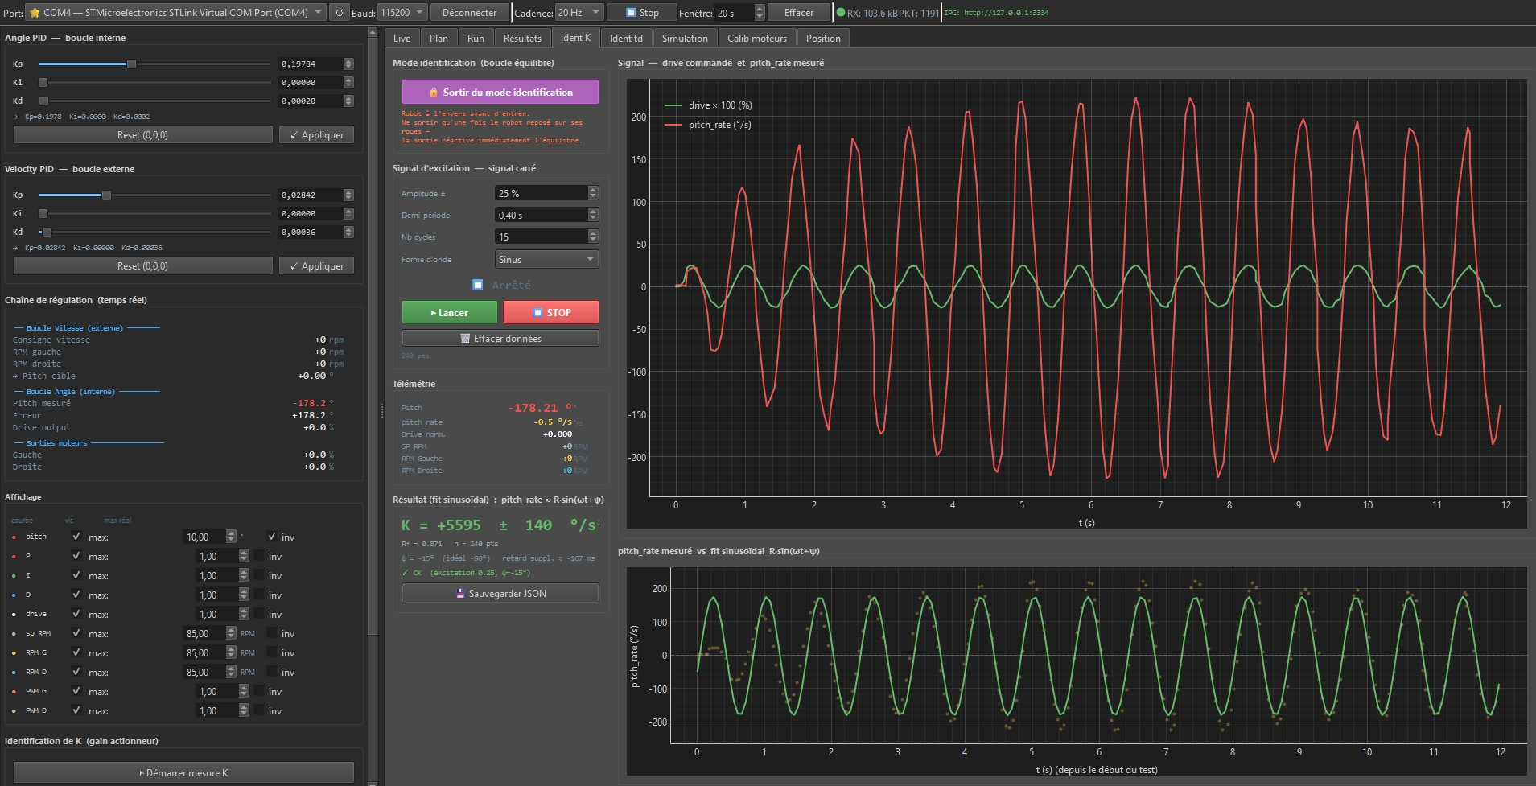

Slide 5
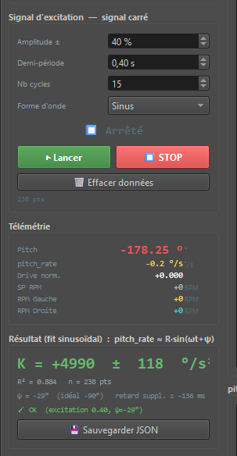
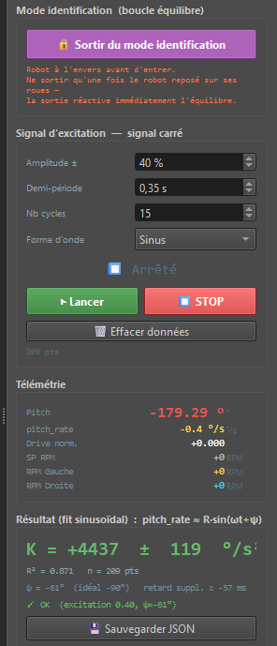
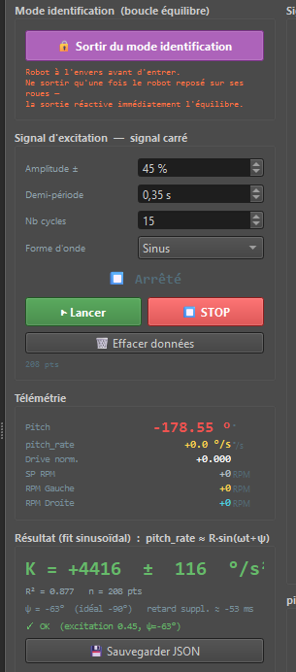
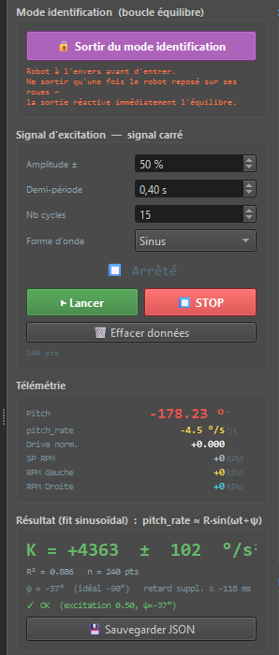

Slide 6
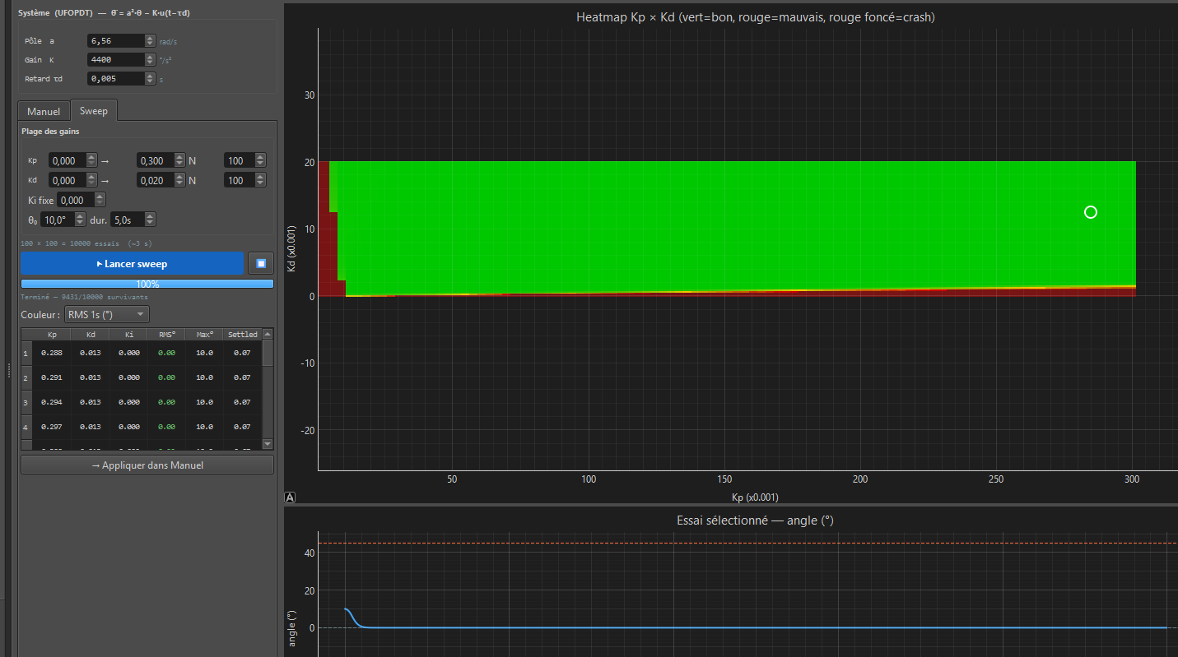

Slide 7
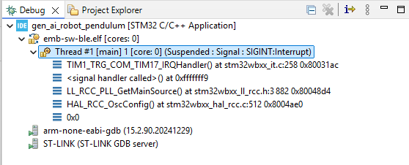


Slide 8
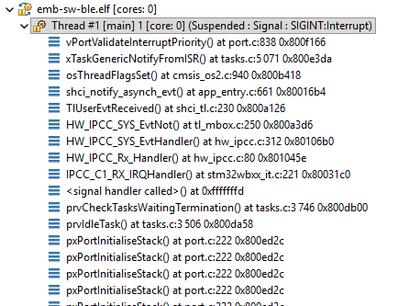
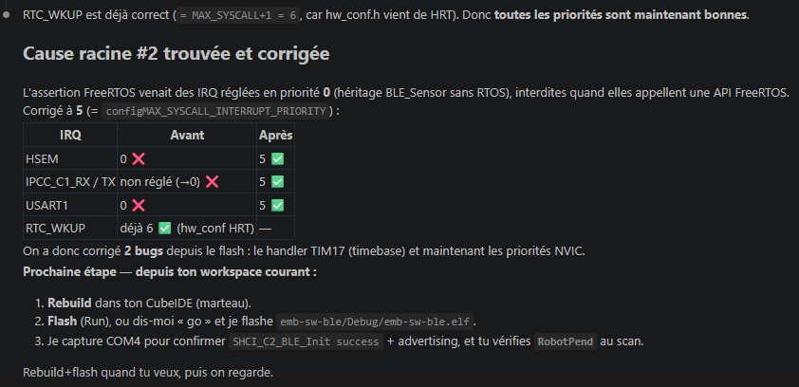


Slide 9
