Slide 1

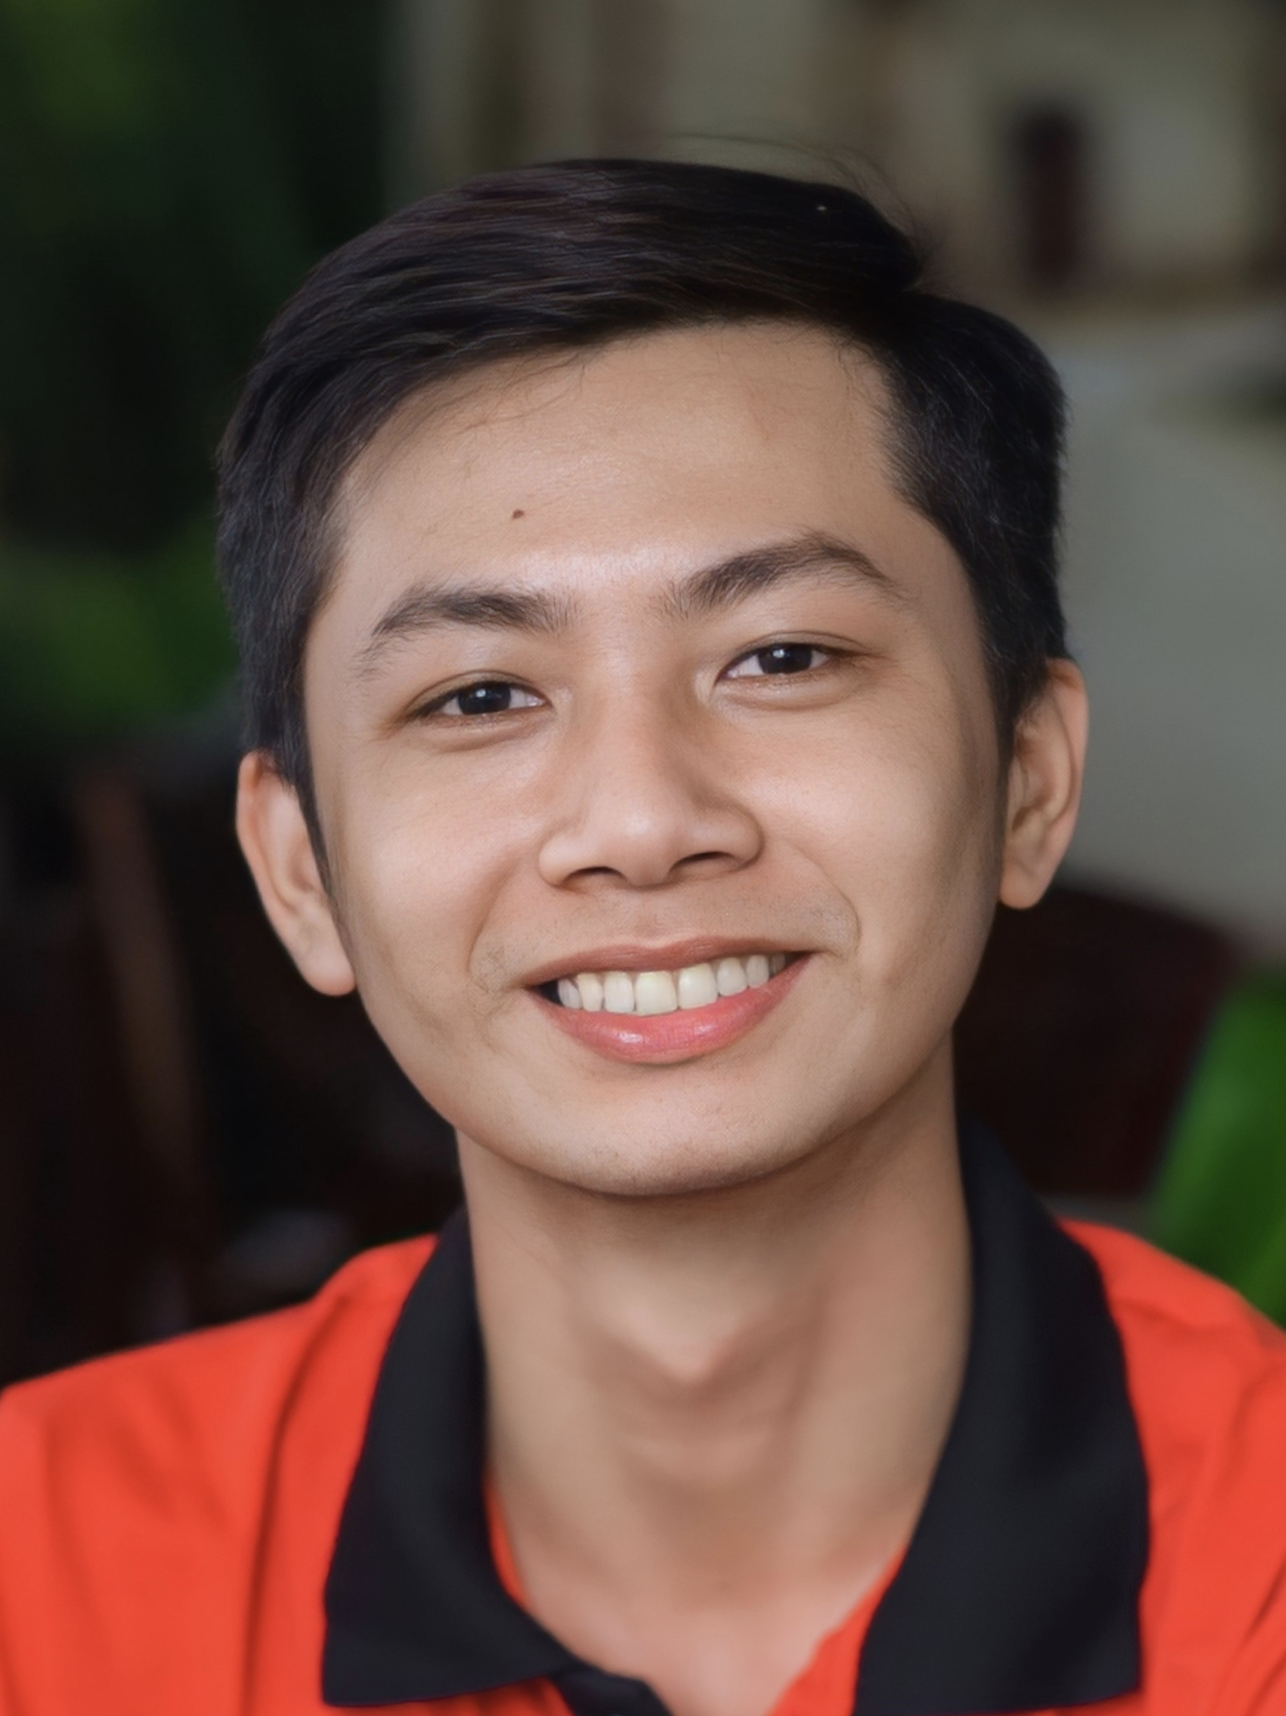





LE DAT EM
[……]
emdatle@gmail.com
Cao Lanh City, Dong Thap , Vietnam
(+84) 393535006
Arp 8, 2002
https://www.linkedin.com/in/ledatem
and ore…
eDUCATION
Mechatronics Engineering Engineer Oct 2020 – Dec 2024
COLLEGE OF ENGINEERING, CAN THO UNIVERSITY
EXPERIENCE
Embedded Systems Engineer March 2021 – Dec 2024
SONG PHU ELECTRICS AND LASER
“Experience in consulting and supplying electronic devices. Production of 3D models, sculpting mica models. Accumulated practical experience in designing electrical circuits, digital circuits, microcontroller programming, and sensor integration. Designing and developing electrical cabinet systems. Providing IoT solutions and implementing automation equipment.”
Water Loss Management Department May 2024 – July 2024
CANTHO 2 WATER SUPPLY JOINT-STOCK COMPANY – 366C Cach Mang Thang Tam Street, Ward Bui Huu Nghia, Binh Thuy District, Can Tho City.
Install and maintain data loggers to monitor water loss. Analyze data to detect and address leaks in the water distribution system.
OBJECTIVE
Proactive, customer-orientated retail professional with over 4 years of experience in reputable shops. Received 3 ‘Passion Awards’ for delivering outstanding service and have consistently surpassed my target KPIs for mystery shoppers.
Project
sKILLS
Soft Skills | Proficient.
Teamwork, Time management, Communication.
Office Computer | Proficient. Word, Excel, PowerPoint,..
Circuit Design| Proficient. Altium, Proteus,..
2D & 3D modeling | Proficient . SolidWorks, CorelDRAW, Simplify3D.
Firmware Programming| Proficient. Arduino, STM32 Cube IDE, VS Code,
Web Development | Basic. HTML, CSS, JavaScript.
LANGUAGES
English | Intermediate. B1 English Proficiency Certificate

Slide 2
COVER LETTER BY
LE DAT EM
CREATIVE DESIGNER
DEAR MR. ANDREW
I AM WRITING A LETTER OF INTEREST IN REGARDS TO THE POSITION IN YOUR COMPANY. YOUR COMPANY IS KNOWN FOR ITS INNOVATION, PROFESSIONALISM, AND RESULTS-DRIVEN MARKETING STRATEGY, WHICH IS WHY I AM CERTAIN I WOULD MAKE A VALUABLE ADDITION TO YOUR TEAM. I WOULD BE INTERESTED IN LEARNING MORE ABOUT THE COMPANY AND AVAILABLE OPPORTUNITIES, SO I HAVE ENCLOSED MY RESUME FOR YOUR CONSIDERATION.
I AM CONFIDENT THAT MY EXPERIENCE IN THIS FIELD WILL BE AN ASSET TO YOUR COMPANY. AS YOU WILL SEE ON MY RESUME, I HAVE A PROVEN RECORD OF ACHIEVEMENTS, WHICH WILL ALLOW ME TO MAKE MAJOR CONTRIBUTIONS TO YOUR COMPANY.
I LOOK FORWARD TO SPEAKING WITH YOU TO DISCUSS HOW MY EXPERIENCE AND ABILITIES MATCH YOUR NEEDS. I WILL CALL YOU ON THE DAY OF THE WEEK TO SEE WHAT DAY AND TIME FIT YOUR BUSY SCHEDULE. DON’T HESITATE TO CONTACT ME AT YOUR PHONE NUMBER OR CONTACT ME BY EMAIL AT YOUR EMAIL ADDRESS SHOULD YOU HAVE ANY QUESTIONS. I LOOK FORWARD TO SPEAKING WITH YOU.

Slide 3
LE DAT EM
[……]
emdatle@gmail.com
Cao Lanh City, Dong Thap , Vietnam
(+84) 393535006
Arp 8, 2002
https://www.linkedin.com/in/ledatem
and ore…
eDUCATION
Mechatronics Engineering Engineer Oct 2020 – Dec 2024
COLLEGE OF ENGINEERING, CAN THO UNIVERSITY – Area II, 3/2 Street, Xuan Khanh Ward, Ninh Kieu District, Can Tho City
Accumulated knowledge in mechatronics, including mechanics, electronics, computer science, and control engineering. Participated in collaborative projects, demonstrating teamwork and leadership skills. Consistently achieved high academic performance, maintaining a GPA of [3.41].
EXPERIENCE
Embedded Systems Engineer March 2021 – Dec 2024
SONG PHU ELECTRICS AND LASER – 132/23C, 3/2 Street, Hung Loi Ward, Ninh Kieu District, Can Tho City
“Experience in consulting and supplying electronic devices. Production of 3D models, sculpting mica models. Accumulated practical experience in designing electrical circuits, digital circuits, microcontroller programming, and sensor integration. Designing and developing electrical cabinet systems. Providing IoT solutions and implementing automation equipment.”
Water Loss Management Department May 2024 – July 2024
CANTHO 2 WATER SUPPLY JOINT-STOCK COMPANY – 366C Cach Mang Thang Tam Street, Ward Bui Huu Nghia, Binh Thuy District, Can Tho City.
Install and maintain data loggers to monitor water loss. Analyze data to detect and address leaks in the water distribution system.
OBJECTIVE
Proactive, customer-orientated retail professional with over 4 years of experience in reputable shops. Received 3 ‘Passion Awards’ for delivering outstanding service and have consistently surpassed my target KPIs for mystery shoppers.
Project
sKILLS
Soft Skills | Proficient.
Teamwork, Time management, Communication.
Office Computer | Proficient. Word, Excel, PowerPoint,..
Circuit Design| Proficient. Altium, Proteus,..
2D & 3D modeling | Proficient . SolidWorks, CorelDRAW, Simplify3D.
Firmware Programming| Proficient. Arduino, STM32 Cube IDE, VS Code,
Web Development | Basic. HTML, CSS, JavaScript.
LANGUAGES
English | Intermediate. B1 English Proficiency Certificate

Slide 4
LE DAT EM
[ … ]
emdatle@gmail.com
Thành phố Cao Lãnh, Tỉnh Đồng Tháp , Việt Nam
0393535006
Arp 8, 2002
https://www.linkedin.com/in/ledatem
Giáo dục
Kỹ sư kỹ thuật Cơ – điện tử Tháng 10, 2020 – Tháng 12, 2024
Trường Bách Khoa, Đại học Cần Thơ – Area II, 3/2 Street, Xuan Khanh Ward, Ninh Kieu District, Can Tho City
Đã tích lũy kiến thức trong lĩnh vực cơ điện tử, bao gồm cơ khí, điện tử, khoa học máy tính và kỹ thuật điều khiển. Tham gia vào các dự án phối hợp, thể hiện kỹ năng làm việc nhóm và lãnh đạo. Luôn đạt thành tích học tập cao, duy trì điểm trung bình cộng (GPA) là [3.41].
Kinh nghiệm
Embedded Systems Engineer Mar 2021 – Dec 2024
Song Phu Electrics and Laser – 132/23C, 3/2 Street, Hung Loi Ward, Ninh Kieu District, Can Tho City Gained practical experience in circuit design, microcontroller programming, and sensor integration.
Kỹ sư Hệ thống Nhúng Tháng 3, 2021 – Tháng 12, 2024
Song Phu Electrics and Laser – 132/23C, 3/2 Street, Hung Loi Ward, Ninh Kieu District, Can Tho City
Accumulated knowledge in mechatronics, including mechanics, electronics, computer science, and control engineering. Participated in collaborative projects, demonstrating teamwork and leadership skills. Consistently achieved high academic performance, maintaining a GPA of [3.41].
OBJECTIVE
Proactive, customer-orientated retail professional with over 4 years of experience in reputable shops. Received 3 ‘Passion Awards’ for delivering outstanding service and have consistently surpassed my target KPIs for mystery shoppers.
Project
sKILLS
Water Loss Management Department May 2021 – July 2024
Song Phu Electrics and Laser – 132/23C, 3/2 Street, Hung Loi Ward, Ninh Kieu District, Can Tho City Proactive, customer-orientated retail professional with over 4 years of experience in reputable shops. Received 3 ‘Passion Awards’ for delivering outstanding service and have consistently surpassed my target KPIs for mystery shoppers.
LANGUAGES
English | Intermediate. B1 English Proficiency Certificate

Slide 5

LE DAT EM
STUDENT
emdatle@gmail.com
Cao Lanh City, Dong Thap , Vietnam
0393535006
Arp 8, 2002
https://www.linkedin.com/in/ledatem
eDUCATION
Mechatronics Engineering Engineer Oct 2020 – Dec 2024
Can Tho University – Area II, 3/2 Street, Xuan Khanh Ward, Ninh Kieu District, Can Tho City
Proactive, customer-orientated retail professional with over 4 years of experience in reputable shops. Received 3 ‘Passion Awards’ for delivering outstanding service and have consistently surpassed my target KPIs for mystery shoppers.
Embedded Systems Engineer Mar 2021 – Dec 2024
Song Phu Electrics and Laser – 132/23C, 3/2 Street, Hung Loi Ward, Ninh Kieu District, Can Tho City Proactive, customer-orientated retail professional with over 4 years of experience in reputable shops. Received 3 ‘Passion Awards’ for delivering outstanding service and have consistently surpassed my target KPIs for mystery shoppers.
EXPERIENCE
OBJECTIVE
Proactive, customer-orientated retail professional with over 4 years of experience in reputable shops. Received 3 ‘Passion Awards’ for delivering outstanding service and have consistently surpassed my target KPIs for mystery shoppers.
Project
sKILLS
LANGUAGES
English | Intermediate. B1 English Proficiency Certificate

