Slide 1



Git & Gitlab
Minh Kha
10 Oct 2022

Slide 2

Table of Contents
What is VCS?
What is Git
Why Git
What is GitLab
Git Workflow
Key Concepts
Git Basics
Demo

Slide 3
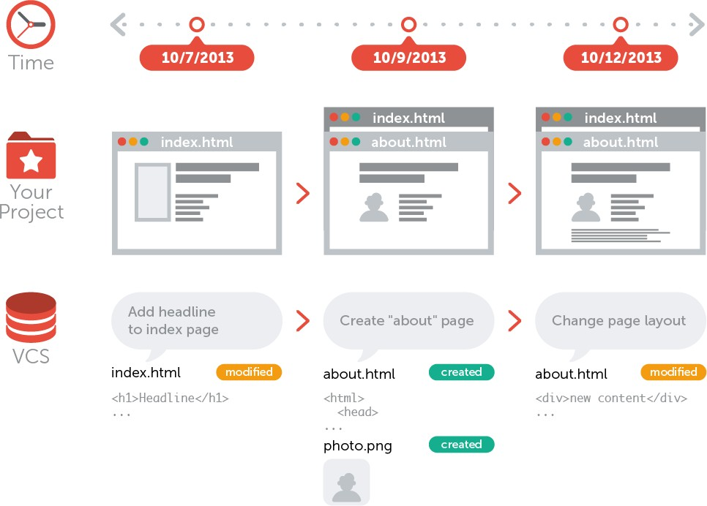
What is VCS?
Version control system: record changes and recall versions

Slide 4
VCS Functions
Allow developers to work simultaneously
Does not allow overwriting each other’s changes
Maintains a history of every version.

Slide 5
VCS Types
Local Version Control Systems
Centralized version control system (CVCS).
Distributed/Decentralized version control system (DVCS).
Notes:
https://serengetitech.com/tech/introduction-to-git-and-types-of-version-control-systems/#:~:text=A%20local%20version%20control%20system,file%20since%20its%20last%20version.

Slide 6

Version Control Systems

Slide 7
What is Git
A Distributed Version Control System

Slide 8
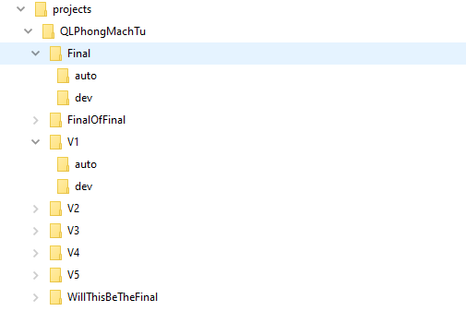
Why Git? (Local Version Control Systems)

Slide 9
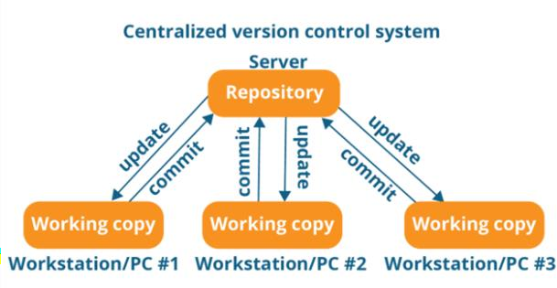
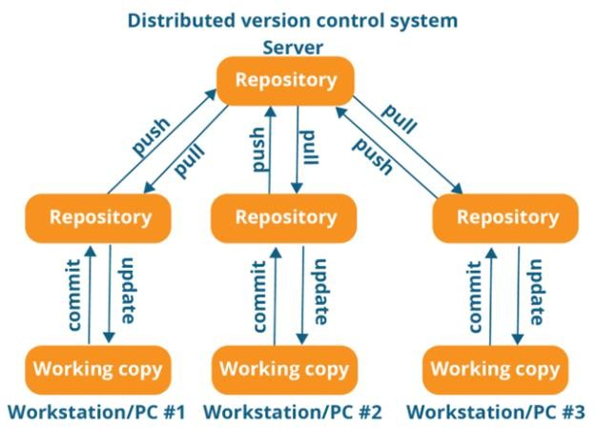
Why Git

Slide 10
Why Git
Fast and small
Security 🡪 SHA1
Snapshots, not differences
No single point of failure
Multiple backups
Make changes without internet access.
Revert back anytime

Slide 11
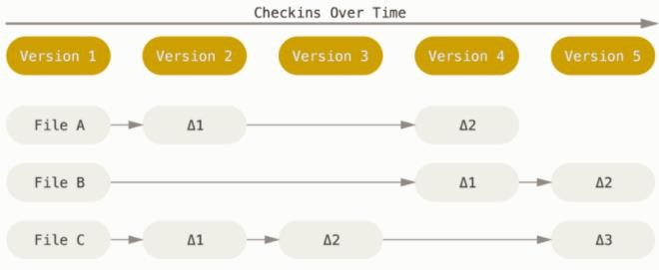
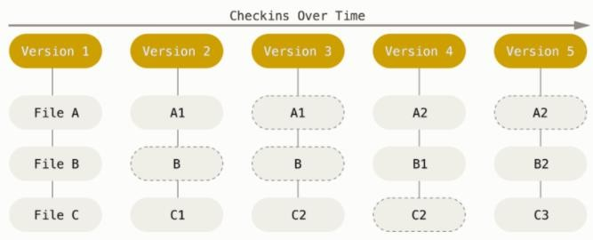
Snapshots, not differences

Slide 12
What is Gitlab
https://gitlab.com/
A cloud service for remote hosting of git repositories
Web-based Git repositories that offers free open and private repository, issue tracking and wikis
A completed DevOps platform: project planning, source code management, monitoring and security

Slide 13

Git Repositories

Slide 14
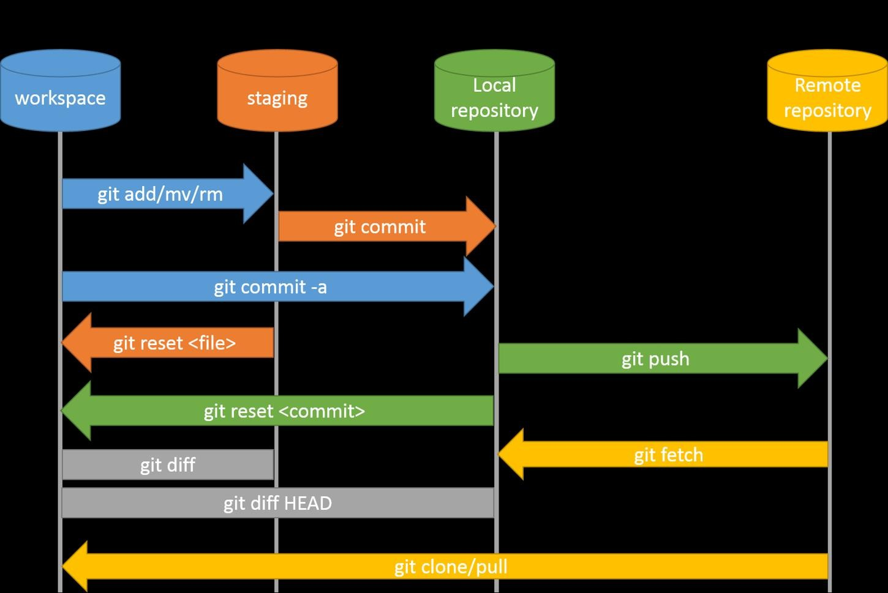
Git Workflow
The three states: Modified, Staged, Committed

Slide 15
Git Key Concepts
Repository
Branch
HEAD/origin
Commit

Slide 16
Key Concepts: Repository
Collection of all files and history of project
Local and Remote repository
git init, clone, pull, fetch, push

Slide 17
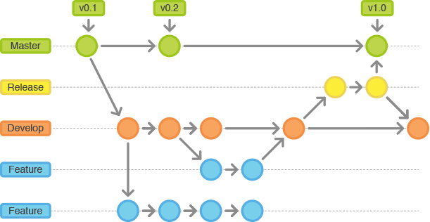
Key concepts: Branch
Branch is nothing but pointer to a specific commit
The default branch is “master”

Slide 18
Key concepts: Branch
Switch to a branch
git checkout master
Create a branch
git branch testing
git checkout -b testing
- git checkout -b testing develop
Delete a branch
git branch -D testing
Merge branch
git merge testing
git rebase testing

Slide 19
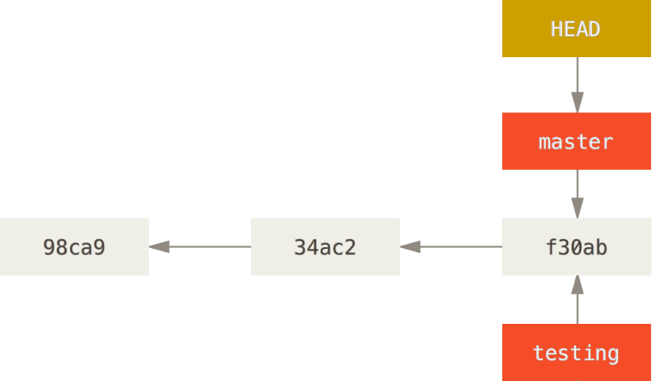
Key Concepts: HEAD
HEAD is a reference to the last commit in the currently checked-out branch

Slide 20
Key Concepts: origin
origin is a remote repository that a project was originally cloned from (original repository's URL)
$ git push origin develop
$ git push https://gitlab.com/hoadoanthingocvn/de-training.git develop

Slide 21
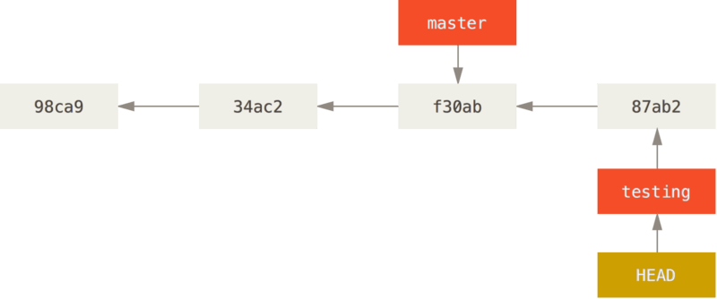
Key Concepts: commit
$git checkout testing
$ vim test.rb
$ git commit -m 'made a change‘

Slide 22
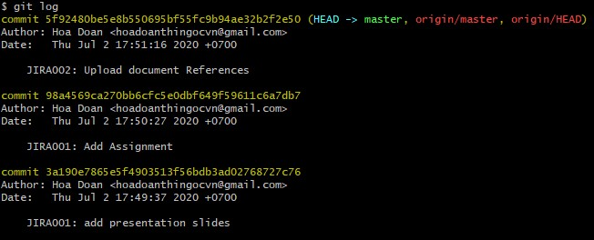
Key Concepts: commit
A commit or revision, is an individual change to a file (or set of files)

Slide 23
Git Basics
Git global setup
git config --global user.name "Minh K"
git config --global user.email minh.khagiai@nashtechglobal.com
Clone a repository by HTTPS
git clone https://gitlab.com/company-training/rookies-batch6/batch6.git
Clone a repository by SSH
git clone git@gitlab.com:company-training/rookies-batch6/batch6.git (configure SSH key on local machine then put it on the Git server - https://docs.gitlab.com/ee/user/ssh.html)

Slide 24
Git Basics
git clone
git checkout -b
git add / git add .
git commit –m
git rebase develop
git push origin develop
git merge
git init
git fetch/pull
git status
git stash
git cherry-pick
git log

Slide 25


Slide 26
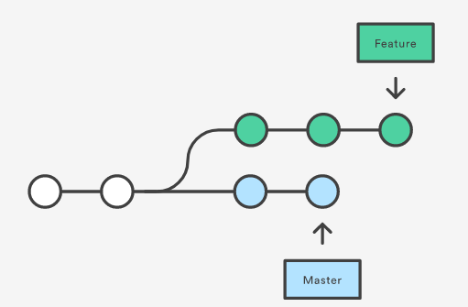
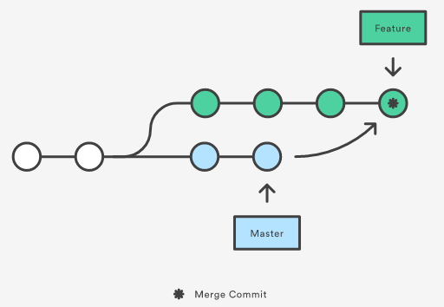
Git merge
https://git-scm.com/book/en/v2/Git-Branching-Basic-Branching-and-Merging

Slide 27
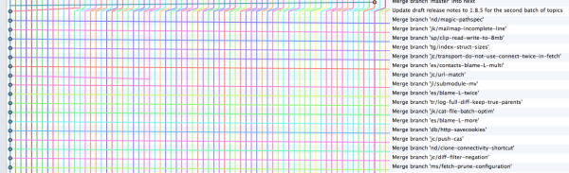
Git merge
https://www.atlassian.com/git/articles/git-team-workflows-merge-or-rebase

Slide 28
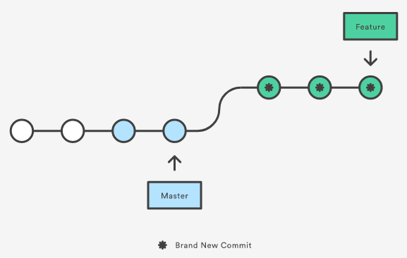
Git rebase

Slide 29
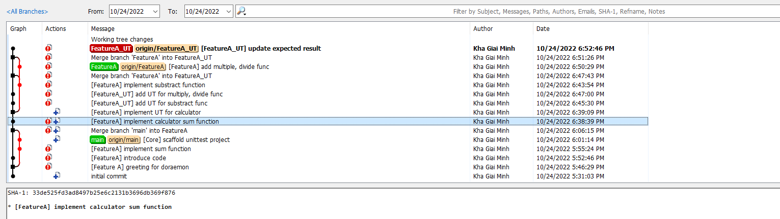
Before rebase

Slide 30
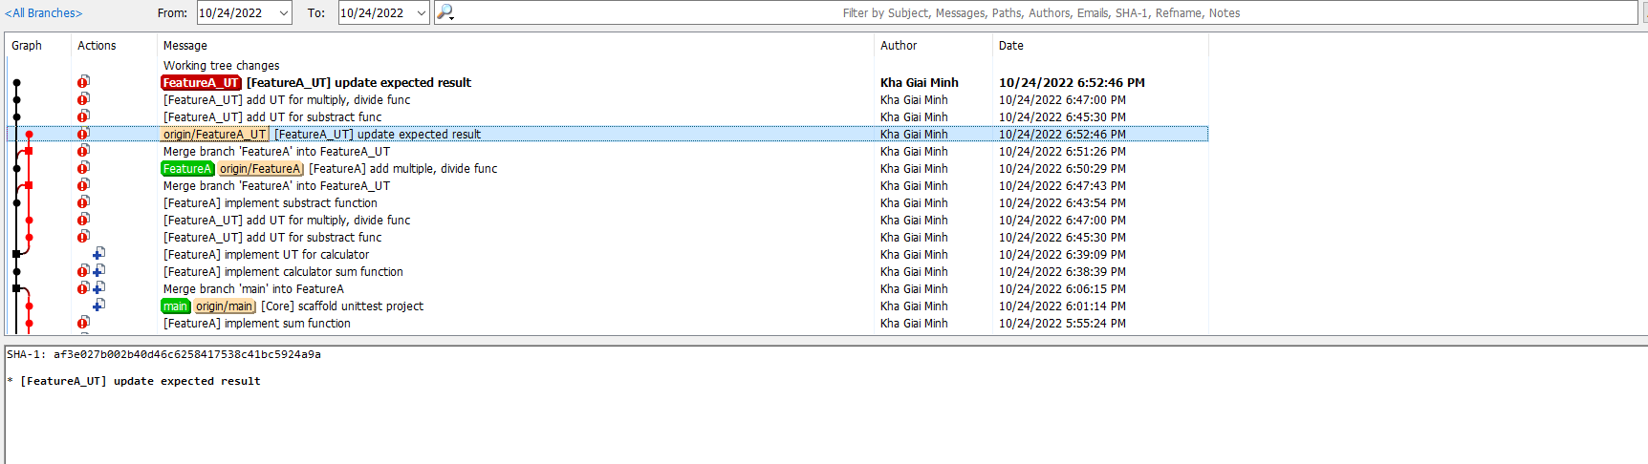
Automatic rebase
git checkout FeatureA_UT
git rebase FeatureA
pick [FeatureA_UT] update expected result
pick [FeatureA_UT] add UT for multiply, divide func
pick [FeatureA_UT] add UT for substract func

Slide 31
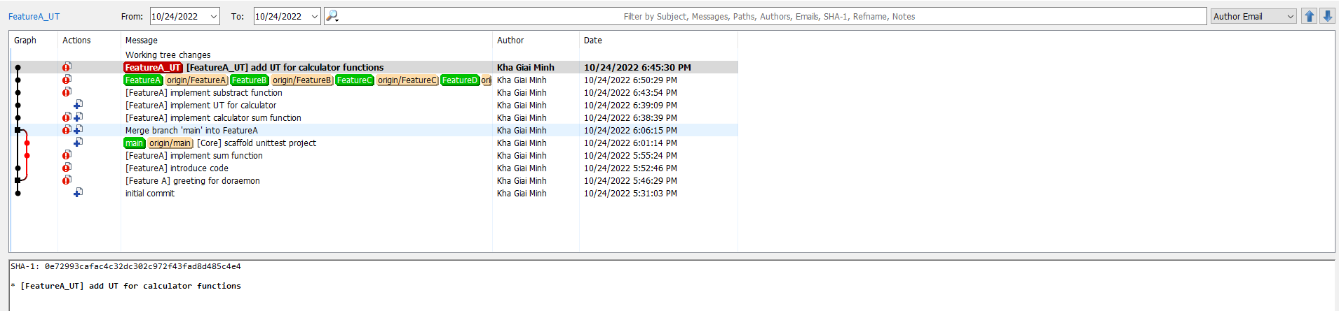
Interactive rebase (reword + fixup)
git checkout FeatureA_UT
git rebase –i FeatureA
reword [FeatureA_UT] update expected result
fixup [FeatureA_UT] add UT for multiply, divide func
fixup [FeatureA_UT] add UT for substract func

Slide 32
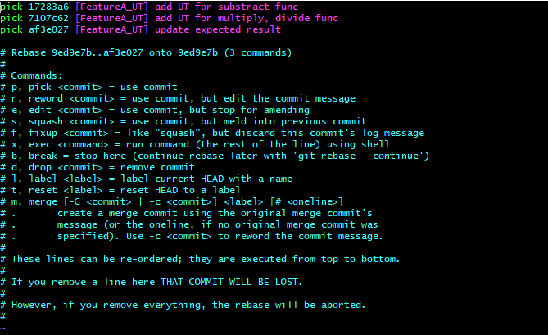
Interactive rebase
git checkout FeatureA_UT
git rebase –i FeatureA

Slide 33
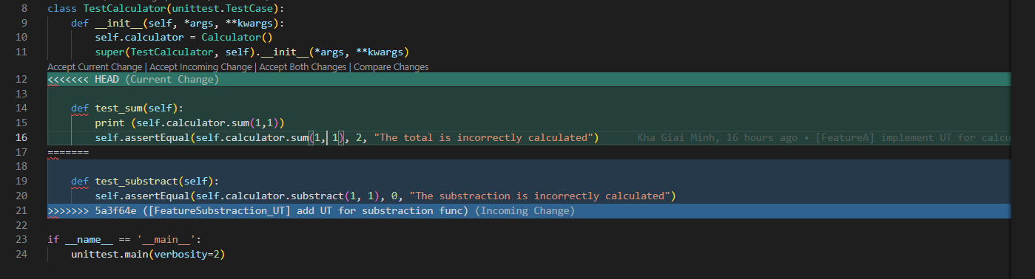
Conflict resolution

Slide 34



Slide 35
References
https://git-scm.com/book/en/v2
https://github.com/github/gitignore
https://github.com/JetBrains/idea-gitignore
https://www.atlassian.com/git/tutorials/comparing-workflows/gitflow-workflow
https://courses.cs.washington.edu/courses/cse403/13au/lectures/git.ppt.pdf
https://www.atlassian.com/git/articles/git-team-workflows-merge-or-rebase
https://git-scm.com/docs/git-bisect

