Slide 1


Selenium IDE For Beginner

Slide 2
1. What is Selenium IDE
Agenda
Features of Selenium IDE
How to use Selenium IDE

Slide 3
What is Selenium IDE?

Slide 4
What is Selenium IDE?
Selenium IDE (Integrated Development Environment).
It is implemented as a Firefox add-on, supports Chrome, Edge extension
Helps quickly recording and playing tests, organizing tests, easy manages test suites
Parallel and Cross-browsers execution with Chrome, Firefox, MS Edge (Chromium), Internet Explorer, and Safari

Slide 5
Selenium IDE – Advantages and disadvantages
Advantages Disadvantages
Capability of record and play back
Flexibility test executing
Debug and set breakpoints supporting
Rich set of features and extensions
Logging capabilities
Parallel and cross-browser supporting
Not suitable for testing extensive data, complex scenario
Not support database testing
Not support error handling
Report and failure capture missing

Slide 6
Features of Selenium IDE

Slide 7
Record and Playback
Features of Selenium IDE
Automatically record test cases via interactions with browser
Instantly playback all test cases or set of test cases
Cross-browser
IDE add-on available on Firefox and Chrome
Able to run cross-browser using browser driver, such as ChromeDriver, GeckoDriver, IE Driver, SafariDriver
Multiple actions and commands
Set of commands – “Selenese”, helps define and execute actions from
recording, like “click a button”, “input a text”, “select an option”

Slide 9
Using Selenium IDE

Slide 10
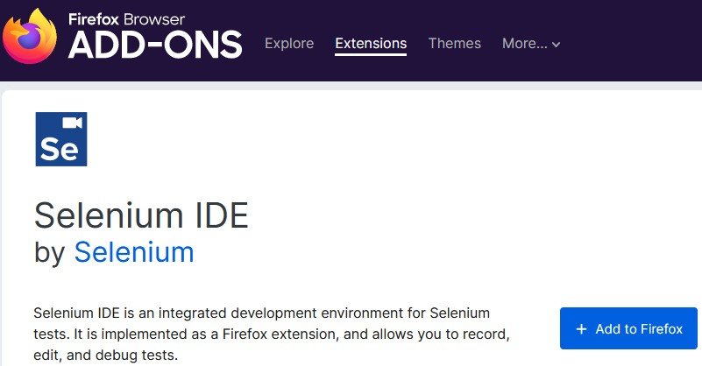
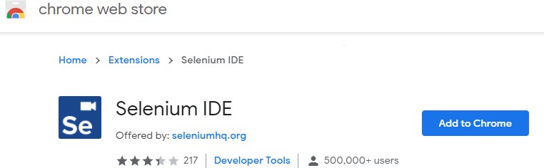
Install
Selenium IDE is now available on
Firefox add-on - Firefox Download
Chrome extension - Chrome Download
https://www.selenium.dev/selenium-ide/

Slide 11
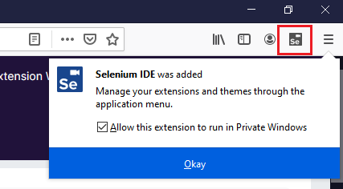
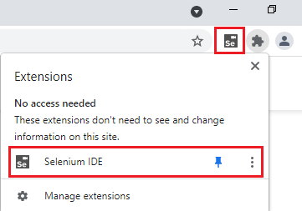
Install
After installed Selenium IDE add-on on Firefox/Chrome, an extension will show in browser tool bar

Slide 12
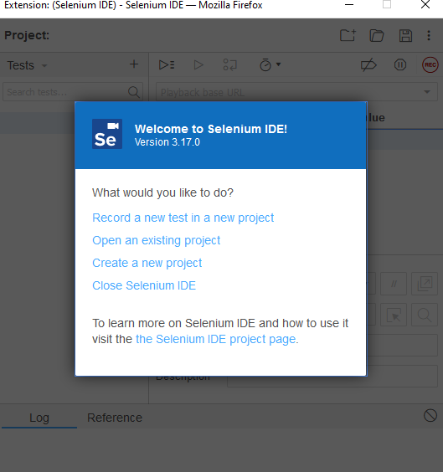
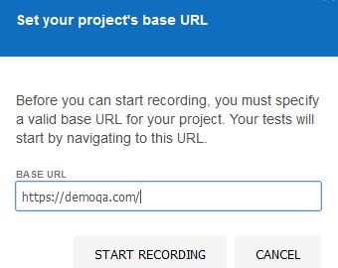
Using Selenium IDE
When first start Selenium IDE, an extension dashboard pops up with several options to get
start
Go through initialization steps and start recording

Slide 13
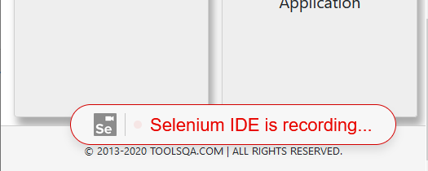

Using Selenium IDE
After click “Start Recording”, a new browser shows up with setting url, and status shows “recording”
Selenium IDE will record all actions, with each action, a status “Recorded” is indicated

Slide 14
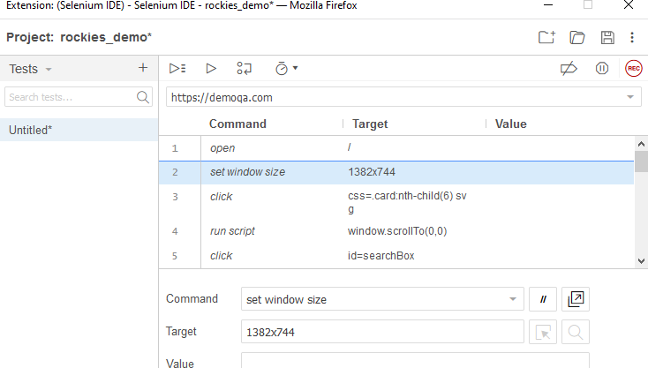
Using Selenium IDE
The extension dashboard is also running along with recording browser
This dashboard provides test case recording management

Slide 15
Using Selenium IDE
Components
Menu
Tool bar
Address bar
Test case pane
Test script editor box
Start/Stop recording button
Log, Reference pan

Slide 16
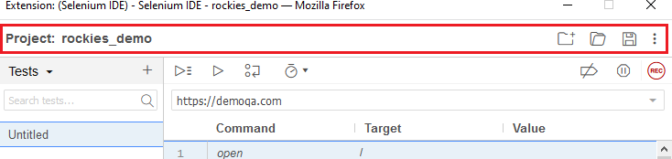
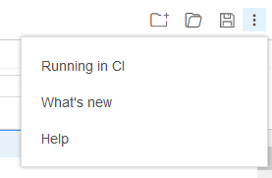
Using Selenium IDE – Menu bar component
The Menu bar shows project name, also allows to rename project
On right menu, there are options to create new project, load other project, save project, and extend options to allow running
on CI environment

Slide 17
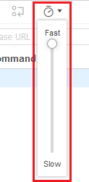
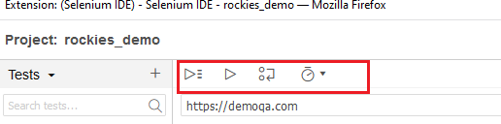
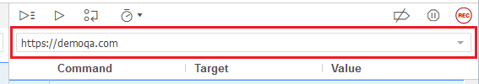
Using Selenium IDE – Tool bar, Address bar
The Tool bar controls the test case executions
Run all test cases
Run current test
Step over command
Speed control
Address bar has a dropdown menu with all previous visited url during recording

Slide 18
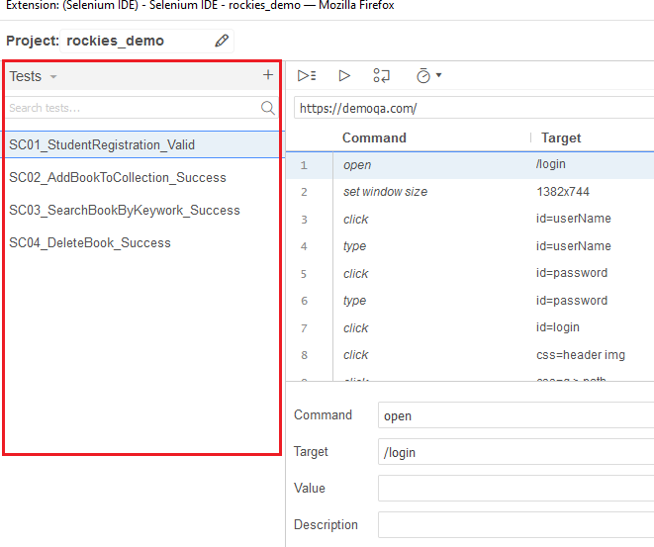
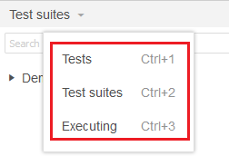
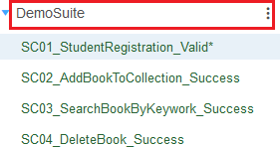
Using Selenium IDE – Test Case pane component
The Test Case pane contains all the test cases that are recorded by IDE
Test Case pane also allows grouping test cases into test suites, adding, removing tests

Slide 19
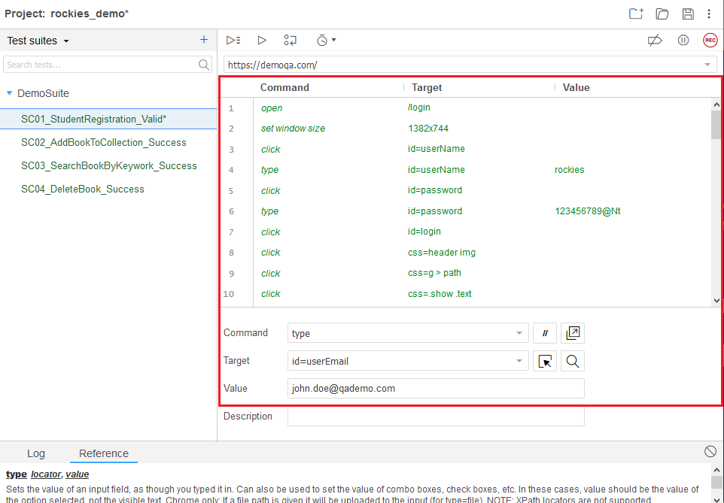
Using Selenium IDE – Test script editor box

Slide 20
Using Selenium IDE – Test Script Editor box
Test Script Editor box displays all actions and commands of test that are recorded by IDE in order which they are performed
Command column is action that perform on web element, like: open, click, type, mouse hover
Target column is element with locator that command interacts to
Value column is used to set value for target element from command

Slide 21
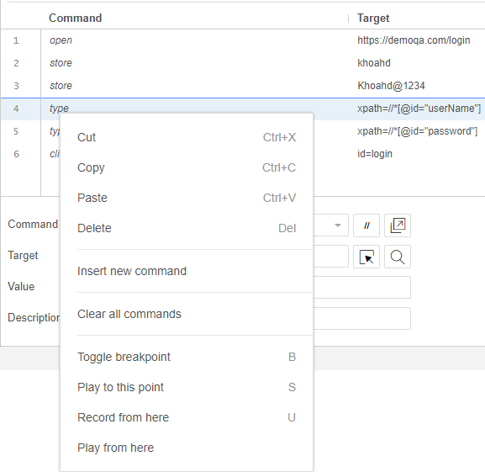
Using Selenium IDE – Test Script Editor box
Additional actions on command
Additional test execution on command

Slide 22
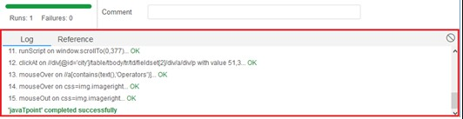
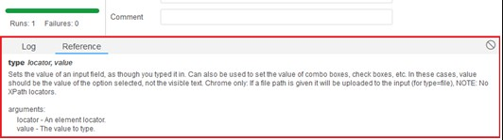
Using Selenium IDE – Log, Reference pane
The Log pane shows runtime message of actions performed by IDE during execution
There are 4 types of log: info, error, debug, and warn
The Reference pane shows some hints, usages of selected ‘selenese’ command in IDE

Slide 23
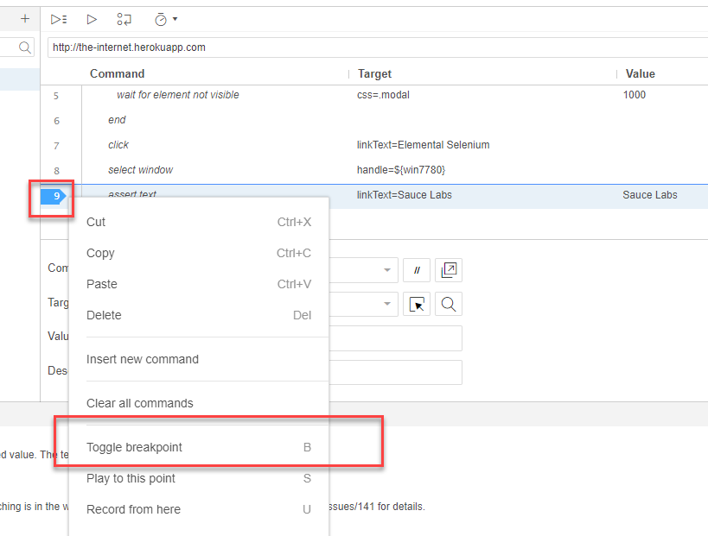
Using Selenium IDE – Debug
Debugging is the process of finding out the error or the cause of the error, in order to have a direction to fix it.

Slide 24
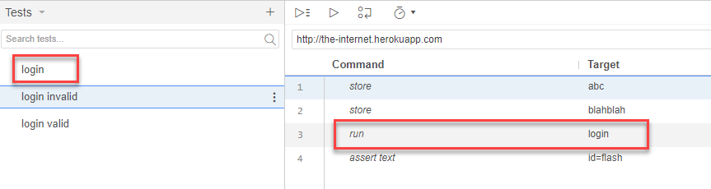
Using Selenium IDE – Run one test from another
run
- Runs a test case from the current project.
arguments
- test case: Test case name from the project.

Slide 25
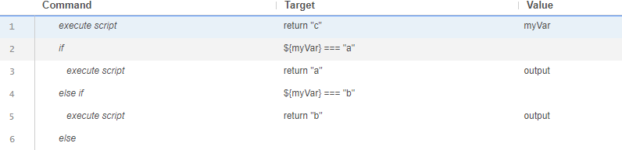
Using Selenium IDE – Conditional logic
If
Else if
Else
end
Control Flow · Selenium IDE

Slide 26
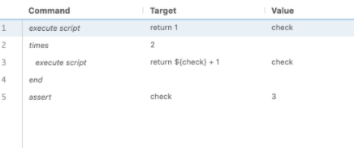
Using Selenium IDE – Looping
Times
Do
While
ForEach
Control Flow · Selenium IDE

Slide 27
Cross browser with Command-line Runner
Command-line runner helps run all Selenium IDE tests on any browser, in parallel, or in Selenium Grid
Setup some dependencies for command-line runner to work:
node: JavaScript runtime environment
npm: NodeJS package manager
selenium-side-runner: Selenium IDE command line runner
browser drivers: to run test on browser on local

Slide 28



Command-line Runner – Setup and Execution
Download and install NodeJS – latest version NodeJS Latest LTS Version: 14.16.1
Make sure Node.js, npm, and node modules are added to PATH environment variables
Install ‘selenium-side-runner’ using npm

Slide 29
Command-line Runner – Setup Browser Drivers
Install browser drivers using npm
For Chrome: “npm install –g chromedriver” For Firefox: “npm install –g geckodriver”
For Edge: “npm install –g edgedriver”
For IE: “npm install –g iedriver”
For Safari: download SafariDriver

Slide 30
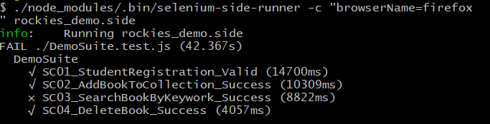
Command-line Runner - Execution
The executor “selenium-side-runner” is located under “/node_modules/.bin” after npm install
Calling this executor with path to test suite file *.side, and with parameter to set browser to be run

Slide 31
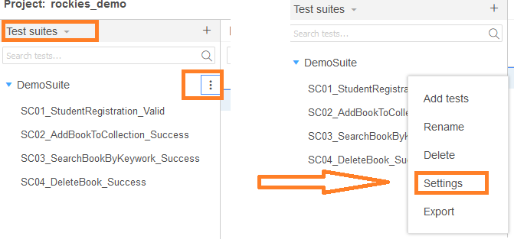
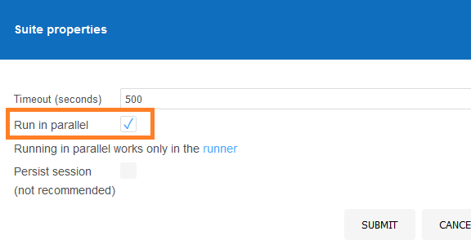
Command-line Runner – Execution in Parallel
In runner, by default, tests are executed parallel automatically at suite level
Configure parallel execution in IDE in order to execute tests in test suite in parallel

Slide 32
Exercise

Slide 33
Exercise
Jira005: [PRACTICE] - UI Automation with Selenium IDE
Deadline: 15 July 2022
Link: https://gitlab.com/rookiesautomationgroup/batch5/-/issues/5
Jira006: [FINAL] UI Automated Testing with Selenium IDE
Deadline: 17 July 2022
Link: https://gitlab.com/rookiesautomationgroup/batch5/-/issues/6

Slide 34
URL References
https://www.selenium.dev/selenium-ide/docs/en/introduction/getting-started
https://the-internet.herokuapp.com/
https://www.selenium.dev/selenium-ide/docs/en/introduction/command-line-runner

Slide 35


Thank you Q & A

