Slide 1


Vietnam-Korea University of Information and Communication Technology
BASIC PROJECT 3
MiniNote
Android Note Management Application for Students
  Students:
    Le Duy Khang - 24IT105
  Supervisor: MSc. Nguyen Dang Y
  Faculty: Computer Science

Slide 2
Contents
01
Motivation & Objectives
04
Database Design
02
05
Key Features & Demo
Technologies Used
Conclusion & Future Work
03
06
System Analysis -Use Case
06

Slide 3
Motivation
Need for effective revision
Difficulty in managing study notes.
A
B
C
D
Apply acquired knowledge.
Need for better focus

Slide 4
Objectives
  Manage study folders
  Create, edit, delete, and view notes
  Create and review flashcards
  Support focused study sessions with Pomodoro
  Store data using PHP API and MySQL
  Build a simple, clean, and user-friendly interface

Slide 5
Technologies Used
Client | Server | Server
Android App | Node.js | Node.js
 | Kotlin XML Layout RecyclerView ViewBinding
 | • Build Android screens • Handle user actions • Display folders and notes
 | Handling REST API Routing request
 | Handling REST API Routing request
API Server | Client | Client
PHP API | ReactJS | ReactJS
 | PHP Apache JSON
 | Handle app requests Add, edit, delete data Return JSON responses
 | SPA Interface Call API with Axios Bootstrap5 to responsive
 | SPA Interface Call API with Axios Bootstrap5 to responsive
Database | Database | Database
MySQL | MongoDB | MongoDB
 | MySQL phpMyAdmin
 | • Store folders • Store notes Store flashcards
 | NoSQL Storage Schema Management Cloud Deployment (Atlas)
 | NoSQL Storage Schema Management Cloud Deployment (Atlas)
Deploy | Deploy | Deploy
XAMPP | Render | Render
 | XAMPP Retrofit
 | Run Apache and MySQL Connect Android to API Test on Emulator
 | Deploy backend Hosting support Free & SSL available
 | Deploy backend Hosting support Free & SSL available
Easy to change colors, photos and Text. You can simply impress your audience and add a unique zing and appeal to your Presentations.

Slide 6
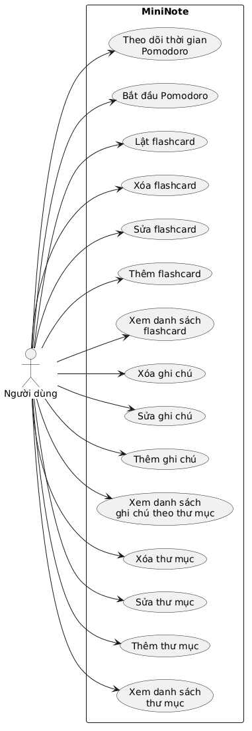
System Analysis -Use Case
Main Actor: User / Student
The user can perform the following functions:
Manage study folders.
Add, edit, delete, and search folders.
Manage notes inside each folder.
Add, edit, and delete notes.Manage flashcards by folder.
Flip cards and move between flashcards.
Use Pomodoro timer for focused study.
View basic profile and application information
Use Case Diagram

Slide 7
Database Design
The system uses MySQL database with three main tables:
folders: Stores study folder information
Main fields:
id
name
note_count
created_at
notes: Stores notes belonging to each folder.
Main fields:
id
folder_id
title
content
created_date
3. flashcard: Stores flashcards belonging to each folder.
Main fields:
id
folder_id
question
answer
created_at

Slide 8

Key features
01
Folder Management:
  Display study folders.
  Add new folders.
  Edit folder names.
  Delete folders.
  Search folders.
02
Note Management
  Display notes by folder.
  Add new notes.
  Edit note content.
  Delete notes
03
Flashcard & Pomodoro:
  Create and review flashcards.
  Flip cards to view answers.
  Choose Pomodoro study sets.
  Start, pause, and reset study timer.

Slide 9

Demo

Slide 10
Conclusion & Future Work
Results
Future Improvements
The application runs successfully on Android Emulator.
Add login and registration.
Folder, note, and flashcard management functions work correctly.
Deploy API and database to an online server.
The Android app can connect to PHP API and MySQL.
Add Contents Title
Add cloud backup and synchronization.

Slide 11
Conclusion
MiniNote is an Android application designed to support students in managing study notes, reviewing knowledge with flashcards, and improving concentration with the Pomodoro technique.
Through this project, I learned how to build an Android application using Kotlin and XML, connect it with PHP API through Retrofit, and store data in MySQL.
Although the application still has some limitations, it has completed the main goals of the project and can be further improved in the future.

Slide 12

Thank you

