Slide 1
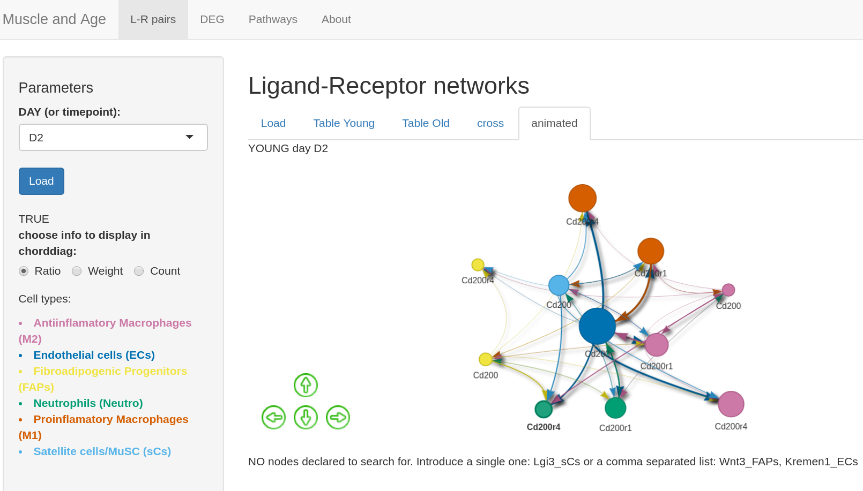
HELP shinyApp code
Localisation input & output data

Slide 2
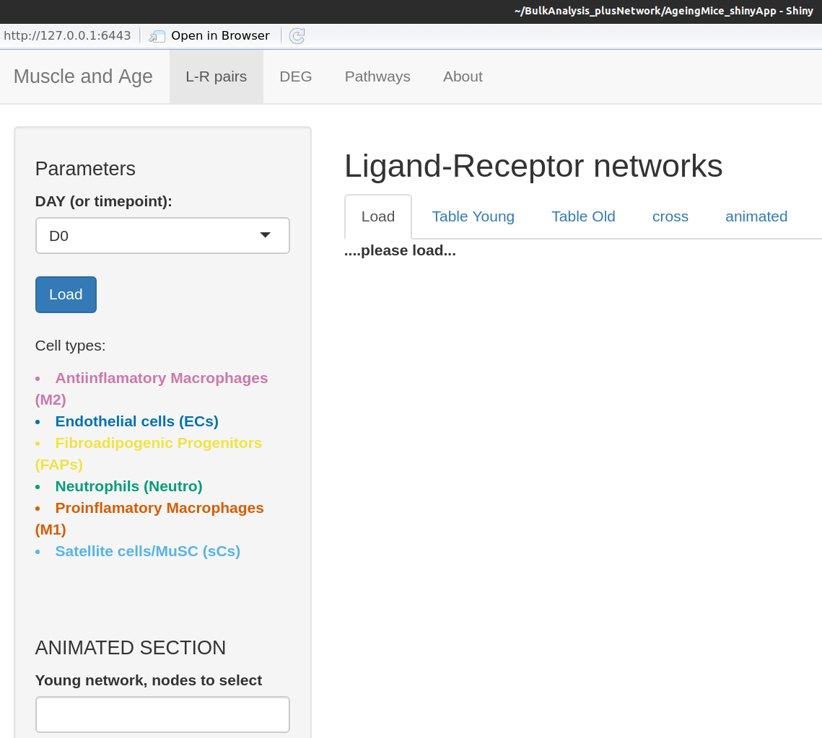
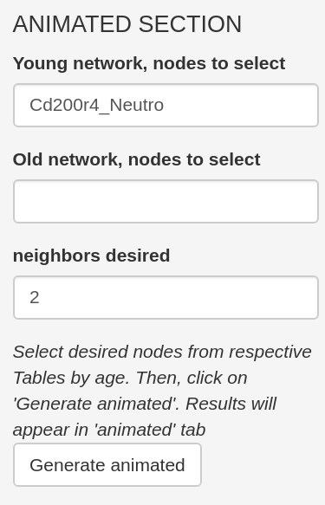
A
A.a
UI
A● navbarPage("Muscle and Age",
A.a● tabPanel( "L-R pairs" ,
A.a.side
A.a.main
input|output
A.a.side● sidebarLayout(
● sidebarPanel( h4("Parameters"), width = 3,
● selectInput("DAY","DAY (or timepoint):",list('D0','D2','D4','D7'),selected = NULL),
● actionButton("LOADSTART", "Load", class="btn-primary"),
A.a.main.1
●mainPanel(
h2("Ligand-Receptor networks"), width = 9,
● tabsetPanel( ……..●tabPanel("Load",
● p("Cell types:"),
● strong(tags$li("Antiinfla….(M2)"
,style="color:#CC79A7")),
● h4("ANIMATED SECTION "),
● textInput("young_nodes", "Young network, nodes to select", value=""),
● numericInput("NEIGH", "neighbors desired", value=1,min = 1,max = 50),
● em("Results will appear in 'animated' tab "),
● actionButton("GO","Generate animated",class="btn-secondary"),

Slide 3
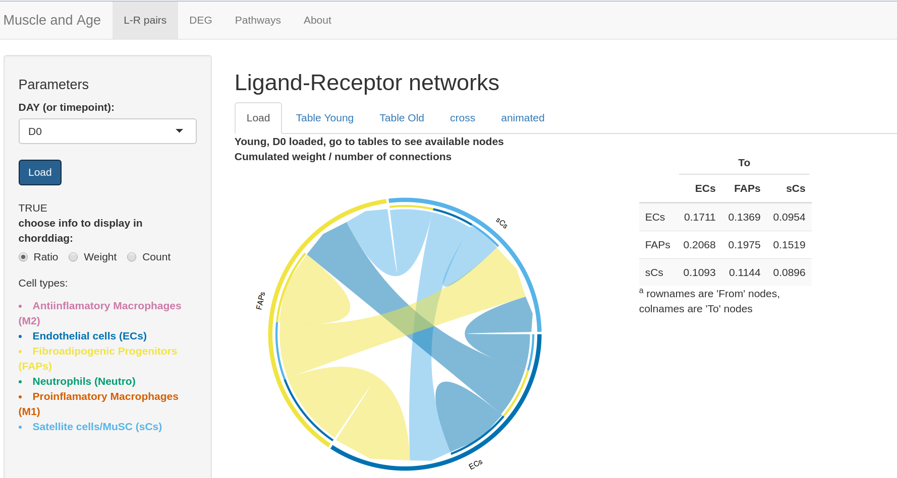
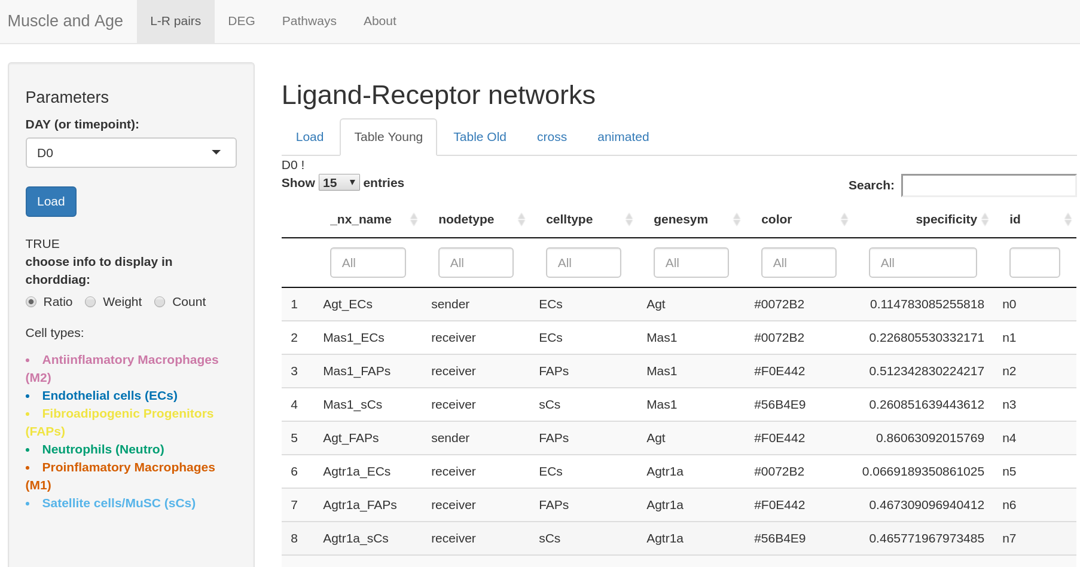
A.a.side ● textOutput("thisiscondition"),
● conditionalPanel( condition ='output.thisiscondition == "TRUE"',
radioButtons("radioAggreg", "choose info to display in chorddiag:",
choices = list("Ratio" ="Ratio" ,"Weight"="CumulateWeight", "Count"="Count"), selected = "Ratio", inline=TRUE)),
UI
A
A.a
input|output
A.a.side
A.a.main
A.a.main.1
●mainPanel(...Ligand-Receptor...,
● tabsetPanel(
●tabPanel("Load",
strong(textOutput("labmain_young")),
fluidRow(
column(width= 7, strong(textOutput ("radiores_young_title")),
plotOutput("radiores_young_A", width="100%")),
column(width=2,
tableOutput("radiores_young_B"))),
● tabPanel("Table Young",
textOutput("labtabyoung"),
DTOutput("tableyoung"),
style= "background-color: #ffffff;" ),

Slide 4
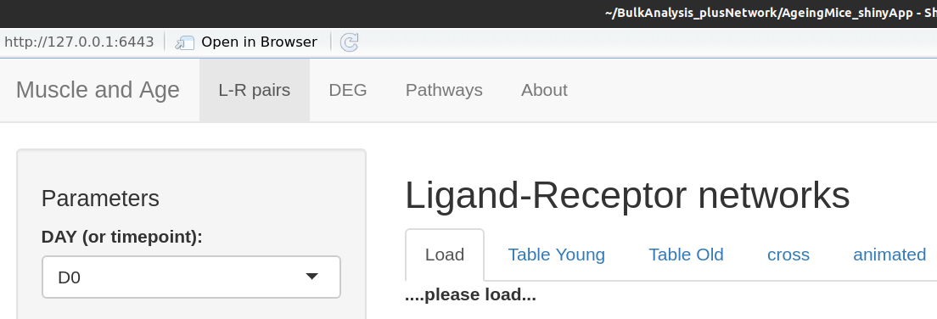
server
◾ observeEvent(
input$DAY,{
if((isolate(currentday$x) == "") || (isolate(currentday$x)!= input$DAY)){
reacAggregPlots$doPlot <- FALSE
output$radiores_young_title <- renderText({""})
output$radiores_young_A <- renderPlot({NULL})
output$radiores_young_B <- renderTable({NULL})
output$labmain_young <- renderText({"....please load..."})
output$crossinf <- renderText({NULL})
}else{next}} # end input$DAY)
input|output
data
displayintroBEST <- function(ag){
output$radiores_young_title <- renderText({
if (reacAggregPlots$doPlot == FALSE) {
return () } else {
if (input$radioAggreg == "Ratio"){
return("Cumulated weight / number of connections ")
}else{
return(isolate(input$radioAggreg))} } })
output$radiores_young_A <- renderPlot({
if (reacAggregPlots$doPlot == FALSE) {
return(NULL) }
else { dochord(ag[["Young"]][[input$radioAggreg]], unicolors= ag[["Colorsmat"]])} } , height = 450, width = 450 )
output$radiores_young_B <- function(){
if (reacAggregPlots$doPlot == FALSE) {
return () }
else {df <- ag[["Young"]][[input$radioAggreg]]
df %>%
knitr::kable("html") %>%
kable_styling("striped", full_width = F) %>%
add_header_above(c(" ", "To" = dim(df)[2])) %>%
add_footnote("rownames are 'From' nodes, colnames are 'To' nodes")
} }

Slide 5
server
◾observeEvent(
input$LOADSTART,{
currentday$x <- isolate(input$DAY)
#sauvegarde du graph assoc au jour
tmpReacGraph = reactive({...read.graph(file=past
(grdir, age,"_",currentday$x,"_igraph_unfi.ml"),
format="graphml")...})
igElmens_list$x[age]<- isolate(tmpReacGraph())
aggreg_day$x[[age]]<-aggreg_matrices[[age]] [[currentday$x]]
reacAggregPlots$doPlot <- TRUE
output$thisiscondition <-
renderText({reacAggregPlots$doPlot})
if ( reacAggregPlots$doPlot == TRUE ){
displayintroBEST(aggreg_day$x)
output$labmain_young <-
renderText({paste("Young, ", currentday$x,
"loaded, go to tables to see available nodes")})
output$labtabyoung <-
renderText({paste(currentday$x, " ! ")})
output$tableyoung <-
renderDT(igraph::as_data_frame(
igElems_list$x[["Young"]],"vertices"),filter =
"top",options = list(pageLength=15))
◾ observeEvent(
input$radioAggreg,{
if (reacAggregPlots$doPlot == FALSE){
print("YOU HAVNT LOADED Anything")
}else{displayintroBEST(aggreg_day$x)}})
input|output
A.a.main.1
data
A.a.main

Slide 6
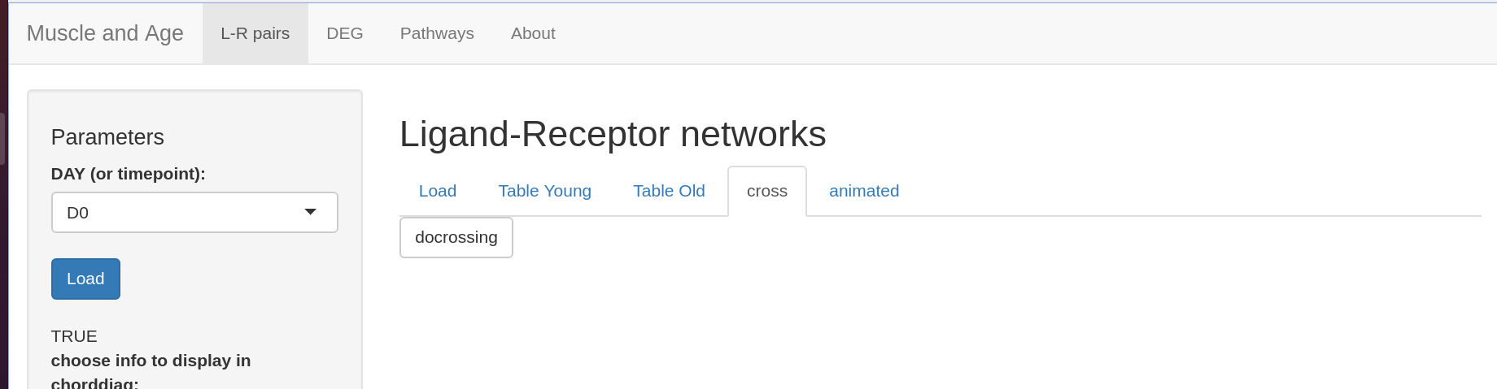
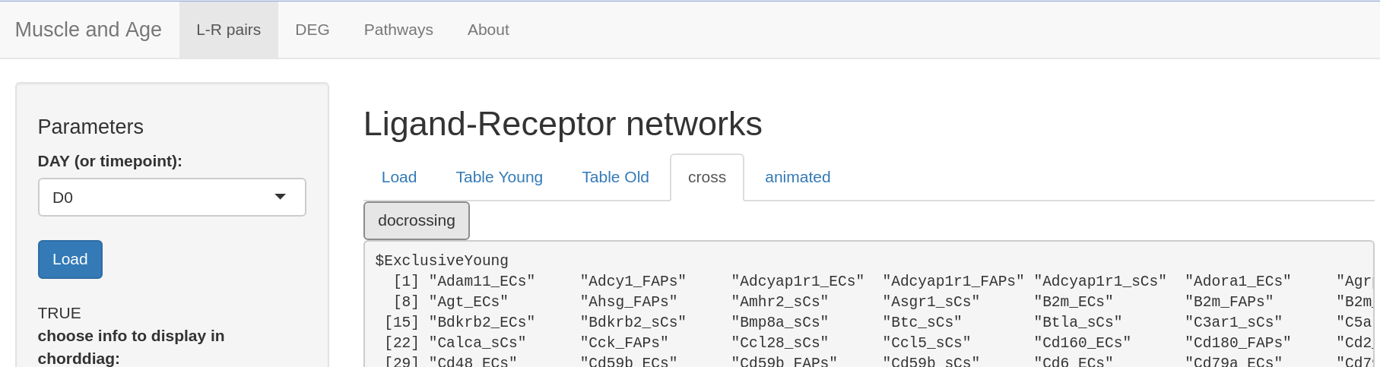
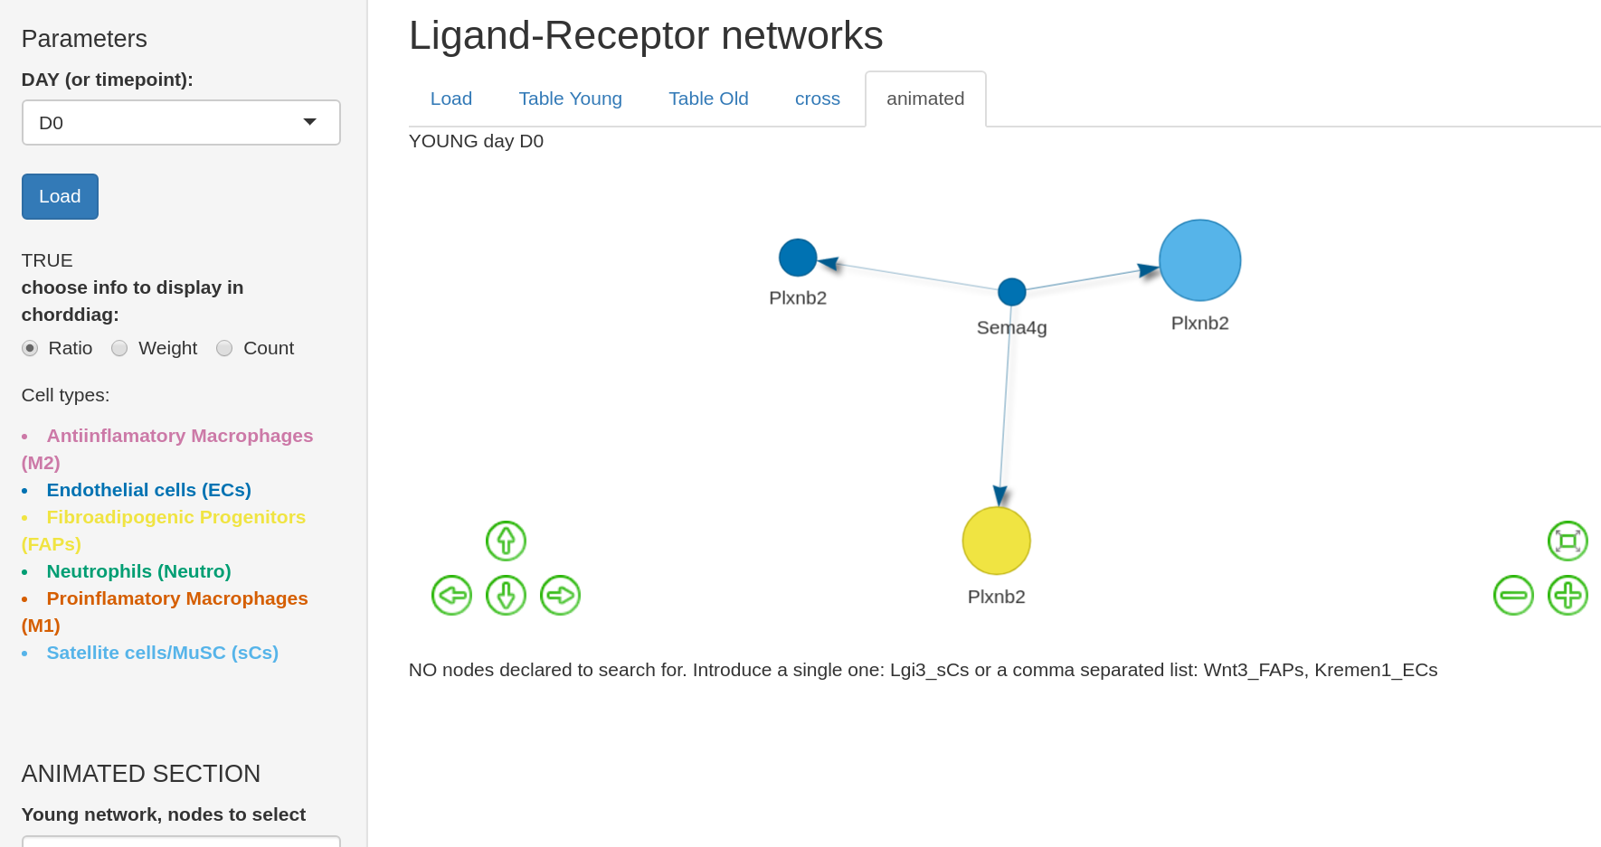
UI
input|output
●mainPanel(...Ligand-Receptor...,
● tabsetPanel(
●tabPanel("cross",
actionButton("docross", "docrossing"),
verbatimTextOutput("crossinf")),
●tabPanel("animated",
textOutput("labtextyoung"),
visNetworkOutput("young",
height="350px"),
style= "background-color: #ffffff;" )
data

Slide 7
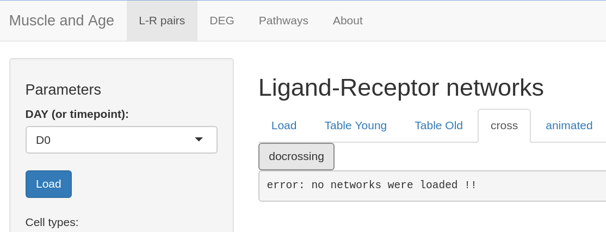
◾observeEvent(
input$docross,{
if (length(igElems_list$x) == 0){
output$crossinf <- renderText({"error: no
networks were loaded !!"})
crossedtab$x = NULL
}else{V_vec = list()
for (age in c("Young","Old")){
V_vec[[age]] =
igraph::as_data_frame(igElems_list$x[[age]],
"vertices")[["_nx_name"]]}
crossedtab$x[["ExclusiveYoung"]] =
sort(setdiff(V_vec[["Young"]],V_vec [["Old"]]))
crossedtab$x[["ExclusiveOld"]] =
sort(setdiff(V_vec[["Old"]],V_vec [["Young"]]))
crossedtab$x[["Intersection"]] =
sort(intersect(V_vec[["Old"]], V_vec[["Young"]
output$crossinf <- renderPrint(crossedtab$x)
}})
server
input|output
data

Slide 8
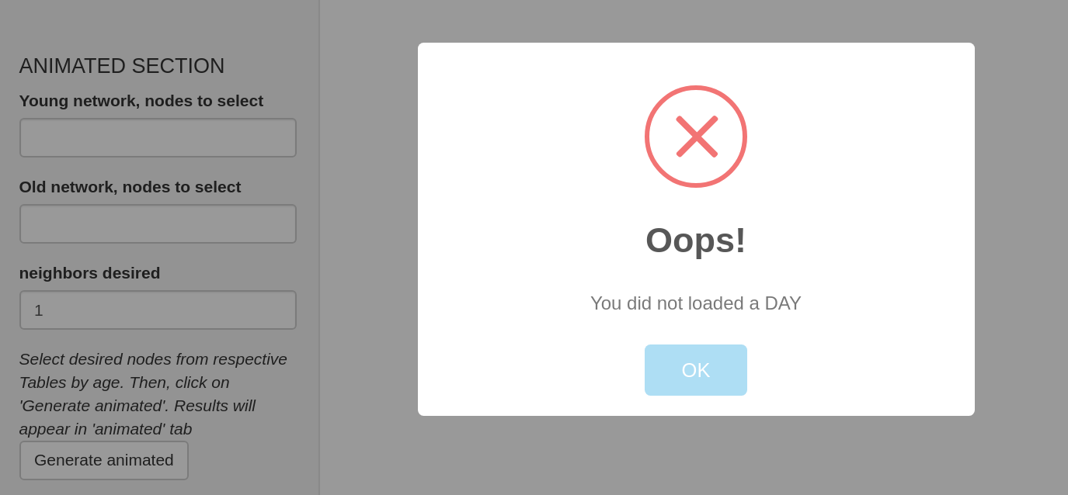
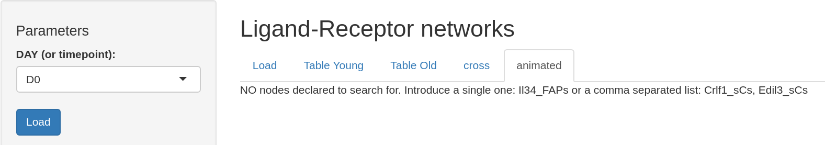
◾observeEvent(
input$GO,{
if (currentday$x == ''){
shinyalert("Oops!", "You did not loaded a DAY",
type = "error")}
else{
pickneigh = list("Young"=c(''), "Old"=c(''))
here.subgr = list()
if (input$young_nodes == "" ){
output$young <- renderVisNetwork({NULL})
output$labtextyoung <- renderText({
paste("NO nodes declared to search for. Introduce a single one:\n","Il34_FAPs\n or a comma separated list:\n ","Crlf1_sCs, Edil3_sCs")})
}else{
pickneigh[["Young"]] = unlist( str_split(
gsub(" ","",input$young_nodes), ",") )
ytrycatch <- tryCatch({
here.subgr[["Young"]] <- doinduced(
igElems_list$x[["Young"]],
pickneigh[["Young"]],orderinp = input$NEIGH)
subnet.y$nodes <- massageDATA(here.subgr[["Young"]])$nodes
subnet.y$edges <- massageDATA(here.subgr[["Young"]])$edges
output$labtextyoung <- renderText({paste("YOUNG day ", currentday$x)})
}
Created subgraph
doinduced function(g, interestvec ,orderinp){
vertex_attr(g)$numid <-
vertex_attr(g)$id
vertex_attr(g)$uniname <-
vertex_attr(g)[["_nx_name"]]
selnodes = V(g)[uniname %in%
interestvec]
selegoV <- ego(g, order
=orderinp, nodes = selnodes
, mode = "all", mindist = 0)
selegoG <- induced_subgraph
(g,unlist(selegoV))
return(selegoG)
}
server
input|output
data
massageDATA <- function(myg){
data <- toVisNetworkData(myg)
data$nodes$label =data$nodes$genesym
data$nodes$value = data$nodes$specificity*10
data$nodes$groupname = data$nodes$celltype
data$edges$width = data$edges$weight * 10
return(data)}

Slide 9
◾observeEvent(
….
pickneigh[["Young"]] = unlist( str_split(
gsub(" ","",input$young_nodes), ",") )
ytrycatch <- tryCatch({
here.subgr[["Young"]] <- doinduced(
igElems_list$x[["Young"]],
pickneigh[["Young"]],orderinp = input$NEIGH)
subnet.y$nodes <- massageDATA(here.subgr[["Young"]])$nodes
subnet.y$edges <- massageDATA(here.subgr[["Young"]])$edges
output$young <- renderVisNetwork({
req(subnet.y$edges)
netout <- visNetwork(
subnet.y$nodes, subnet.y$edges,
physics = FALSE) %>%
visEdges(shadow=T, arrows="to",
physics=FALSE) %>%
visInteraction(navigationButtons = TRUE)
netout
}) }, warning = function(war){
output$young <- renderVisNetwork({NULL})
output$labtextyoung <- renderText({
paste("this node is not not in Young at this day")}) }, error = function(err){
output$young <- renderVisNetwork({NULL})
output$labtextyoung <- renderText({
paste("this node is not not in Young at this day")})}, finally = { print("bad entry by user at input$young_nodes")}}
massageDATA <- function(myg){
data <- toVisNetworkData(myg)
data$nodes$label =data$nodes$genesym
data$nodes$value = data$nodes$specificity*10
data$nodes$groupname = data$nodes$celltype
data$edges$width = data$edges$weight * 10
return(data)}
server
input|output
data
Created subgraph
doinduced function(g, interestvec ,orderinp){
vertex_attr(g)$numid <-
vertex_attr(g)$id
vertex_attr(g)$uniname <-
vertex_attr(g)[["_nx_name"]]
selnodes = V(g)[uniname %in%
interestvec]
selegoV <- ego(g, order
=orderinp, nodes = selnodes
, mode = "all", mindist = 0)
selegoG <- induced_subgraph
(g,unlist(selegoV))
return(selegoG)
}

Slide 10
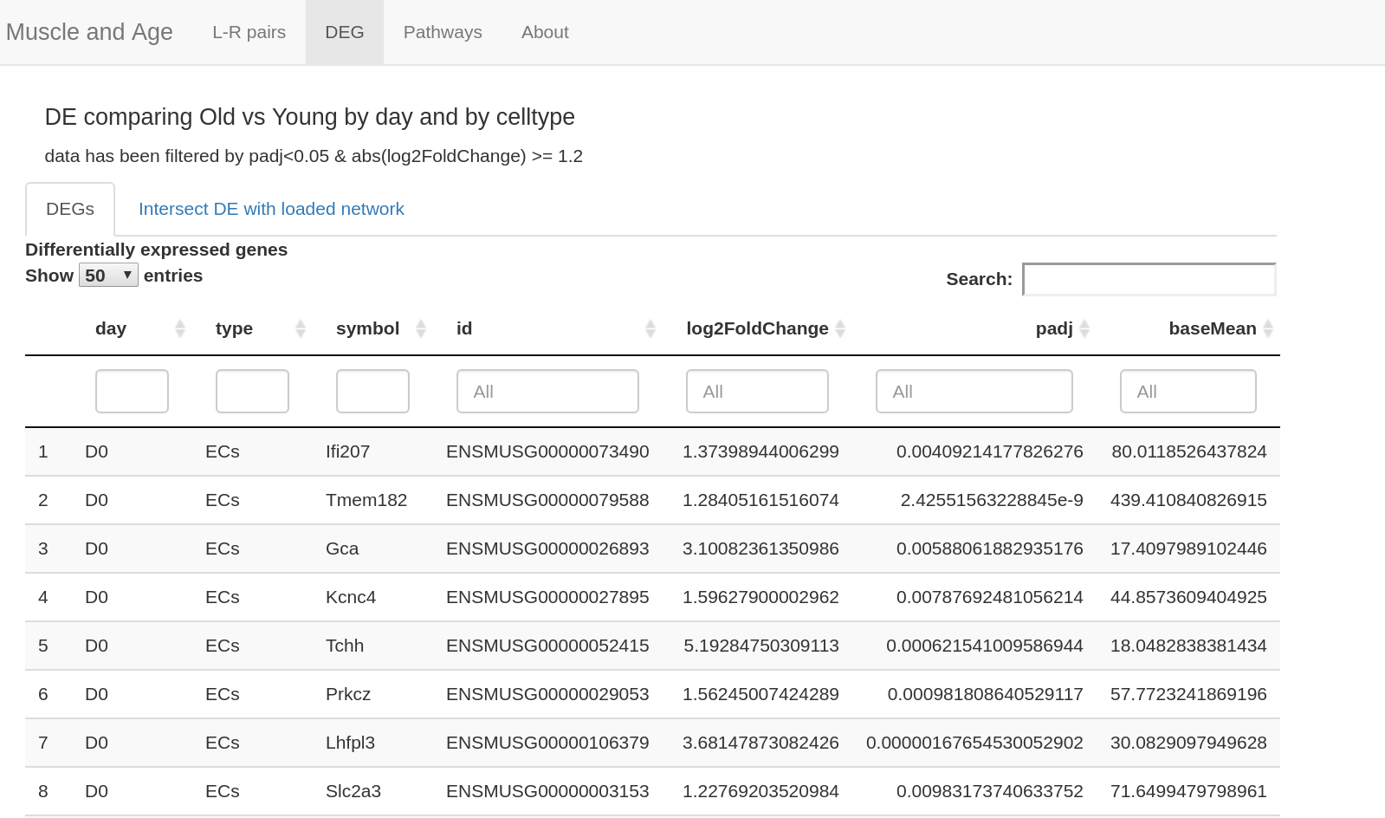
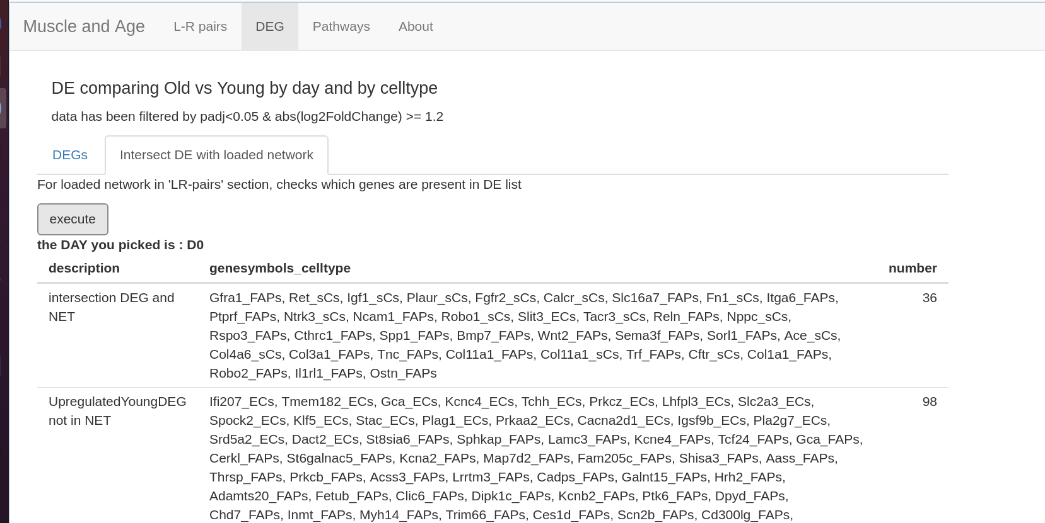
A
A.a
UI
A● navbarPage("Muscle and Age",
A.a● tabPanel( "DEG" ,
input|output
fluidPage(
column(8, h4("DE comparing Old vs Young by day and by celltype"),
p("data has been filtered by padj<0.05 & abs(log2FoldChange) >= 1.2")),
fluidRow(
column(1),
column(10,
tabsetPanel(
tabPanel("DEGs", strong("Differentially expressed genes"),
textOutput("currentDE_classical"),DTOutput("DE_classical")),
tabPanel("Intersect DE with loaded network",
p("For loaded network in 'LR-pairs' section,
checks which genes are present in DE list"),
actionButton("execu_LR_DE","execute"),
strong(textOutput("daywaspick")),
tableOutput("details_crossing"),

Slide 11
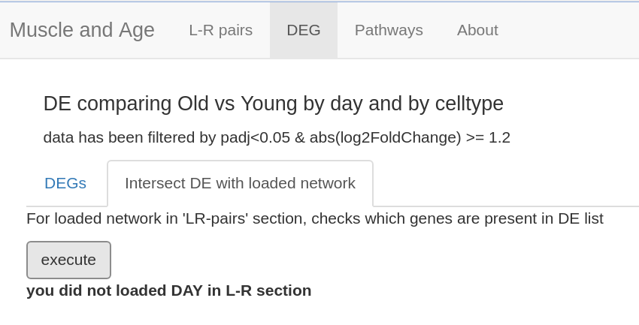
◾observeEvent(
input$execu_LR_DE,{
if (currentday$x == ''){
output$daywaspick <- renderText({paste("you did not loaded DAY in L-R section")})
}else if(currentday$x != isolate(input$DAY)){
output$daywaspick <- renderText({paste("error, the day in selector is not same as loaded")})
}else if(is.null(crossedtab$x)){
output$daywaspick <- renderText({paste("day:",
currentday$x," you must also click 'docross' in 'cross' tab in L-R section")})
}else{
output$daywaspick <- renderText({paste("the DAY you picked is : ", currentday$x)})
server
input|output
data
Intersect DEG et Reseaux RL
tmp_c <- DEclassic.show$x %>% filter(day == currentday$x)
tmp_c <- tmp_c %>% mutate(name = paste0(symbol, '_',type))
v_c_youngUp <- tmp_c %>% filter(log2FoldChange > 0) %>% pull(name)
v_c_oldUp <- tmp_c %>% filter(log2FoldChange < 0) %>% pull(name)
g.o = igraph::as_data_frame(igElems_list$x[["Old"]], "vertices")
g.y = igraph::as_data_frame(igElems_list$x[["Young"]], "vertices")
v_o = g.o[["_nx_name"]]
v_y = g.y[["_nx_name"]]
union_net = union(v_o, v_y)
intersectDEG_n_NET = intersect(union_net, tmp_c$name)
YinDEG_notinNET = setdiff(v_c_youngUp, v_y)
OinDEG_notinNET = setdiff(v_c_oldUp, v_o)
inNET_notinDEG_hyperYoung = setdiff(crossedtab$x[["ExclusiveYoung"]], v_c_youngUp )
inNET_notinDEG_hyperOld = setdiff(crossedtab$x[["ExclusiveOld"]], v_c_oldUp)
output$details_crossing <- renderTable({data.frame(
"description" = c("intersection DEG and NET",
"UpregulatedYoungDEG not in NET",
"UpreglatedOldDEG not in NET"),
"genesymbols_celltype" = c(
paste(intersectDEG_n_NET, collapse=", "),
paste(YinDEG_notinNET, collapse=", " ),
paste(OinDEG_notinNET, collapse=", ")),
"number" = c( length(intersectDEG_n_NET),
length(OinDEG_notinNET ),
length(OinDEG_notinNET)

Slide 12
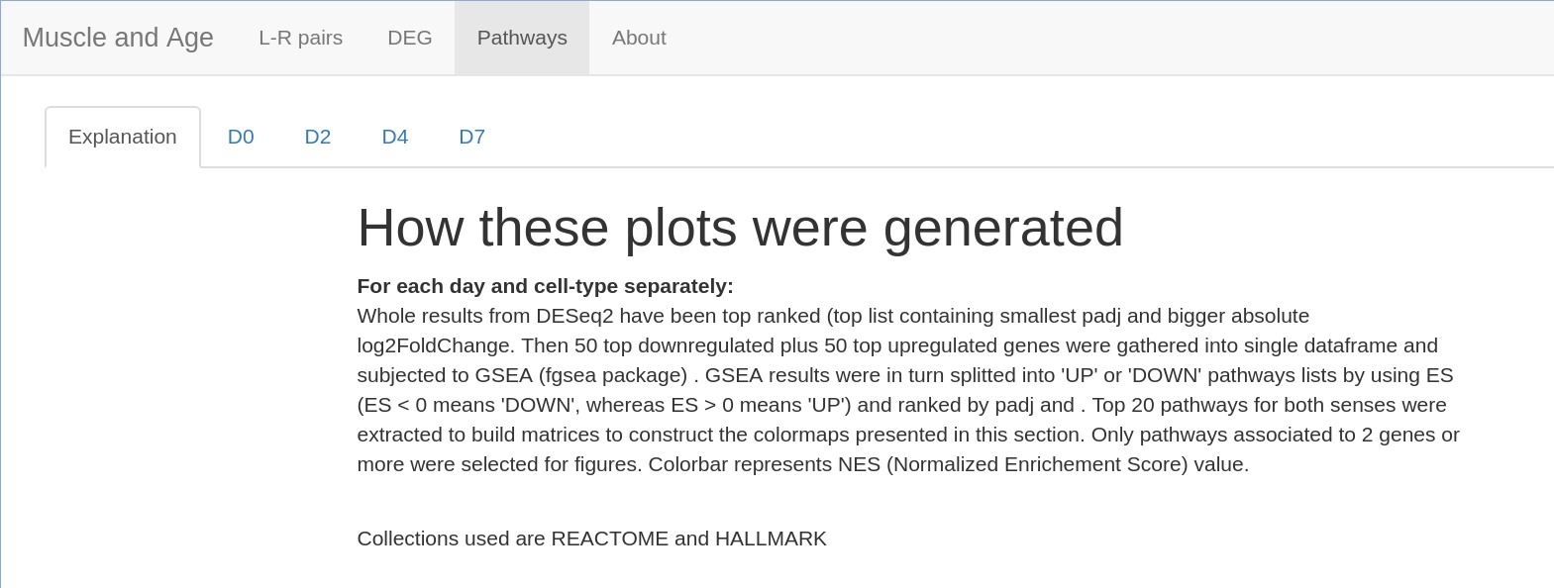
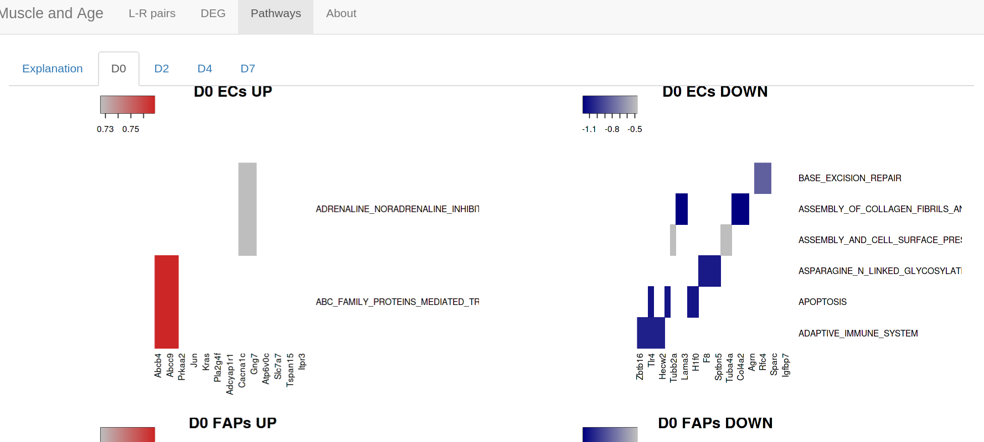
A
A.a
UI
A● navbarPage("Muscle and Age",
A.a● tabPanel( "Pathways" ,
input|output
fluidPage(
fluidRow(
column(12,
tabsetPanel(
tabPanel("Explanation",
column(2),
column(8,h1("How these plots were generated"), strong("For each day and cell-type separately:"),
p("Whole results from DESeq2 have been top,....
p("Collections used are REACTOME and HALLMARK"))),
tabPanel("D0",
column(6,
plotOutput("D0_ECs_UP"),
plotOutput("D0_FAPs_UP"),
plotOutput("D0_sCs_UP")),
column(6,
plotOutput("D0_ECs_DOWN"),
plotOutput("D0_FAPs_DOWN"),
plotOutput("D0_sCs_DOWN")),),
tabPanel("D2", ...

Slide 13
server
input|output
data
mhp = readRDS("Data/fgsea_matrices4heatmaps.rds")
sapply(names(mhp[['D0']]), function(CT, k = 'D0'){
output[[paste0(k,"_",CT,"_","UP")]] <- renderPlot({
heatmap3(as.matrix(mhp[[k]][[CT]][["UP"]]),
scale = "none",
col=colorRampPalette(c("gray","firebrick3"))(256),
Colv = NA, Rowv = NA,
cexRow = 1,
cexCol = 1,
ColSideWidth = ncol(mhp[[k]][[CT]][["UP"]]),
margins = c(7,10),
main = paste(k, CT, "UP"))
})
output[[paste0(k,"_",CT,"_","DOWN")]] <- renderPlot({
heatmap3(as.matrix(mhp[[k]][[CT]][["DOWN"]]),
scale = "none",
col=colorRampPalette(c("navy","gray"))(256),
Colv = NA, Rowv = NA,
cexRow = 1,
cexCol = 1,
ColSideWidth = ncol(mhp[[k]][[CT]][["DOWN"]]),
margins = c(7,10),
main = paste(k, CT, "DOWN")

Slide 14
https://shiny.rstudio.com/gallery/

