Slide 1
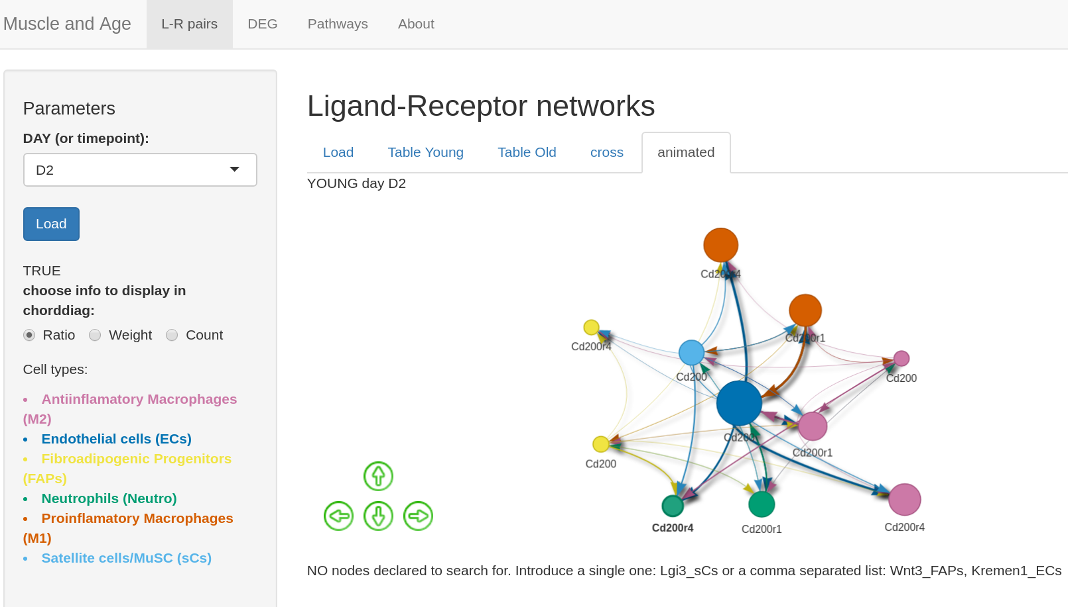
HELP shinyApp code
Localisation input & output data

Slide 2
