Slide 1
ELECTRONIC PIANO
GROUP 13
Le Minh Hieu 20215048
Tran Sy Hieu 20215053
Nguyen Manh Hieu 20215050
Nguyen Viet Hieu 20215051

Slide 2
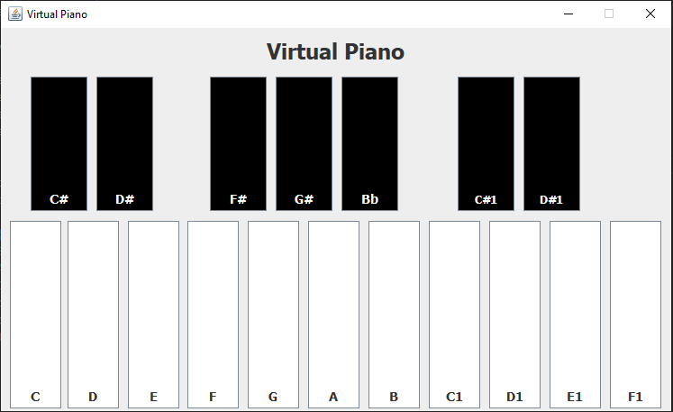
Problem Statement
Piano is a popular musical instrument. In this project, we implemented an application that provides GUI for the user to virtually play an electronic piano
On the main menu: title of the application, piano GUI , help menu, quit
User can play the piano by interacting with GUI
Help menu shows the basic usage and aim of the program
Quit exits the program. Remember to ask for confirmation
Keyboard: C (Do), D (Re), E (Mi), F (Fa), G (Sol), A (La), B (Xi), ...

Slide 3
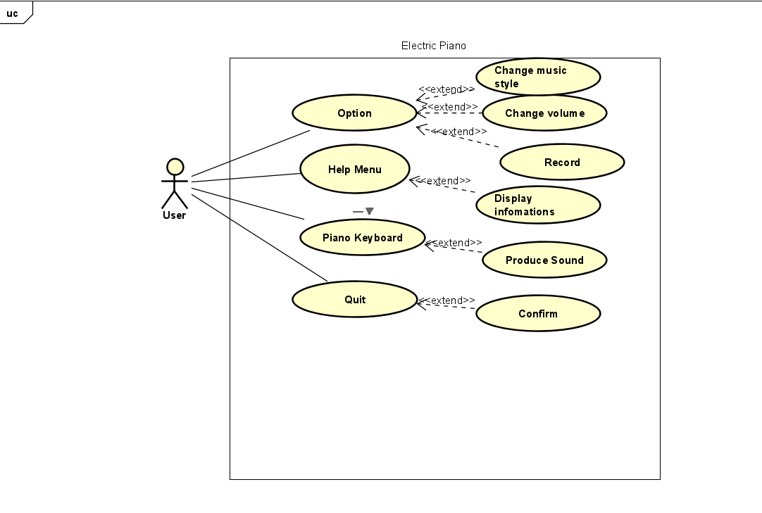
Use case diagram

Slide 4
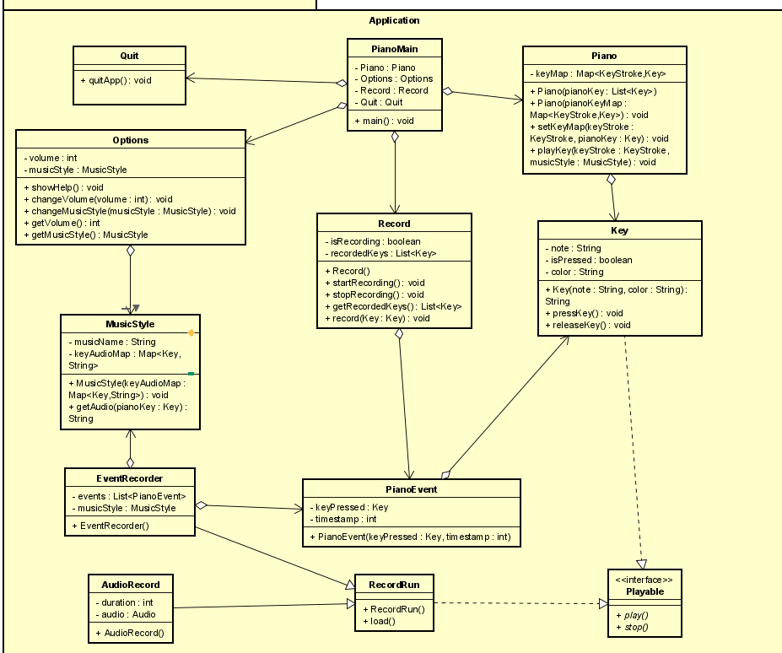
DETAIL class diagram

Slide 5
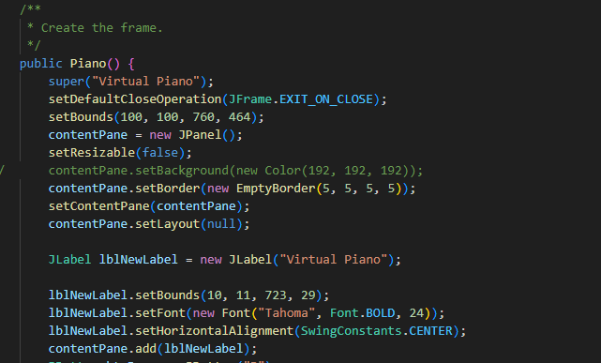
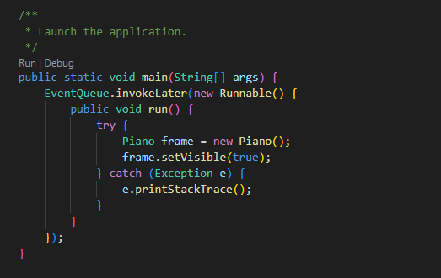

Slide 6
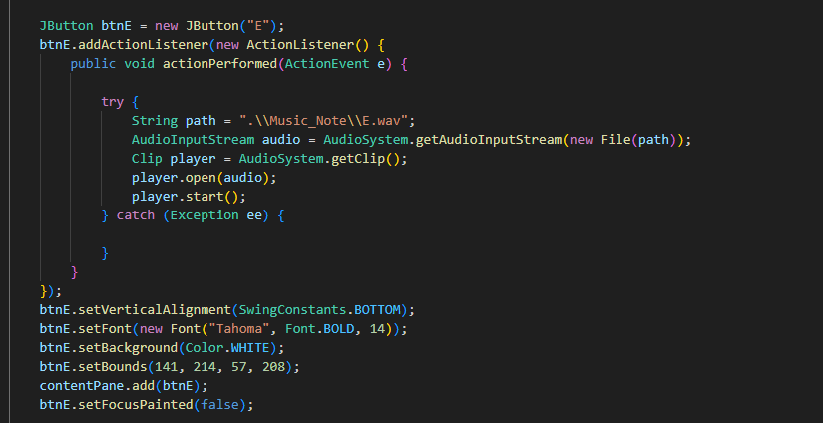

Slide 7
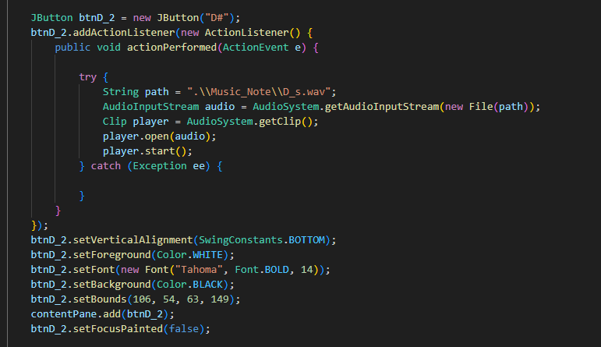

Slide 8
Record Video demo

