Slide 1


BUILT-IN FUNCTIONS
FUNCTIONS AND WILDCARDS IN SQL
the leading software outsourcing company in Vietnam.

Slide 2
Table of contents
Function Overview
String Functions
Math Functions
Date Functions
Other Useful Functions
Wildcards

Slide 3
Functions in SQL Server

Slide 4

SQL Functions
String Functions – for manipulating text, both from table values or user input
E.g. concatenate column values
Math Functions – calculations and working with aggregate data
E.g. perform geometry and currency operations
Date and Time Functions
E.g. find length of timespan
Miscellaneous Functions

Slide 5
String Functions

Slide 6
String Functions
Concatenation – combine strings
CONCAT replaces NULL values it with empty string
SELECT FirstName + ' ' + LastName
AS [Full Name]
FROM Employee
SELECT CONCAT(FirstName, ' ', LastName)
AS [Full Name]
FROM Employee

Slide 7
String Functions (2)
SUBSTRING – extract part of a string
Example: get short summary of article
SUBSTRING(String, StartIndex, Length)
Index is 1-based!
SELECT ArticleId, Author, Content,
SUBSTRING(Content, 1, 200) + '...' AS Summary
FROM Articles

Slide 8
String Functions (3)
REPLACE – replace specific string with another
Example: censor the word blood from album names
REPLACE(String, Pattern, Replacement)
SELECT REPLACE(Title, 'blood', '*****')
AS Title
FROM Album

Slide 9
String Functions (4)
LTRIM & RTRIM – remove spaces from either side of string
LEN – count number of characters
DATALENGHT – get number of used bytes (double for Unicode)
LTRIM(String)
RTRIM(String)
LEN(String)
DATALENGTH(String)

Slide 10
String Functions (5)
LEFT & RIGHT – get characters from beginning or end of string
Example: name shorthand (first 3 letters)
LEFT(String, Count)
RIGHT(String, Count)
SELECT Id, Start,
LEFT(Name, 3) AS Shorthand
FROM Games

Slide 11
Problem: Obfuscate CC Numbers
Our database contains credit card details for customers
Provide a summary without revealing the serial numbers
ID | FirstName | LastName | PaymentNumber
1 | Guy | Gilbert | 5645322227179083
2 | Kevin | Brown | 4417937746396076
… | … |  | …
ID | FirstName | LastName | PaymentNumber
1 | Guy | Gilbert | 564532**********
2 | Kevin | Brown | 441793**********
… | … |  | …

Slide 12
Solution : Obfuscate CC Numbers
We reveal the first 6 digits and obfuscate the rest
Bonus – create View for use by client apps
SELECT CustomerID,
FirstName,
LastName,
LEFT(PaymentNumber, 6) + '**********'
FROM Customers
CREATE VIEW v_PublicPaymentInfo AS
…

Slide 13
String Functions (6)
LOWER & UPPER – change letter casing
REVERSE – reverse order of all characters in string
REPLICATE – repeat string
LOWER(String)
UPPER(String)
REVERSE(String)
REPLICATE(String, Count)

Slide 14
String Functions (7)
CHARINDEX – locate specific pattern (substring) in string
STUFF – insert substring at specific position
If omitted, begins at 1
CHARINDEX(Pattern, String, [StartIndex])
STUFF(String, StartIndex, Length, Substring)
Number of character
to delete

Slide 15
Math Functions

Slide 16
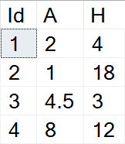
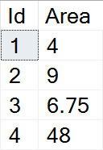
Math Functions
Basic arithmetic operations
Example: find area of triangles by given side and height
SELECT Id,
(A*H)/2 AS Area
FROM Triangles

Slide 17
Math Functions (2)
PI – get the value of Pi as float (15 –digit precision)
ABS – absolute value
SQRT – square root (result will be float)
SQUARE – raise to power of two
SELECT PI() --3.14159265358979
ABS(Value)
SQRT(Value)
SQUARE(Value)

Slide 18
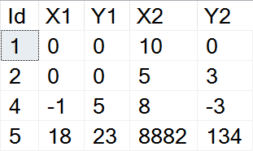
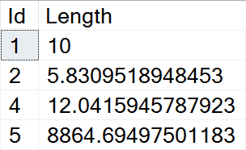
Example: Line Length
Find the length of a line by given coordinates of end points
SELECT Id,
SQRT(SQUARE(X1-X2) + SQUARE(Y1-Y2))
AS Length
FROM Lines

Slide 19
Math Functions (3)
POWER – raise value to desired exponent
ROUND – obtain desired precision
FLOOR & CEILING – return the nearest integer
POWER(Value, Exponent)
Can be negative
ROUND(Value, Precision)
FLOOR(Value)
CEILING(Value)

Slide 20
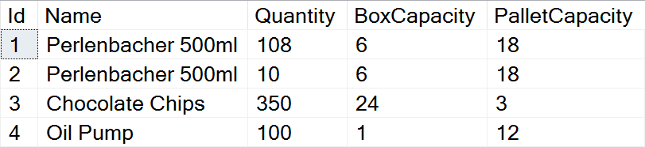
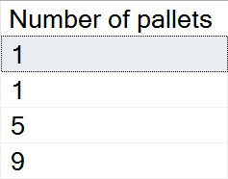
Problem: Pallets
Calculate the required number of pallets to ship each item
BoxCapacity specifies how many items can fit in one box
PalletCapacity specifies how many boxes can fit in a pallet

Slide 21
Solution : Pallets
Since we can't use half a box or half a pallet, we need to round up to the nearest integer value
SELECT
CEILING(
CEILING(
CAST(Quantity AS float) /
BoxCapacity) /
PalletCapacity)
AS [Number of pallets]
FROM Products

Slide 22
Math Functions (4)
SIGN – returns +1, -1 or 0, depending on value sign
RAND – get a random float value in range [0,1)
If Seed is not specified, one is assigned at random
SIGN(Value)
RAND()
RAND(Seed)

Slide 23
Date Functions

Slide 24
Date Functions
DATEPART – extract a segment from a date as an integer
Part can be any part and format of date or time
For a full list, see the official documentation
DATEPART(Part, Date)
year, yyyy, yy
YEAR(Date)
month, mm, m
MONTH(Date)
day, dd, d
DAY(Date)

Slide 25
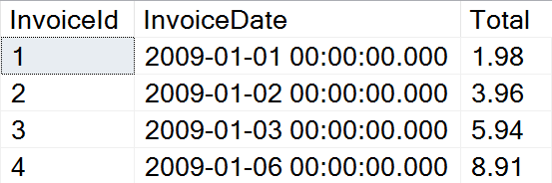
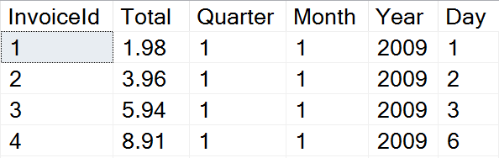
Problem: Quarterly Report
Prepare sales data for aggregation by displaying yearly quarter, month, year and day of sale

Slide 26
Solution: Quarterly Report
Use DATEPART to get the relevant parts of the date
This statement might be useful as a View
SELECT InvoiceId, Total,
DATEPART(quarter, InvoiceDate) AS Quarter,
DATEPART(month, InvoiceDate) AS Month,
DATEPART(year, InvoiceDate) AS Year,
DATEPART(day, InvoiceDate) AS Day
FROM Invoice

Slide 27
Date Functions (2)
DATEDIFF – find difference between two dates
Part can be any part and format of date or time
Example: Show employee experience
DATEDIFF(Part, FirstDate, SecondDate)
SELECT ID, FirstName, LastName,
DATEDIFF(year, HireDate, '2017/01/25')
AS [Years In Service]
FROM Employees

Slide 28
Date Functions (3)
DATENAME – get a string representation of a date's part
DATEADD – perform date arithmetic
Part can be any part and format of date or time
GETDATE – obtain current date and time
DATENAME(Part, Date)
SELECT DATENAME(weekday, '2017/01/27')
DATEADD(Part, Number, Date)
SELECT GETDATE()

Slide 29
OTHER FUNCTIONS

Slide 30
Other Functions
CAST & CONVERT – convert between data types
ISNULL – swap NULL values with a specified default value
Example: Display Not Finished for projects with no EndDate
CAST(Data AS NewType)
CONVERT(NewType, Data)
ISNULL(Data, DefaultValue)
SELECT ProjectID, Name,
ISNULL(CAST(EndDate AS varchar), 'Not Finished')
FROM Projects

Slide 31
Other Functions (2)
OFFSET & FETCH – get only specific rows from the result set
Used in combination with ORDER BY for pagination
SELECT ID, FirstName, LastName
FROM Employees
ORDER BY ID
OFFSET 10 ROWS
FETCH NEXT 5 ROWS ONLY
Rows to skip
Rows to include

Slide 32
Other Functions (3)
OVER determines the partitioning and ordering of a rowset before the associated window function is applied
Using in
Ranking functions
Aggregate functions
Analytic functions
Window functions might have the following arguments in their OVER clause:
PARTITION BY that divides the query result set into partitions.
ORDER BY that defines the logical order of the rows within each partition of the result set.
Notes:
Determines the partitioning and ordering of a rowset before the associated window function is applied. That is, the OVER clause defines a window or user-specified set of rows within a query result set. A window function then computes a value for each row in the window. You can use the OVER clause with functions to compute aggregated values such as moving averages, cumulative aggregates, running totals, or a top N per group results.

Slide 33
Other Functions (3)
object_id | min | max
3 | 3 | 2139154666
5 | 3 | 2139154666
... | ... | ...
2123154609 | 3 | 2139154666
2139154666 | 3 | 2139154666
select
object_id, type
, [min] = min(object_id) over(partition by type order by object_id)
, [max] = max(object_id) over(partition by type order by object_id)
from sys.objects
select object_id
, [min] = min(object_id) over()
, [max] = max(object_id) over()
from sys.objects
object_id | type | min | max
68195293 | PK | 68195293 | 68195293
631673298 | PK | 68195293 | 631673298
711673583 | PK | 68195293 | 711673583
... | ... | ...
3 | S | 3 | 3
5 | S | 3 | 5
6 | S | 3 | 6
... | ... | ...
97 | S | 3 | 97
98 | S | 3 | 98
select object_id
, type
, [min] = min(object_id) over(partition by type)
, [max] = max(object_id) over(partition by type)
from sys.objects
object_id | type | min | max
68195293 | PK | 68195293 | 711673583
631673298 | PK | 68195293 | 711673583
711673583 | PK | 68195293 | 711673583
... | ... | ...
3 | S | 3 | 98
5 | S | 3 | 98
... | ... | ...
98 | S | 3 | 98

Slide 34
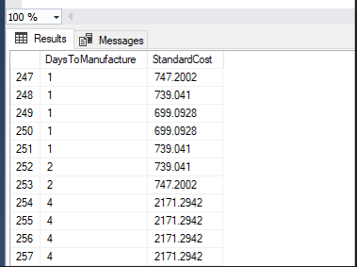
Other Functions (4)
1
PIVOT
DaysToManufacture | AverageCost
0 | 5.0885
1 | 223.88
2 | 359.1082
4 | 949.4105
2
Cost_Sorted_By_Production_Day | 0 | 1 | 2 | 3 | 4
AverageCost | 5.0885 | 223.88 | 359.1082 | NULL | 949.4105
Notes:
You can use the PIVOT and UNPIVOT relational operators to change a table-valued expression into another table. PIVOT rotates a table-valued expression by turning the unique values from one column in the expression into multiple columns in the output. And PIVOT runs aggregations where they're required on any remaining column values that are wanted in the final output. UNPIVOT carries out the opposite operation to PIVOT by rotating columns of a table-valued expression into column values.

Slide 35
Other Functions (4)
SELECT DaysToManufacture, AVG(StandardCost) AS AverageCost
FROM Production.Product
GROUP BY DaysToManufacture;
1
SELECT 'AverageCost' AS Cost_Sorted_By_Production_Days,
[0], [1], [2], [3], [4]
FROM
(
SELECT DaysToManufacture, StandardCost
FROM Production.Product
) AS SourceTable
PIVOT
(
AVG(StandardCost)
FOR DaysToManufacture IN ([0], [1], [2], [3], [4])
) AS PivotTable;
2

Slide 36
Wildcards
Selecting results by partial match

Slide 37
Using WHERE … LIKE
Wildcards are used with WHERE to filter for partial match
Similar to Regular Expressions
Example: Find all employees who's first name starts with "Ro"
SELECT ID, FirstName, LastName
FROM Employees
WHERE FirstName LIKE 'Ro%'
Wildcard symbol

Slide 38
Wildcard Characters
Supported characters include
ESCAPE – specify prefix to treat special characters as normal
% --any string, including zero-length
_ --any single character
[…] --any character within range
[^…] --any character not in the range
SELECT ID, Name
FROM Tracks
WHERE Name LIKE '%\_max%' ESCAPE '\'

Slide 39
BUILT-IN FUNCTIONS
END

