Slide 1
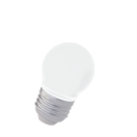
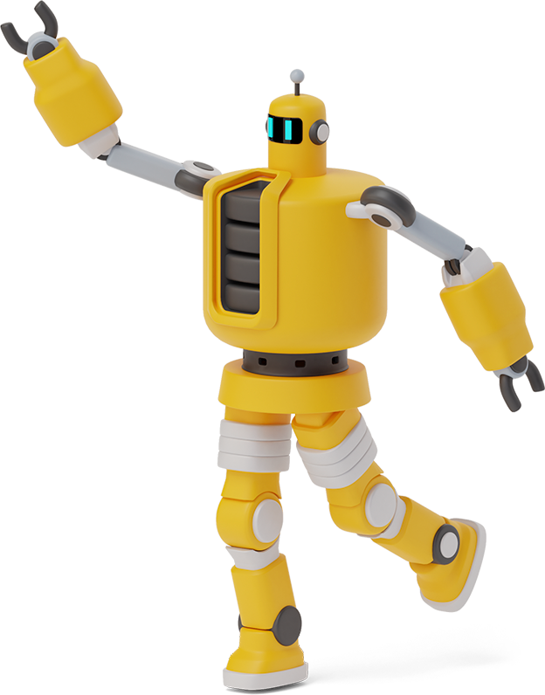

Naive Bayes Tutorial
Thành Viên:
+ Lê Hoàng Long – 518H0035
+ Nguyễn Tuấn Dũng – 518H0613
Giảng viên: Lê Cung Tưởng

Slide 2
Roadmap
Industrial Use Of Naïve Bayes
Demo
What is Naive Bayes?
1
3
5
2
4
What is Bayes'
Theorem?
Bayes's Theorem Example

Slide 3

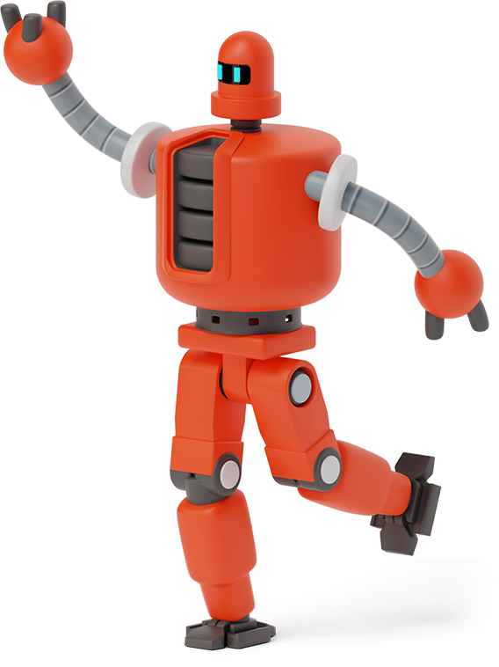
What is Naive Bayes?
1
Let’s start with the first set of slides

Slide 4
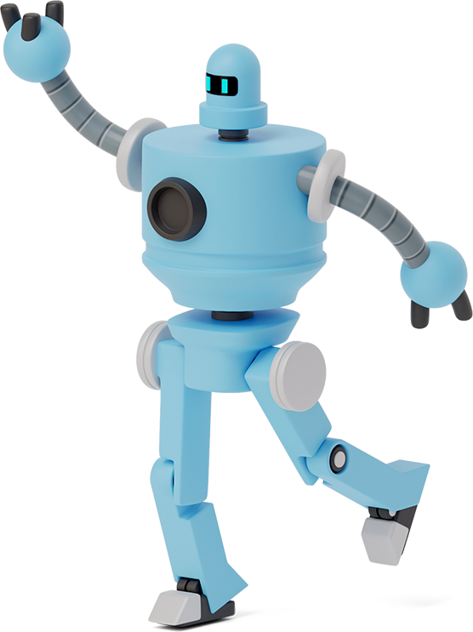
“Naive Bayes is a simple but surprisingly powerful algorithm for predictive modeling”.

Slide 5

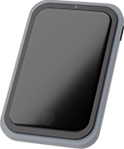
The Naive Bayes classifier assumes that the presence of a feature in a class is not related to any other. Even if these features depend on each other or depend on the existence of other features, all of these properties contribute independently to the probability that a particular fruit is an apple or oranges. banana, and that's why it's called "Naive."

Slide 6
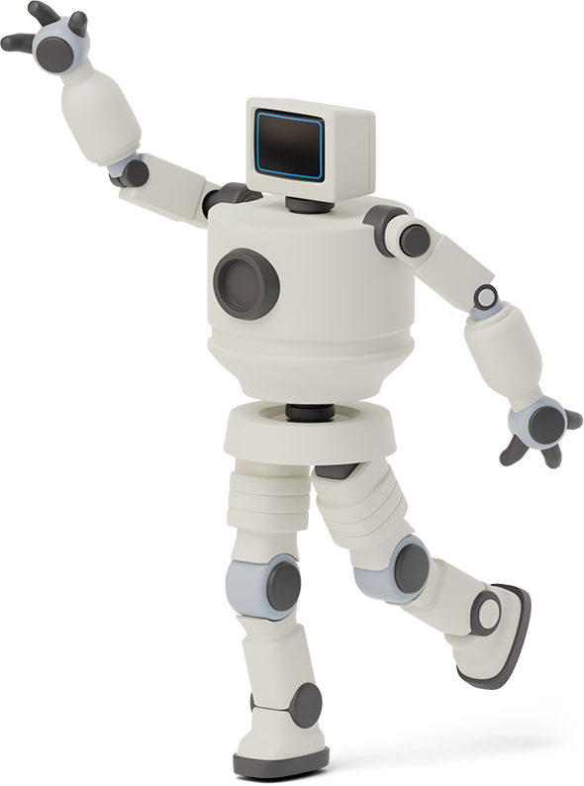

What is Bayes' Theorem?
2

Slide 7
In statistics and the theory of probability, Bayes' theorem describes the probability of an event, based on prior knowledge of the conditions that may be related to the event. It serves as a way to find a conditional probability

Slide 8

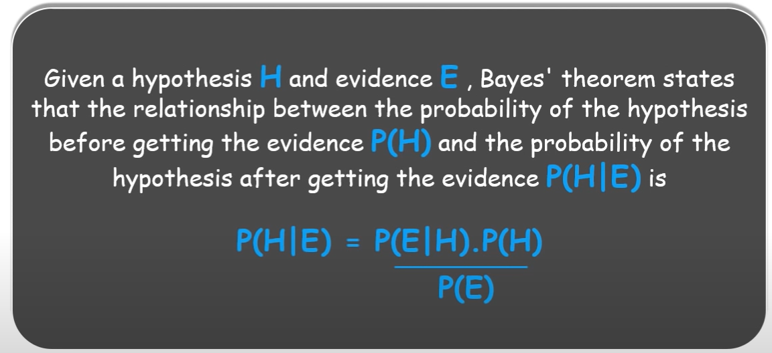

Slide 9

3) Industrial Use Of Naïve Bayes
Now that you have an idea of what exactly Naive Bayes is and how it works, let's see where it is used in the industry.

Slide 10
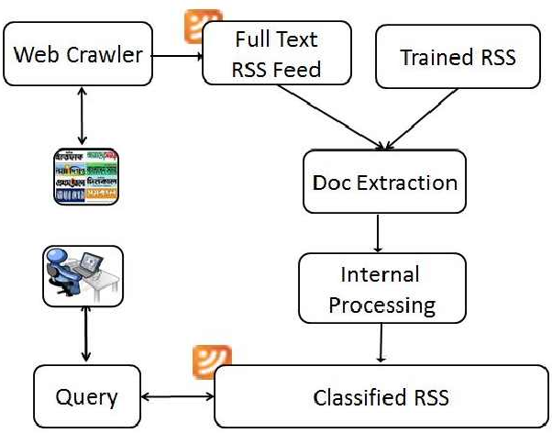
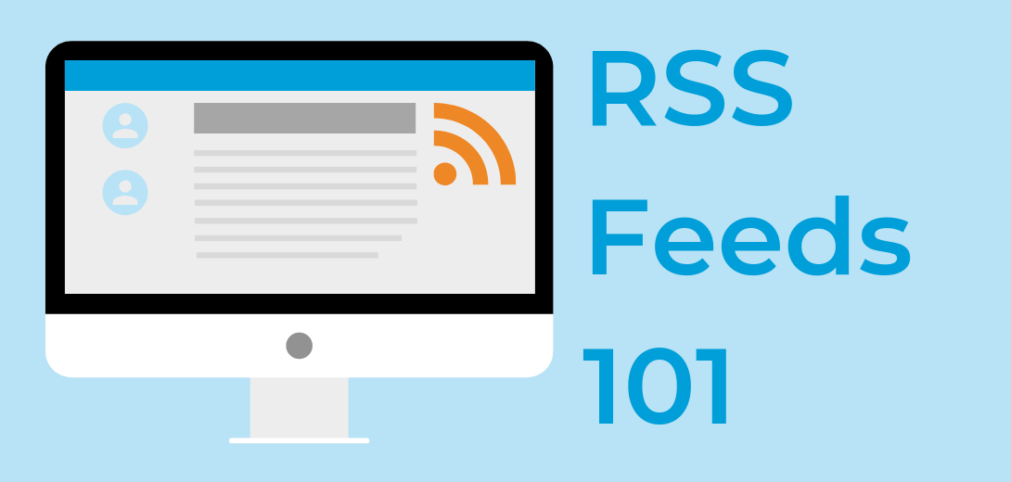

Slide 11
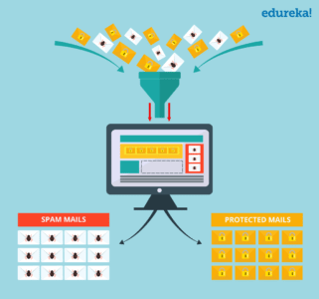
SPAM FILTERING

Slide 12

MEDICAL DIAGNOSTIC

Slide 13
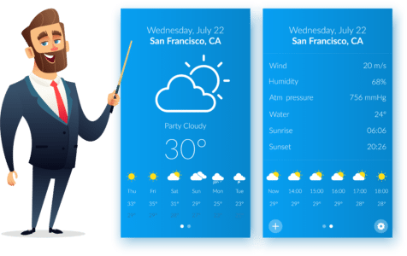
Weather Forecast
A Bayes-based model for weather prediction is used, where the following probabilities are used to calculate the likelihood of each class label for the data input instance and the most likely model is considered output results.

Slide 14
Example
4
Predict the future with some weather data.

Slide 15
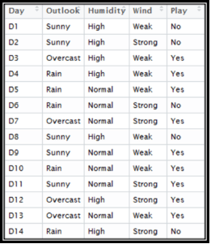
Frequency Table |  | Play
 |  | Yes | No
Outlook | Sunny | 2 | 3
 | Overcast | 4 | 0
 | Rainy | 3 | 2
Frequency Table |  | Play
 |  | Yes | No
Humidity | High | 3 | 4
 | Normal | 6 | 1
Frequency Table |  | Play
 |  | Yes | No
Wind | Strong | 3 | 3
 | Week | 6 | 2

Slide 16
P(x|c) = P(sunny|Yes) = 2/9 = 0.22
Likelihood Table |  | Play
 |  | Yes | No
Outlook | Sunny | 2/9 | 3/5 | 5/14
 | Overcast | 4/9 | 0/5 | 4/14
 | Rainy | 3/9 | 2/5 | 5/14
 |  | 9/14 | 5/14
P(x) = P(sunny) = 5/14 = 0.36
P(c) = P(Yes) = 9/14 = 0.64
Likelihood of ‘Yes’ given Sunny is
P(c|x) = P(Yes|Sunny)= P(Sunny|Yes) * P(Yes) / P(Sunny) = (0.22 * 0.64) / 0.36 = 0.391
Similarly Likelihood of ‘No’ given Sunny is
P(c|x) = P(No|Sunny)= P(sunny|No) * P(No) / P(Sunny) = (0.6 * 0.36) / 0.36 = 0.6

Slide 17
Likelihood table for Humidity
Likelihood table for Wind
Likelihood Table |  | Play
 |  | Yes | No
Humidity | High | 3/9 | 4/5 | 7/14
 | Normal | 6/9 | 1/5 | 7/14
 |  | 9/14 | 5/14
Likelihood Table |  | Play
 |  | Yes | No
Wind | Strong | 3/9 | 3/5 | 6/14
 | Week | 6/9 | 2/5 | 8/14
 |  | 9/14 | 5/14
P(Yes|Hight) = (0.33 * 0.6) / 0.5 = 0.42
P(Yes|Week) = (0.67 * 0.64) / 0.57 = 0.75
P(No|Hight) = (0.8 * 0.36) / 0.5 = 0.58
P(No|Week) = (0.4 * 0.36) / 0.57 = 0.25

Slide 18
Suppose we have a day with following values:
Outlook = Rain
Humidity = High
Wind = Weak
Play = ?
Likelihood of ‘Yes’ on that Day = P(Outlook = Rain|Yes) * P(Humidity=High|Yes) * P(Win =Week|Yes) * P(Yes)
= 3/9 * 3/9 * 6/9 * 9/14 = 0.0477
Likelihood of ‘No’ on that Day = P(Outlook = Rain|No) * P(Humidity=High|No) * P(Win =Week|No) * P(No)
= 2/5 * 4/5 * 2/5 * 5/14 = 0.0457

Slide 19

P(Yes) = 0.0477 / ( 0.0477+0.0457) = 0.51
Our model predicts that there is a 51% chance there will be game tomorrow
😉 😉
P(No) = 0.0457 / ( 0.0477+0.0457) = 0.49

Slide 20
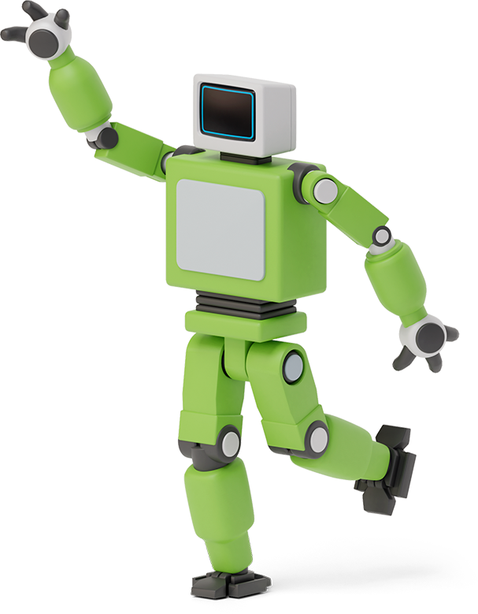
5
Demo
Naive Bayes with SKLEARN

Slide 21

What is Sklearn ?
Scikit-learn is a free machine learning library for Python. It features various algorithms like support vector machine, random forests, and k-neighbours, and it also supports Python numerical and scientific libraries like NumPy and SciPy.

Slide 22
Types Of Naïve bayes
Gaussian NB
It should be used for features in decimal form. GNB assumes features to follow a normal distribution.
MultiNomial NB
It should be used for the features with discrete values like word count 1,2,3...
Bernoulli NB
It should be used for features with binary or boolean values like True/False or 0/1

Slide 23
Thanks for listening

