Slide 1

Project Customer Churn Prediction Analyst

Slide 2
Predicting custopmers will be abandoned in business management
This is a project that showcases the critial importance of customer churn prediction in various industries such as telecommunications, internet service, providers, pay TV companies, insurance company and alarm monitoring services.

Slide 3
Understading Customer Loss
Customer Churn: Is the condition in which customer stop using a business’s services or products for a certain period of time
Importance:
Reduced revenue: Customers leaving means businesses lose revenue from them.
High costs: The costs to attract new customers is much higher than cost to retain existing customer.
Brand reputation: A high customer churn rate can negatively affect a brand’s reputation and image.
Sectors where churn prediction is important:
Telecommunications
Companies that provide phone and internet services need to predict customer churn to maintain a stable customer base.
Internet (ISP)
ISPs need to retain customers to ensure stable cash flow and minimize marketing costs
Insurance firms
Churn prediction helps insurances companies minimize losses from customers cancelling contracts.
Alarm monitoring services
Ensure security and continuous service to retain existing customers.

Slide 4
APPENDIX
Detailed source code for loading and processing data
https://github.com/LeHoangNam123/project_customer_churn/tree/loading_and_processing_data
Detailed source code for the EDA implementation
https://github.com/LeHoangNam123/project_customer_churn/tree/Performing_EDA_
Detailed source code for building and evaluating prediction models
https://github.com/LeHoangNam123/project_customer_churn/tree/building_and_evaluating_prediction_models
Detailed explanation of terms and model evaluation indicators
Accuracy: The percentage of correct predictions out of total predictions.
Precision: The percentage of correct positive predictions out of all positive predictions made.
Recall: The percentage of correct positive predictions out of all actual positive cases.
F1 Score: The harmonic mean of Precision and Recall, used to evaluate models when there is an imbalance between Precision and Recall.

Slide 5
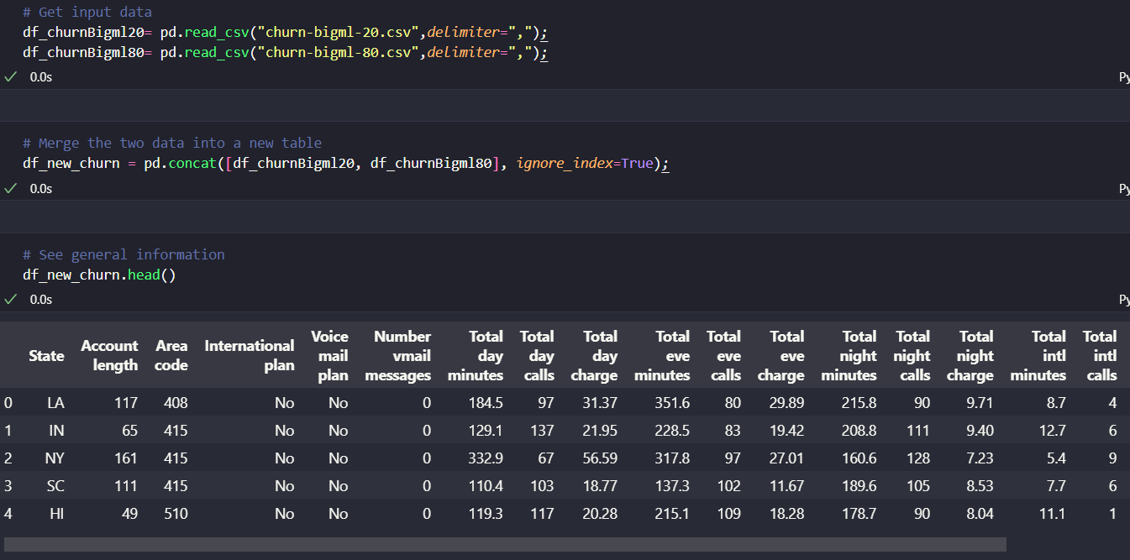
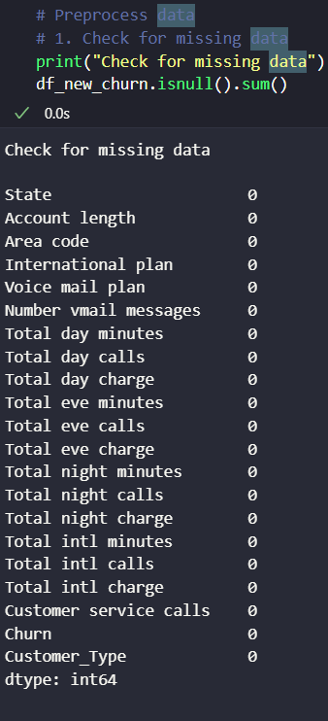
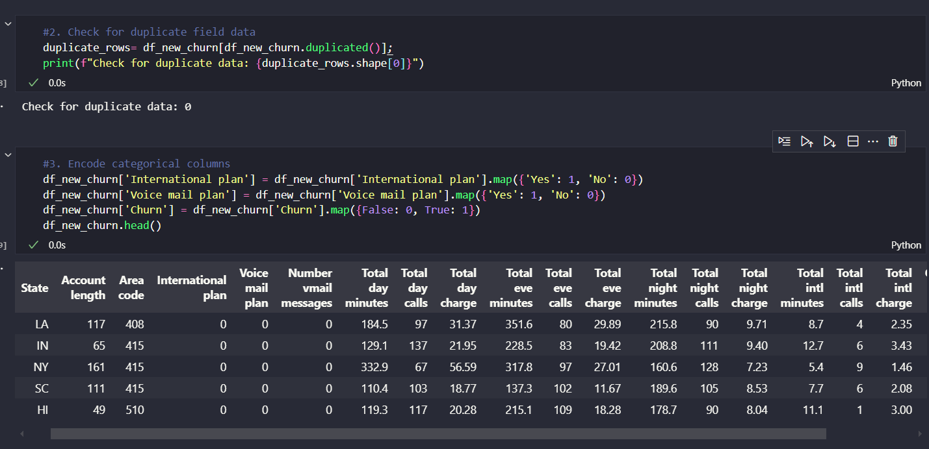
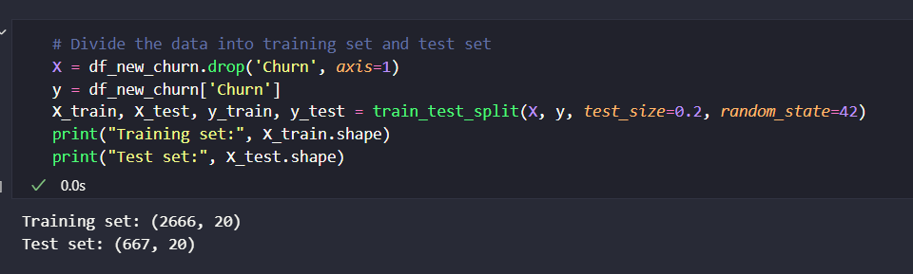
Understading and Processing data
Data about a telecommunications company’s customers, including information such as service calls and wether customers churn.

Slide 6
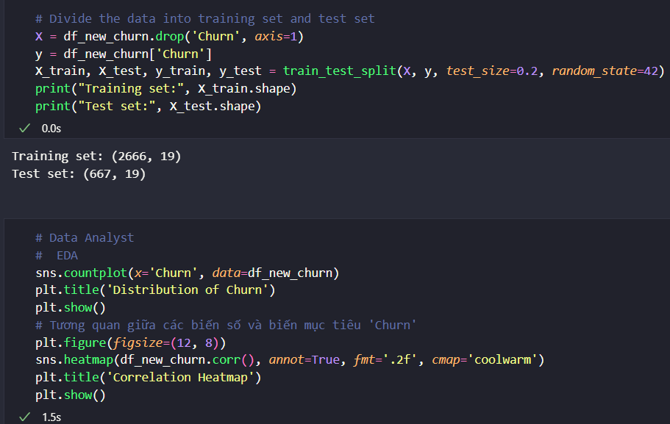
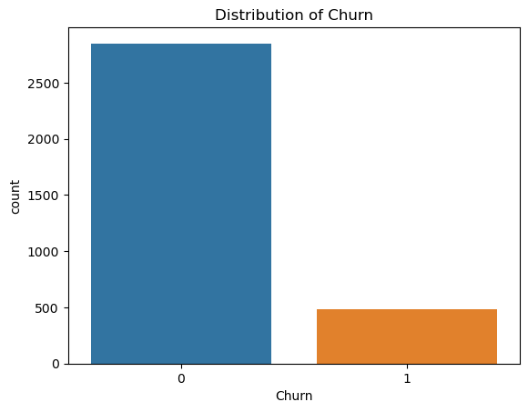
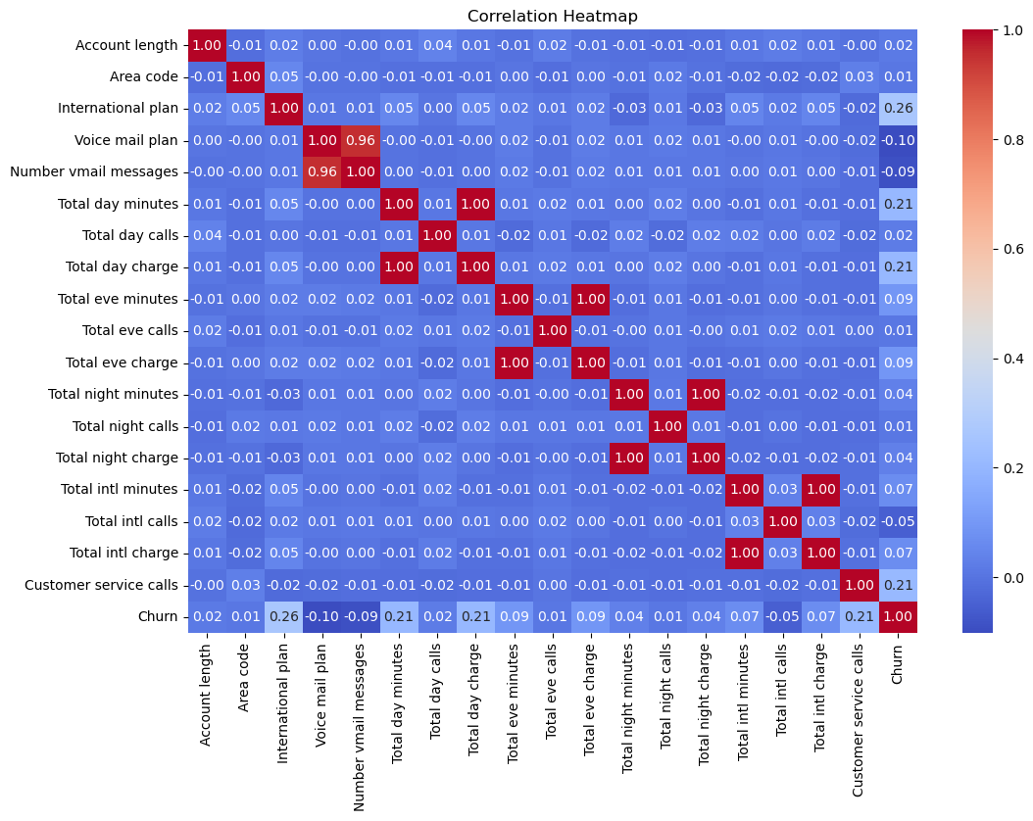
Exploratory Data Analyst(EDA)
Describe the purpose of EDA:
Exploratory Data Analyst(EDA) is the process of analyzing data initially to discover patterns, detect outliers, test assumptions, and understand data structure. The main purposes of EDA are:
Gain a better understanding of data characteristics and relationships. Detect outliers and trends.
Evaluate the distribution of data and test statistical assumptions.
Identify important features and their impact on goals.

Slide 7
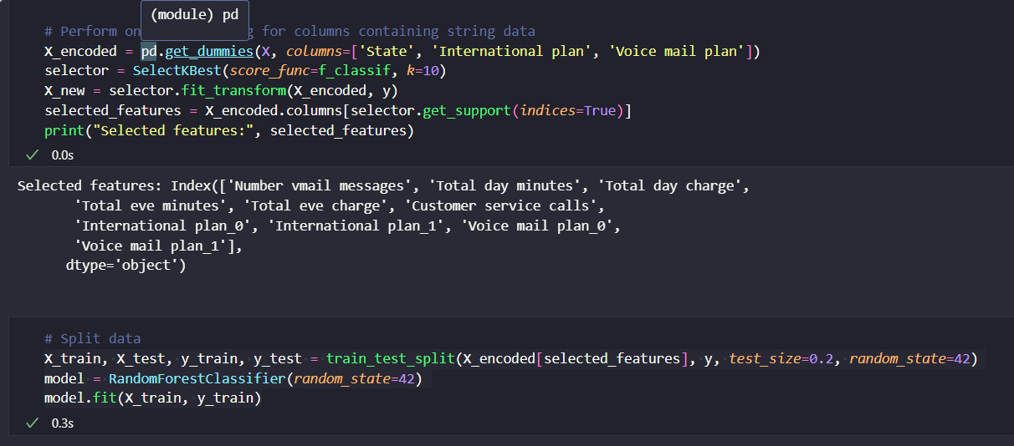
Model Construction
Description of the selected model(Ramdom ForestClassifier)
Ramdom Forest is a popular machine learning method for classification and regression problems.
It combines multiple(Decision Trees) to create a powerfull model.
Ramdom Forest automatically handles problems like overfitting and does not requie many tuning parameter.

Slide 8
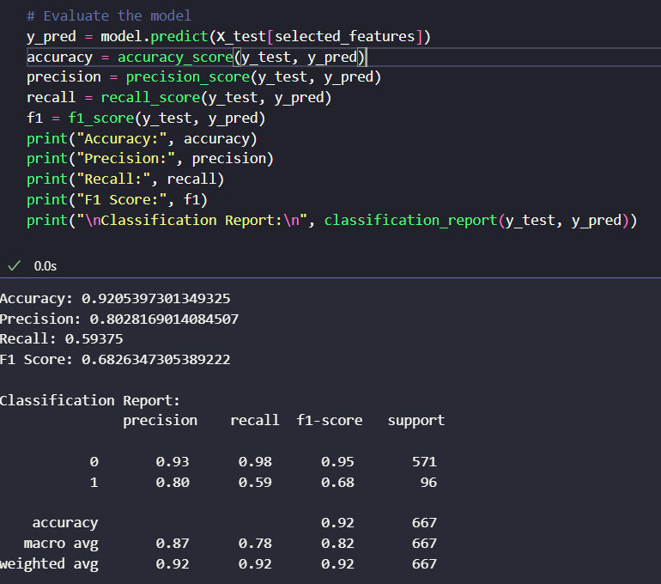
Model Evaluation
In this step, we will list and display the evaluation metrics of the trained model, including:
Accuracy: The ratio of correctly predicted instances to the total instances in the test data.
Precision: The ratio of correctly predicted positive instances to the total predicted positive instances.
Recall: The ratio of correctly predicted positive instances to the actual positive instances in the data.
F1-score: The harmonic mean of precision and recall, providing an overall measure of the model's performance.
The evaluation results of the model are as follows:
Accuracy: 92.05%
Precision: 80.28%
Recall: 59.38%
F1-score: 68.26%

Slide 9
Conclusion
In this process, we have performed a series of steps to predict customer churn. From understanding and preprocessing the data to exploratory analysis and model building, we have created a robust system for predicting and managing customer churn.
The model evaluation has shown positive results, with high accuracy and impressive model evaluation metrics. This underscores the importance of predictive analytics in customer retention.
By leveraging advanced predictive techniques, businesses can detect and address churn risks effectively. This not only optimizes customer retention strategies but also enhances the success and profitability of the enterprise.

