Slide 1
Federated Calculations Fitbit dataset
Isaias Rivera CS 528-01

Slide 2
Team Description
The team is only myself. I am a third year undergraduate computer science student doing Co-Terminal at Illinois Tech. I value my online privacy greatly, which is why I took an interest in this class.

Slide 3
Application
The ultimate goal with this project was to have the capability of running calculations over an entire user base.
This means the server, or whoever is running the calculation would not know any intermediate values of the computation. The only thing that should be revealed is the final computation to the entity requesting.

Slide 4
Dataset
Fitbit Fitness obtained from Kaggle includes personal fitness tracker data from 33 Fitbit users. The data includes things like daily calories burnt to hourly steps taken.
Each user is separated with their own data, where no other object/entity is allowed directly access this data.

Slide 5
Privacy and Security Technique
When a attribute is to be used for a calculation Laplacian noise is added to the value.
Because calculations can use multiple attributes, it is also ensured that privacy parameter is split up between each attribute.
Additionally, to ensure the entity requesting the calculation does not see any intermediary values, the calculations are performed on HE values as it is passed from user to user.

Slide 6
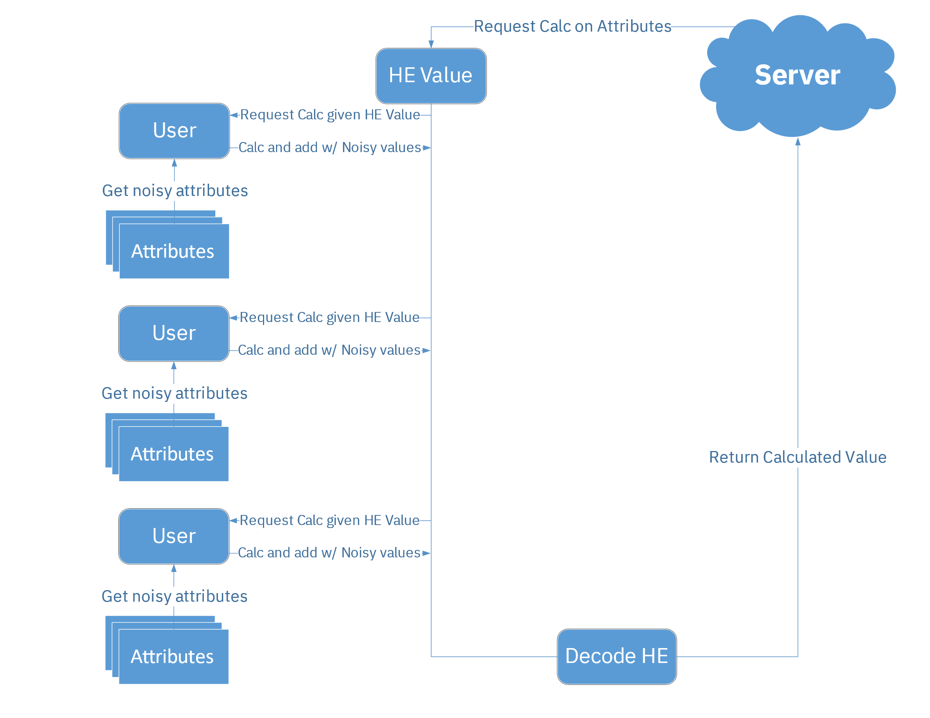
Lifecycle of a request

Slide 7
Implementation
This project was made using Python 3.10.
Currently, communication between Server and User is done on the same instance, however, both objects do not access attributes directly from each other.

Slide 8
Example User
--------[ 8877689391 ]--------
daily
TotalSteps 31
TotalDistance 31
TrackerDistance 31
LoggedActivitiesDistance 31
VeryActiveDistance 31
ModeratelyActiveDistance 31
LightActiveDistance 31
SedentaryActiveDistance 31
VeryActiveMinutes 31
FairlyActiveMinutes 31
LightlyActiveMinutes 31
SedentaryMinutes 31
Calories 31
heart
Value 228841
hourly
Calories 735
TotalIntensity 735
AverageIntensity 735
StepTotal 735
An example of a single User in the dataset Each number represents the number of entries for that specific field

Slide 9
Example Calculation
users: list[User] = dataset.get_dataset() # Get all users as objects
server = Server(users, epsilon=3) # Initialize a server with privacy parameter epsilon of 3
# Example calculation given a list of attributes, determined upon request
def test(pub: PubKey, acc: EncryptedNumber, usr: list[Number]) -> EncryptedNumber | bool:
calories = usr[0]
mod_active_dist = usr[1]
if mod_active_dist != 0:
acc = acc + EncodedNumber.encode(pub, calories * mod_active_dist)
return acc
return False
print(server.requestFieldAvg(FRAME.HEART.BPM).value) # Print the overall average of heart BPM
# Run function test with the fields "daily calories" and "Daily moderately active distance"
request = server.requestAction([FRAME.DAILY.CALORIES, FRAME.DAILY.MODERATELY_ACTIVE_DISTANCE], 0, test)
print(request.value / request.counter) # Print the average, counter is how many users actually ran the calculation

Slide 10
Example Results
Heart BPM
79.5
Test function calculation
2511.54573138182

Slide 11
Moving Forward
In addition to a server being able to run calculations on a userbase, I also would want each user to be able to compare with each other without revealing each other’s values. This might be accomplished with garbled circuits, however that might be too inefficient. Additionally, this could be expanded to federated learning, where each user could create a local model and be grouped with a server model.

Slide 12
Thank You!

