Slide 1


Requirements Analysis and Designs
First plan 6 days
Team member - Group 18
NGUYỄN VĂN HƯNG - 520H0637
LÊ HUỲNH MỸ DUYÊN - 520H0626

Slide 2
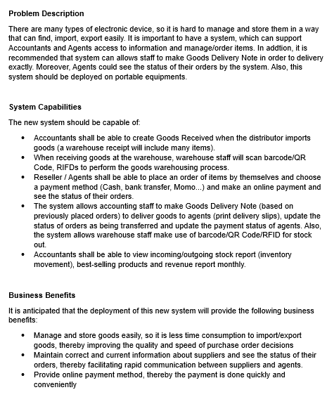

Initial Activities
Pre-project
System
Vision
Document

Slide 3
Problem Description
There are many types of electronic device, so it is hard to manage and store them in a way that can find, import, export easily. It is important to have a system, which can support Accountants and Agents access to information and manage/order items. In addtion, it is recommended that system can allows staff to make Goods Delivery Note in order to delivery exactly. Moreover, Agents could see the status of their orders by the system. Also, this system should be deployed on portable equipments.

Slide 4
System Capabilities
The new system should be capable of:
Accountants shall be able to create Goods Received when the distributor imports goods (a warehouse receipt will include many items).
When receiving goods at the warehouse, warehouse staff will scan barcode/QR Code, RIFDs to perform the goods warehousing process.
Reseller / Agents shall be able to place an order of items by themselves and choose a payment method (Cash, bank transfer, Momo...) and make an online payment and see the status of their orders.
The system allows accounting staff to make Goods Delivery Note (based on previously placed orders) to deliver goods to agents (print delivery slips), update the status of orders as being transferred and update the payment status of agents. Also, the system allows warehouse staff make use of barcode/QR Code/RFID for stock out.
Accountants shall be able to view incoming/outgoing stock report (inventory movement), best-selling products and revenue report monthly.

Slide 5
Business Benefits
It is anticipated that the deployment of this new system will provide the following business benefits:
Manage and store goods easily, so it is less time consumption to import/export goods, thereby improving the quality and speed of purchase order decisions
Maintain correct and current information about suppliers and see the status of their orders, thereby facilitating rapid communication between suppliers and agents.
Provide online payment method, thereby the payment is done quickly and conveniently

Slide 6

Day 1: Activities
Plan the project
Base on System Capabilities, we determine the major components:
Actors:
Accountants
Agents
Warehouse Staff
Functions:
Create Goods Received
Scan barcode/QR Code, RIFDs
Payment
View/Update the status of agents orders
Make Goods Delivery Note
View/Update the payment status of agents
View incoming/outgoing stock report

Slide 7
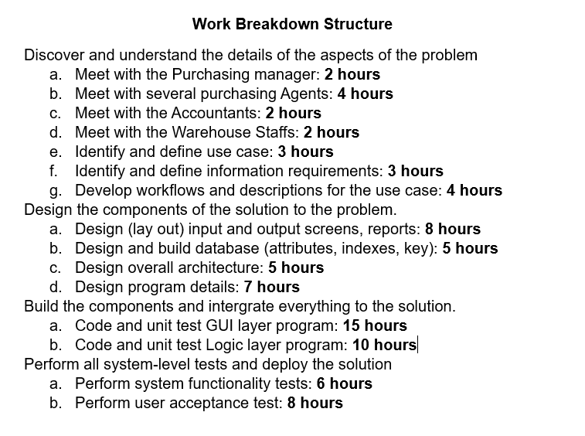
Day 1: Activities
Work Breakdown
Structure for
Iteration

Slide 8
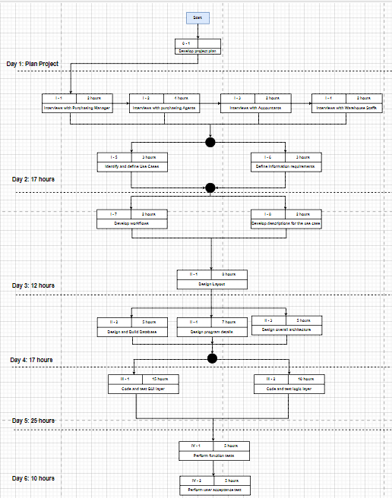
Day 1: Activities
Work Sequence Draft for
Iteration

Slide 9
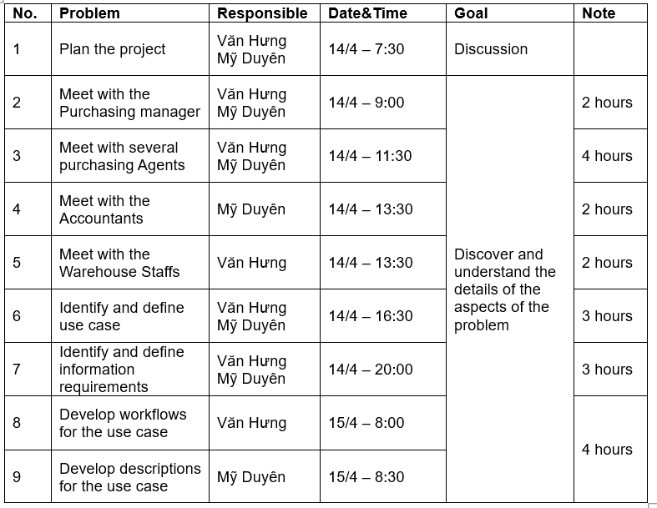
Day 1: Activities
Determine team members and responsibilities

Slide 10
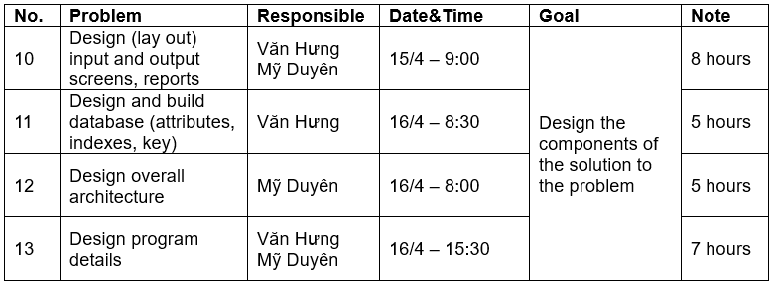
Day 1: Activities
Determine team members and responsibilities (continue)

Slide 11
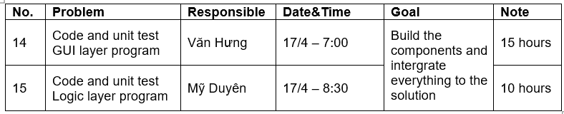
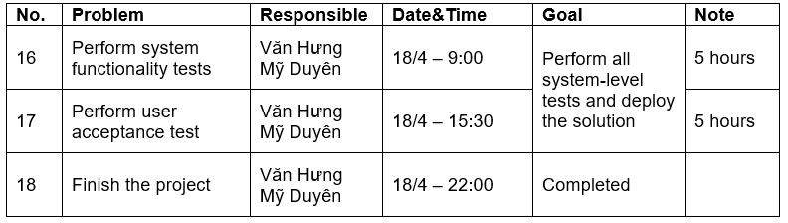
Day 1: Activities
Determine team members and responsibilities (continue)

Slide 12
Day 2: Activities
Discover and Understand Details
Identify Use Cases: Both subsystems
Identify Object Classes: Both subsystems
Preliminary Class Diagram: Both subsystems

Slide 13
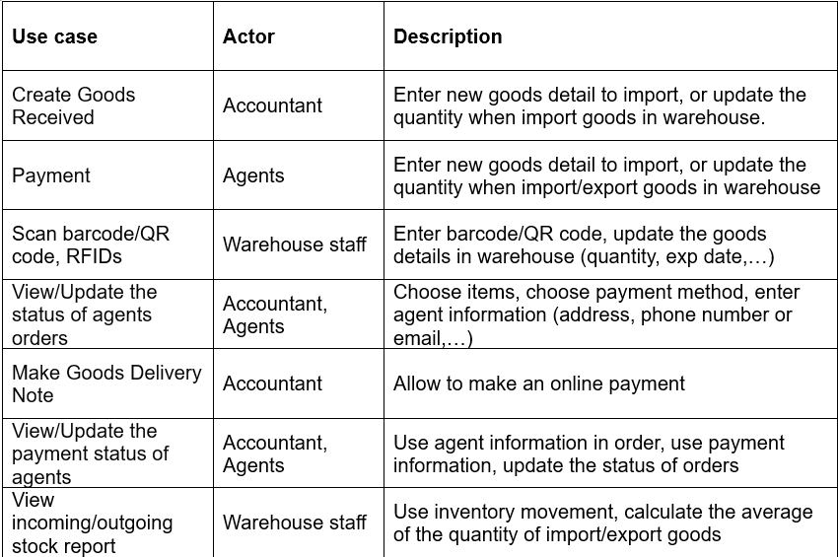
Day 2: Activities
Identify Use Cases: Both subsystems

Slide 14
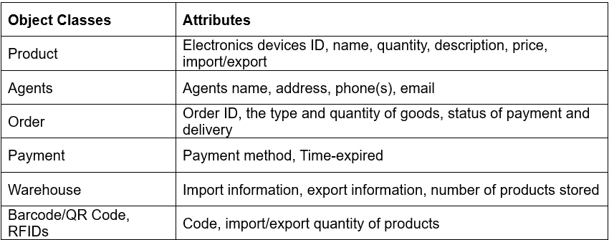
Day 2: Activities
Identify Object Classes: Both subsystems

Slide 15
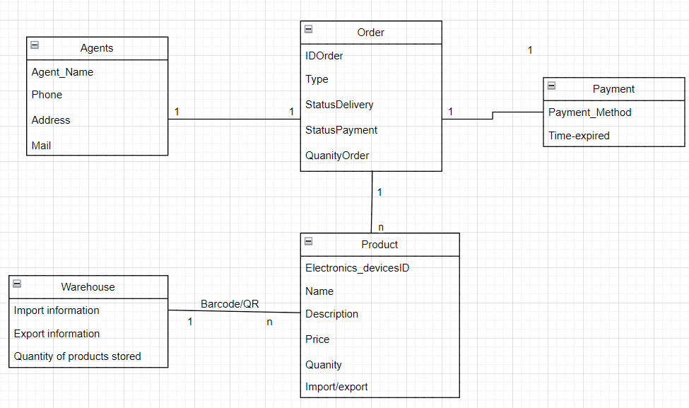
Day 2: Activities
Preliminary Class Diagram: Both subsystems

Slide 16
Day 3: Activities
Discover and Understand Details(continue)
Use case diagram
Design System Components
Draft screen layout
Create Goods Received
View/Update the payment status of agents

Slide 17
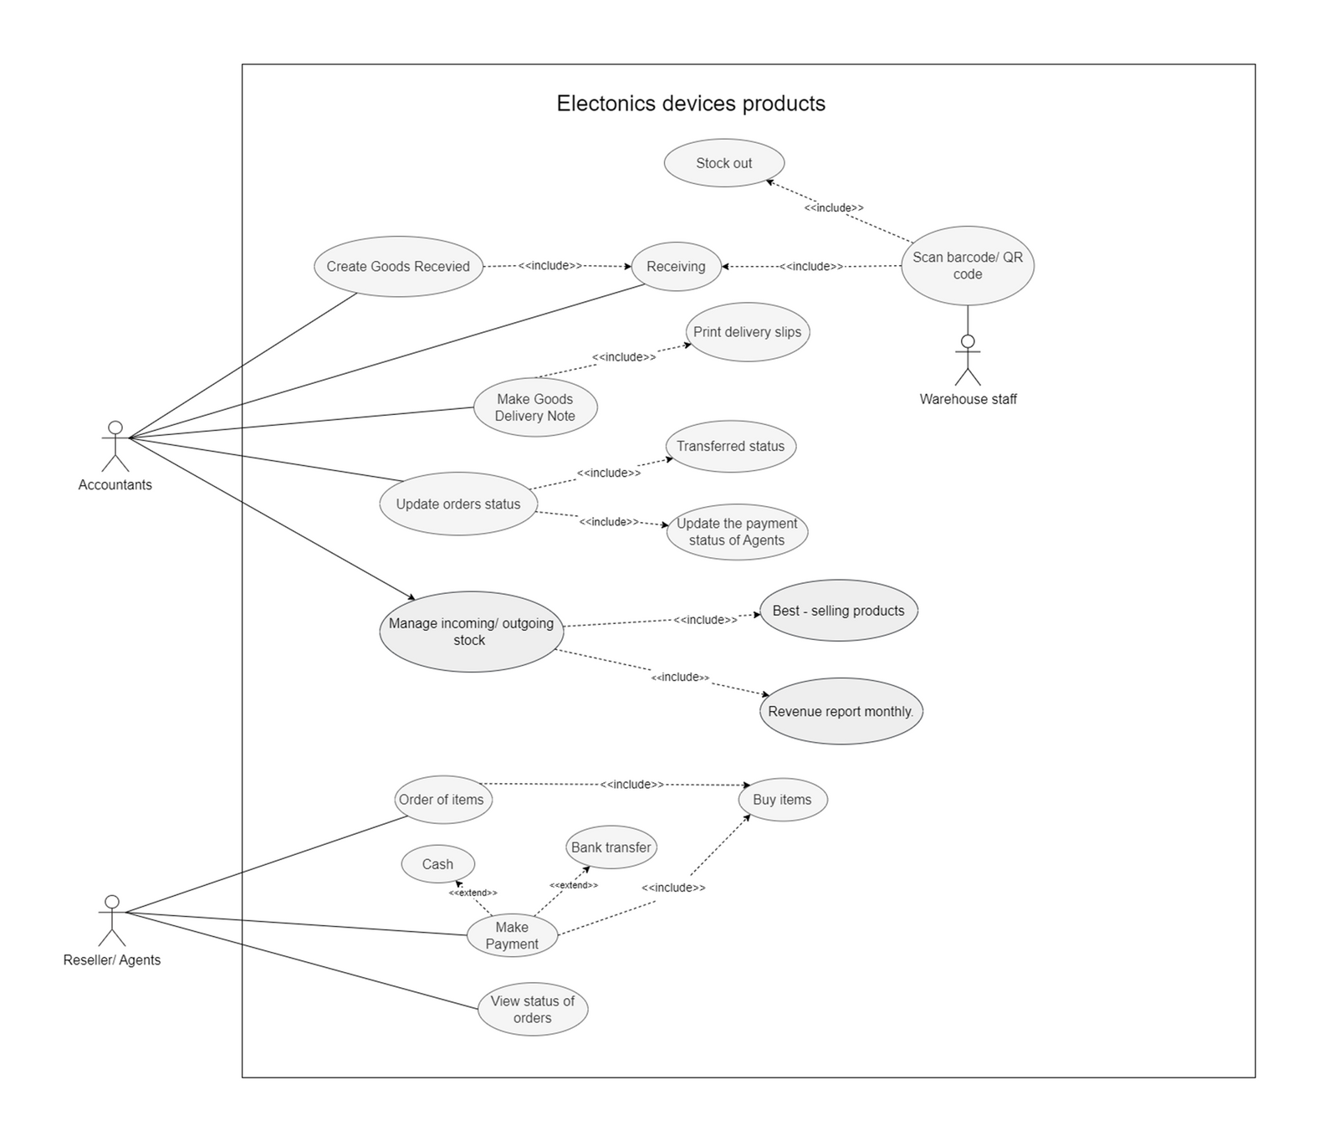
Use Case Diagram

Slide 18
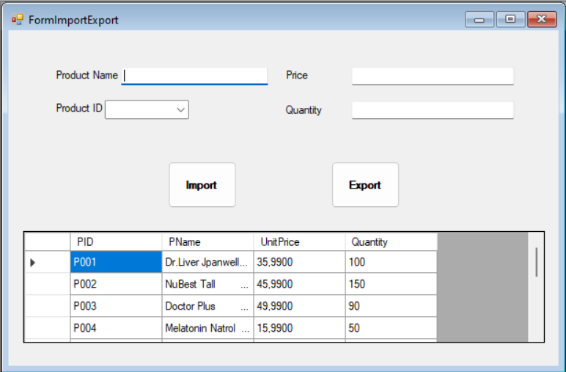
Day 3: Activities
Draft Screen Layout: Create Goods Received

Slide 19
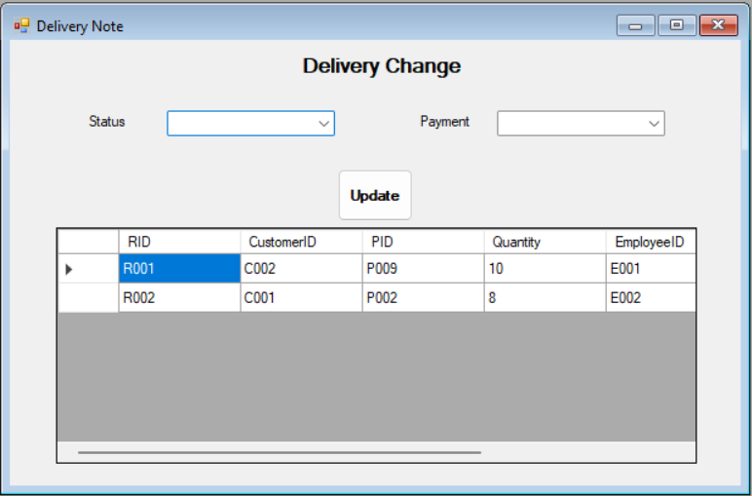
Day 3: Activities
Draft Screen Layout: View/Update the payment status of agents

Slide 20
Day 4: Activities
Design System Components(continue)
·Design the database (schema)
·Design the system’s high level structure

Slide 21
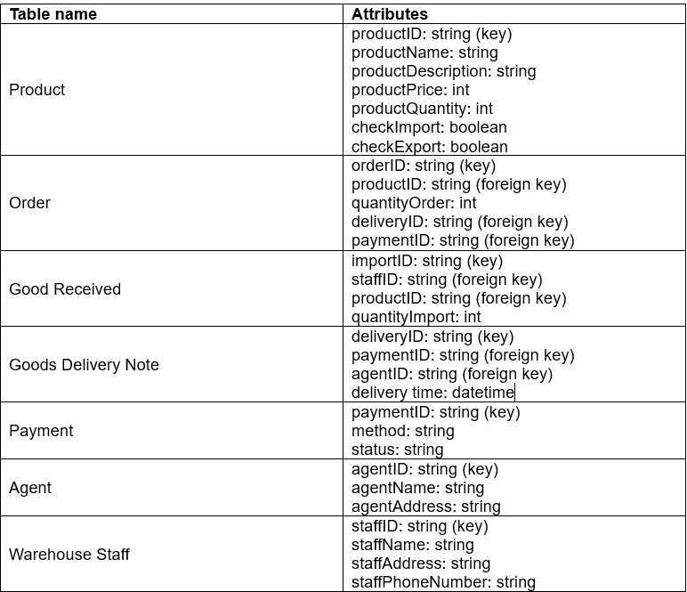
Day 4: Activities
Database Schema

Slide 22
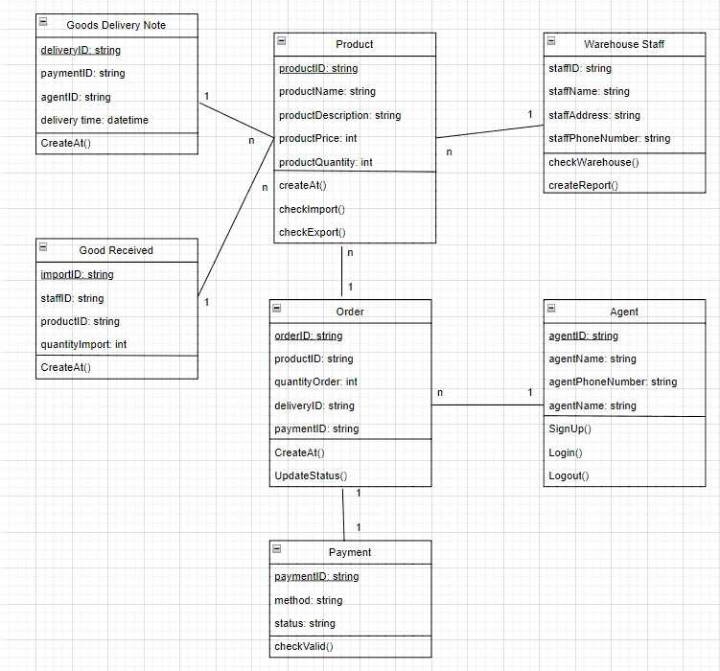
Day 4: Activities
Preliminary Design Class Diagram

Slide 23


Day 4: Activities
Architectural Configuration Diagram
Accountant
Create Goods Received
Choose payment method
Order
Payment
Goods Received
Make delivery note
Send to warehouse
Check warehouse
Delivery Note
Staff
Scan code
Update database

Slide 24
Day 5: Activities
Design System Components(continue)
Build, Test, and Integrate System Components

Slide 25
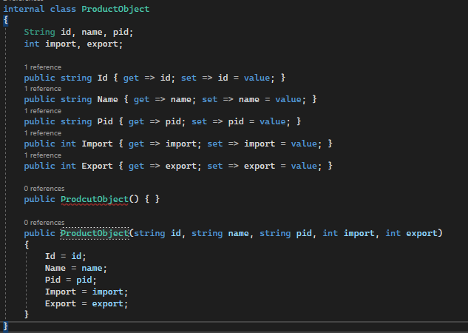
Day 5: Activities
C# code Example for Product Object

Slide 26
Day 6: Activities
Complete System Testing and Deploy the System
Perform system functional testing
Perform user acceptance testing
Possibly deploy part of system

Slide 27

Day 6: Activities
Workflow of Testing: Create Goods Received
Start
Create an Goods Received (test)
Fix error
End
Conduct test (check database, program,.)
Document errors
and issue

