Slide 1
https://docs.google.com/presentation/d/1kc7KSp4vkfgLLDUZ_amhfde9QAU5eHWZ/edit?usp=sharing&ouid=114508209391673439562&rtpof=true&sd=true
Double Descent in Overparameterized MLPs
A Teacher-Student MLP Study
Jia Yang Le · Azis Maarij Jamil · Komila Askarova
STAN47 – Deep Learning and AI Methods · Lund University · March 2026

Slide 2
Presentation Roadmap
1
2
3
4
Double Descent
Theory & Setup
Optimizer Effects
Regularization
Weight Decay
Conclusions &
Discussion
Jia Yang Le
Komila Askarova
Azis Maarj Jamil
All

Slide 3
DOUBLE DESCENT
Bias-Variance Tradeoff
The Classical Paradigm
Test Error
Underfitting
(High Bias)
Overfitting
(High Variance)
Models fit by minimizing training error (ERM)
Underfitting: too simple → high bias, poor train & test
Overfitting: too complex → low train error, high test error
Classical solution: find the 'sweet spot' of complexity
Classical wisdom: more parameters = more overfitting
Sweet
Spot
⚠ Modern deep networks are massively overparameterized — yet they generalize well. Why?

Slide 4
DOUBLE DESCENT
The Double Descent Phenomenon
←
↑
→
Classical Regime
Interpolation Peak
Modern Regime
Underparameterized
Critical threshold
Overparameterized
p/n < 1
p/n ≈ 1
p/n > 1
Bias-variance tradeoff holds. Increasing width → lower train & test error.
Model fits training data exactly. Test error spikes at its peak.
The 'crisis point'.
Model overfits training data perfectly. But test error descends again.
Benign overfitting!
Key metric: Parameter-to-sample ratio p/n where p = model parameters, n = training samples
Belkin et al. (2019) · Nakkiran et al. (2019)

Slide 5
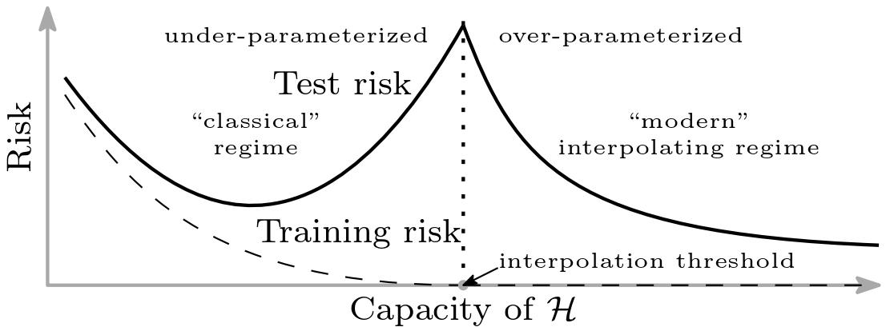
Belkin et al. (2019)

Slide 6
DOUBLE DESCENT
Our Experimental Journey
1
2
3
4
Fully-Trainable
MLP (Att. 1–4)
Random Features
Regression (Att. 4a)
Refined MLP
Evaluation (Att. 5–6)
Frozen-Layer
MLP (Att. 7–8b)
→
→
→
❌ No clear
interpolation spike
✓ Clean double
descent confirmed
❌ Still smooth —
feature learning masks it
✓ Clear double
descent reproduced
Key insight: double descent visibility depends on representation learning · optimization · and evaluation protocol

Slide 7
DOUBLE DESCENT
Why Fully-Trainable MLPs Hide It
Phases 1 & 3: Negative Result
Phase 2: Diagnostic — Random Features
Train MSE decreases as width grows (as expected)
Test MSE curve remains smooth (no spike visible)
Interpolation occurs but does not cause catastrophic test error
To isolate the effect, we switched to fixed random ReLU features with a closed-form linear readout (Attempt 4a):
φ(x) = ReLU(Wx),
solve linear readout only
n_train = 256, d_in = 50, noise_std = 0.5
Capacity = number of random features m
Interpolation confirmed at m = 260
Three reasons why:
Feature learning: width changes the effective hypothesis class, not just capacity
Implicit regularization: SGD/Adam bias toward minimum-norm interpolants
Benign overfitting: overparameterized nets generalize despite zero train error
✓ Canonical double descent confirmed — sharp train collapse, clear test peak, second descent
Attempt 4a confirmed the DGP can produce double descent — the fully-trainable MLP's feature learning was masking it.

Slide 8
RESULTS: NOTEBOOK 1
Final Design: Frozen-Layer MLP (Attempt 8b)
Architecture
Training Protocol
x
ReLU(Wx)
FROZEN
aᵀ·h
TRAINED
Data:
n_train = 256, n_test = 4 096, d = 50
→
→
→ ŷ
Teacher:
Linear: y = xᵀw* + ε, noise_std = 0.5
f(x) = aᵀ · ReLU(Wx)
Width sweep:
m = 10, 20, … 400, 500, 700 … 8 000
First layer W: random init, frozen throughout
Readout a: trained via Adam to convergence
Width m controls capacity — only a grows with m
This bridges random features theory and deep networks
Optimizer:
Adam, lr = 0.01
Stop criterion:
Train MSE < 1e-8 (guaranteed interpolation)
Eval:
Test MSE vs. clean teacher (no noise)
Freezing the first layer eliminates feature learning — capacity is purely width-driven, giving a clean interpolation threshold.

Slide 9
RESULTS: NOTEBOOK 1
Double Descent: Actual Results (Attempt 8b)
Key Findings
Train MSE → 0 at width ≈ n_train = 256 (guaranteed by early-stop)
Test MSE peaks sharply at m = 260 (test MSE = 52.43)
Second descent: test MSE falls to ~0.80 at m = 3 000
Overparameterized models recover — benign overfitting confirmed
Result reproduces Belkin et al. (2019) qualitatively
Peak
m=260
Peak: width = 260 → test MSE = 52.43
x-axis: hidden width m. y-axis: MSE. Data: n_train=256, noise_std=0.5, Adam, early-stop at train MSE<1e-8.

Slide 10
Part 2
Optimization Effects
How optimizer choice shapes behavior near the interpolation threshold
Presented by Azis

Slide 11
OPTIMIZATION

Slide 12
Part 3
Regularization Effects
How L2 weight decay reshapes the generalization curve
Presented by Kamila

Slide 13
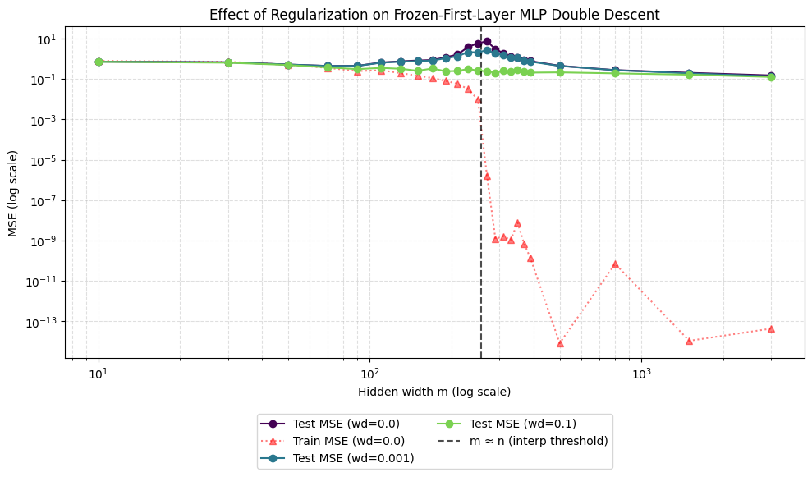
REGULARIZATION
Weight Decay (L2 Regularization)
Key Findings
Regularization Stabilizes Training
Adding L2 regularization (weight decay):
wd = 0.001, reduces spike
wd = 0.1, completely removes spike
Overparameterization as Implicit Regularization (For wd = 0.0, when m ≫ n) :
Test error drops again (second descent)
Model spreads noise across many parameters
SGD + redundancy made into implicit regularization

Slide 14
Conclusions
Double descent is real — confirmed in a frozen-feature MLP: test MSE peaks at width=260 (52.43), then descends to 0.80 at width=3 000.
✓
Fully-trainable MLPs hide the effect: feature learning and optimizer bias (SGD/Adam) smooth out the interpolation spike — benign overfitting.
✓
Optimizer choice (Adam vs. SGD) affects convergence speed and generalization, but not the fundamental structure of the double descent curve.
✓
L2 regularization suppresses the peak but introduces bias. Optimal strength depends on noise level.
✓
Double descent visibility depends on capacity × optimization × representation learning — not capacity alone.
✓

Slide 15
ANALYSIS
Strengths & Limitations
✅ Strengths
⚠ Limitations
Controlled teacher-student setup cleanly isolates model complexity effects
Large test set (10 000) gives stable, reliable MSE estimates
Fixed seeds ensure full reproducibility across all conditions
Systematic parameter sweeps across wide range (4 → 1 024 neurons)
Three separate experiments isolate noise, optimizer, and regularization effects
Synthetic task — real-world data has structure, not Gaussian noise
Only two-layer MLPs tested — results may differ for deeper or convolutional architectures
Fixed n = 1 000 — epoch-wise double descent not explored
SGD learning rate hand-tuned — may not be fully optimal comparison
Minimum-norm solution theory not directly verified empirically

Slide 16
REFERENCES
References & Author Contributions
References
Author Contributions
[1] Belkin et al. (2019). Reconciling modern machine learning practice and the bias-variance tradeoff. PNAS.
Jia Yang Le
Double descent theory, teacher-student setup
[2] Nakkiran et al. (2019). Deep Double Descent: Where Bigger Models and More Data Hurt. ICLR 2020.
Azis Maaraij Jamil
[3] Goodfellow, Bengio & Courville (2016). Deep Learning. MIT Press. (Ch. 5, 7, 8)
Regularization study, weight decay analysis
[4] Zhang et al. (2017). Understanding deep learning requires rethinking generalization. ICLR.
Komila Askarova
[5] Kingma & Ba (2015). Adam: A Method for Stochastic Optimization. ICLR.
Optimizer comparison, SGD vs Adam analysis
🔗 github.com/LeJ7-commits/double-descent-overparameterized-mlps

Slide 17
Thank You
Questions & Discussion
STAN47 – Deep Learning and AI Methods · Lund University · March 2026
Key takeaway: Double descent shows that classical bias-variance theory may be incomplete. Overparameterized models can generalize well — understanding when and why requires new theoretical tools.

