Slide 1
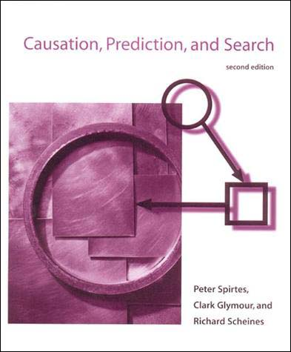
Causation, Prediction, Search: Bayesian Networks and Automated Causal Discovery

Slide 2
What is Causality?
Probabilistic Causation: If X is the causal variable and Y is the effect variable, then a change in the VALUE of X results in a change in the DISTRIBUTION of Y.
If X and Y are events, X should precede Y temporally, and the causal relation is anti-symmetric.
Deterministic Causation is a special case of Probabilistic Causation. The DISTRIBUTION of Y changes to some constant C.
C ~ Uniform(C, C + epsilon) [ lim as epsilon -> 0]

Slide 3
Causal Equations
Functional Form: X := f(DirectCauses(X), error)
Income:= β1*Education + β2*SES + e_{income}
For this talk, we will deal with linear causal equations.
Errors are assumed to be Normally Distributed with mean 0.
Variables are assumed to be a standard Normal Distribution (Central Limit Theorem).

Slide 4

Causal Calculus (Do-Calculus)
Do-Operator: Allows to use intervene and set a value for a given variable.
Pr(Y| do[X]); Not the same as Pr(Y|X)
Causal Effect: E[Y|do(X=a)] – E[Y|do(X=b)]

Slide 5

Rain and Sidewalk Example
Pr(Y,X) | X = No Rain | X = Rain
Y=Dry | 0.63 | 0.015 | 0.645
Y=Wet | 0.07 | 0.285 | 0.355
 | 0.7 | 0.3 | 1.00
Rain
Sidewalk
 | P(X| Wet) | P(X| do(Wet))
X = No Rain | .197 | 0.7
X = Rain | 0.802 | 0.3
Rain
Sidewalk

Slide 6
Interventions/Manipulations
Probabilistic Conditioning | Causal Conditioning
Pr(Y|X = x) | Pr(Y| do(X = x))
Factual | Counter-factual
Select sub-population | Generate new population
Passive observation | Active Manipulation
Calculate from full DAG | Calculate from altered DAG

Slide 7
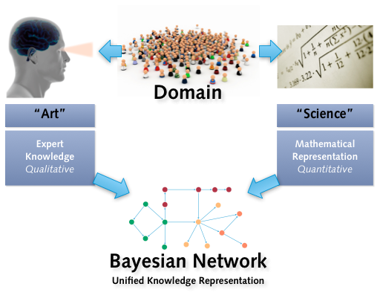
Bayesian Networks

Slide 8
Emotions and Decision-Making
Decision
Incidental Emotion
System 2
Integral Emotion
Integral Emotion
Integral Emotion
Option 1
Option 2
Option 3

Slide 9
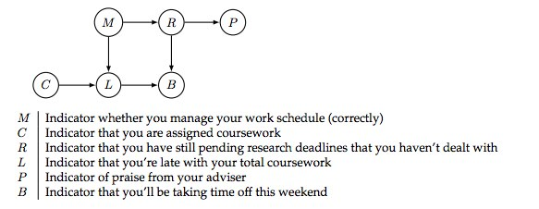
Grad Student Example

Slide 10
Bayesian Network- 3 Cases
Chain
Dependent given no information. Independent given B.
A
B
C
B
A
C
Fork
Independent given no information. Dependent given B.
A
C
Collider
B

Slide 11
D-separation
Directional-Separation: No path for influence to flow between two variables.
Conditional Independence is the same as D-separation.
If two variables are d-separable by conditioning on other variables in the graph, there is no edge between the two.

Slide 12
Bayes Ball
EQ
Thief
Thief, EQ independent
Thief, Police dependent
Police, Dog dependent
Thief, Dog dependent
β1
β2
Alarm
β3
β4
Police
Dog

Slide 13
Bayes Ball
EQ
Thief
Thief, EQ dependent
Thief, Police independent
Police, Dog independent
Thief, Dog independent
β1
β2
Alarm
β3
β4
Police
Dog

Slide 14
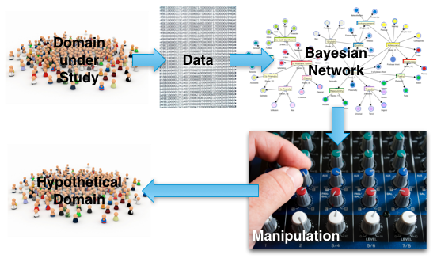
PREDICTION

Slide 15
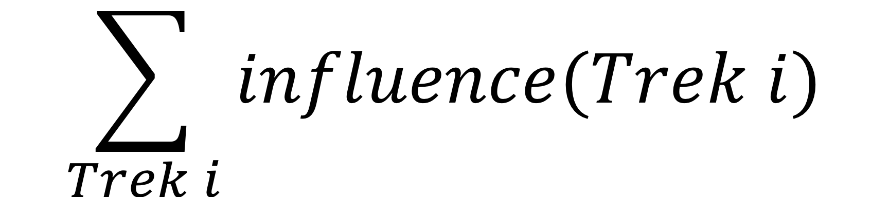
Trek Rule
Trek: Any d-connected path between variable X and variable Y.
Influence along trek is product of edge coefficients on the trek.
Total Correlation is sum of influence along each trek.

Slide 16
Trek Rule Example
Exercise
β2
β1
Causal Equations
TV:= e_{tv}
Exercise:= β1*TV + e_{exercise}
Diet:= β3*TV + e_{diet}
BMI:= β2*Exercise + β4*Diet + e_{BMI}
TV
BMI
β3
Diet
β4
Correlational Equations
BMI = (β2)Exercise + e*_{BMI}
BMI = (β4)Diet + e*_{BMI}
Exercise = (β3β1)Diet + e*_{Exercise}
Diet = (β1β3)Exercise + e*_{Diet}
BMI = (β1β2 + β3β4)TV + e*_{BMI}

Slide 17
Proof of Corr(TV,BMI)
Standardize all variables to normal Distribution.
Corr(TV,BMI) = Cov(TV,BMI) =E[TV*BMI] – E[TV]E[BMI]
E[TV*(β2*Exercise + β4*Diet)] =
E[β2*Exercise*TV + β4*Diet*TV] =
E[β2β1*TV² + β3β4*TV²] =
E[(β1β2+ β3β4) TV²] = (β1β2+ β3β4) E[TV²]
(β1β2+ β3β4) Var(TV) = (β1β2+ β3β4)

Slide 18
Trek Rule Example
Exercise
β2
β1
Causal Equations
Exercise:= e_{exercise}
TV:= β1*Exercise + β3*Diet+ e_{tv}
Diet:= e_{diet}
BMI:= β2*Exercise + β4*Diet + e_{BMI}
TV
BMI
β3
Diet
β4
Correlational Equations
BMI = (β2)Exercise + e*_{BMI}
BMI = (β4)Diet + e*_{BMI}
BMI = (β1β2 + β3β4)TV + e*_{BMI}
Diet = (0)Exercise + e*_{Diet}

Slide 19
Empirical Test
Regression | Graph A | Graph B
X = Exercise, Y = BMI | 1.2295; SE = 0.0043 | -0.5796; SE = 0.0033
X = Diet, Y = BMI | 1.0114; SE = 0.0056 | -0.3011; SE = 0.0030
X = TV, Y = BMI | -0.5824; SE = 0.0020 | -0.1803; SE = 0.0050
X = TV, Y = Exercise | -1.2600; SE = 0.0061 | -1.0485; SE = 0.0001
X = TV, Y = Diet | -1.3919; SE = 0.0052 | 1.2001; SE = 0.0027
X = Diet, Y = Exercise | 0.0135, SE = 0.0035 | -0.6894, SE = 0.0030

Slide 20
When Correlation Fails
X
Corr(X,Y) = β1 + β2β3 = 0
Corr(X,I) = β₂β_{In} = β₂*1 = β₂
Cor(Y,I) = β₃β_{In} + β₁β₂β_{In} = -6
Cor(Y,I) = β₃ + β₁β₂ = -6
β2 = -2
Z
β1 = 4
β_{In} = 1
Y
β3 = 2
I
β1 + β2β3 = 0 (Equation 1)
β₃ + β₁β₂ = -6 (Equation 2)
2 Equations, 2 unknowns

Slide 21
Measurement Error – In the Effect
Causal Equations
Happiness := B2*Income + e_{happiness}
Happy_M := Happiness + e_{measure}
 | Happ = B1*Inc + e_{Happ} | H_m = B1*Inc + e_{m}
B1 | E[Happ] = E[β1*Inc + e] = β1*E[Inc] = β1 | E[H_{m}] = E[Happ + e] = E[β1*Inc + e +e] = β1*E[Inc] = β1
Var | Var(Happ) = Var(Happy) | Var(H_m) = Var(Happy + e_{m}) = Var(Happ) + V(e_{m})
Income
β1
Happiness
1
Happy_m

Slide 22
Measurement Errors – In The Cause
Causal Equations
IQ := Smart + e_{measure}
Inc := β1*Smart + e_{Inc}
 | Inc = B1*Smart + e_{Inc} | Inc = B1*IQ + e_{inc}
B1 | Cov(Inc,Smart) = E[Smart*Inc] = E[= β1*Smart²] = β1*V(Smart) = β1 | Cov(Inc,IQ) = E[Smart*Inc] /{(Var(IQ)^{0.5}} = Β1/ {(Var(Smart) + Var(e)}^{0.5}
Smart
β1
Income
1
I.Q.

Slide 23
Measurement Error – In Both
Smart
β3
Happy
Measurement error in effect increases standard error of regression coefficient.
Measurement error in cause attenuates regression coefficient to 0.
The design of the methodology hinders ability to find significant results.
1
1
I.Q.
Cat Ears

Slide 24
Software Packages for ACM
R package “pcalg” (Probabilistic Causal Graphs)
Needs other libraries to work properly. Use my script.
TETRAD: Java applet; Simulate population and test inferences.
http://www.phil.cmu.edu/projects/tetrad/

Slide 25
PC Algorithm
Assumes no hidden variables.
Assumes data is multivariate normal.
Starts with complete graph; removes edges between X,Y if X and Y are independent.
Try to remove edge between X and Y by conditioning on other variables in the graph.
Orient the edges to preserve consistency.

Slide 26
FCI Algorithm
Allows for hidden variables.
Assumes data is multivariate Normal and satisfies conditions pertaining to partial correlations.
Assumes the possible D-separation sets are sparse.

Slide 27
Further Reading
Causality: Models, Reasoning, and Inference by Judea Pearl.
Causation, Prediction, Search by Peter Sprites, Clark Glymour, and Richard Scheines.
Causal Inference and Direct Effect by Bayesia Labs
Causal Inference Book by Miguel Hernan
Notes by Cosmos Shalizi included in GitHub repo.
Talk by Judea Pearl in April

