Slide 1
Robo Writer
By
Jit Nandi
Jay Lee
Nick Kolkin
Albert Chu

Slide 2
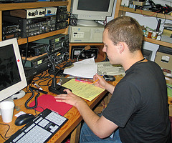
The Issue We Wanted To Tackle
Notes:
Currently a single Red Cross Dispatcher must pay attention to incident reports from many sources, while simultaneously filling out a form in Word. We want to help make this process more streamlined, so the Dispatcher can quickly and easily perform the preliminary administrative tasks necessary to kick off the response of their dedicated volunteers.

Slide 3

Our Solution
Notes:
Over the last couple Decades there have been advances in a broad field called Machine Learning, In which computers ‘learn’ from decisions based on known information, to predict what it’s decision should be when presented with new information

Slide 4
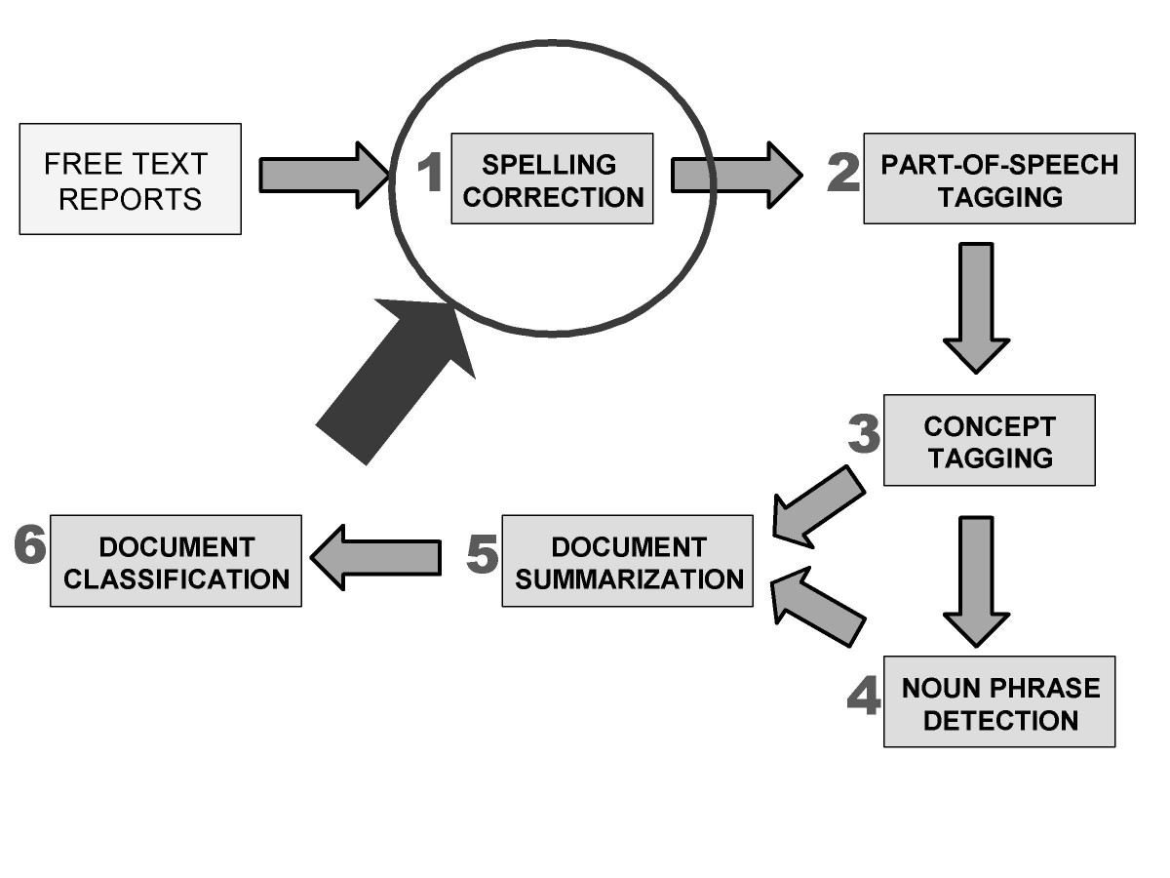
Our Solution
Notes:
Within Machine Learning there is a sub-field called Natural Language Processing, which focuses on classifying language in various ways, such as identifying important information by linking them to abstract concepts (place, time, etc.)

Slide 5

Our Solution
Notes:
There are many open source projects that implement these algorithms, and we utilized these libraries to make a rough prototype, showcasing a method for making Disaster Incident Reports quick and easy to fill out

Slide 6
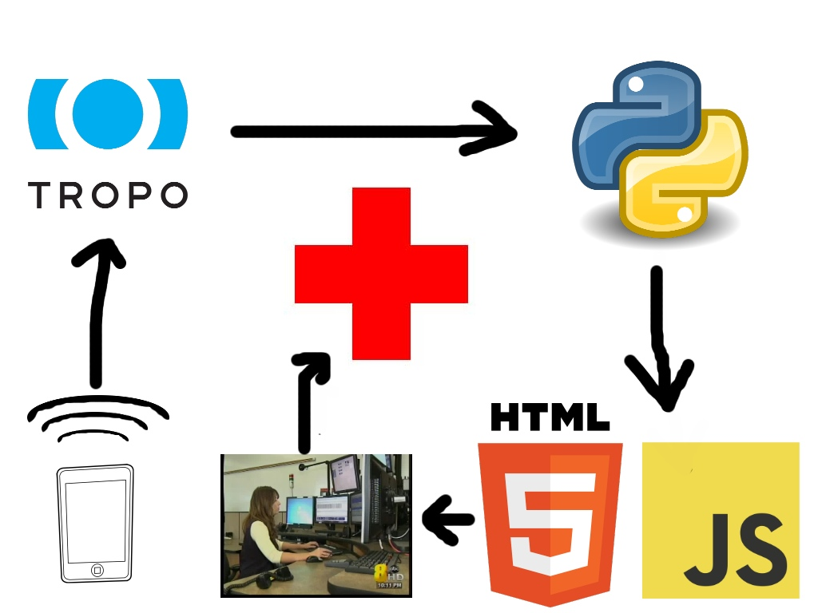
Our Solution
Notes:
First a call from a Notifier is made to a set phone #, in this case linked to our tropo account. Then an automated system asks for the basic details of the emergency, before forwarding the caller to a human operator. Meanwhile the Natural Language Processing algorithm attempts to interpret the phone call. Then when the operator opens the document to fill out their Initial Disaster Report, many of the important fields are already filled out with the algorithm’s best guess, based on the phone call.

Slide 7
Demo

Slide 8
Future Goals
Currently we focus on the most important aspects of the form, disaster type, address, and the Caller’s name. We’d like to expand this eventually to include all information gathered by the initial call
We’d also like to add the capability to send the form to a central database where the information could easily be retrieved and added to

Slide 9

Thanks For Hosting Us!

Slide 10
And Thanks For Listening! Any Questions?

