Slide 1

Optimization speed meeting
Sensitivity Analysis

Slide 2
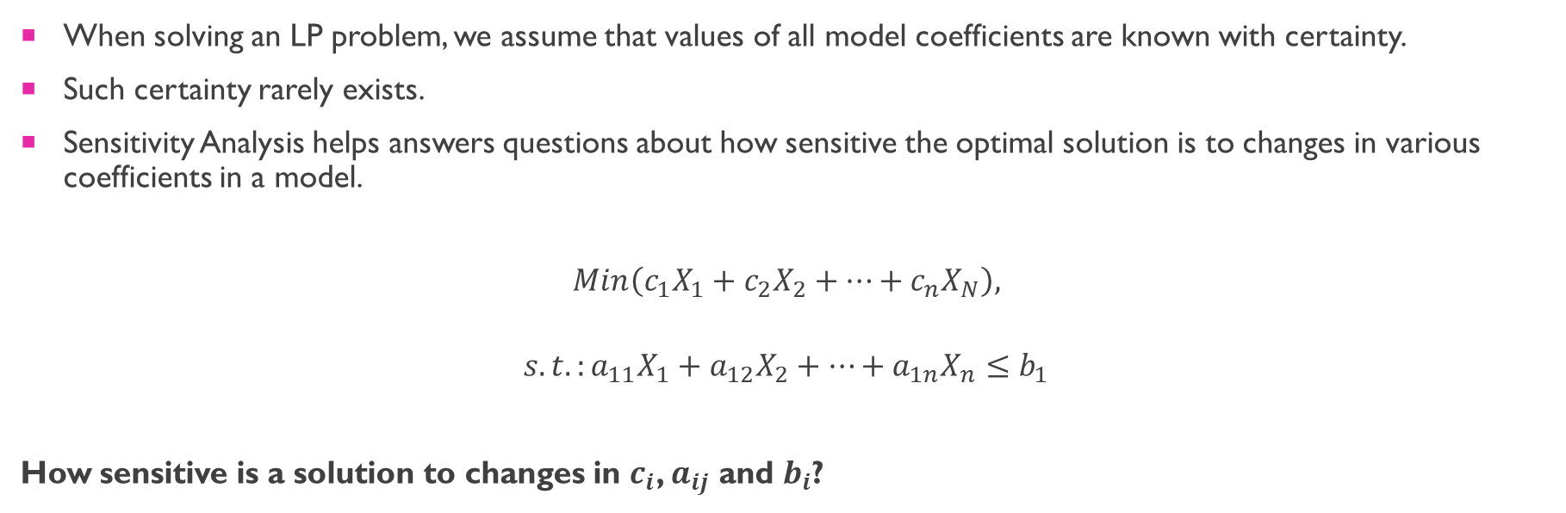
Introduction
When solving an LP problem, we assume that values of all model coefficients are known with certainty.
Such certainty rarely exists.
Sensitivity Analysis helps answers questions about how sensitive the optimal solution is to changes in various coefficients in a model.
$$Min\left(c_{1}X_{1}+c_{2}X_{2}+…+c_{n}X_{N}\right),$$ $$s.t.:a_{11}X_{1}+a_{12}X_{2}+…+a_{1n}X_{n}≤b_{1}$$
How sensitive is a solution to changes in $c_{i}$, $a_{ij}$ and $b_{i}$?

Slide 3
Which questions?
Impact on the optimal objective function value of changes in constrained resources.
Amounts by which objective function coefficients can change without changing the optimal solution.
Impact on the optimal objective function value of forced changes in decision variables.

Slide 4
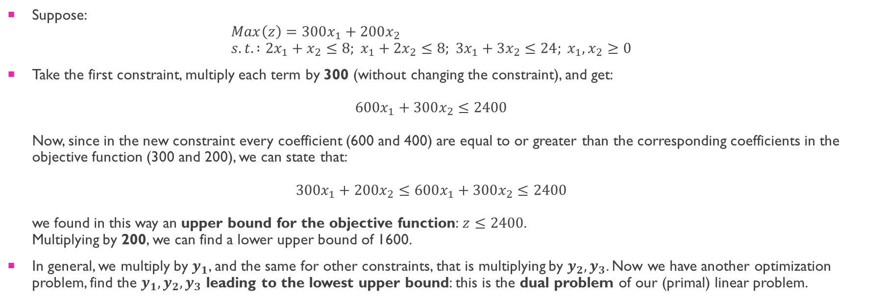
Dual of a linear problem (1)
Suppose: $Max\left(z\right)=300x_{1}+200x_{2}$ $s.t. :2x_{1}+x_{2}≤8; x_{1}+2x_{2}≤8; 3x_{1}+3x_{2}≤24; x_{1}, x_{2}≥0$
Take the first constraint, multiply each term by 300 (without changing the constraint), and get: $600x_{1}+300x_{2}≤2400$ Now, since in the new constraint every coefficient (600 and 400) are equal to or greater than the corresponding coefficients in the objective function (300 and 200), we can state that: $300x_{1}+200x_{2}≤600x_{1}+300x_{2}≤2400$ we found in this way an upper bound for the objective function: $z≤2400$. Multiplying by 200, we can find a lower upper bound of 1600.
In general, we multiply by $y_{1}$, and the same for other constraints, that is multiplying by $y_{2}, y_{3}$. Now we have another optimization problem, find the $y_{1}, y_{2}, y_{3}$ leading to the lowest upper bound: this is the dual problem of our (primal) linear problem.

Slide 5
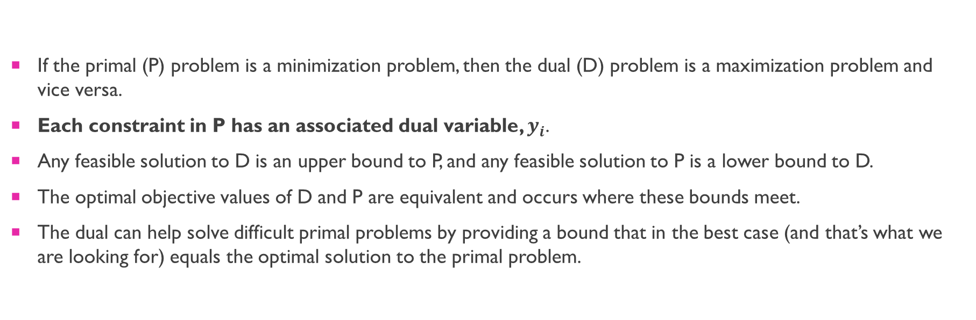
Dual of a linear problem (2)
If the primal (P) problem is a minimization problem, then the dual (D) problem is a maximization problem and vice versa.
Each constraint in P has an associated dual variable, $y_{i}$.
Any feasible solution to D is an upper bound to P, and any feasible solution to P is a lower bound to D.
The optimal objective values of D and P are equivalent and occurs where these bounds meet.
The dual can help solve difficult primal problems by providing a bound that in the best case (and that’s what we are looking for) equals the optimal solution to the primal problem.

Slide 6
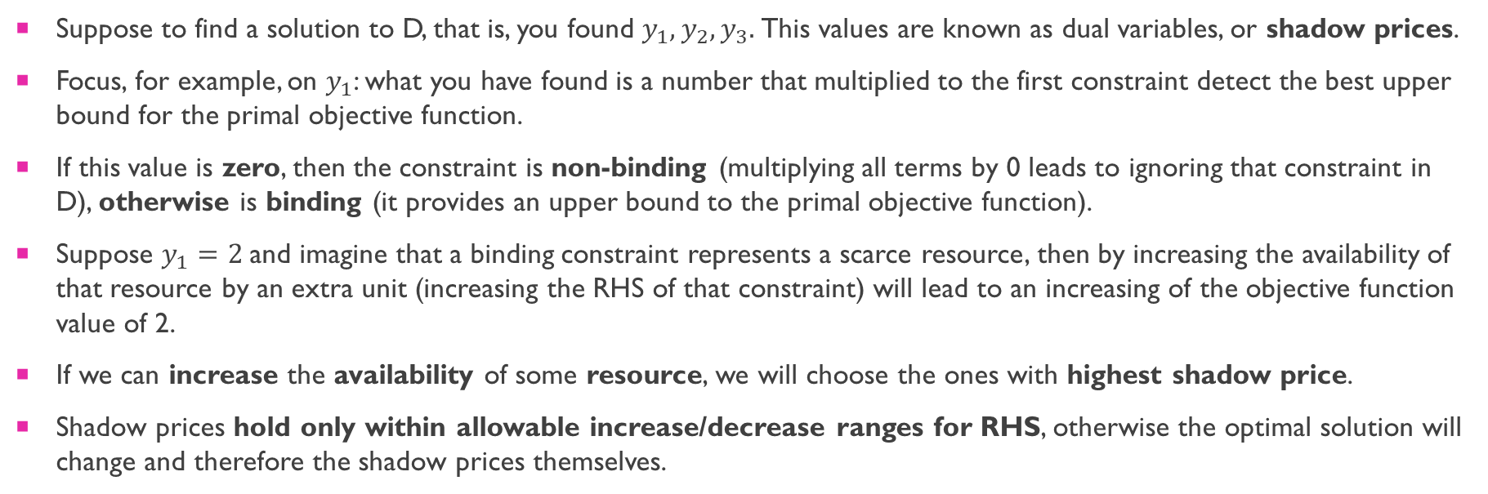
Shadow prices
Suppose to find a solution to D, that is, you found $y_{1}, y_{2}, y_{3}.$This values are known as dual variables, or shadow prices.
Focus, for example, on $y_{1}$: what you have found is a number that multiplied to the first constraint detect the best upper bound for the primal objective function.
If this value is zero, then the constraint is non-binding (multiplying all terms by 0 leads to ignoring that constraint in D), otherwise is binding (it provides an upper bound to the primal objective function).
Suppose $y_{1}=2$and imagine that a binding constraint represents a scarce resource, then by increasing the availability of that resource by an extra unit (increasing the RHS of that constraint) will lead to an increasing of the objective function value of 2.
If we can increase the availability of some resource, we will choose the ones with highest shadow price.
Shadow prices hold only within allowable increase/decrease ranges for RHS, otherwise the optimal solution will change and therefore the shadow prices themselves.

Slide 7
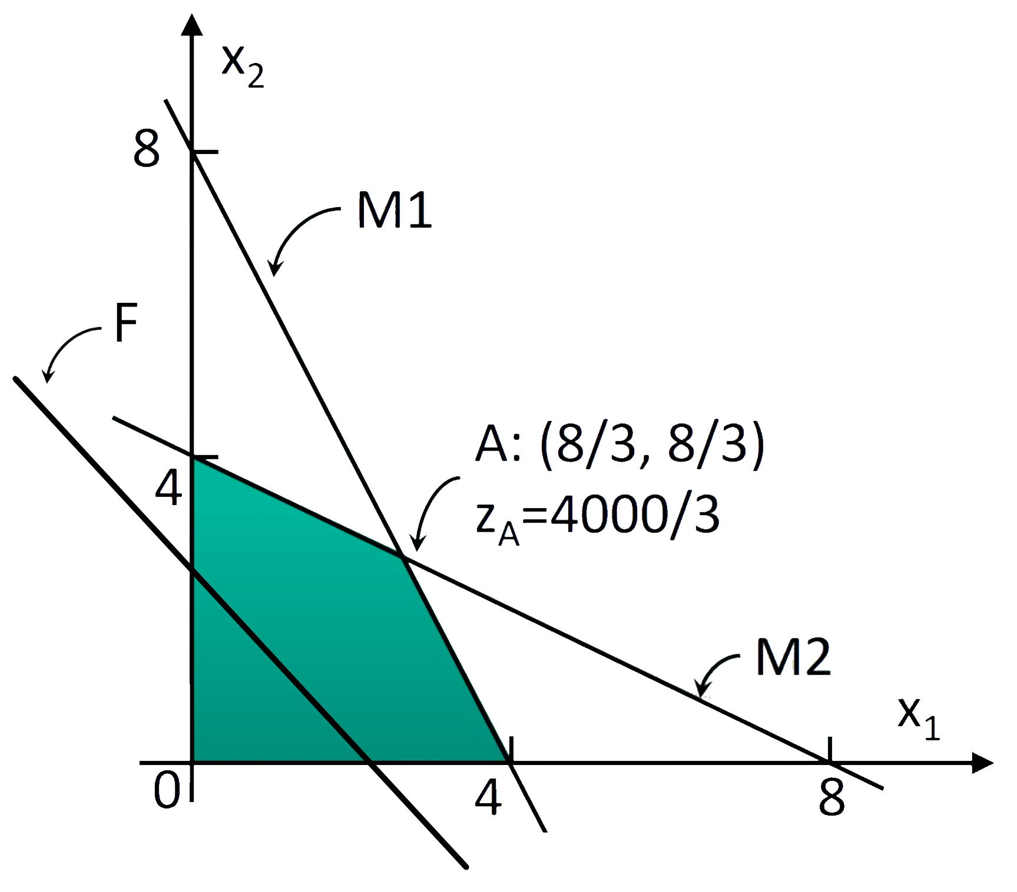
Binding constraints
A constraint is binding if the constraint becomes an equality when the solution values are substituted.
Graphically, binding constraints are constraints where the optimal solutions lies exactly on the line representing that constraint.

Slide 8
slack
For any solution, the difference between the left and the right-hand sides of a constraint is known as the slack value.
The slack value for a binding constraint is always zero: the constraint is met exactly.
The slack value indicates whether there are unused resources.

Slide 9

Objective Function coefficients
Allowable Increase/Decrease indicate the amounts by which an objective function coefficient can change without changing the optimal solution, assuming all other coefficients remain constant.

Slide 10
Reduced Costs
The reduced cost of a variable gives an indication of the amount the objective will change with a unit increase in the variable value.
If all reduced costs for an LP are non-positive (0 or less), it follows that the objective value can only decrease (and not increase) with a change in the variable value, and therefore the solution (when maximizing) is optimal.
Multiple optimal solutions exist when one or more non-basic variables with a zero reduced cost exist in an optimal solution (that is, variable values that can change without affecting the objective value).

Slide 11
Summary
Shadow Price: increase the availability of resources with the highest shadow prices.
Slack: show if any unused resources.
Allowable Increase/Decrease objective function coefficients: it shows the sensitivity of the optimal solution, relatively to changes in objective function coefficients.
Reduced costs: it shows the how much the objective value will change with a unit increase in a variable value.

Slide 12
Code - docplex

